Slide 1
Pathology of the spine
Happy Back Yoga Academy

Slide 2
Degenerative Disc Disease

Slide 3
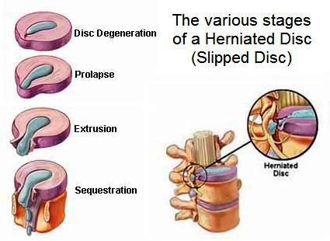
Disc Bulge vs. Disc Herniation

Slide 4
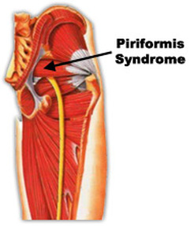
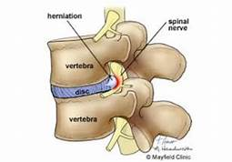
Sciatica vs. Piriformis Syndrome

Slide 5
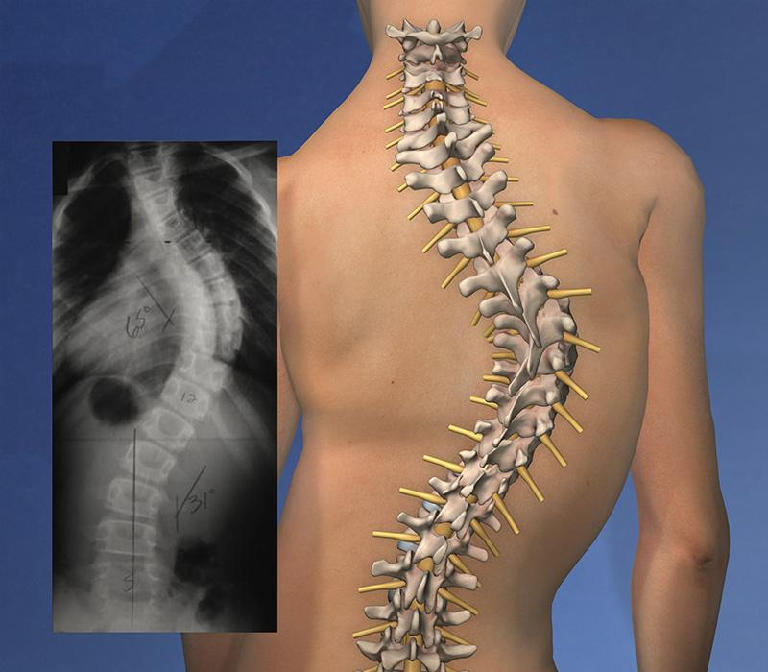
Scoliosis
All curves have a component of side bend and rotation
Structural vs. functional scoliosis
C-shape vs. S-shape
Thoracic vs. Lumbar

Slide 6
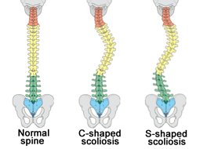
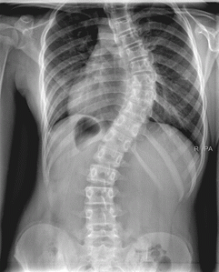
Types of Curves

Slide 7
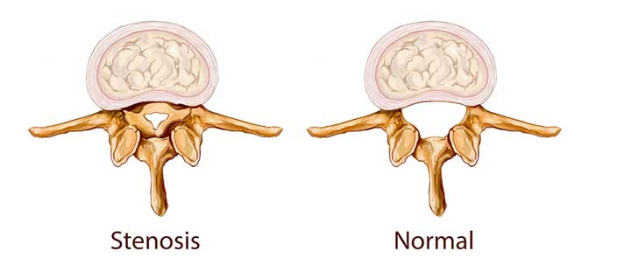
Spinal Stenosis
Avoid Extension exercises
Symptoms relieved by forward flexion
Work on spinal stabilization exercises

Slide 8
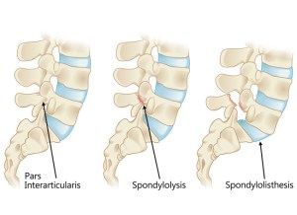
Spondylolisthesis
Often occurs in young athletes/ gymnasts
Avoid Spinal Extension - Backbends
Work in neutral spine and stabilization exercises

Slide 9
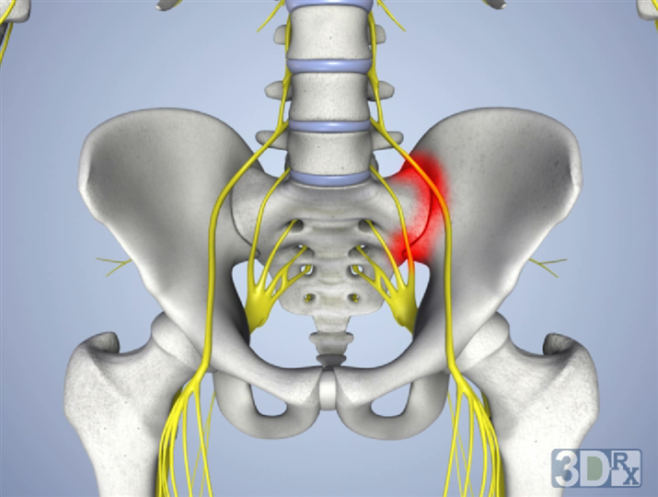
Sacroiliac (SI) Joint Dysfunction
Pain around the dimples of the buttocks
Local pain, can extend into buttocks or groin area
Many causes - so there is different treatment for different individuals
May feel better in forward bends or back bends
Tends to be worse with transitions - sit to stand, lying to sit

Slide 10
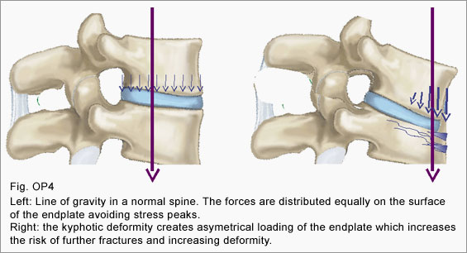
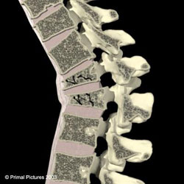
Osteoporosis

