Slide 1
Improving Your Life Network
© Ashley Clark 2015 - 2020

Slide 2
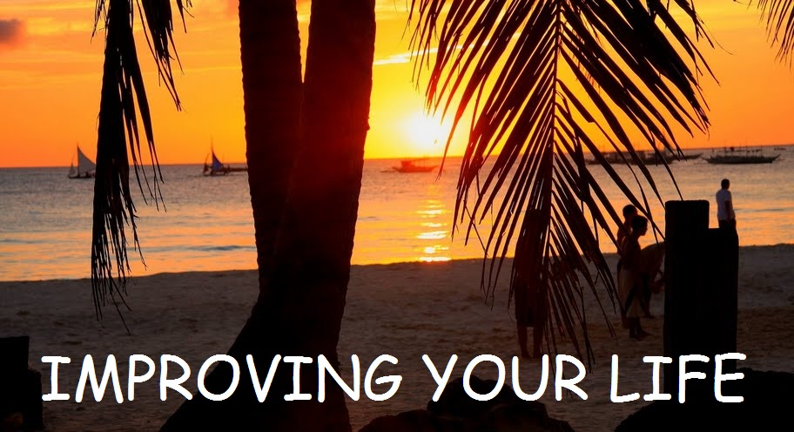
A Step By Step Guide To Making Real And Lasting Improvement To All Aspects Of Your Life.
Simple Steps To Discover Your Purpose In Life And Achieve Your True Potential
1st Edition
By Rhea & Ashley Clark
Copyright © 2019 Improving Your Life Network
All Rights Reserved

Slide 3
About The Authors
We created the Improving Your Life Network back in 2007 with a single ambitious goal ; to provide the information, resources, tools, and coaching needed to improve all areas of life for anyone who is prepared to dedicate the time every day.
Over the years we have learnt about, tried, and evaluated more than one hundred mind-set courses , fitness programs, diets, daily routines, vision, purpose, & goal setting exercises, etc. (some great, some not so great!)…
Our philosophy is to share what has worked well for us and helped us achieve lifestyle and financial freedom and transform health and happiness in our own lives.
We are genuinely passionate about helping as many people as possible transform their lives… and of course we do offer all the coaching programs, resources, recommendations, and opportunities you need to assist in transforming your life.
Rhea & Ashley Clark

Slide 4
INTRODUCTION
This presentation (and all the resources in the Improving Your Life Network) is designed to lead you step-by-step through your transformational journey to become a better version of yourself and make profound improvement to every aspect of your life.
Hopefully, all will become clear as you explore the content and the network, and you will see just how profound the improvement in your life will be if you are prepared to implement the strategies and ideas that we share with you.
So, how is it structured and how does it all work?
The presentation is divided into sections which map out every step that you need to follow in order to unleash your true potential and dramatically improve your life.
In addition there are a number of resources and recommendations which cover the different aspects of life improvement in far greater detail, and as you will see there is a clear starting point which will start to unlock your potential and become the ‘roadmap’ to your success and prosperity.
We highly recommend that you read through the whole presentation first, then go back to each section in order, download all the free resources, and check out our recommendations to dive deeper into each subject (we only recommend what we personally use / have used and consider to be the best of the best).
Improving Your Life Network
© Ashley Clark 2015 - 2020

Slide 5
INTRODUCTION
We strongly advise that as you check out each section in turn; TAKE ACTION! …and repeat the steps over and over again to continuously improve.
REMEMBER:
It is not enough to just intellectually understand the process and the information… IT IS USELESS UNLESS YOU:
ACT ON IT STAY FOCUSSED and BE DETERMINED TO SUCCEED!
So, let’s get started!
Improving Your Life Network
© Ashley Clark 2015 - 2020

Slide 6
THE 7 STEPS TO SUCCESS
CONTENTS:
MODULE #1: How Is Your Life?
MODULE #2: The Prosperity Mindset
MODULE #3: Vision & Purpose
MODULE #4: Wealth & Legacy
MODULE #5: Goals & Milestones
MODULE #6: Mind Over Matter
MODULE #7: Routine For Success
MODULE #8: Noise & Environment
MODULE #9: Friends & Lovers
MODULE #10: Nutrition & Metabolism
MODULE #11: The Success Roadmap; ‘Lean Living’
Improving Your Life Network
© Ashley Clark 2015 - 2020

Slide 7
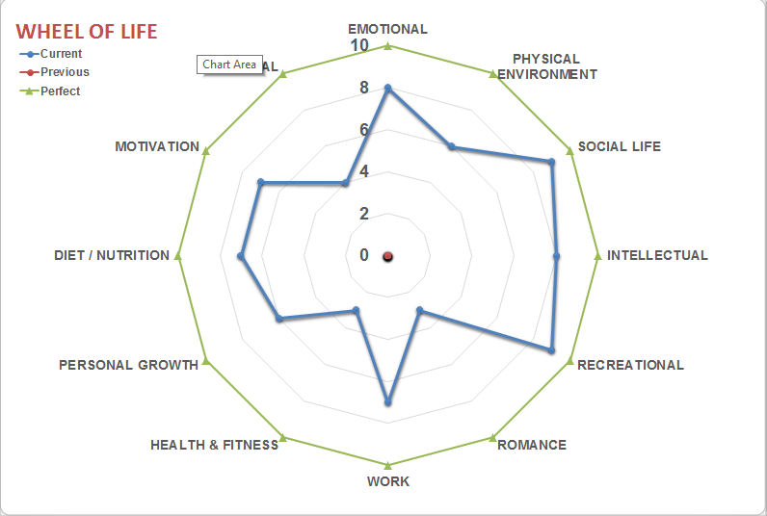
MODULE #1: How Is Your Life?
The first step is to do a simple exercise to determine which parts of your life require the most improvement and focus; This is the ‘LifeTracker Assessment’ and will generate your ‘Wheel Of Life’.
Download the file below this presentation (it’s in excel format, but guaranteed safe!) and complete the LifeTracker exercise by following the simple instructions.
Print out your ‘Wheel Of Life’ (the whole exercise should only take 15 minutes or so to do).
Improving Your Life Network
© Ashley Clark 2015 - 2020

Slide 8
MODULE #1: How Is Your Life?
The ‘Wheel Of Life’ shows clearly the strongest and weakest aspects of your life and the ‘balance’
(imagine that this was a wheel on a bike…
Would you get a smooth ride?).
Clearly, the weakest areas need to be prioritised to restore balance.
There is a separate file with coaching exercises to get you started with this process; go ahead, download it, print everything out, and complete the exercises using a good old-fashioned pen or pencil (your mind will be far more engaged that way!).
These are a certain type of question specifically designed to challenge your current thinking and find solutions from within yourself. This is by far the most important and effective part of the whole process.
However, restoring balance is just the first step; the aim has to be to improve the overall size of the wheel to take your life to the next level of success.
Improving Your Life Network
© Ashley Clark 2015 - 2020

Slide 9
MODULE #1: How Is Your Life?
You should repeat the ‘LifeTracker’ exercise on a regular basis, say, every month or two, to track the progress you are making and adjust your focus accordingly.
A word of advice and warning though; you must be totally honest when completing this and all the other exercises and questions in this program, otherwise, you are only fooling yourself and will not make any real improvement.
Now that you have a clear vision of the current status of your life and you are committed to continually improving, the next step is to become aware of everything that is holding you back and preventing you from making the changes that will truly drive improvement and success…and then remove those obstacles!
In MODULE #2: The Prosperity Mindset we detail the exact proven process you need to follow and give you all the resources and the action plan you need…
If you haven’t done so already…
Please complete the LifeTracker Coaching Exercises now while your enthusiasm and motivation is high and your mind is suitably focussed.
See you in MODULE# 2.
Improving Your Life Network
© Ashley Clark 2015 - 2020

