Slide 1
Let’s Make Lemonade!

Slide 2
Things we need:
5-8 lemons (precut in half)

Slide 3
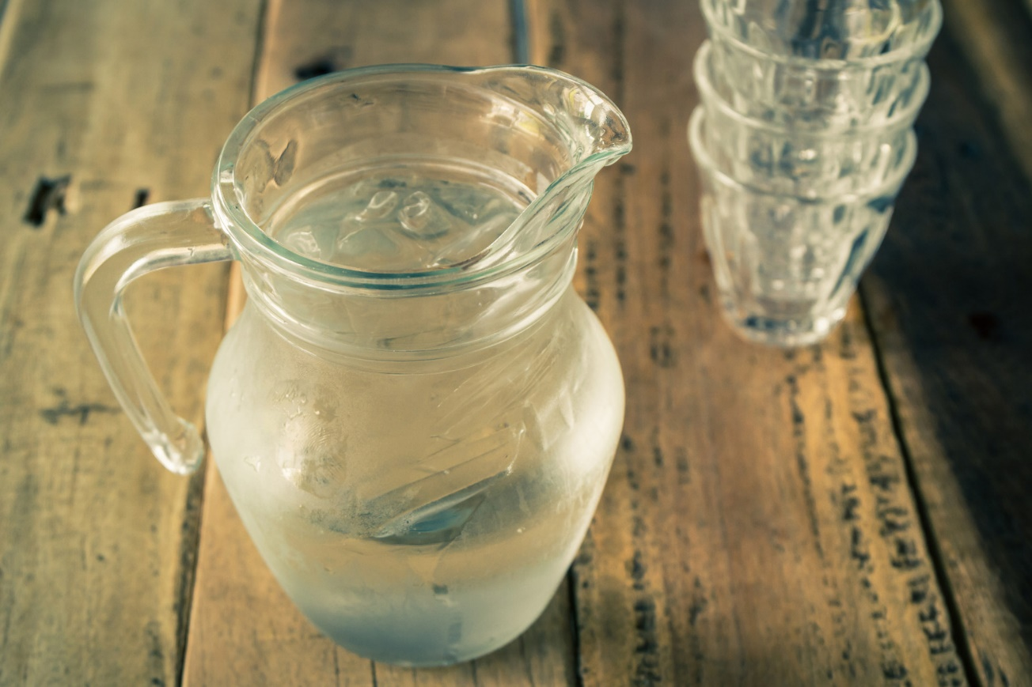
6 cups of water

Slide 4
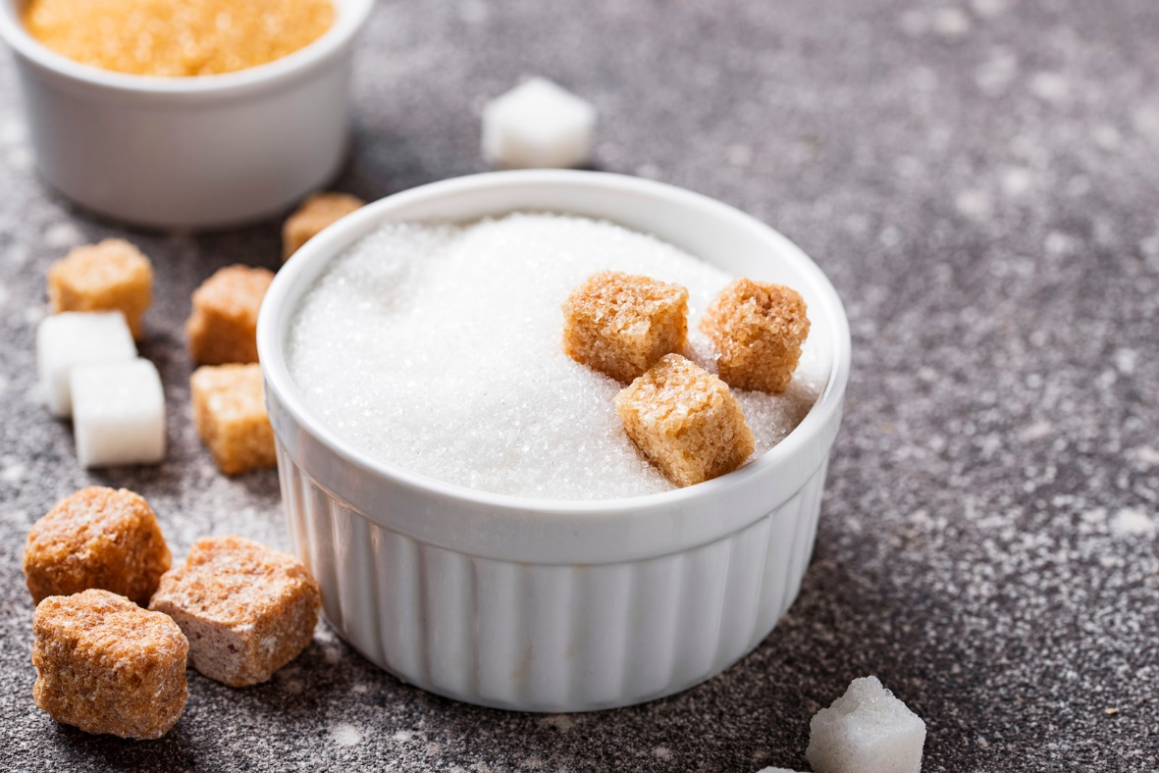
1 cup of sugar

Slide 5
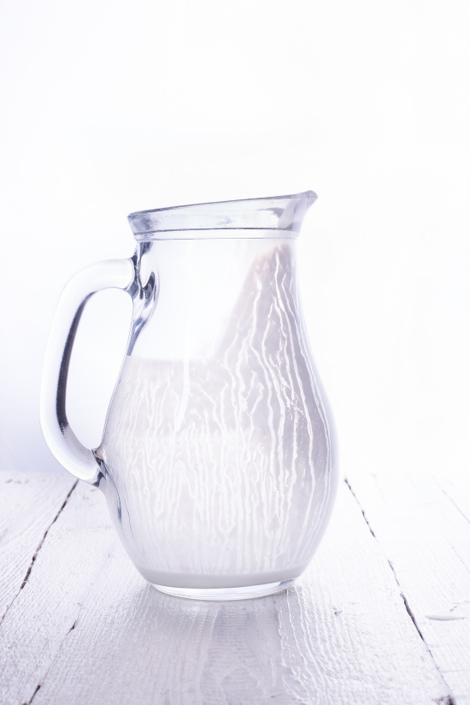
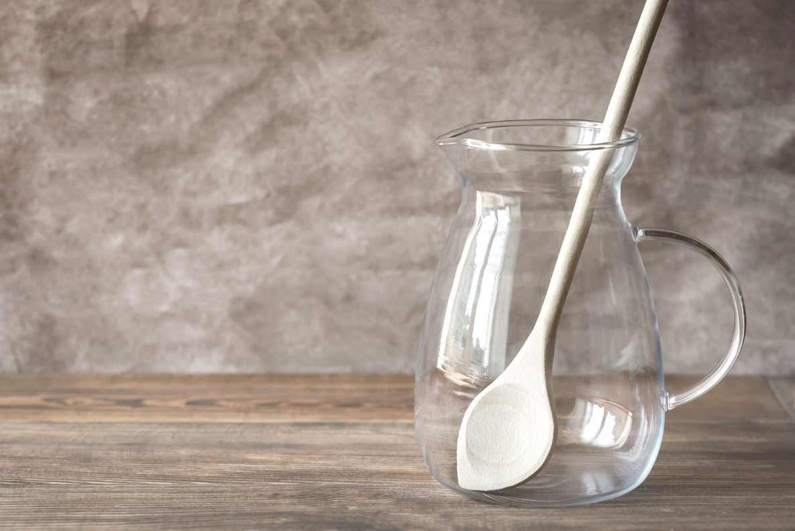
Pitcher

Slide 6
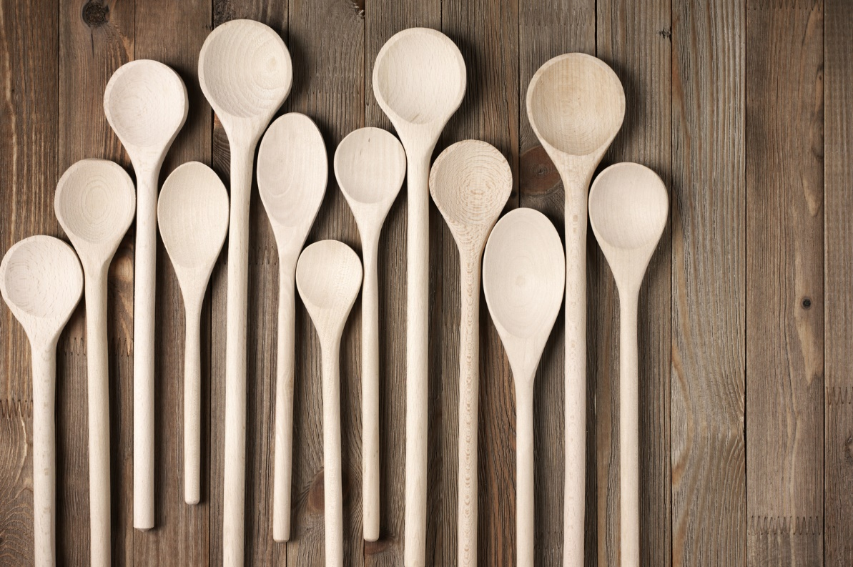
Big spoon to stir

Slide 7
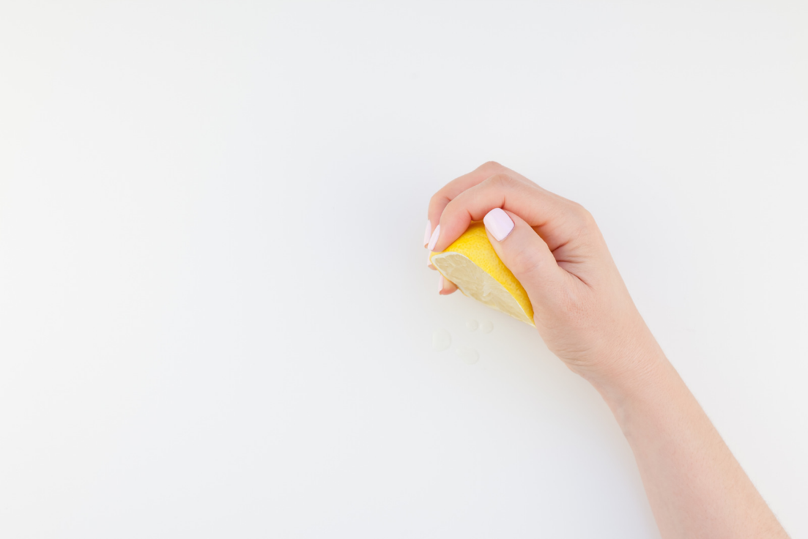
1. Squeeze lemons into the pitcher to get their juice.

Slide 8
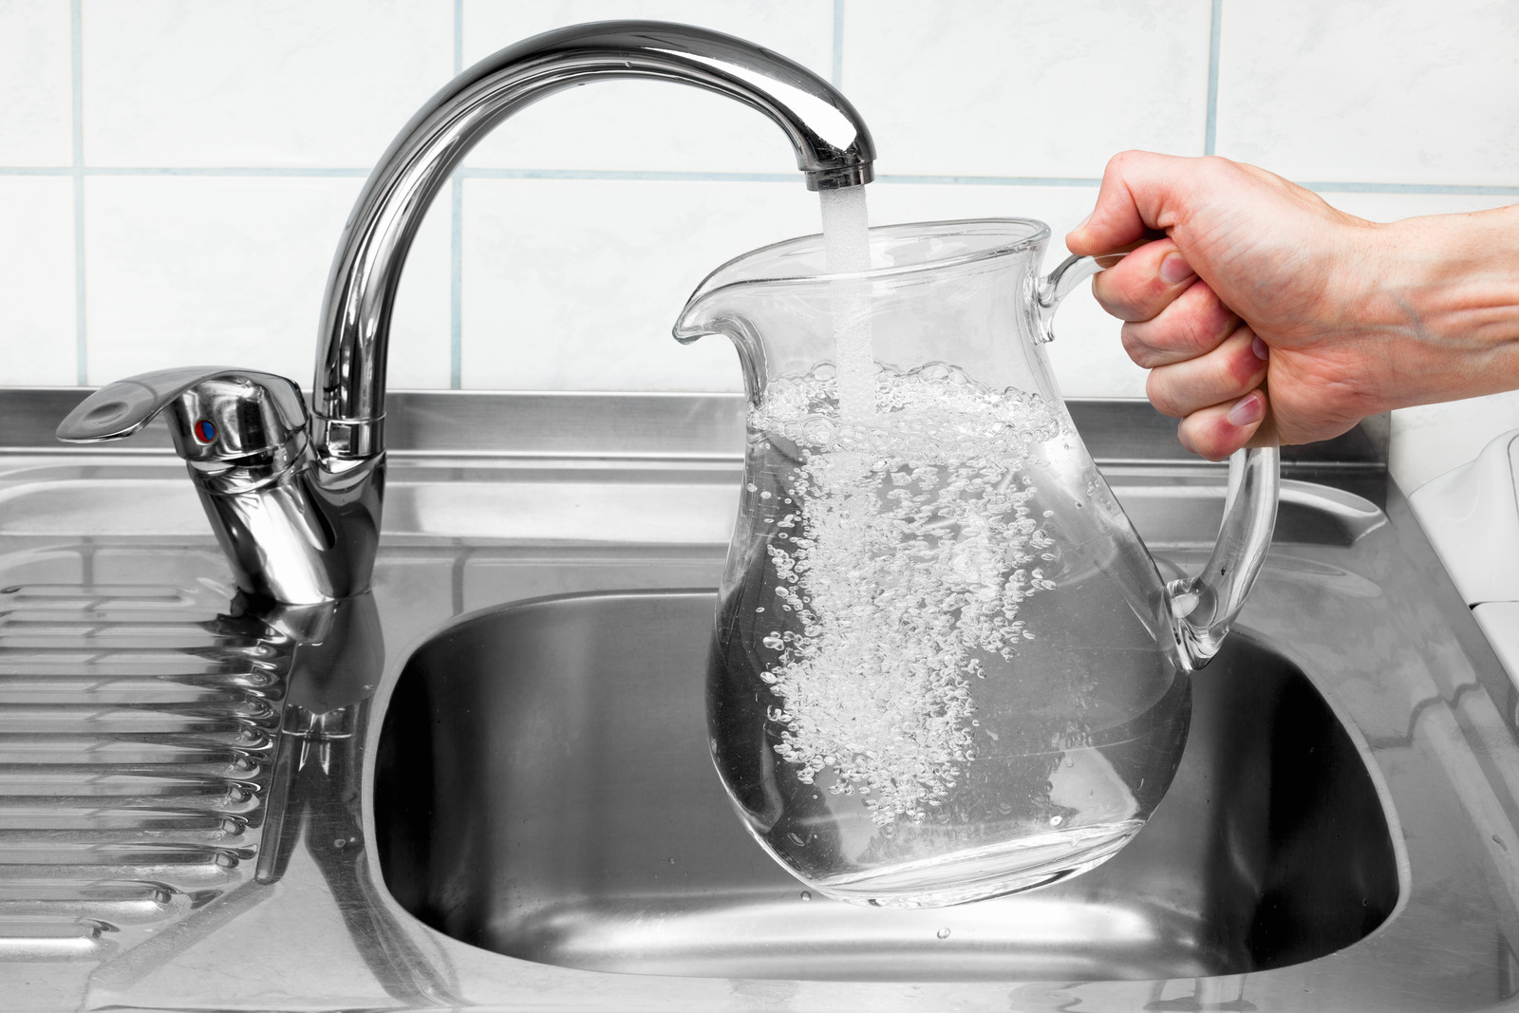
2. Add 6 cups of water to the pitcher.

Slide 9
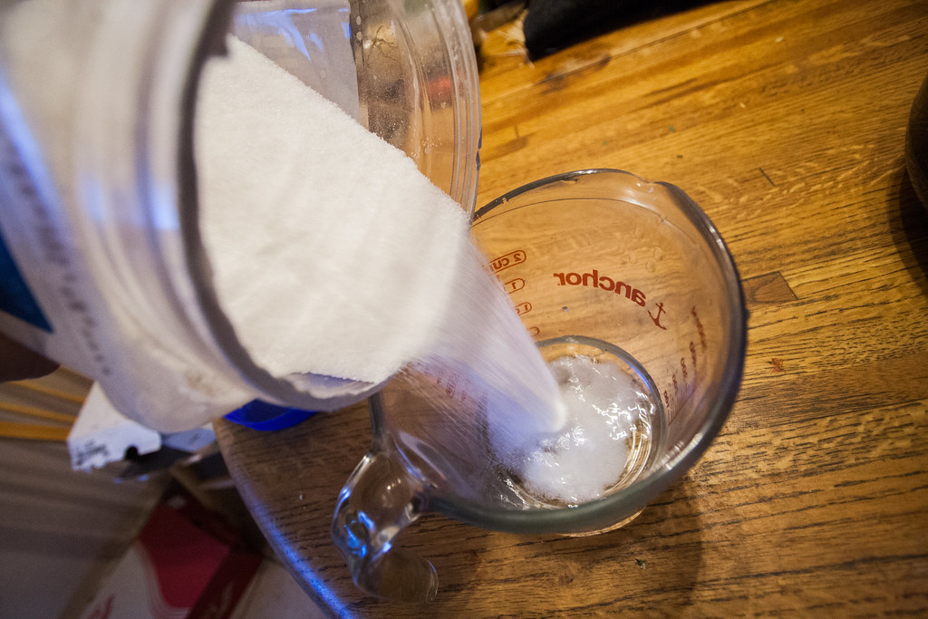
3. Pour 1 cup of sugar into the pitcher.

Slide 10
4. Stir until mixed.

Slide 11
5. Add ice, if you want.

Slide 12
6. Drink and enjoy!

Slide 13
Review: Do you remember how to make lemonade?

