Slide 2
Clinical Services & Quality Management
August, 2020
DBH Training
One-to-One Safety Observations and Documentation

Slide 3
National Patient Safety Goals and DBH:
“Did You Know?”
Effective July 1, 2019, seven new and revised elements of performance (EPs) were applicable to all Joint Commission-accredited hospitals and behavioral health care organizations.
These new requirements are at National Patient Safety Goal (NPSG) 15.01.01 and are designed to improve the quality and safety of care for those who are being treated for behavioral health conditions and those who are identified as high risk for suicide. Because there has been no improvement in suicide rates in the U.S., and since suicide is the 10th leading cause of death in the country, The Joint Commission re-evaluated the NPSG in light of current practices relative to suicide prevention.
However, we continue to fall short at times.
Patients on 1:1 observations in our facilities have secured sharps.
Patients on 1:1 observations in our facilities have managed to asphyxiate themselves in bathrooms.
Patient records reviewed for evidence of 1:1 observation have no reference or verification of such an observation.

Slide 4
Training Overview:
Review the purpose and importance of One-on-One Safety Observations
Review the protocol for observing a patient 1:1
Provide instructions on what to include in the One-on-One Documentation
Introduce the 1:1 Safety Attestation Shift Note
Review requirements and frequency

Slide 5
Defining One-to-One:
One-On-One
One staff member must remain within very close proximity, (very close proximity = within arm’s length)
Mitigate risks patient would be exposed to (e.g., remove shoelaces, limit time in restroom, incorporate safety measures such as directing patient to sing in shower)
Staff patterns must accommodate (staff’s sole responsibility is one-to-one observation)
Staff patterns must be configured to accommodate breaks, etc.

Slide 6
One-on-One Documentation Workflow:
The aim of one to one (1:1) supervision is to provide continuous observation for an individual patient for a period of time during acute physical or mental illness (e.g., determined a high suicide risk).
↓
Clinical and/or Medical team will determine patient needs to be on a 1:1 observation
Notification of 1:1 status will be entered by the Therapist in the Urgent Issue of the EMR
Patient will have a staff member assigned to them by clinician and/or treatment team to support the 1:1 observation
↓
At the conclusion of the shift, the staff member assigned for 1:1 observation, via the Group Notes Schedule for each shift will enter a
1:1 Safety Attestation Shift Note..
Includes staff member(s) identified that support the 1:1 observation during shift.
Includes observations of patient and interactions during shift.
Includes relevant safety-related concerns.

Slide 7
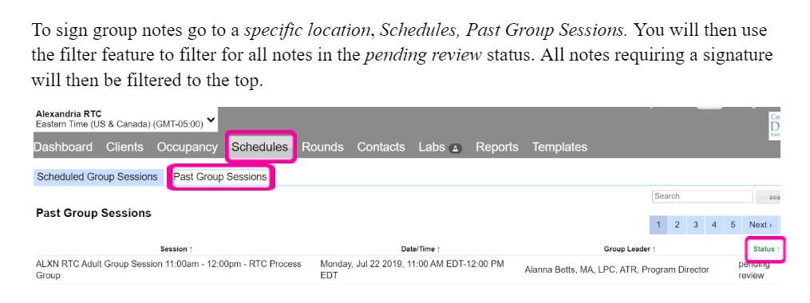
Instructions for Entering Shift Notes: (1 of 2)
Instructions:
If more than two patients are placed on a 1:1, (with two different staff members), the first staff member must enter in the 1:1 Safety Attestation Shift Note in the Group Notes and then must change the “Group Leader” to the other staff member assigned in order for them to complete their 1:1 Safety Attestation Shift Note.

Slide 8
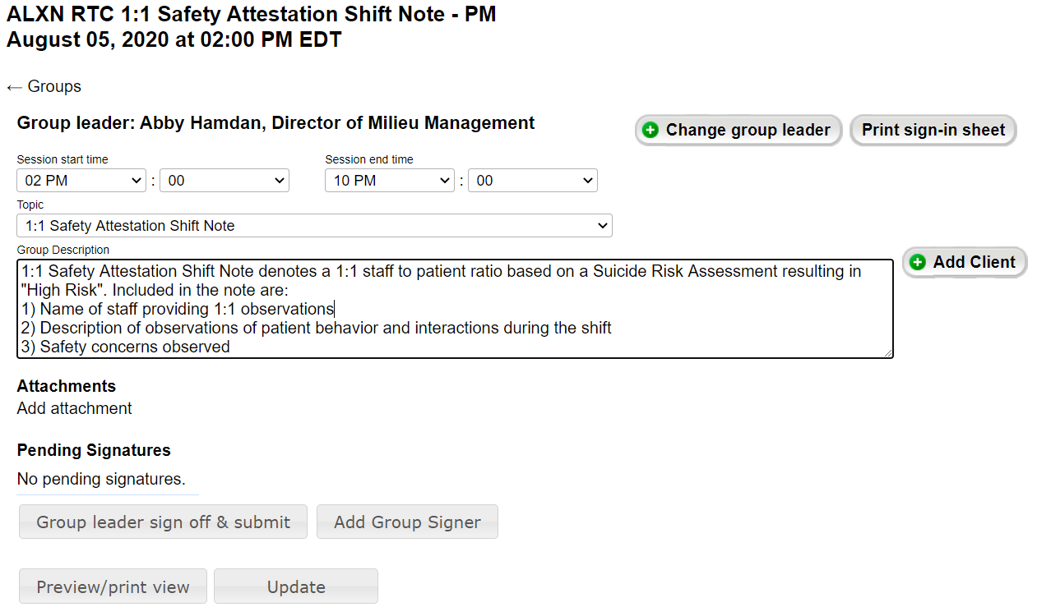
Instructions for entering Shift Notes: (2 of 2)

Slide 9
Conclusion and Resources:
Worldwide, someone dies by suicide every 40 seconds. More than 800,000 people die by suicide annually, and for every death there are an additional 10-25 attempts (World Health Organization [WHO], 2017). In the United States, suicide is the 10th leading cause of death, and suicide rates are 22% higher than global averages (Center for Disease Control and Prevention [CDCP], 2017). U.S. suicide rates increased a staggering 25% over the past decade while other leading causes of death declined (CDCP, 2016).
The ZERO SUICIDE Model
The foundational belief of Zero Suicide is that suicide deaths in health care systems are preventable. To learn more about safe and effective care for suicide risk, visit the Zero Suicide website.
National Suicide Prevention Lifeline
1-800-273-TALK (8255); The Lifeline is a 24-hour toll-free phone line for people in suicidal crisis or emotional distress; an online chat option is also available.
“The point is that being able to demonstrate ‘due diligence’ is not about having a thing (a policy or a system or a heap of procedures and checklists) it is about doing a thing” – Max Geyer

