Slide 1
The Curves of the Spine: Coming back to Nature
Happy Back Yoga Academy

Slide 2
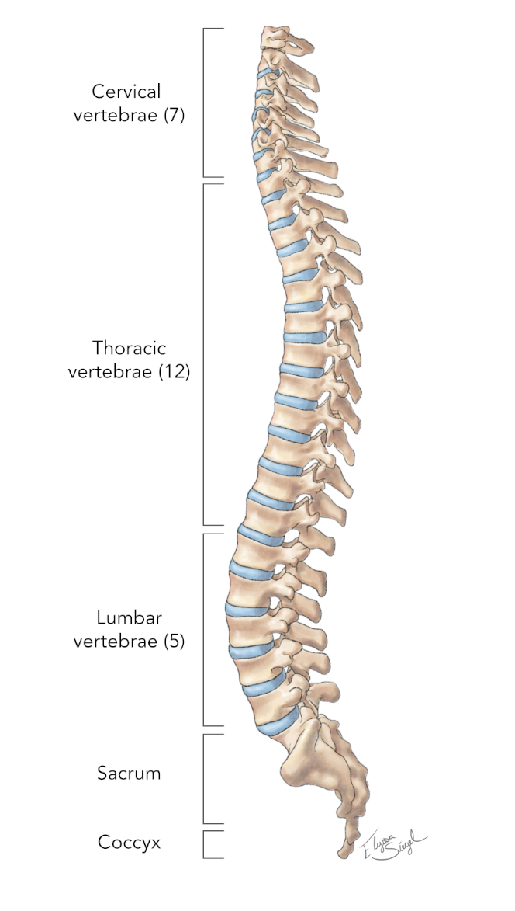
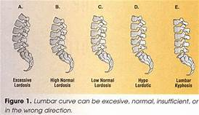
Cervical curve = lordosis – 7 verterae
Thoracic curve = kyphosis – 12 vertebrae
Lumbar curve = lordosis – 5 vertebrae
Sacrum = at 30 degree angle

Slide 3
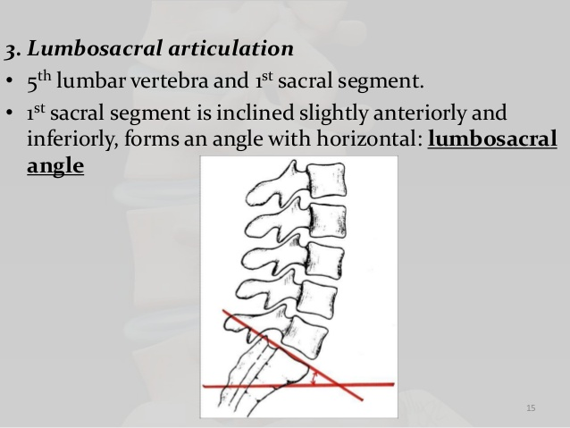
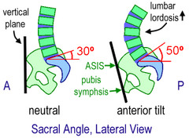
Lumbosacral angle

Slide 4
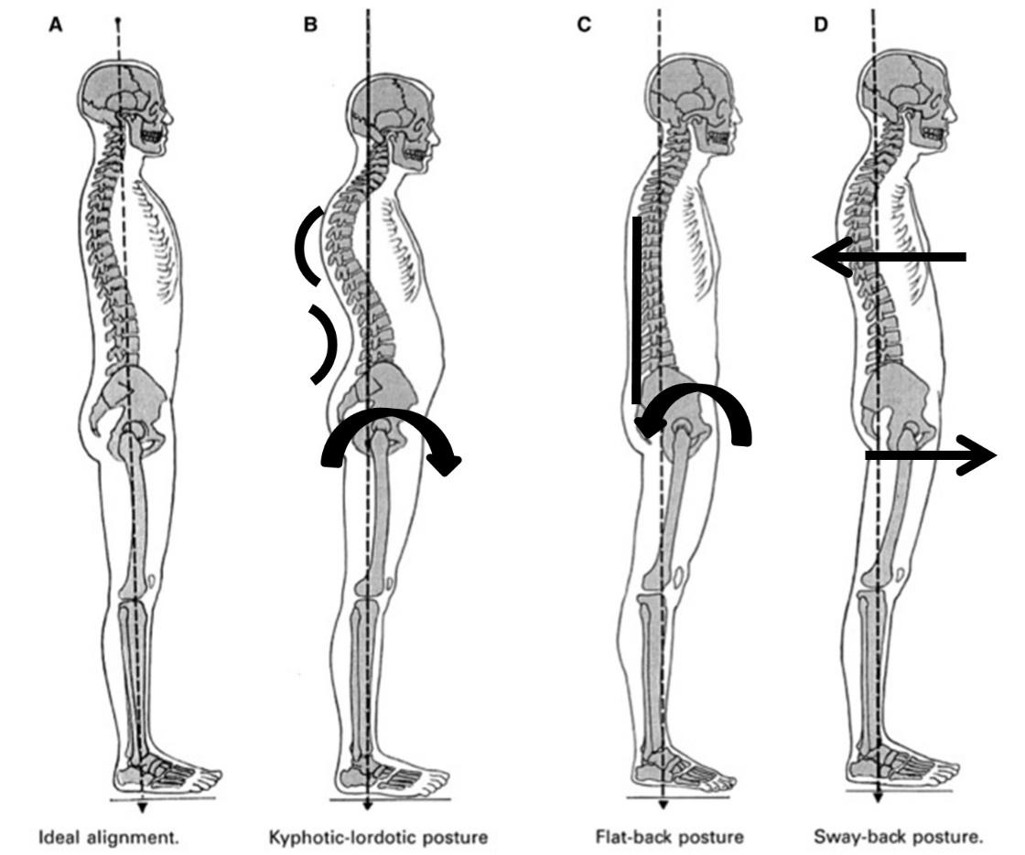
Common postural conditions

