Slide 1
Sources for Ideation
- Creative Thinking
Lateral
Divergent
“Creative thinking is not a talent, it is a skill that can be learnt.”
Edward de Bono
SCAMPER (Tool)

Slide 2
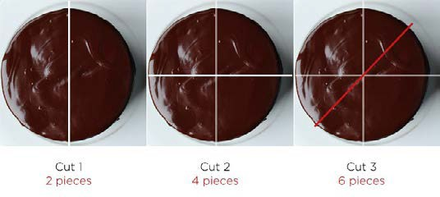
Lateral Thinking
- Pretend that you’re hosting some friends at your house for dinner. After the meal, you bring out a round cake that you’d like to cut into eight slices, so everyone can have one. But there’s a catch: you can only make three cut marks before your only knife will break. How will you do it?
- Business Examples of Lateral Thinking
- It may be tempting to cut the cake like most people do when asked this question:
- Tool for Lateral Thinking
Forced Connection
Cut 1
2 pieces
Cut 2
4 pieces
Cut 3
6 pieces
- With just one more cut, you can make eight pieces, but if you’re limited to three cuts, you can only make six this way. So now what?

Slide 3
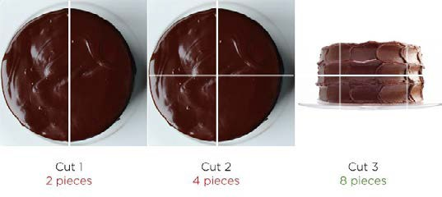
- The solution is to turn the problem on its side:
Cut 1
2 pieces
Cut 2
4 pieces
Cut 3
8 pieces
KEEP THE ‘PROBLEM STATEMENT’ IN FRONT OF YOU
All ideas generated should be in context to the problem statement.

Slide 4
Forced Connection
1. Level 1: Make a list of 10 random words
(more random better)
Level 2 : Think of more words associated with each of the random word selected before
Select one post it from the Observation / Empathy Canvas OR Connect with Problem Statement
Connect this word from post it or problem statement & new random word
If you get a new relevant idea = Great!!
If not : Take the new random word OR Try Level 2
A new idea / word emerges (if not try level 2)
If you want a better solution i.e. contextual to your project, then select another post it and try the same again
Exercise : 15 min. Generate as many ideas as possible using this tool - Now Share your top 2 ideas

Slide 5
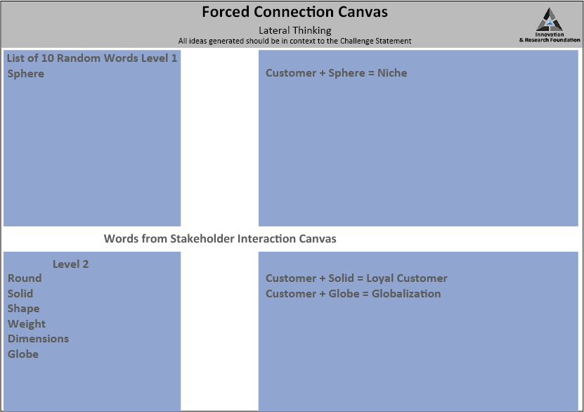
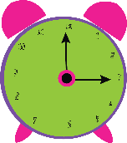
30 mins

Slide 6
Forced Connection: Exercise for Later
1. Level 1: Make a list of 10 random words
(more random better)
Level 2 : Think of more words associated with each of the random word selected before
2. Select one post it from the Stakeholders Interaction canvas
Connect this word from post it & new random word
A new idea / word emerges
If you want a better solution i.e. contextual to your project, then select another post it and try the same again
KEEP THE‘PROBLEM STATEMENT’ IN FRONT
OF YOU
All ideas generated should be in context to the problem
statement.

Slide 7
Random Word
Level 1
Sphere
Level 2
Round
Solid
Shape
Weight
Dimensions
Globe
Resulting idea
Level 1 :
Customer + Sphere =
Niche
Level 2
Customer + Solid = Loyal Customer
Customer + Globe = Globalization
Word from Canvas Customer

