Slide 1
U.S. Department of Veterans Affairs
PTSD
Myths & Misconceptions
Tim Oldani
Outreach Specialist

Slide 2
PTSD
“Keeping the promise”
What is PTSD?
Tim Oldani
Outreach Specialist

Slide 3
PTSD
“Keeping the promise”
Post-traumatic stress disorder (PTSD) is a mental health condition that's triggered by a terrifying event — either experiencing it or witnessing it. Symptoms may include flashbacks, nightmares and severe anxiety, as well as uncontrollable thoughts about the event
Tim Oldani
Outreach Specialist

Slide 4
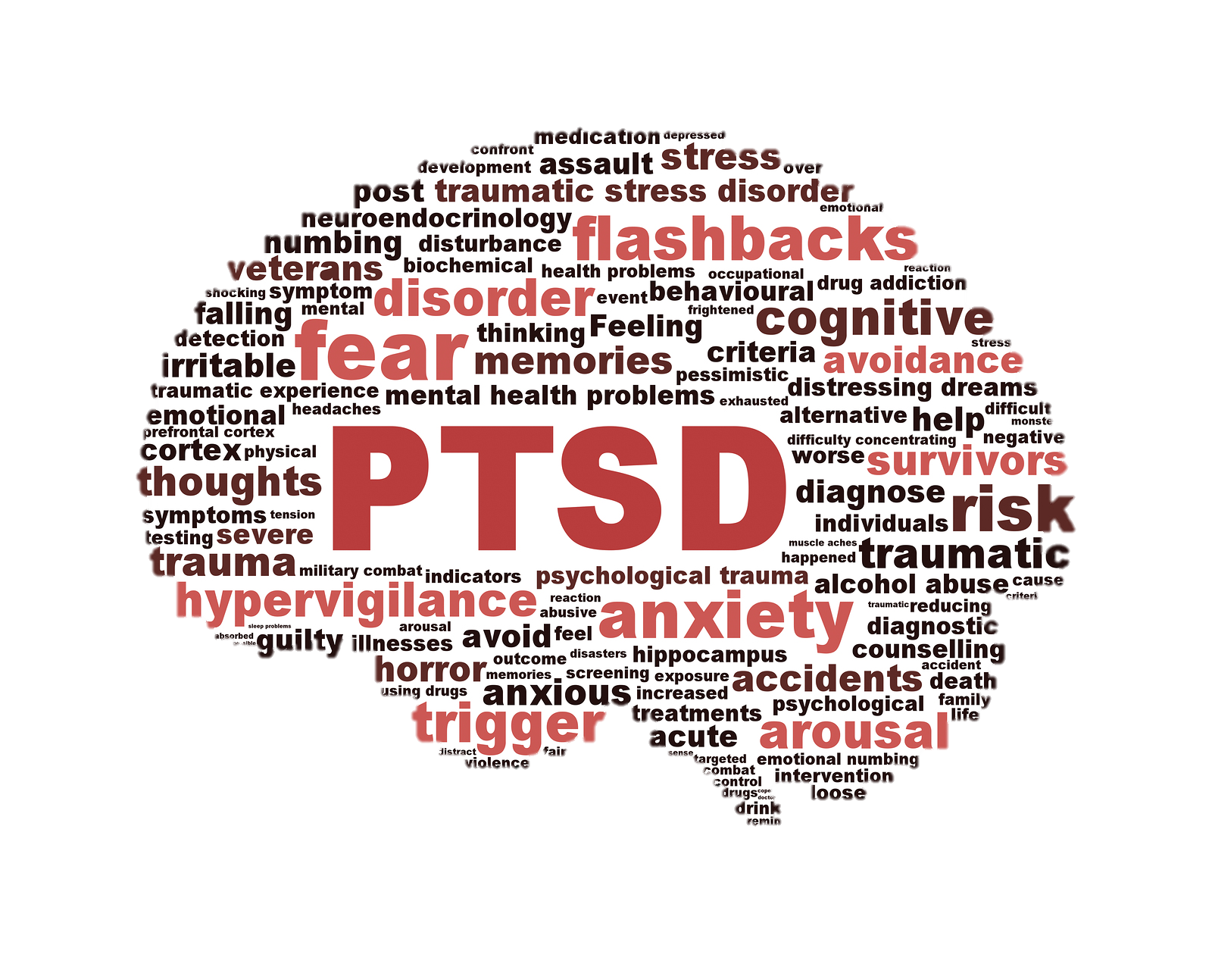
PTSD
“Keeping the promise”
Tim Oldani
Outreach Specialist
Notes:
Post-traumatic stress disorder is a mental health issue that is often accompanied by a great deal of stigma, among both the military and civilian populations. Several myths about the condition appear to contribute to this stigmatization. Misunderstanding can lead to various negative implications, such as prejudice and maltreatment. And this misunderstanding is nothing new. For as long as humans have been fighting wars, there has been a psychological impact of warfare, as well as a misunderstanding about PTSD and its implications. From nostalgia, shell shock, war strain, or combat fatigue, there have been many attempts to explain the psychological ramifications of combat. As an evolving construct, the psychological impact of war has changed over time. There is still more to learn, and combat-related PTSD remains a major focus of military psychology. The military, in particular, has played a key role in risk and resilience treatment, assessment, and research. Despite this influx of PTSD research, popular myths about PTSD remain and it is important for them to be addressed. Below, are several of these myths debunked.

Slide 5
PTSD
“Keeping the promise”
What is Stigma?
PTSD is a sign of Mental Weakness…
Tim Oldani
Outreach Specialist
Notes:
Post-traumatic stress disorder is a mental health issue that is often accompanied by a great deal of stigma, among both the military and civilian populations. Several myths about the condition appear to contribute to this stigmatization. Misunderstanding can lead to various negative implications, such as prejudice and maltreatment. And this misunderstanding is nothing new. For as long as humans have been fighting wars, there has been a psychological impact of warfare, as well as a misunderstanding about PTSD and its implications. From nostalgia, shell shock, war strain, or combat fatigue, there have been many attempts to explain the psychological ramifications of combat. As an evolving construct, the psychological impact of war has changed over time. There is still more to learn, and combat-related PTSD remains a major focus of military psychology. The military, in particular, has played a key role in risk and resilience treatment, assessment, and research. Despite this influx of PTSD research, popular myths about PTSD remain and it is important for them to be addressed. Below, are several of these myths debunked.

Slide 6
PTSD
“Keeping the promise”
PTSD is a sign of Mental Weakness…
FALSE
Tim Oldani
Outreach Specialist
Notes:
1. PTSD is a sign of mental weakness.
This, unfortunately, is a very common myth, which may be rooted an individual’s visceral, emotional beliefs about what it means to be a member of the military. Therefore, it is a difficult myth to combat. Developing PTSD is not a sign of weakness, be it mental weakness or weakness of character. It is an understandable human response to uncommon experiences. Although the most common outcome following trauma is one of recovery or resiliency, there are several factors, besides one’s own internal strength, that may influence whether an individual will develop PTSD, including: severity of the trauma, type of trauma (i.e., was it an interpersonal trauma where someone was specifically targeted, such as rape? Or was it something that happened by chance, like a natural disaster), number of traumas (i.e., previous trauma experienced in youth, or experiencing multiple traumas at once or compounded upon one another), duration (i.e., was the trauma a one-time event or long-term), one’s neurobiology, and whether the person has a support system to help them. Individuals are at increased risk for PTSD if they do not have a good interpersonal support system, which provides further argument for the damaging effect of stigma

Slide 7
PTSD
“Keeping the promise”
People with PTSD are Crazy or Dangerous…
FALSE
Tim Oldani
Outreach Specialist
Notes:
Several classic war movies, as well as sensationalized media coverage, have helped perpetuate the “crazy war vet” stereotype, which is an inaccurate depiction. PTSD is not characterized by psychosis or violence. Rather, symptoms of PTSD surround coping with the memory and implications of a traumatic experience (e.g., distressing memories and changes in mood). Furthermore, “crazy” is never the best word choice. “Crazy” is not a diagnosis, rather it is a damaging and stigmatizing label.

Slide 8
PTSD
“Keeping the promise”
People with PTSD cannot function in military or work environments…
FALSE
Tim Oldani
Outreach Specialist
Notes:
Military members with PTSD are often afraid to seek treatment for fear of separation from the military, but people can have PTSD and still effectively do their job, even a military job. It is a manageable and treatable diagnosis, and being diagnosed with PTSD does not necessarily mean one’s career is over.

Slide 9
PTSD
“Keeping the promise”
people can have PTSD and still effectively do their job, even a military job. It is a manageable and treatable diagnosis, and being diagnosed with PTSD does not necessarily mean one’s career is over.
Tim Oldani
Outreach Specialist

Slide 10
PTSD
“Keeping the promise”
Military Veterans with PTSD have many desirable Strengths to make them a good fit for any organization or company…
TRUE
Tim Oldani
Outreach Specialist
Notes:
Employers and companies can benefit from hiring Veterans. Military personnel are often cross-trained in multiple skills and have experience in varied tasks and responsibilities. Many Veterans have learned what it means to put in a hard day's work. They have also come to appreciate the challenges and satisfaction of a job well done. Much of this experience can translate to their participation in the workforce making the Veteran an asset on the job.
Strengths the Veteran can bring to the workplace include:
Working well in a team. Teamwork is considered an essential part of daily life and is the foundation on which safe military operations are built.
Having a sense of duty. Responsibility for job performance and accountability for completing missions are something to take pride in.
Experiencing self-confidence. Holding a realistic estimation of self and ability based on experiences is expected of each Service Member.
Being organized and disciplined.
Possessing a strong work ethic. In the military, the mission always comes first.
Having the ability to follow through on assignments, even under difficult or stressful circumstances.
Possessing a variety of cross-functional skills, such as extensive training on computer programs and systems, interacting with various people with different skills to accomplish a task, and coordinating and troubleshooting problems in novel and known conditions.
Being able to problem solve quickly and creatively.
Being able to adapt to changing situations.
Being able to follow rules and schedules.
Hiring a Veteran can result in the hiring of a dedicated employee who has developed valuable teamwork, leadership, and job skills.

Slide 11
PTSD
“Keeping the promise”
Nothing can be done for those who are diagnosed with PTSD
FALSE
Tim Oldani
Outreach Specialist
Notes:
PTSD is very responsive to treatment. There are several different types of treatments, developed for different types of people, which have all been found to be effective. If you have PTSD and have undergone unsuccessful treatment previously, there may be other options still available such as cognitive behavioral therapy, cognitive processing therapy, or prolonged exposure. New interventions continue to be developed and talking with a professional is a good way to review many options with great results to choose from.
There are a lot of misconceptions about PTSD that contribute to its stigma. Reconsidering some of these common myths may help to better understand the circumstances of fellow service members, and provide them support.
One VERY EFFECTIVE resource and agency for Veterans and Military Service Members for PTSD related care is the U.S. Department of Veterans Affairs Readjustment Counseling Service; better known as the Vet Center.

Slide 12
VET CENTER SERVICES
“Keeping the promise”
Readjustment counseling is a wide range of services offered to eligible Veterans and their families in the effort to make a successful transition from military to civilian life. Services offered at the 300 Vet Centers nationwide include:
Individual and group Counseling for Veterans and their families
Family counseling for military related issues
Bereavement counseling
Military sexual trauma counseling and referral
Outreach
Substance abuse assessment and referral
Employment referral
Referral to other VA services
Community education
Tim Oldani
Outreach Specialist

Slide 13
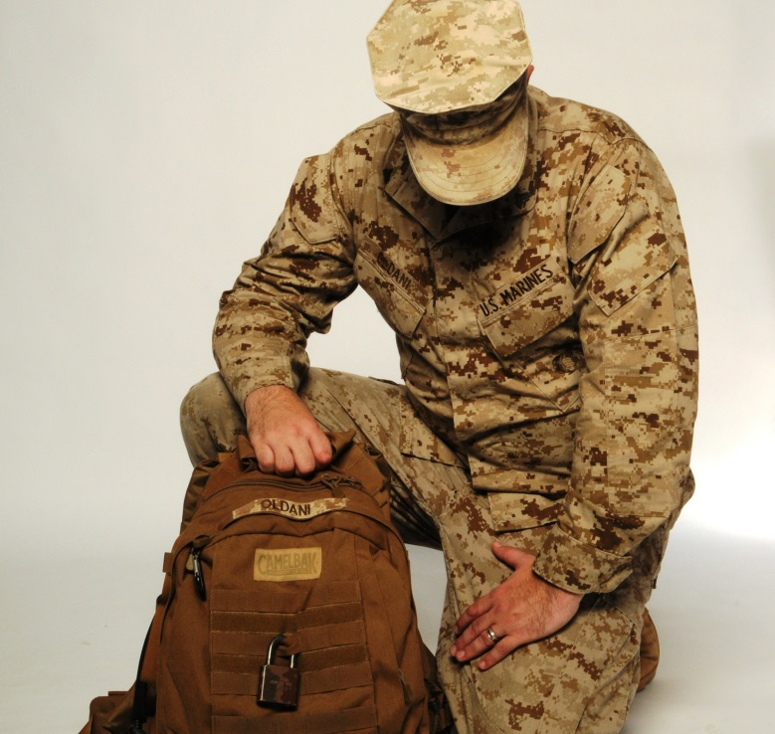
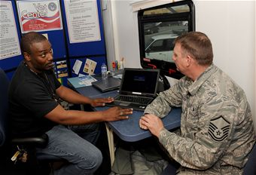
“Keeping the promise”
All Vet Centers have available evening and/or weekend hours
To help accommodate the schedules of Veterans, Servicemembers, and their families
Over 72% of Vet Center staff are Veterans, of which the majority are Combat Veterans
To provide a unique understanding of the combat and military experiences
Tim Oldani
Outreach Specialist

Slide 14
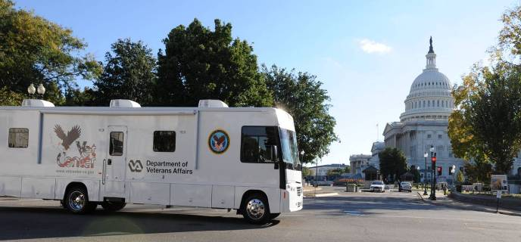
MOBILE VET CENTER (MVC’s)
“Keeping the promise”
Fleet of 70 Vehicles
Provides outreach and services to Veterans and families geographically distant
from existing VA services.
Provides early access to Vet Center services to Veterans newly returning from war via
outreach to demobilization active military bases, National Guard, and Reserve locations
nationally.
Each Mobile Vet Center is equipped with a state of the art satellite communications
package that includes fully encrypted tele-conferencing equipment, access to all
VA systems and connectivity to emergency response systems
Tim Oldani
Outreach Specialist

Slide 15
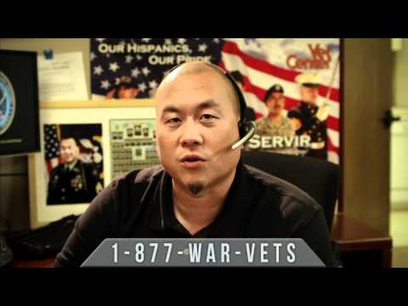
24/7 HOTLINE
“Keeping the promise”
Vet Center Combat Veteran Call Center
877- WAR-VETS (927-8387)
Around the clock & Confidential
The staff are combat Veterans
Warm handoff
Tim Oldani
Outreach Specialist

Slide 16
GETTING CONNECTED
“Keeping the promise”
WEBSITE: www.vetcenter.va.gov
HOTLINE: 877-WAR-VETS (927-8387)
Vet Center (RCS) Outreach Coordinator:
Tim Oldani
Office – (440) 845-5023
Mobile – (216) 401-4861
Timothy.Oldani@va.gov
Tim Oldani
Outreach Specialist

Slide 17
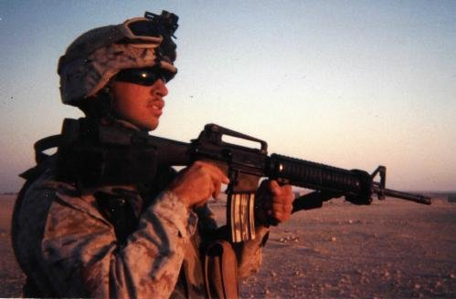
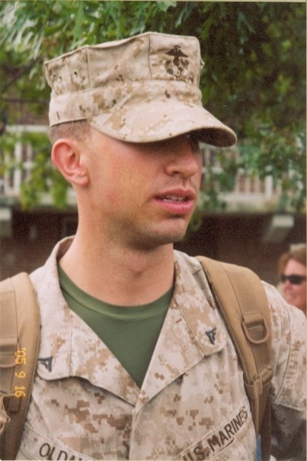
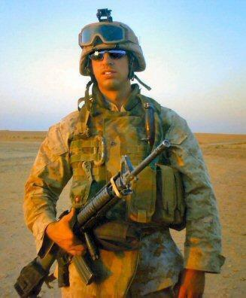
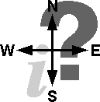
QUESTIONS
“Keeping the promise”
WEBSITE: www.vetcenter.va.gov
OHIO Outreach Coordinator:
Tim Oldani
Email – Timothy.oldani@va.gov
Office – (440) 845-5023
Mobile – (216) 401-4861
HOTLINE: 877-WAR-VETS (927-8387)

