Slide 1
Resilience

Slide 2
What is Resilience?
Resilience is our ability to bounce back from the stresses of life.
It’s not about avoiding stress but learning to thrive - despite stress.
But, like an elastic band, which eventually snaps if stretched too many times, we too can snap if stretched too far.
Healthy resilience strategies give us the tools to consistently strengthen our elastic band – or our ability to thrive under pressure.
1993 - 2021

Slide 3
What we are covering in this talk
What is resilience?
The “Five Pillars of Resilience”
The Benefits of resilience
What is positive psychology?
1993 - 2021

Slide 4
The study of resilience is more important now than ever
Our productivity over the past 20 years has soared, and with this increase in productivity has come an increase in our stress levels.
Our work–life balance has plummeted, and burnout, stress, anxiety and a whole host of other mental health issues are being experienced by so many of us.
COVID has bought an immense set of challenges to us all – and aside from the physical health issues, there is financial strain, uncertainty about the future and more - this all leads to overwhelm.
1993 - 2021

Slide 5
Learning to live a more resilient life has numerous benefits including:
Decreased depressive symptoms & increased emotional well-being
Enhanced working memory
Better, healthier sleep
Improved immune system function
Immune system modulation – to a healthier, more balanced state
Enriched relationships
Better ability to cope when we experience emotional disruptions
Improved health – overall – better self-care leads to better lifestyle choices
1993 - 2021

Slide 6
Resilience is made up of five pillars: self awareness, mindfulness, self care, positive relationships & purpose.
By strengthening and using these pillars, we in turn, become more resilient.
Instead of experiencing an overwhelming downwards spiral when we encounter stress in our lives, these five pillars work together to lift us up out of the chaos we are feeling.
Obtaining and maintaining these skills takes practice.
1993 - 2021

Slide 7
1993 - 2021

Slide 8
Improved resilience = fewer depressive symptoms & increased emotional well-being
We all experience difficult moments in life. Each of us faces disappointment, loss, and change as a natural part of our lives.
Being resilient doesn’t mean that these difficult moments goes away.
What it does mean is that we now have the tools to better cope with life.
These tools — such as random acts of kindness, gratitude, sociability, helping others and more - increase our ability to bounce back in a healthy, robust way.
Furthermore, we then have the mental/emotional/physical bandwidth to support others
1993 - 2021

Slide 9
The five pillars of resilience – an overview

Slide 10
Relationships
Relationships - both personal and professional - can create love and trust, provide role models for us, and offer encouragement and reassurance to help bolster our own resilience / self-care.
Positive relationships help us to buffer stressful experiences, provide us with feedback to change our view of life experiences, and help us to cope with stressors to maintain a sense of balance and well-being.
1993 - 2021

Slide 11
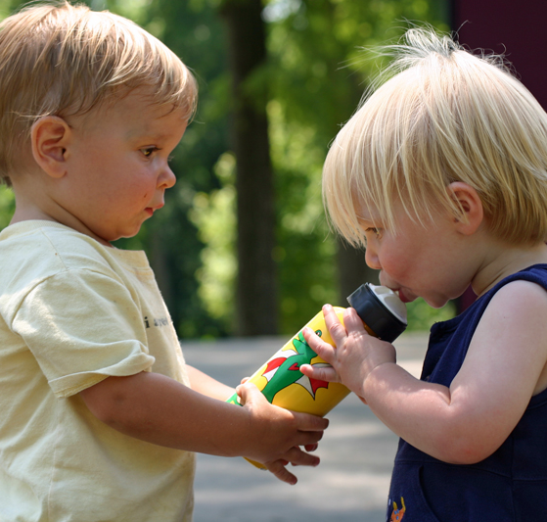
Positive relationships
Positive Relationships are the people who support and care for us — and we care for them. One of the most profound experiences we can have in our lives is the connection we have with other human beings.
By building positive relationships with others, we will be happier and more fulfilled and feel more supported, supportive, and connected.
Positive and supportive relationships will help us to feel healthier, happier, and more satisfied with our lives.
1993 - 2021

Slide 12
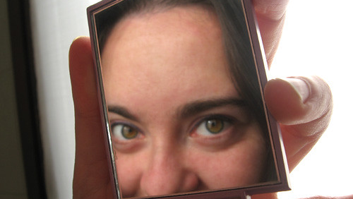
Self awareness
Self Awareness is having a clear perception of your personality, including strengths, weaknesses, thoughts, beliefs, motivation, and emotions.
This allows you to understand other people, how they perceive you, your attitude and your responses to them in the moment.
1993 - 2021

Slide 13
Self awareness
It also helps us cope when we experience emotional disruptions:
Learning to become aware of our thought patterns and our internal language helps us to reframe our thinking.
This can allow us to respond to disruptions in healthier ways.
Experiencing life from a place of possibility opens us up to opportunities where we can grow, learn, and continue to contribute.
It can reshape our purpose and be used to have a positive impact in the lives of others.
1993 - 2021

Slide 14
Mindfulness
Mindfulness is a state of active, open attention on the present.
When you’re mindful, you observe your thoughts and feelings from a distance, without judging them good or bad.
Instead of letting your life pass you by, mindfulness means living in the moment and awakening to experience.
1993 - 2021

Slide 15
Self care
Self care is unique for each person and can be understood in many different ways.
In its simplest form, the term refers to our ability as human beings to function effectively in the world while meeting the multiple challenges of daily life with a sense of energy, vitality, and confidence.
Self care is initiated and maintained by us as individuals — it requires our active engagement.
1993 - 2021

Slide 16
Purpose
Purpose is a recognition that we belong to and serve something bigger than ourselves. Our purpose helps to shape the mindset and attitude we have toward others and the events we experience.
We can find purpose in our faith, family, a political party, volunteering, helping, creating something, being green, or being a part of an organisation, society or group of like-minded people.
1993 - 2021

Slide 17
What else does cultivating resilience do for us?

Slide 18
Improves your working memory
As mentioned earlier, in the past 20 years, our productivity has increased dramatically.
We have more resources for information than ever before – most which are just a click away.
But immediacy has led to sacrificing attributes such as accuracy and thoughtfulness.
Allowing ourselves even 30 minutes during the middle of our day to focus on a single task gives needed rest to our prefrontal cortex – the part of our brain where our working memory is stored.
1993 - 2021

Slide 19
Respected Positive Psychology researcher Isen and colleagues showed that negotiators induced to feel good were more likely to discover integrative solutions in a complex bargaining task.
Overall, 20 years of experiments by Isen and her colleagues show that when people feel good, their thinking becomes more creative, integrative, flexible and open to information.
Isen, A. M. 1987. Positive affect, cognitive processes and social behavior.
Advances in Experimental Social Psychology 20:203–253.
1993 - 2021

Slide 20
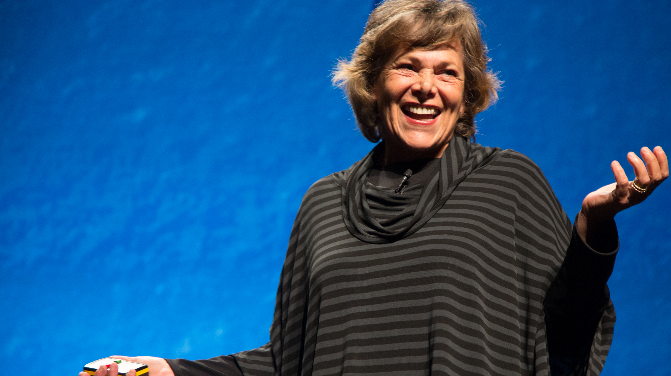
Epigenetics
Research also shows us that we are more than the result of our genetic make-up. We now know that environmental factors — lifestyle choices and other factors such as stress — and more importantly our reactions to these stressors - influences our response to disease.
Our thoughts, perceptions, and attitudes play an important role in our overall health.
(See Professor Ellen Langer’s experiments – including the Counter-Clockwise study)
Picture credit By PopTech - https://flickr.com/photos/poptech/10468080855/in/album-72157637014325336/, CC BY-SA 2.0
1993 - 2021

Slide 21
What is Positive Psychology?

Slide 22
What is Positive Psychology?
Positive psychology complements traditional psychology’s focus on pathology. It studies strengths, virtues, and the factors that contribute to a full and meaningful life.
“Probably the biggest insight is that happiness is not just a place, but also a process.
Happiness is an ongoing process of fresh challenges and . . . it takes the right attitudes and activities to continue to be happy.”
– Ed Diener
1993 - 2021

Slide 23
Martin Seligman, often referred to as the founder of positive psychology, describes it as:
“The scientific study of optimal human functioning that aims to discover and promote the factors that allow individuals and communities to thrive.”

Slide 24
Positive Psychology Theory
Positive psychology was born out of the need to scientifically study the positive aspects of life.
The theory of positive psychology has evolved greatly over the last few years—an ever-growing body of research has been uncovering the building blocks of happiness and well-being.
Through multiple studies, Martin Seligman found that the extent to which people were aware of and using their signature strengths (for example, courage, persistence, and wisdom) greatly impacted the quality of their lives.
1993 - 2021

Slide 25
The PERMA Model
Seligman spent years developing a theory of well-being called the PERMA model. The model comprises five elements that create the foundation of a flourishing life:
Positive Emotions;
Engagement;
Relationships;
Meaning;
Accomplishments.
1993 - 2021

Slide 26
Each of these elements has three properties:
It contributes to well-being;
People pursue the element for its own sake - not just to attain the other elements;
It can be measured and defined independently from the other elements.
1993 - 2021

Slide 27
The PERMA Model In-Depth
Let’s take a deeper look at each aspect of the PERMA model.
It consists of five components:
1993 - 2021

Slide 28
1. Positive Emotions
Barbara Fredrickson, through her broaden-and-build theory, explains that positive emotions can build our physical, intellectual, and social abilities.
She hypothesized that by broadening our awareness and thought-action repertoire, we look for creative and flexible ways of thinking and acting.
Over time, this broadening effect builds skills and resources. Fredrickson’s research shows that people who experience positive emotions make more connections, create more inclusive categories, and have heightened levels of creativity.

Slide 29
Greater creativity and open-mindedness
Barbara Friedrickson and Alice Isen and her colleagues tested the clinical reasoning of practicing physicians.
They made some of the physicians feel good by giving them a small bag of candy, then asked all of them to think aloud while they solved a case of a patient with liver disease.
Subsequent analyses revealed that physicians who felt good were faster to integrate case information and less likely to become anchored on initial thoughts or come to premature closure in their diagnosis.
Fredrickson, B. L. (2003). The value of positive emotions:
The emerging science of positive psychology is coming to understand why
it’s good to feel good. American Scientist, 91, 330–335
1993 - 2021

Slide 30
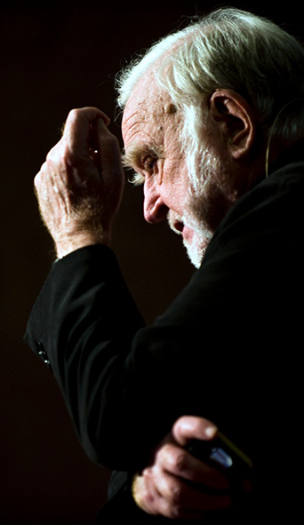
2. Engagement
Mihaly Csikszentmihalyi, the researcher who coined the term “flow,” believes happiness isn’t something that simply happens.
Instead, Csikszentmihalyi says it’s the product of an individual facing challenges that are neither too demanding, nor too simple, for one’s abilities.
Flow is an experience of optimal psychological functioning, where we are completely absorbed in a task that slightly exceeds our skill level, and therefore, requires us to stretch to a new level of performance.
“The best moments in our lives are not the passive, receptive, relaxing times . . . The best moments usually occur if a person’s body or mind is stretched to its limits in a voluntary effort to accomplish something difficult and worthwhile.”
Mihaly Csikszentmihalyi
1993 - 2021

Slide 31
When experiencing flow, concentration becomes so laser-focused that everything else seems to disappear and perception of time is altered.
The incessant voice in our head also quiets down when experiencing flow.
The prefrontal cortex, the area of the brain responsible for cognitive processes such as self-reflection and self-consciousness, shows less activation during states of flow.
The result is a heightened level of performance and creativity.
1993 - 2021

Slide 32
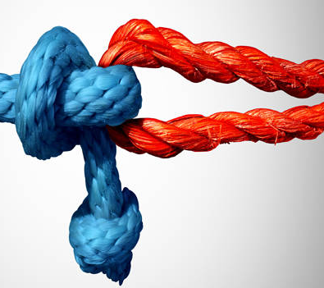
3. Relationships
As humans, we are hardwired to connect with others. We have a need for connection, love, and physical and emotional proximity to others.
The need for connection begins at birth–human babies depend on others to care for them because they are unable to survive on their own.
In addition, humans develop and learn about life and navigating the world through interactions with other people and the perspectives they offer.
It might not come as a surprise, then, that studies have repeatedly shown that the one thing that sets happier people apart is the quality of their relationships.
1993 - 2021

Slide 33
Psychiatrist Robert Waldinger is behind one of the longest and most-complete studies of adult life. The study followed two cohorts of men for 75 years, starting in 1938. These men answered surveys every two years about the quality of their marriages, job satisfaction, and social activities. Every five years, researchers examined the subjects’ physical health.
The study had one question to answer, What keeps us happy and healthy? The results revealed a simple answer: good relationships.
Dr. Christopher Peterson (1950-2012), summed this up perfectly with his famous quote:
“Other people matter.”
1993 - 2021

Slide 34
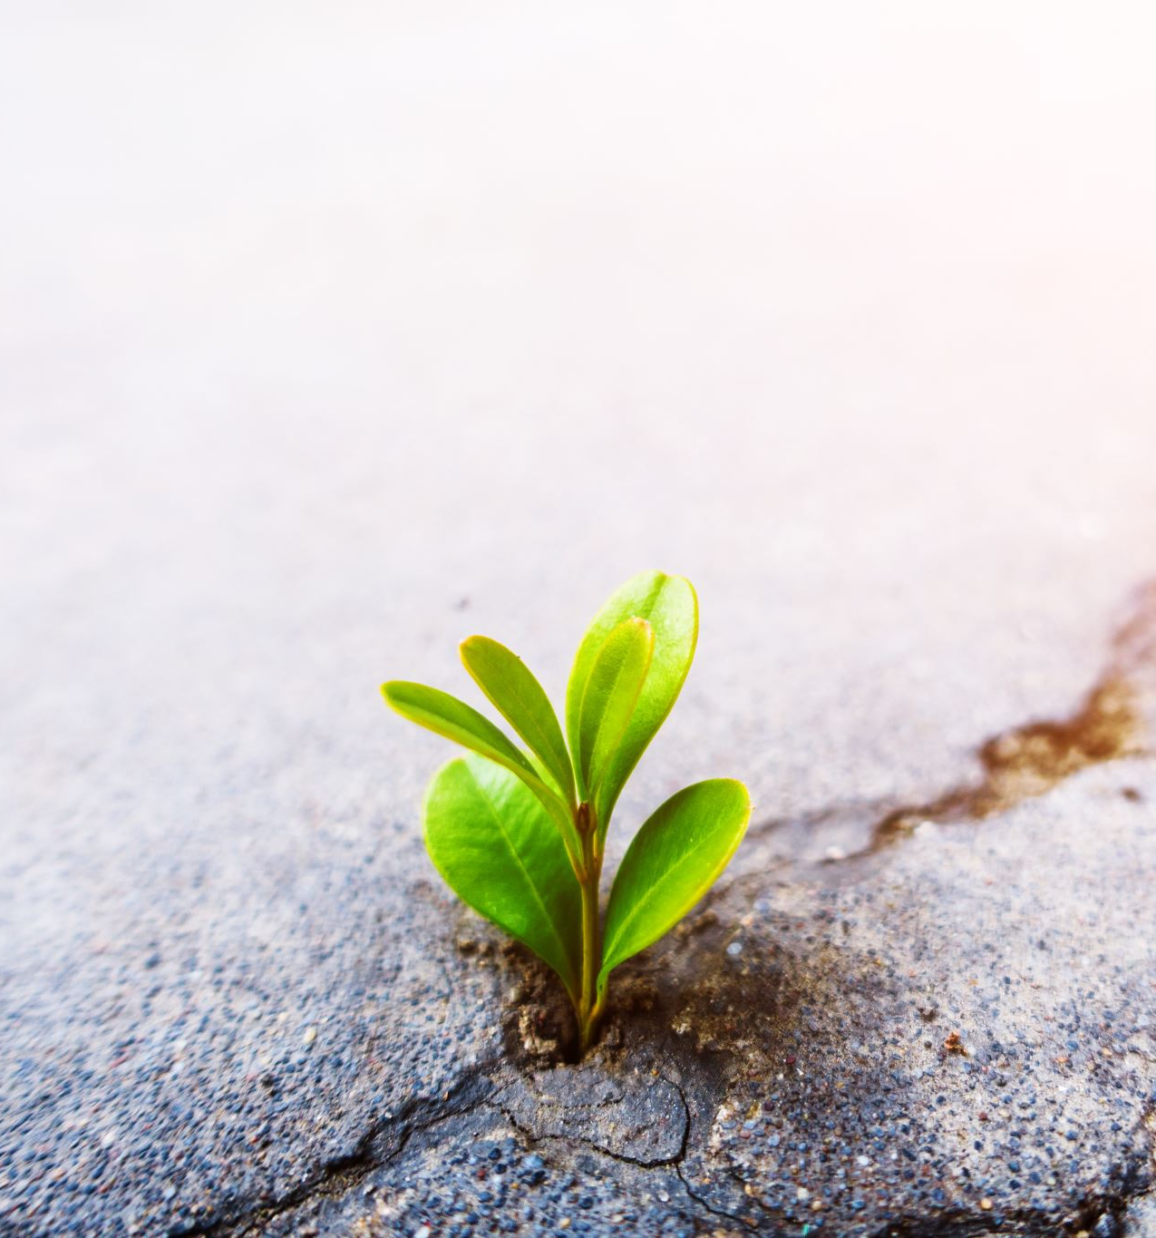
4. Meaning
Seligman believes that our level of well-being is affected by our choices, attitudes, and behaviours.
“There are no shortcuts. Well-being takes effort and persistence”.
And while positive emotions are necessary to a healthy life, fostering a deeper, more enduring sense of well-being requires an exploration of meaning.
“Use your signature strengths and virtues in the service of something much larger than you are.”
1993 - 2021

Slide 35
He also states that authentic happiness is:
“A preface to the meaningful life and that while it is possible take drugs to generate the effects of positive emotion and pleasure through pharmacology, it is not possible to synthesize the positive effects of being in the flow or of experiencing meaning.”
When we only chase pleasure for its own sake and fail to use our strengths toward something meaningful, we might squander our potential. But when we apply and develop our unique strengths and virtues toward something bigger than ourselves, we experience a deeper sense of satisfaction.
1993 - 2021

Slide 36
5. Accomplishments
People who feel personally involved in achieving their goals indicate higher levels of well-being and are in better health than people who lack a sense of direction in their lives.
Not all goals contribute equally to well-being. Goals that lead to well-being are personally meaningful.
1993 - 2021

Slide 37
About Me:
Here is your chance to shine!
Tell your audience about how the work you do helps people. What is the transformation you provide? Can you give two or three brief case studies, illustrating how you have helped people just like them?
Remember to leave your contact details up on the screen at the end of your presentation.

Slide 38
Thank you for joining me today. Please connect with me:
Over at my private practice development closed Facebook group – “Jayney Goddard MasterClasses”
At The Complementary Medical Association Facebook Page and Private Members Group
At The "Complementary Medical Association" and "Jayney Goddard" YouTube channels
Email: Jayney@The-CMA.org.uk
CMA office: Admin@The-CMA.org.uk, 0845 129 8434 / 01450 850630
CMA website: The-CMA.org.uk
1993 - 2021

Slide 39
Copyright notice
All or any part of this document or presentation may not be copied, distributed or otherwise used in any way without the express permission of the officers of The Complementary Medical Association. If you would like to seek permission to use all or any part of this document, please contact The CMA at Admin@The-CMA.org.uk.
Similarly, The CMA logo is a Registered Trademark and property of The CMA and unauthorized use of said trademark is illegal.
1993 - 2021

