Slide 1
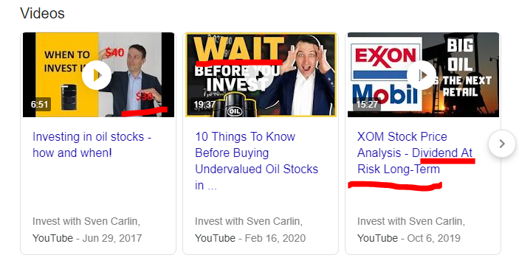
OIL AT $20 – TIME TO TAKE A LOOK!
By Sven Carlin – Independent Private Investor And Researcher

Slide 2
OIL INVESTING STRATEGY
OIL PRICE
FUTURE OIL PRICE
OIL STOCKS
INVESTMENT OUTCOMES
INTERESTING OIL INFO

Slide 3
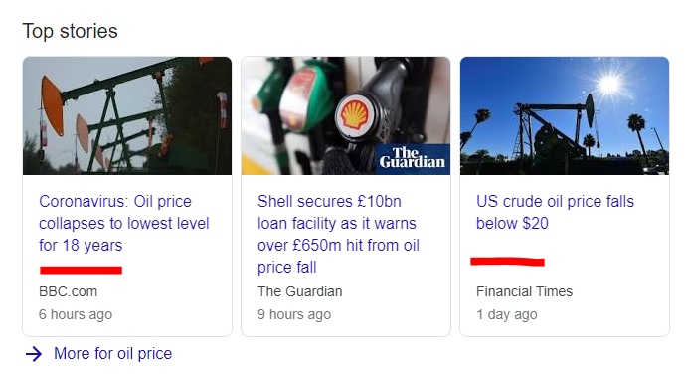
OIL INVESTING STRATEGY
OIL PRICE
FUTURE OIL PRICE
OIL STOCKS
INVESTMENT OUTCOMES
INTERESTING OIL INFO

Slide 4
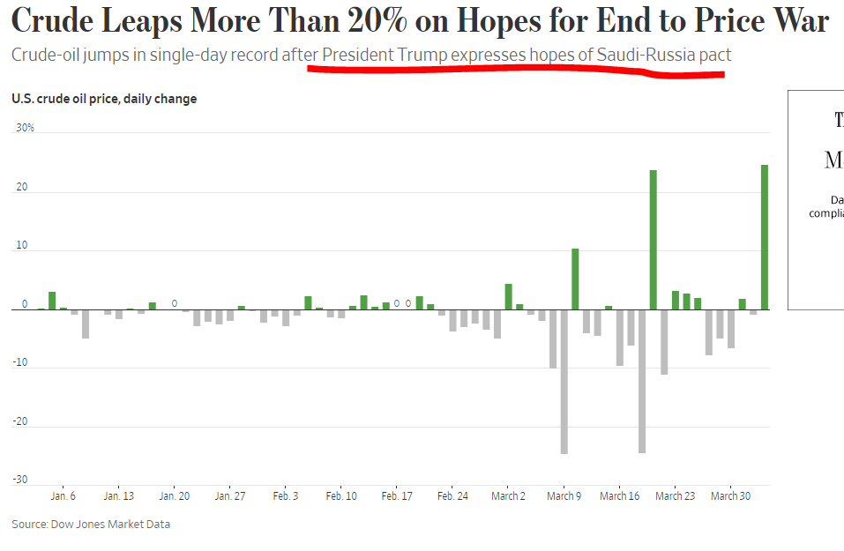
OIL INVESTING STRATEGY
OIL PRICE
FUTURE OIL PRICE
OIL STOCKS
INVESTMENT OUTCOMES
INTERESTING OIL INFO

Slide 5
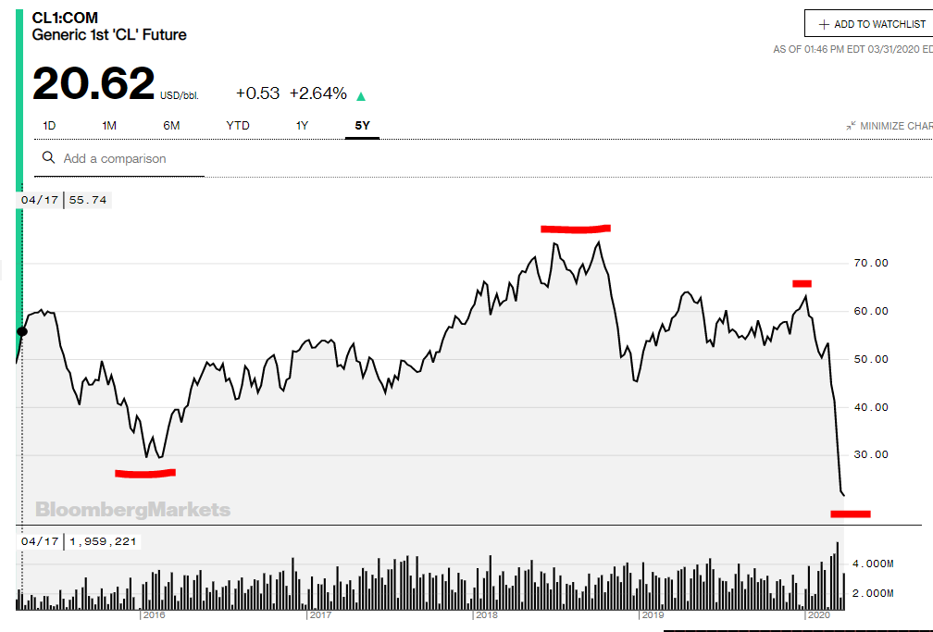
OIL INVESTING STRATEGY
OIL PRICE
FUTURE OIL PRICE
OIL STOCKS
INVESTMENT OUTCOMES
INTERESTING OIL INFO

Slide 6
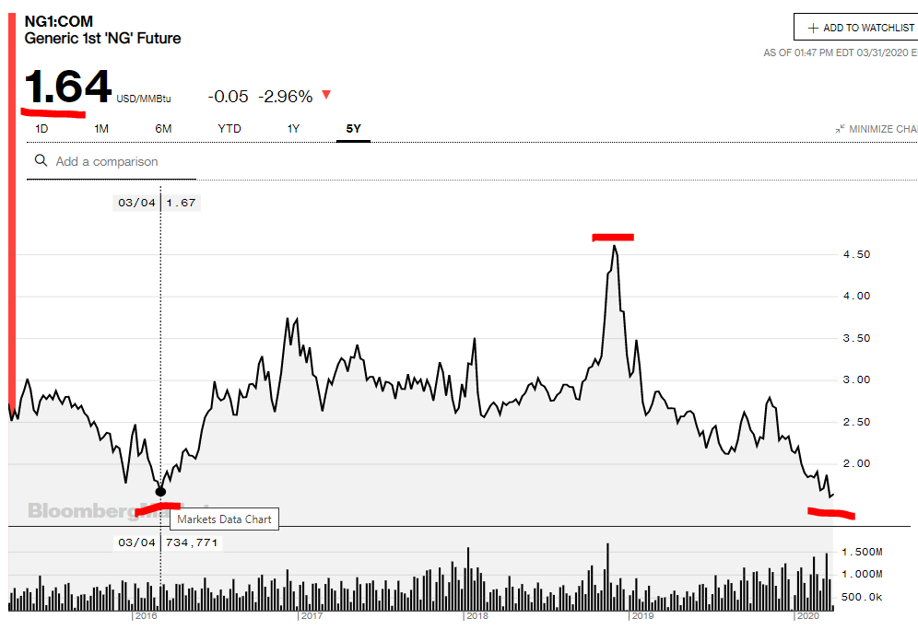
OIL INVESTING STRATEGY
OIL PRICE
FUTURE OIL PRICE
OIL STOCKS
INVESTMENT OUTCOMES
INTERESTING OIL INFO

Slide 7
OIL INVESTING STRATEGY
We are going to be wrong – but a look at fundamentals can make us not that much wrong – all I need!
SUPPLY AND DEMAND
SUPPLY – pump at will for now
DEMAND – DOWN a LOT
OIL PRICE
FUTURE OIL PRICE
OIL STOCKS
INVESTMENT OUTCOMES
INTERESTING OIL INFO

Slide 8
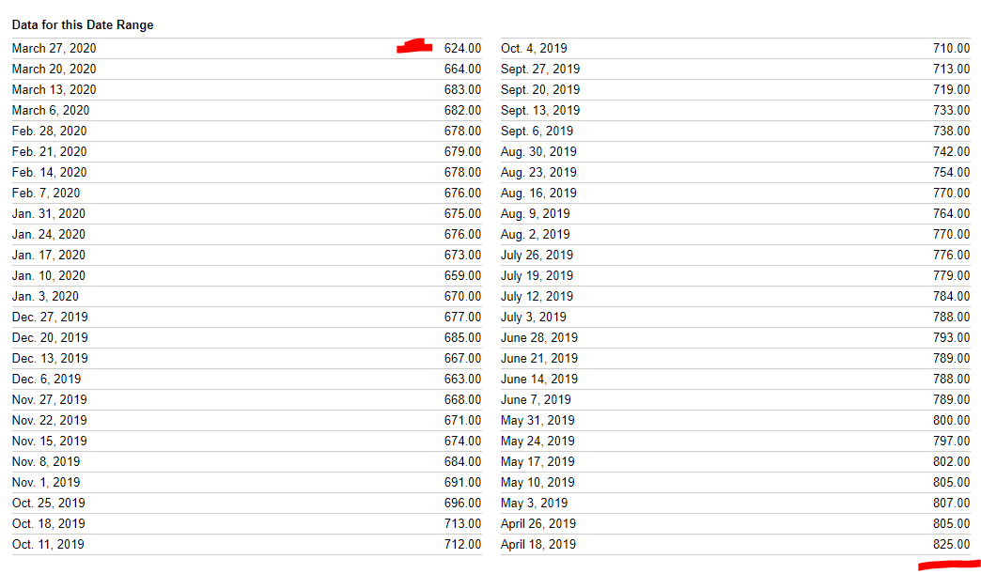
OIL INVESTING STRATEGY
SUPPLY – US OIL RIG COUNT
OIL PRICE
FUTURE OIL PRICE
OIL STOCKS
INVESTMENT OUTCOMES
INTERESTING OIL INFO

Slide 9
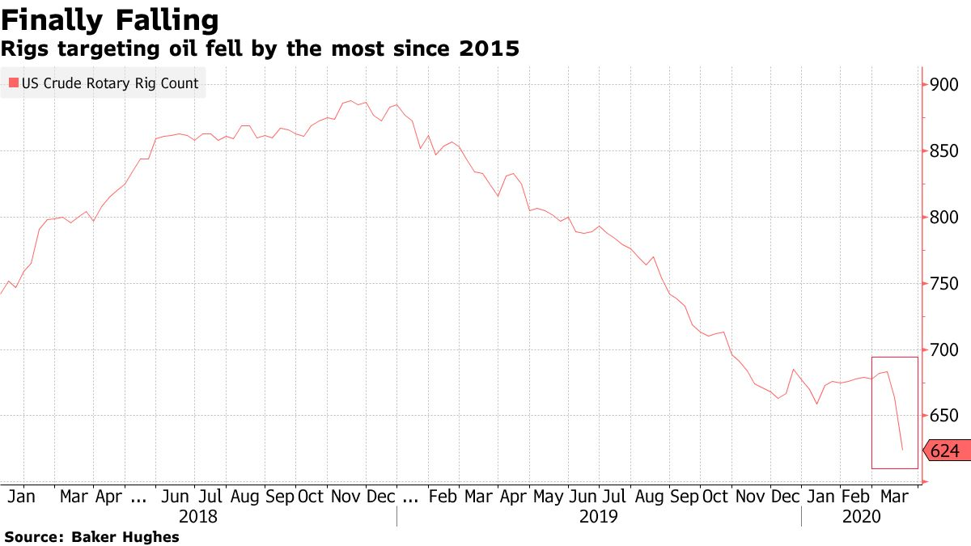
OIL INVESTING STRATEGY
SUPPLY – US OIL RIG COUNT
OIL PRICE
FUTURE OIL PRICE
OIL STOCKS
INVESTMENT OUTCOMES
INTERESTING OIL INFO

Slide 10
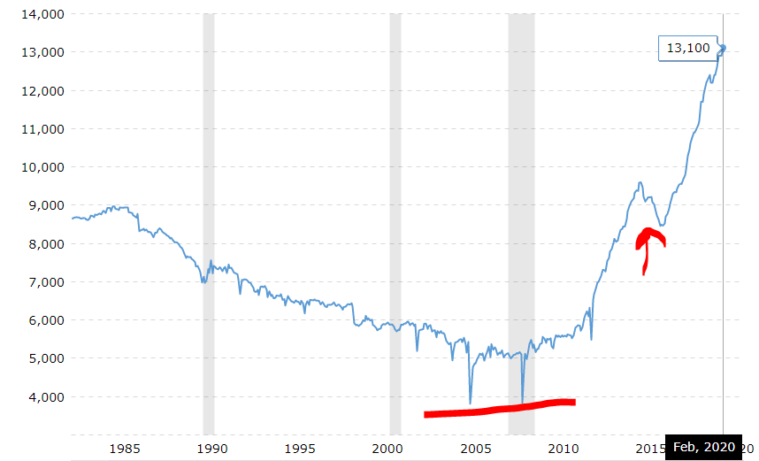
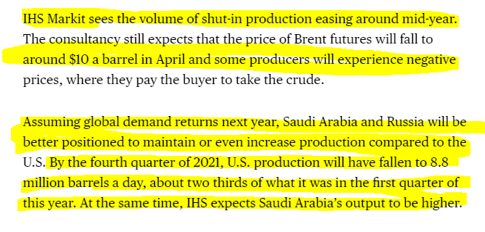
OIL INVESTING STRATEGY
SUPPLY – consequences
OIL PRICE
FUTURE OIL PRICE
OIL STOCKS
INVESTMENT OUTCOMES
INTERESTING OIL INFO

Slide 11
OIL INVESTING STRATEGY
SUPPLY – consequences
OIL PRICE
FUTURE OIL PRICE
OIL STOCKS
INVESTMENT OUTCOMES
INTERESTING OIL INFO

Slide 12
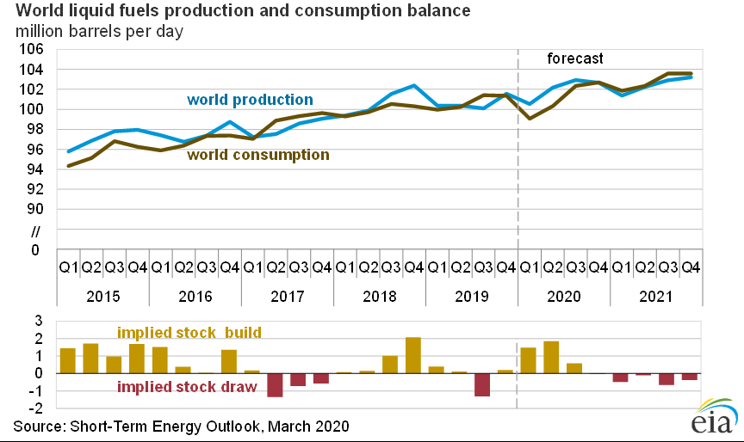
OIL INVESTING STRATEGY
SUPPLY & DEMAND – consequences
OIL PRICE
FUTURE OIL PRICE
OIL STOCKS
INVESTMENT OUTCOMES
INTERESTING OIL INFO

Slide 13
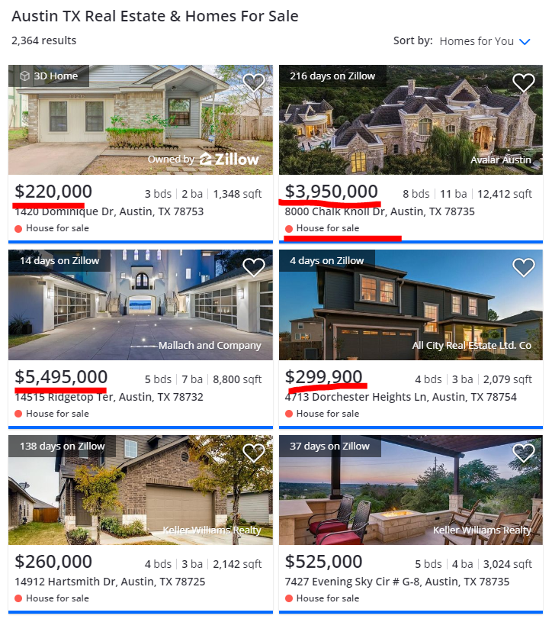
OIL INVESTING STRATEGY
SUPPLY & DEMAND – consequences
OIL PRICE
FUTURE OIL PRICE
OIL STOCKS
INVESTMENT OUTCOMES
INTERESTING OIL INFO

Slide 14
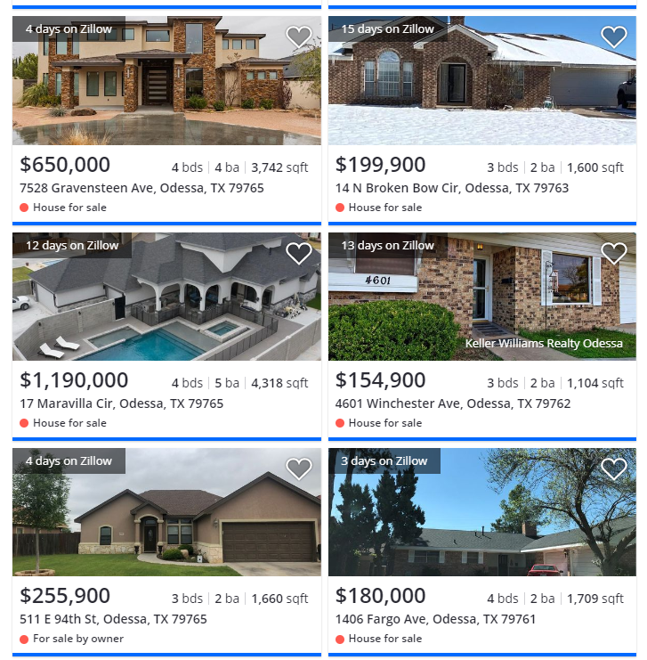
OIL INVESTING STRATEGY
SUPPLY & DEMAND – consequences
OIL PRICE
FUTURE OIL PRICE
OIL STOCKS
INVESTMENT OUTCOMES
INTERESTING OIL INFO

Slide 15
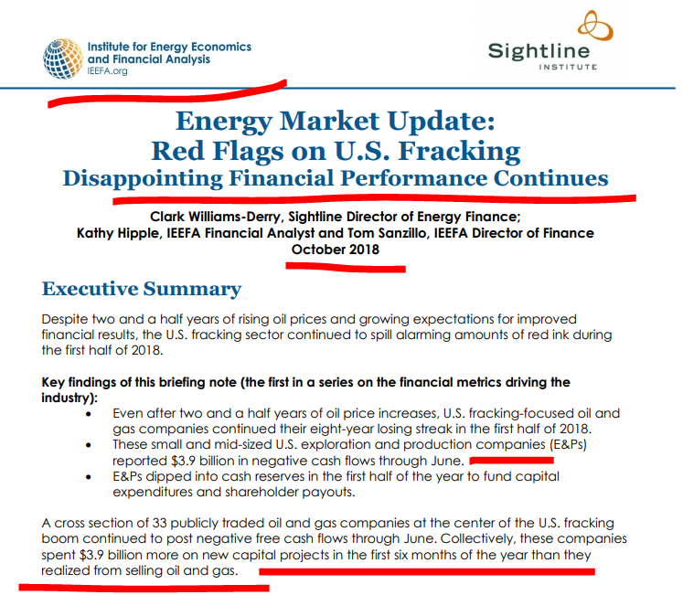
OIL INVESTING STRATEGY
SUPPLY & DEMAND – consequences
OIL PRICE
FUTURE OIL PRICE
OIL STOCKS
INVESTMENT OUTCOMES
INTERESTING OIL INFO

Slide 16
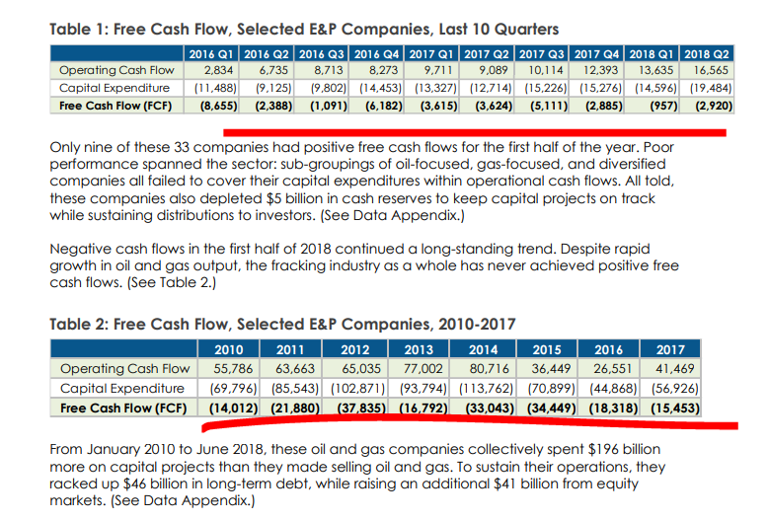
OIL INVESTING STRATEGY
SUPPLY & DEMAND – consequences
OIL PRICE
FUTURE OIL PRICE
OIL STOCKS
INVESTMENT OUTCOMES
INTERESTING OIL INFO

Slide 17
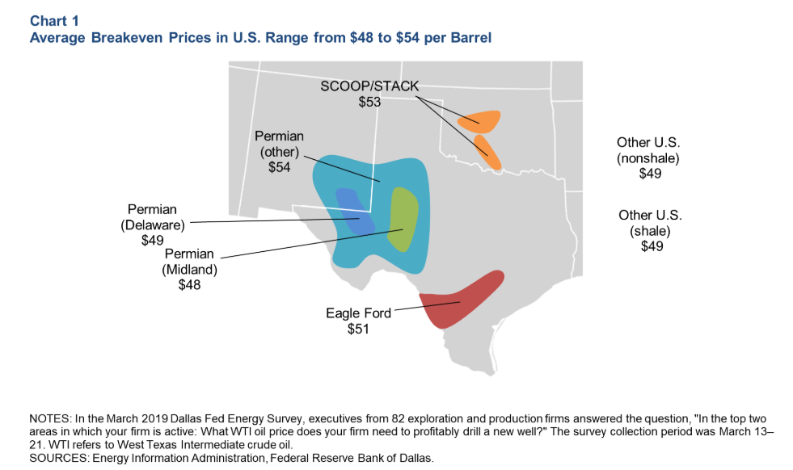
OIL INVESTING STRATEGY
SUPPLY & DEMAND – consequences
OIL PRICE
FUTURE OIL PRICE
OIL STOCKS
INVESTMENT OUTCOMES
INTERESTING OIL INFO

Slide 18
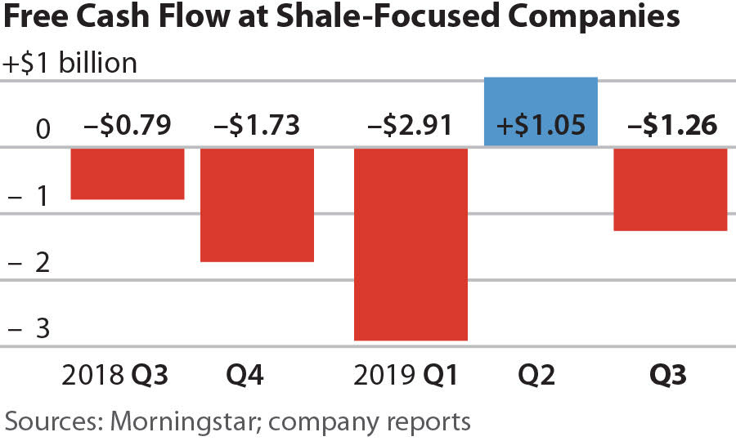
OIL INVESTING STRATEGY
SUPPLY & DEMAND – consequences
OIL PRICE
FUTURE OIL PRICE
OIL STOCKS
INVESTMENT OUTCOMES
INTERESTING OIL INFO

Slide 19
OIL INVESTING STRATEGY
SUPPLY & DEMAND – consequences
IMPORTANCE OF PRODUCTION UP!
SANCTIONS TO LOW COST PRODUCERS ( RUSSIA, IRAN)
TRYING TO KEEP THE HOUSE OF CARDS UP
OIL PRICE
FUTURE OIL PRICE
OIL STOCKS
INVESTMENT OUTCOMES
INTERESTING OIL INFO

Slide 20
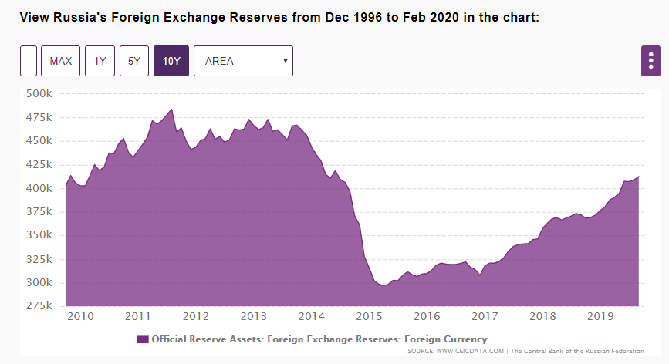
OIL INVESTING STRATEGY
SUPPLY & DEMAND – consequences
IN THE MEANTIME
OIL PRICE
FUTURE OIL PRICE
OIL STOCKS
INVESTMENT OUTCOMES
INTERESTING OIL INFO

Slide 21
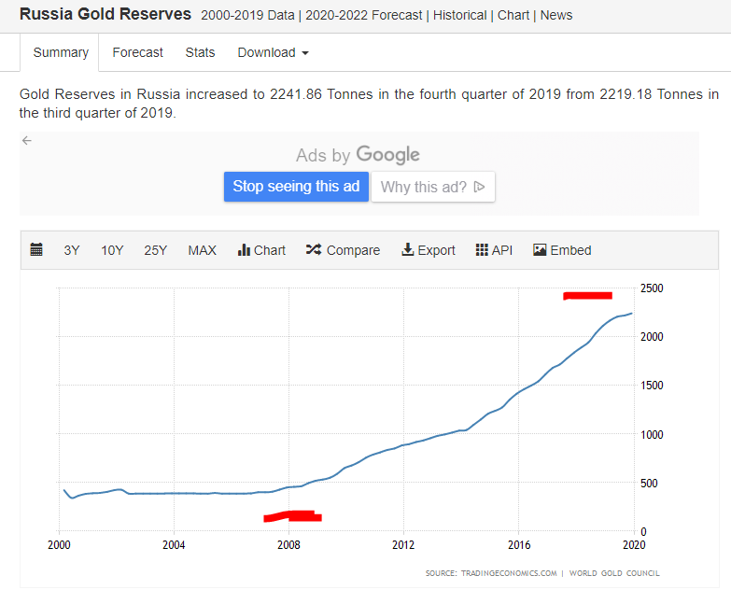
OIL INVESTING STRATEGY
SUPPLY & DEMAND – consequences
IN THE MEANTIME
OIL PRICE
FUTURE OIL PRICE
OIL STOCKS
INVESTMENT OUTCOMES
INTERESTING OIL INFO

Slide 22
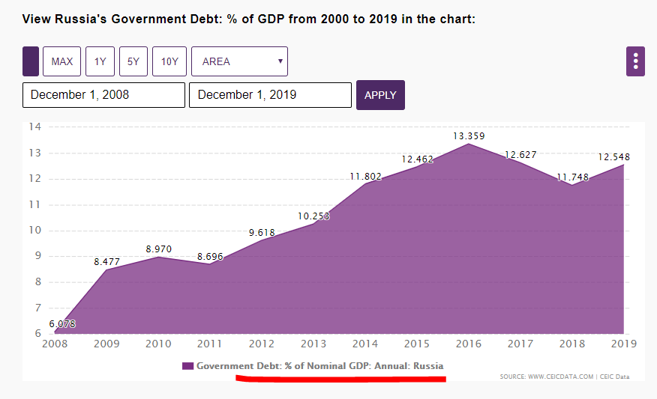
OIL INVESTING STRATEGY
SUPPLY & DEMAND – consequences
IN THE MEANTIME
OIL PRICE
FUTURE OIL PRICE
OIL STOCKS
INVESTMENT OUTCOMES
INTERESTING OIL INFO

Slide 23
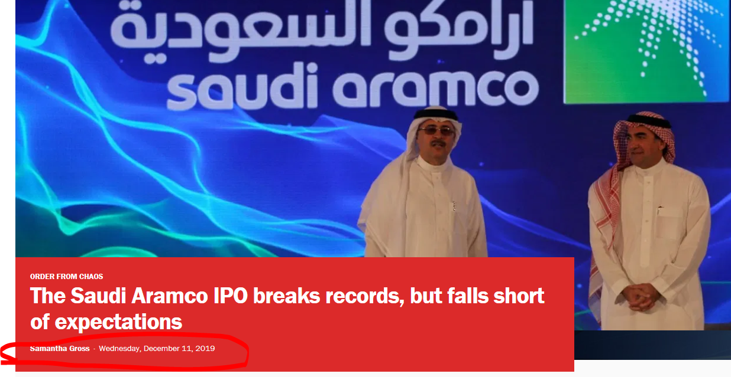
OIL INVESTING STRATEGY
SUPPLY & DEMAND – consequences
IN THE MEANTIME
OIL PRICE
FUTURE OIL PRICE
OIL STOCKS
INVESTMENT OUTCOMES
INTERESTING OIL INFO

Slide 24
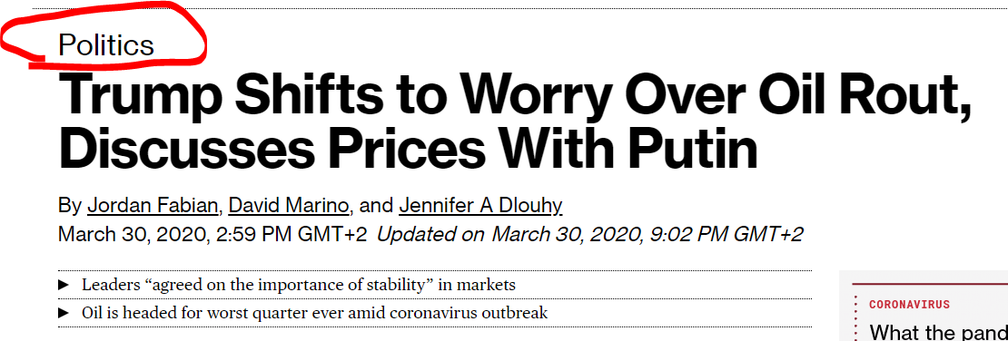
OIL INVESTING STRATEGY
SUPPLY & DEMAND – consequences
IN THE MEANTIME
OIL PRICE
FUTURE OIL PRICE
OIL STOCKS
INVESTMENT OUTCOMES
INTERESTING OIL INFO

Slide 25
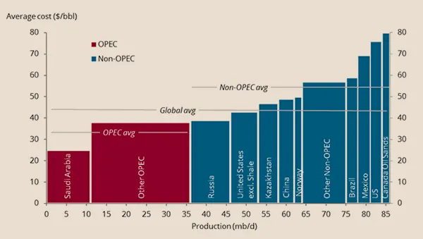
OIL INVESTING STRATEGY
SUPPLY & DEMAND – consequences
The marginal producer sets the price!
OIL PRICE
FUTURE OIL PRICE
OIL STOCKS
INVESTMENT OUTCOMES
INTERESTING OIL INFO

Slide 26
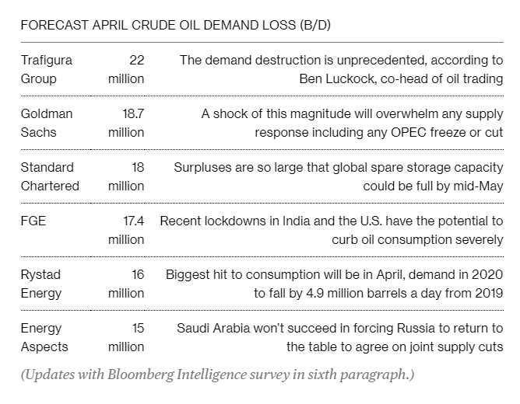
OIL INVESTING STRATEGY
SUPPLY & DEMAND – consequences
The marginal producer sets the price!
OIL PRICE
FUTURE OIL PRICE
OIL STOCKS
INVESTMENT OUTCOMES
INTERESTING OIL INFO

Slide 27
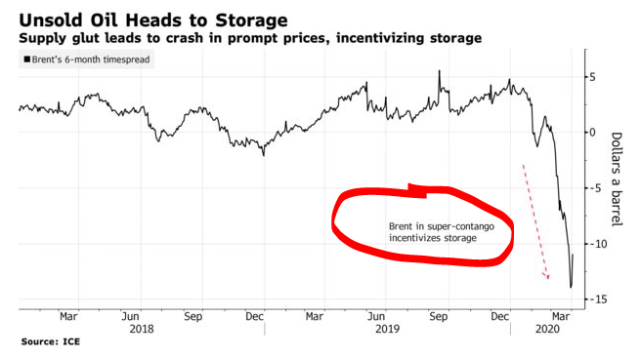
OIL INVESTING STRATEGY
SUPPLY & DEMAND – consequences
The marginal producer sets the price!
OIL PRICE
FUTURE OIL PRICE
OIL STOCKS
INVESTMENT OUTCOMES
INTERESTING OIL INFO

Slide 28
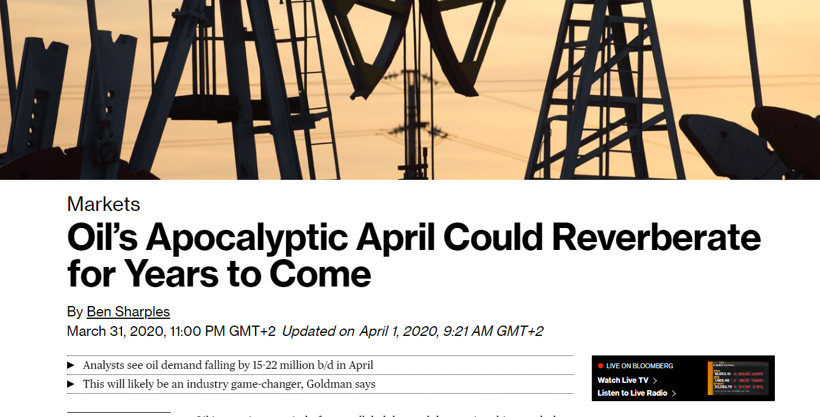
OIL INVESTING STRATEGY
SUPPLY & DEMAND – consequences
The marginal producer sets the price!
OIL PRICE
FUTURE OIL PRICE
OIL STOCKS
INVESTMENT OUTCOMES
INTERESTING OIL INFO

Slide 29
OIL INVESTING STRATEGY
SUPPLY & DEMAND – consequences
The marginal producer sets the price!
LONG TERM PRICES STILL AROUND $50 – but decline from $60 is big deal!
OIL PRICE
FUTURE OIL PRICE
OIL STOCKS
INVESTMENT OUTCOMES
INTERESTING OIL INFO

Slide 30
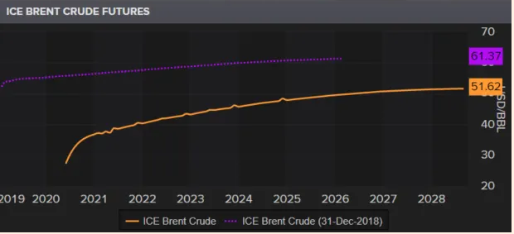
OIL INVESTING STRATEGY
SUPPLY & DEMAND – consequences
The marginal producer sets the price!
LONG TERM PRICES STILL AROUND $50 – but decline from $60 is big deal!
OIL PRICE
FUTURE OIL PRICE
OIL STOCKS
INVESTMENT OUTCOMES
INTERESTING OIL INFO

Slide 31
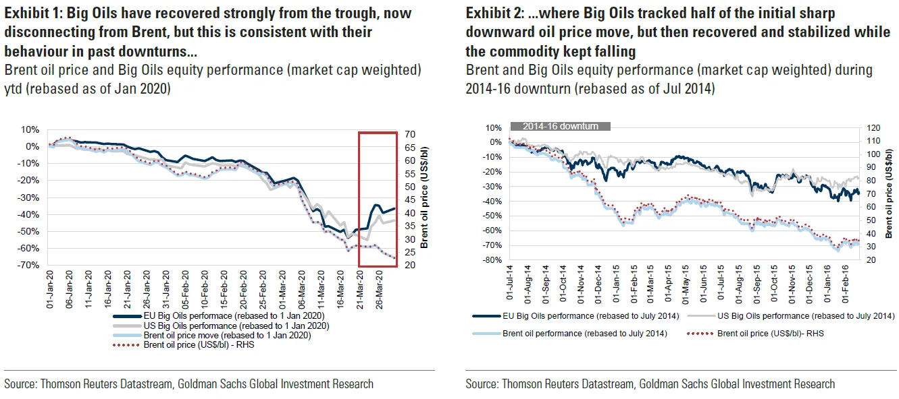
OIL INVESTING STRATEGY
OIL PRICE
FUTURE OIL PRICE
OIL STOCKS
INVESTMENT OUTCOMES
INTERESTING OIL INFO

Slide 32
OIL INVESTING STRATEGY
OIL PRICE
FUTURE OIL PRICE
OIL STOCKS
INVESTMENT OUTCOMES
INTERESTING OIL INFO

Slide 33
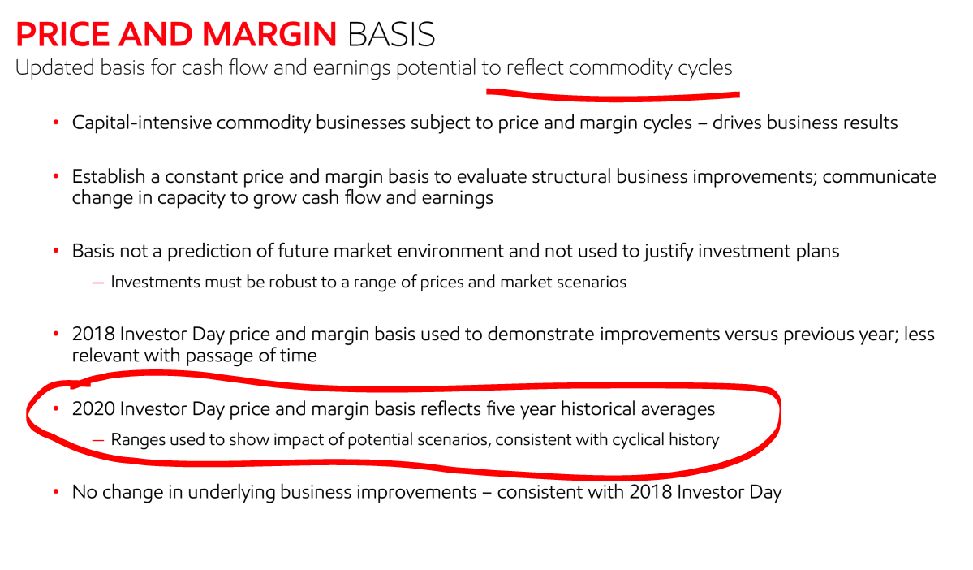
OIL INVESTING STRATEGY
EXXON – it is a commodity cycle
OIL PRICE
FUTURE OIL PRICE
OIL STOCKS
INVESTMENT OUTCOMES
INTERESTING OIL INFO

Slide 34
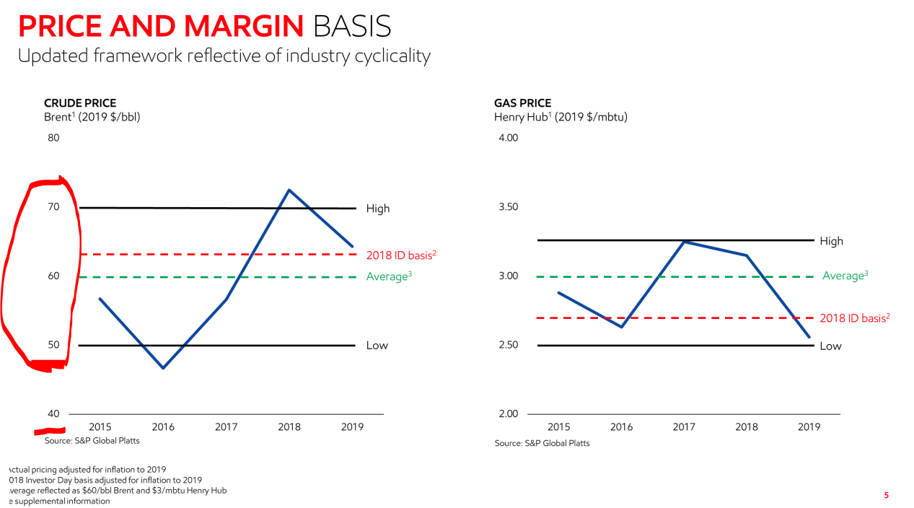
OIL INVESTING STRATEGY
EXXON – it is a commodity cycle
OIL PRICE
FUTURE OIL PRICE
OIL STOCKS
INVESTMENT OUTCOMES
INTERESTING OIL INFO

Slide 35
OIL INVESTING STRATEGY
EXXON – it is a commodity cycle
OIL PRICE
FUTURE OIL PRICE
OIL STOCKS
INVESTMENT OUTCOMES
INTERESTING OIL INFO

Slide 36
OIL INVESTING STRATEGY
EXXON – it is a commodity cycle
OIL PRICE
FUTURE OIL PRICE
OIL STOCKS
INVESTMENT OUTCOMES
INTERESTING OIL INFO

Slide 37
OIL INVESTING STRATEGY
EXXON – it is a commodity cycle
OIL PRICE
FUTURE OIL PRICE
OIL STOCKS
INVESTMENT OUTCOMES
INTERESTING OIL INFO

Slide 38
OIL INVESTING STRATEGY
EXXON – it is a commodity cycle
OIL PRICE
FUTURE OIL PRICE
OIL STOCKS
INVESTMENT OUTCOMES
INTERESTING OIL INFO

Slide 39
OIL INVESTING STRATEGY
EXXON – it is a commodity cycle
OIL PRICE
FUTURE OIL PRICE
OIL STOCKS
INVESTMENT OUTCOMES
INTERESTING OIL INFO

Slide 40
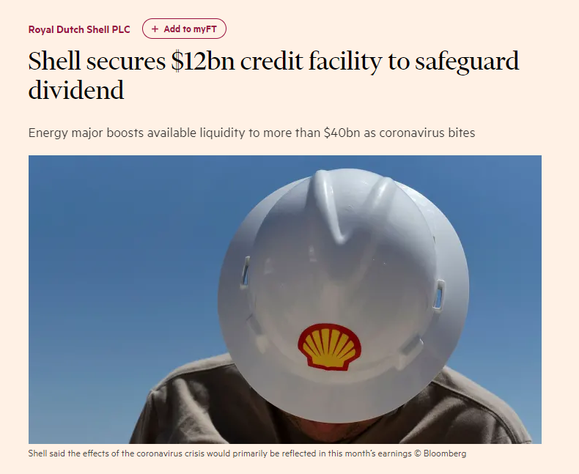
OIL INVESTING STRATEGY
SHELL – TAKING LOANS TO PAY DIVIDEND!!!
OIL PRICE
FUTURE OIL PRICE
OIL STOCKS
INVESTMENT OUTCOMES
INTERESTING OIL INFO

Slide 41
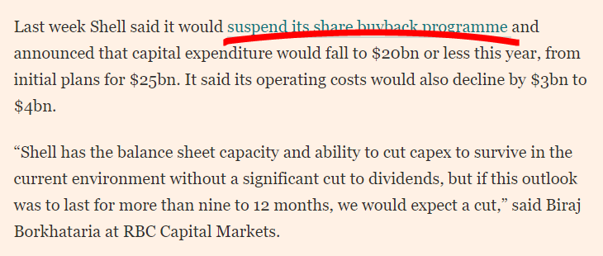
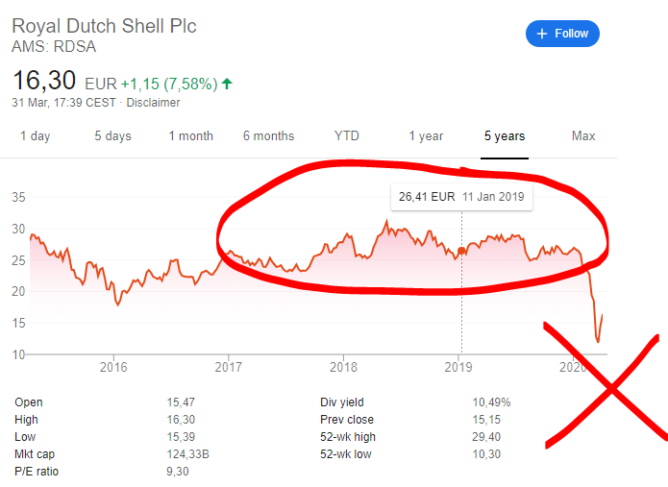
OIL INVESTING STRATEGY
SHELL – TAKING LOANS TO PAY DIVIDEND!!!
OIL PRICE
FUTURE OIL PRICE
OIL STOCKS
INVESTMENT OUTCOMES
INTERESTING OIL INFO

Slide 42
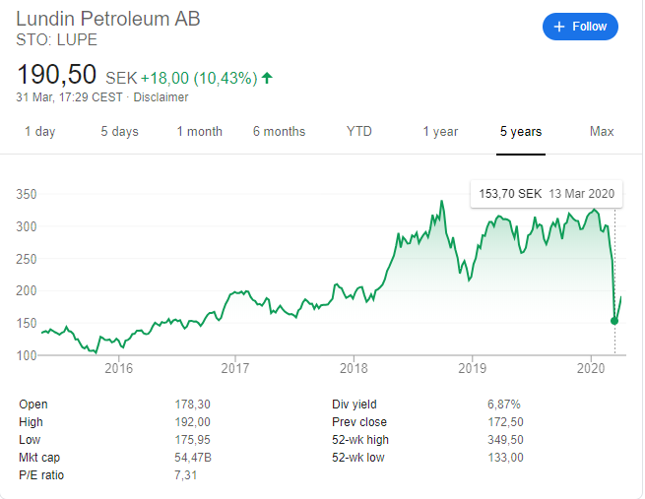
OIL INVESTING STRATEGY
Lundin Petroleum
OIL PRICE
FUTURE OIL PRICE
OIL STOCKS
INVESTMENT OUTCOMES
INTERESTING OIL INFO

Slide 43
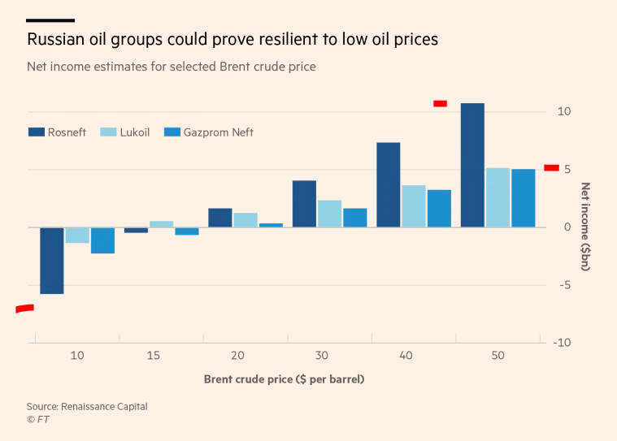
OIL INVESTING STRATEGY
Flexible taxes, rubble costs
OIL PRICE
FUTURE OIL PRICE
OIL STOCKS
INVESTMENT OUTCOMES
INTERESTING OIL INFO

Slide 44
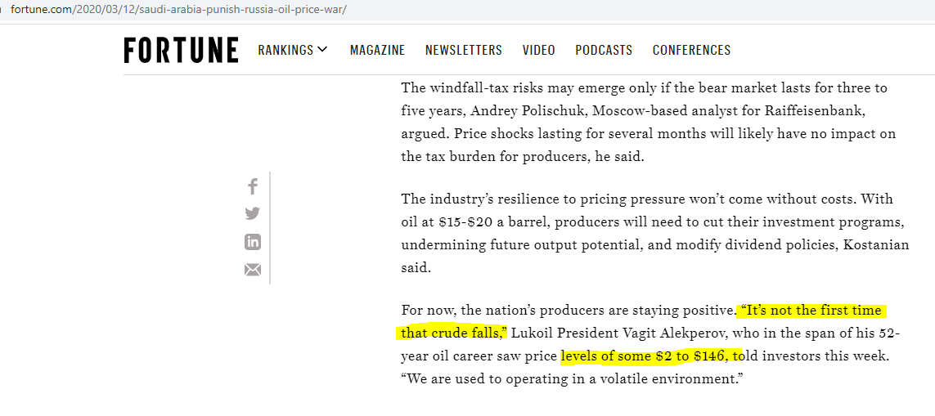
OIL INVESTING STRATEGY
Flexible taxes, rubble costs
OIL PRICE
FUTURE OIL PRICE
OIL STOCKS
INVESTMENT OUTCOMES
INTERESTING OIL INFO

Slide 45
OIL INVESTING STRATEGY
Flexible taxes, rubble costs
OIL PRICE
FUTURE OIL PRICE
OIL STOCKS
INVESTMENT OUTCOMES
INTERESTING OIL INFO

Slide 46
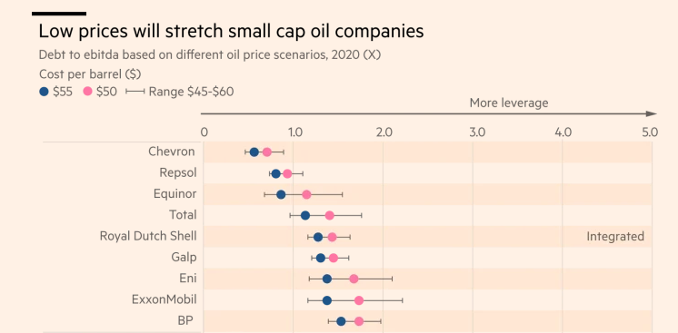
OIL INVESTING STRATEGY
OIL PRICE
FUTURE OIL PRICE
OIL STOCKS
INVESTMENT OUTCOMES
INTERESTING OIL INFO

Slide 47
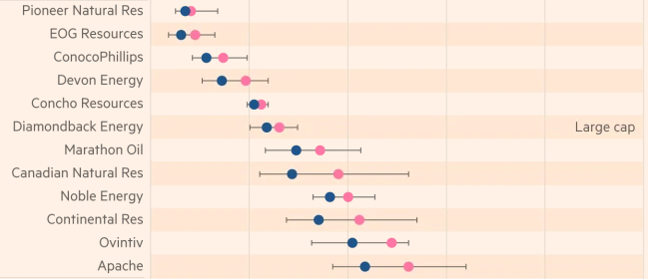
OIL INVESTING STRATEGY
OIL PRICE
FUTURE OIL PRICE
OIL STOCKS
INVESTMENT OUTCOMES
INTERESTING OIL INFO

Slide 48
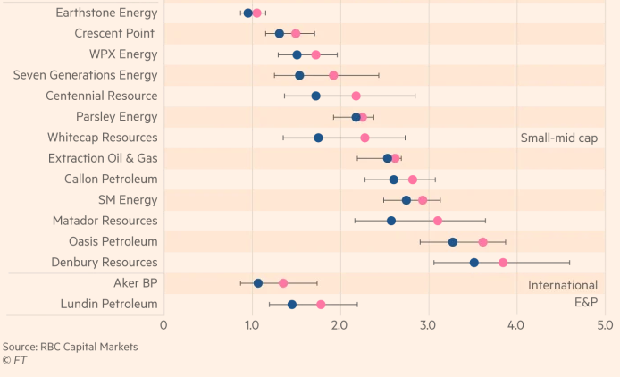
OIL INVESTING STRATEGY
OIL PRICE
FUTURE OIL PRICE
OIL STOCKS
INVESTMENT OUTCOMES
INTERESTING OIL INFO

Slide 49
OIL INVESTING STRATEGY
OIL PRICE
FUTURE OIL PRICE
OIL STOCKS
INVESTMENT OUTCOMES
INTERESTING OIL INFO

Slide 50
OIL INVESTING STRATEGY
HIGH DEBT – DOESN’T SURVIVE SCENARIO:
Debt holders take over the company, restructure and try to get out some value – current shareholders wiped out!
OIL PRICE
FUTURE OIL PRICE
OIL STOCKS
INVESTMENT OUTCOMES
INTERESTING OIL INFO

Slide 51
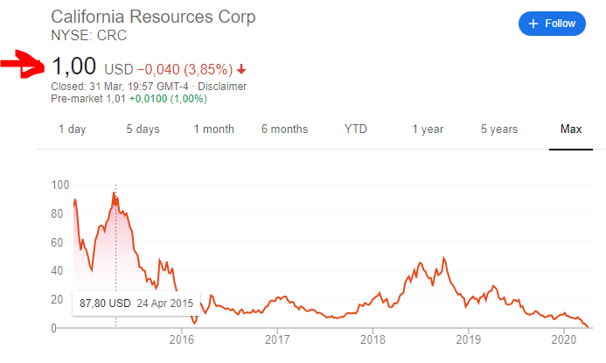
OIL INVESTING STRATEGY
HIGH DEBT – DOESN’T SURVIVE SCENARIO:
Debt holders take over the company, restructure and try to get out some value – current shareholders wiped out!
OIL PRICE
FUTURE OIL PRICE
OIL STOCKS
INVESTMENT OUTCOMES
INTERESTING OIL INFO

Slide 52
OIL INVESTING STRATEGY
HIGH DEBT – DOESN’T SURVIVE SCENARIO:
Debt holders take over the company, restructure and try to get out some value – current shareholders wiped out!
HOWEVER, if survival and higher oil price – big boom in price! RISK REWARD – 10x vs total loss!
OIL PRICE
FUTURE OIL PRICE
OIL STOCKS
INVESTMENT OUTCOMES
INTERESTING OIL INFO

Slide 53
OIL INVESTING STRATEGY
OIL PRICE WILL RECOVER - $50 at least is needed for investments but first the $70 needed for investments need to feel the pain – 2020 oversupply
Going into 2021 stabilization $40, $50, depending on political plays
Also, with the economies slowly coming back and ramping up demand.
DANGER: FREE MONEY TO EVERYBODY – CAN KEEP UP PRODUCTION FOR LONGER – THUS FEEL NO PAIN AND CREATE A DISTORTED MARKET (Isn’t it already)
1) 63% of all US oil production is from Tight Oil (shale). The drilling method used means it is capital intensive and requires constant injections of cash. Therefore low oil prices and tighter credit means Roughly 63% Of US oil is not economically viable, especially at low prices. They are bullshit firms riding the credit cycle. Lots of broke US firms
2) Russia is basically only about 2 things, oil and gas. It needs them for its foreign currency. It will do whatever it takes to protect them. It can produce oil at around 15 dollars.
3) big oil firms have been there, seen that, got the T shirt.
4) remove 63% of US production, prices go up
OIL PRICE
FUTURE OIL PRICE
OIL STOCKS
INVESTMENT OUTCOMES
INTERESTING OIL INFO

Slide 54
OIL INVESTING STRATEGY
OIL PRICE WILL RECOVER - $50 at least is needed for investments but first the $70 needed for investments need to feel the pain – 2020 oversupply
Going into 2021 stabilization $40, $50, depending on political plays
Also, with the economies slowly coming back and ramping up demand.
DANGER: FREE MONEY TO EVERYBODY – CAN KEEP UP PRODUCTION FOR LONGER – THUS FEEL NO PAIN AND CREATE A DISTORTED MARKET (Isn’t it already)
OIL PRICE
FUTURE OIL PRICE
OIL STOCKS
INVESTMENT OUTCOMES
INTERESTING OIL INFO

Slide 55
OIL INVESTING STRATEGY
OIL PRICE
FUTURE OIL PRICE
OIL STOCKS
INVESTMENT OUTCOMES
INTERESTING OIL INFO

Slide 56
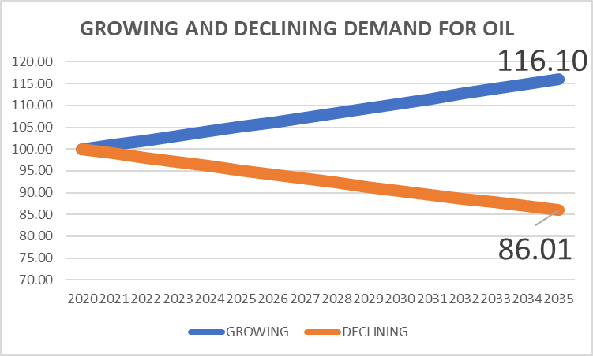
OIL INVESTING STRATEGY
THE MAIN QUESTION FOR OIL – LONG-TERM DEMAND – growth of 1% or decline of 1% per year?
HUGE DIFFERENCE!!!!!!
OIL PRICE
FUTURE OIL PRICE
OIL STOCKS
INVESTMENT OUTCOMES
INTERESTING OIL INFO

Slide 57
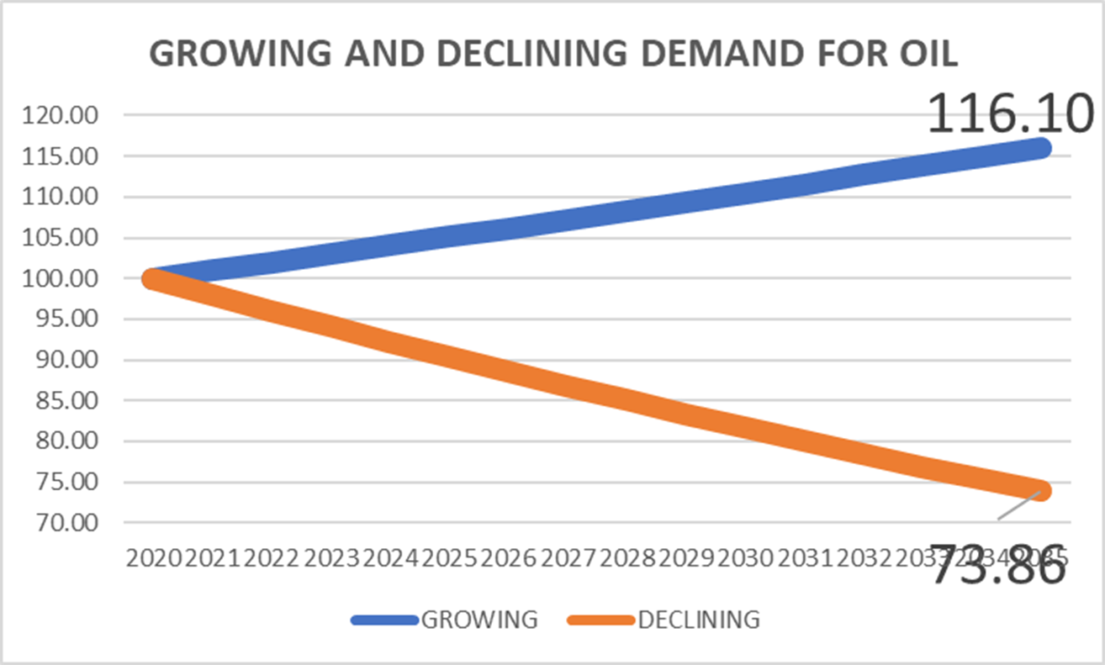
OIL INVESTING STRATEGY
THE MAIN QUESTION FOR OIL – LONG-TERM DEMAND – growth of 1% or decline of 1% per year?
HUGE DIFFERENCE!!!!!!
OIL PRICE
FUTURE OIL PRICE
OIL STOCKS
INVESTMENT OUTCOMES
INTERESTING OIL INFO

Slide 58
OIL INVESTING STRATEGY
OIL PRICE
FUTURE OIL PRICE
OIL STOCKS
INVESTMENT OUTCOMES
INTERESTING OIL INFO

