Slide 1
Minimialism- A beautiful life with Less
Objective:
How does minimalism help me to rethink about things that are truly important?
Why is less = more?
How do I need to save?
Email: sunrainearthsre@gmail.com
For 1-1 mentoring on minimalism

Slide 2
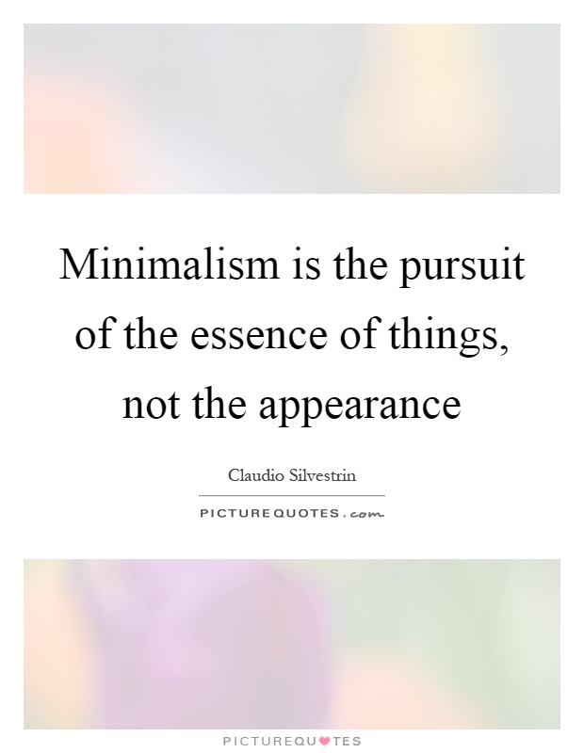

Slide 3
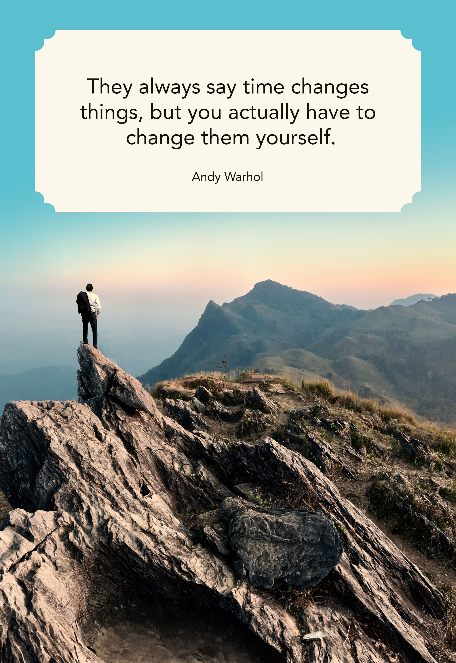
This could be a life saver when you realise you need to make the change starting today or never…

Slide 4
Topic: How does minimalism help me to rethink about things that are truly important? Answer these questions truthfully What makes you happiest? What do you value most in life?

Slide 5
Video on Minimalism https://www.youtube.com/watch?v=0Co1Iptd4p4 (Minimalism in USA) https://www.youtube.com/watch?v=14NwNY1tEVg (what is minimalism?) https://www.youtube.com/watch?v=w7rewjFNiys
What is minimalism?
Minimalism is about the desire to live with fewer material possessions, or not own a car or a television, or travel all over the world. Minimalism is a tool that can assist you in finding freedom.
How does adopting the idea of minimalism help you to save money?
More contented with what you have and to save money by not buying things unnecessary.

Slide 6
Get Inspired!!! Be motivated to be minimalist!
Minimalism is the thing that gets us past the things so we can make room for life's most important things—which actually aren't things at all.
At age 30, best friends Joshua Fields Millburn & Ryan Nicodemus walked away from their six-figure corporate careers, jettisoned most of their material possessions, and started focusing on what's truly important.
In their debut book, Joshua & Ryan, authors of the popular website The Minimalists, explore their troubled pasts and descent into depression. Though they had achieved the American Dream, they worked ridiculous hours, wastefully spent money, and lived paycheck to paycheck. Instead of discovering their passions, they pacified themselves with ephemeral indulgences—which only led to more debt, depression, and discontent.
After a pair of life-changing events, Joshua & Ryan discovered minimalism, allowing them to eliminate their excess material things so they could focus on life's most important "things": health, relationships, passion, growth, and contribution.

Slide 7
How to be a minimalist?
Do (SUPER)
Don’ts (TIC)
Save
Upcycling
Pursue your passion
Eco-friendly
Relationship
Don’t follow the trends (herd mentality)
Don’t increase your expenditure
Don’t compare with others

Slide 8
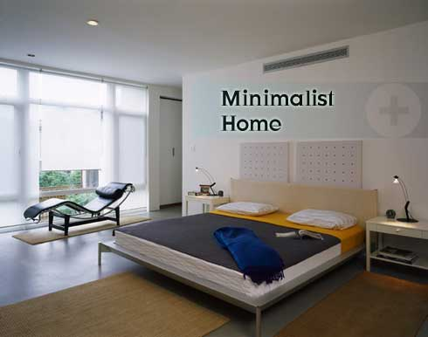
What do you observe in a minimalist’s home?
How should your home look like?
“Clear your mind, clear your baggage!”

Slide 9
Now let’s watch the video on Minimalism: https://www.youtube.com/watch?v=27So9GlE87w

Slide 10
Based on the vide, What is your one takeaway from this documentary about Minimalism?
Focus on life's most important "things":
Health, relationships, passion, growth, and contribution.

Slide 11
Ask yourself everyday…
1) Do you think it is difficult to save $1 a day? Why or Why not?

Slide 12
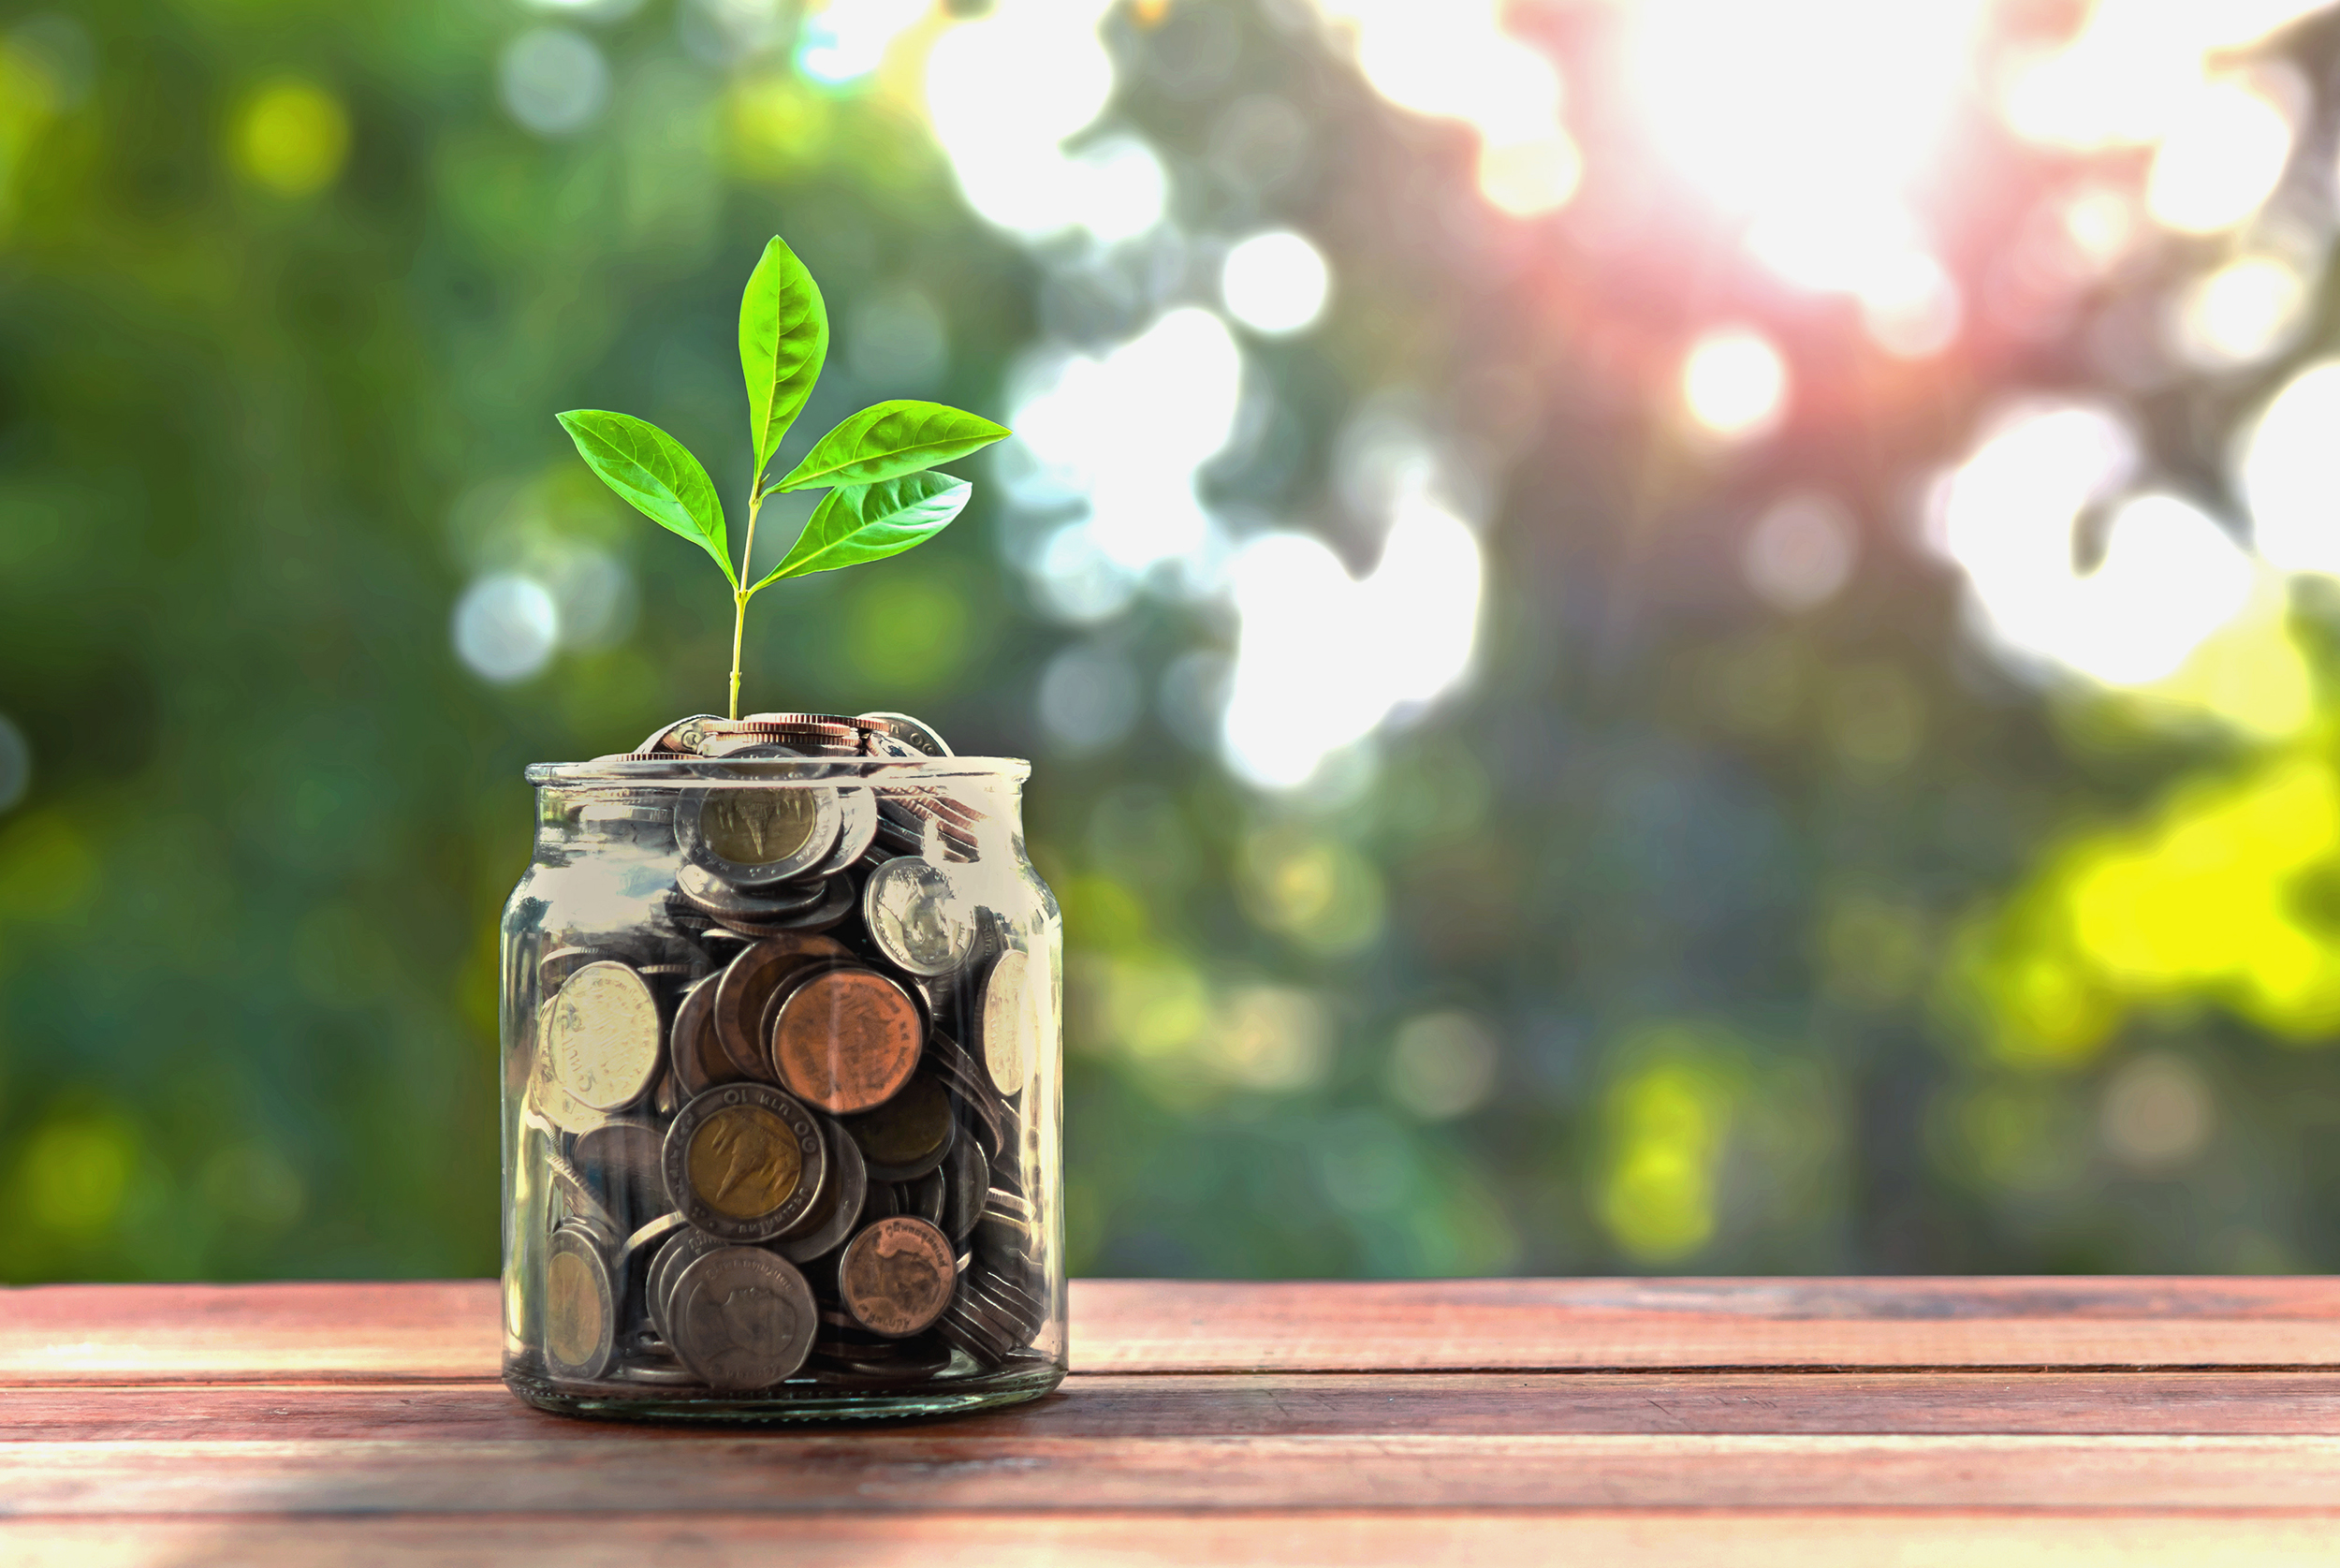
2. What are some ways you can try to save money?
A) Self-control and avoid going to malls when there are sales.
B) Save your money into your bank.
C) Have app in your phone to do budgeting and remind yourself not to exceed your budget.

Slide 13
The little things in life counts…

Slide 14
Set Small Goals to help you adopt Minimalist lifestyle
Today I will be saving $20 …
I am going to stop buying clothes for this whole month.
Declutter : I am going to donate to charity all the things I do not want anymore.

Slide 15
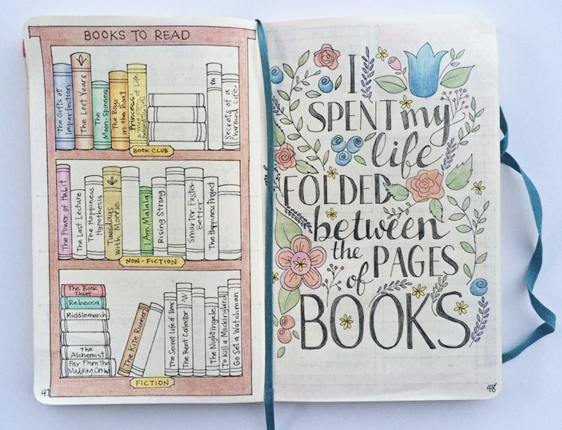
Keep a journal to record what makes you happy everyday.
What makes me happy today!

Slide 16
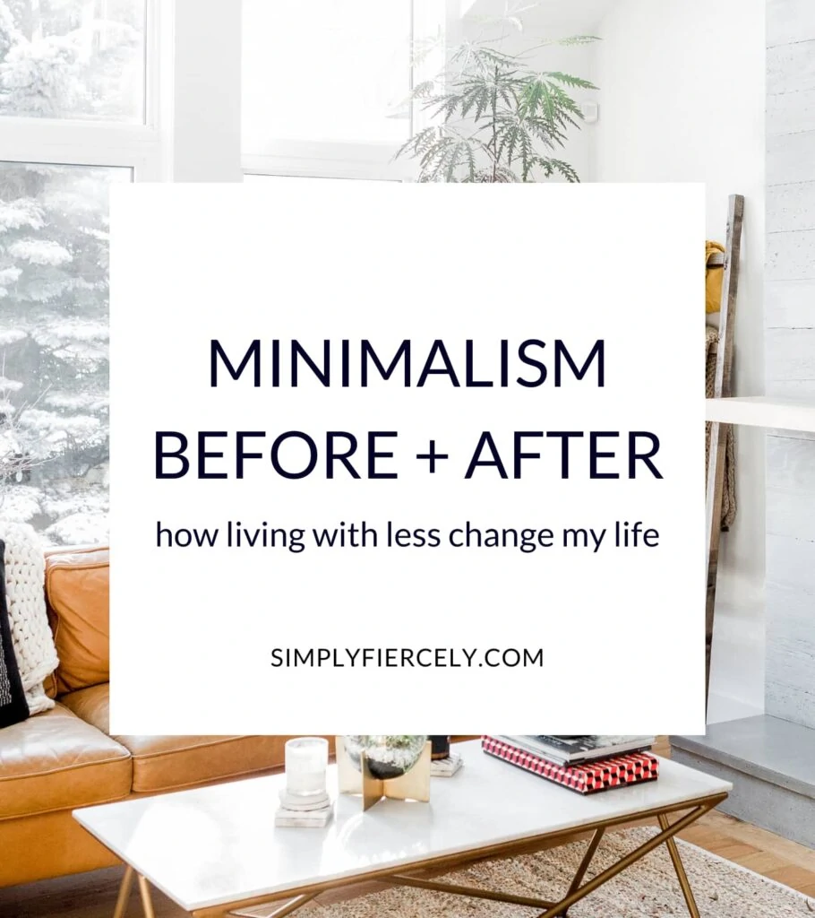
Reflect upon & review your progress and how adopting a minimalism has benefitted you.
Minimalism has changed ….

