Slide 1
Business Essentials – Starting your CKD Practice
Jessianna Saville, MS, RDN, CSR, LD, CLT
Steve Della Croce, MS, RDN, CDE, LD

Slide 2
Objectives
Understand growing epidemic of CKD
Creating your vision (Intentional design to avoid overwhelm!)
Becoming a provider
Business structure
Getting paid – insurance and billing
Baseline purpose for clients/Establish ideal clientele
Office essentials
Office helps
Forms you need to start

Slide 3
Module 1.1: Think About Your Vision

Slide 4
Knowing the Need of your Niche
Do you know how many people are impacted by X health concern?
Find the data
Find the research
Find where these people gain treatment and support
This Photo by Unknown Author is licensed under CC BY

Slide 5
What is your ultimate goal?
Have a lucrative side-hustle?
Quit your current RD job?
Build a profitable business?
Influence the conversation about your niche (if Renal –CKD) intervention through diet therapy?
Just help people without regard to money?
Create something using my expertise?

Slide 6
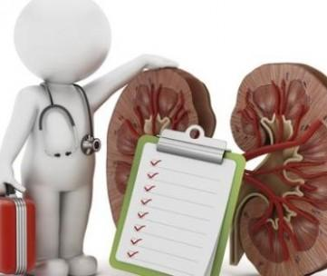
Prevalence of CKD
Kidney disease is the 9th leading cause of death in US
About 14% of general population of US has CKD.
50% of individuals with CKD have Diabetes and/or self reported Cardiovascular disease (CVD)
About 3 out 4 new cases of CKD will have diabetes or hypertension
Notes:
Reference: CDC 2014

Slide 7
Rising Incidence of CKD Among Medicare Patients

Slide 8
Projected growth of CKD
CKD >30 years old - 28 million in 2020 and nearly 38 million in 2030. –Hoerger 2015
>50% of Americans born today will develop CKD stage 3+ during their lifetime –Grams 2013

Slide 9
Necessity of CKD MNT
Figure. Selected recommendations from the chronic kidney disease (CKD) Academy of Nutrition and Dietetics evidence-based nutrition practice guidelines executive summary for medical nutrition therapy for target population of adults > 18 years of age with CKD stages 1-5 with or without renal replacement therapy by a Registered dietitian nutritionist using the Nutrition Care Process (NCP)
Selected Recommendations for NCP | Evidence rating
NCP Screening and Referral
MNT provided by an RDN has been shown to be effective in demonstrating signiﬁcant improvements in anthropometric and biochemical measures sustained longer than 1 year | Strong Imperative
MNT should be initiated at least 12 months before anticipation of RRT; recommended to be initiated at CKD diagnosis to maintain adequate nutritional status, prevent disease progression, and delay RRT. | Strong Imperative
The RDN should monitor every 1 to 3 months, conditional on nutritional status, comorbidities, and disease-progression risk. | Strong Conditional
Recommended RDN time requirements for MNT of approximately 2 hours/month for up to 1 year may be required to provide effective care. | Strong Conditional
NCP Nutrition Assessment
Food/nutrition-related history should be assessed and related to changes, including but not limited to food and nutrient intake with biochemical parameters, medication and dietary supplements, knowledge and beliefs, access to food. | Consensus Imperative
Body weight for the purpose of calculating nutritional needs should be estimated and assessed using clinical judgment, preferably with serial weight measures within the context of CKD (changes in ﬂuid status, kidney function, and body composition). | Consensus Imperative
Biochemical parameters, preferably integrating data over time, should be assessed to effectively determine nutrition diagnosis and nutrition prescription. | Consensus Imperative
Guideline ratings: strong (practitioners should follow unless a clear and compelling rationale for alternative is present, quality of evidence reviewed was excellent/good; consensus (practitioners should assess and follow flexibly, expert opinion support but evidence was lacking. Statement ratings: conditional (specific situation) or imperative (broadly applicable. From the Academy’s evidence-based library complete report and auxiliary materials. Refer to the full report for complete set of recommendations.
Beto JA, Ramirez WE, Bansal VK.J Acad Nutr Diet. 2014;114(7).
Notes:
Tip: Add your own speaker notes here.

Slide 10
VISION So you’re thinking about CKD MNT…
Common opportunities that exist? How would you like to contribute?
Help people with CKD locally
Help people with CKD virtually
Blog about kidney disease
Write about nutrition and CKD (books, etc…)
What is your ultimate vision of what you’d like to do? What needs do you see? What do you love to do? Work towards your strengths!
Notes:
This is an important question to start thinking about now. You can always change, but knowing ahead of time is a wonderful way to start
Help people with CKD locally – working with nephrologist
Help people with CKD virtually – online work
Blog about kidney disease – yes, you can make money here

Slide 11
Income Outside of Traditional Counseling Models
Passive Income: Ads, Affiliate programs,
Supplement Sales
E-Products (RD2RD, courses, etc…)
Membership Sites
Sell Physical Goods (think of going to the chiropractor! What do they sell you?)
Freelance writing (check out “RDs Who Write” Facebook Group
Write a book
Speaking
Become an influencer

Slide 12
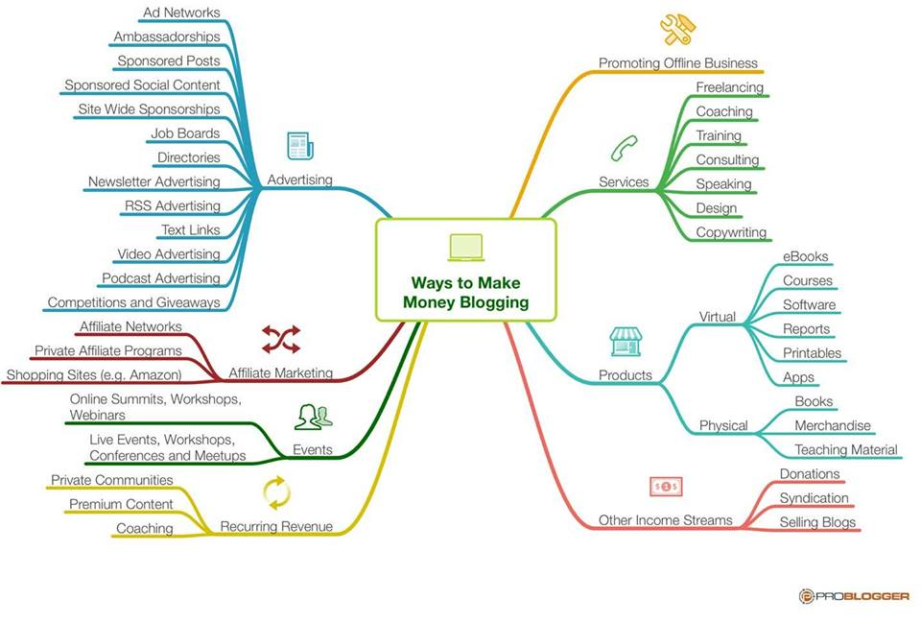
More Income Sources!

Slide 13
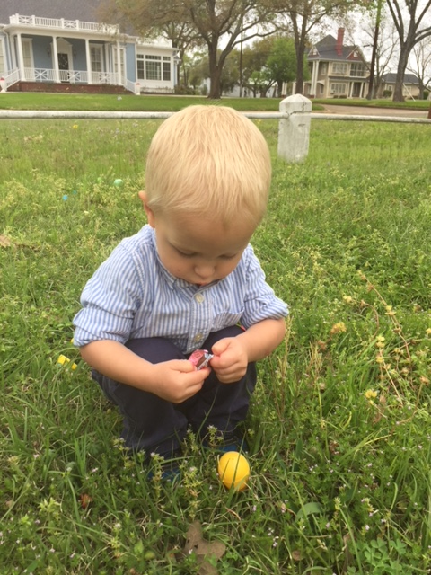
Still not sure what you want to do?
“Use your strengths, strengthen your weaknesses!”

Slide 14
Movement and Power

Slide 15
QUESTIONS?????

Slide 16
Helpful Tools
YouTube Video: Vision for your Business: https://www.youtube.com/watch?v=Jtz05G1B4i8
Vision Worksheet: Take time to fill out – seems odd but very helpful
Share your vision statement to the Teachable board or Facebook group to get some feedback
“Four Things a Service Business Must Get Right” – Harvard Business Review Article that I Love☺
Healthcare Blogs/Websites to bookmark – ideas for healthcare on the web
Build a Wellness Blog – by Chrissy Carroll
Love the Daily Greatness Business planner for business planning and execution – link below for 5% off: http://dailygreatnessusa.refr.cc/jessiannar

