Slide 1
How to
Succeed as a
Product Manager
From Ideation to Launch

Slide 2
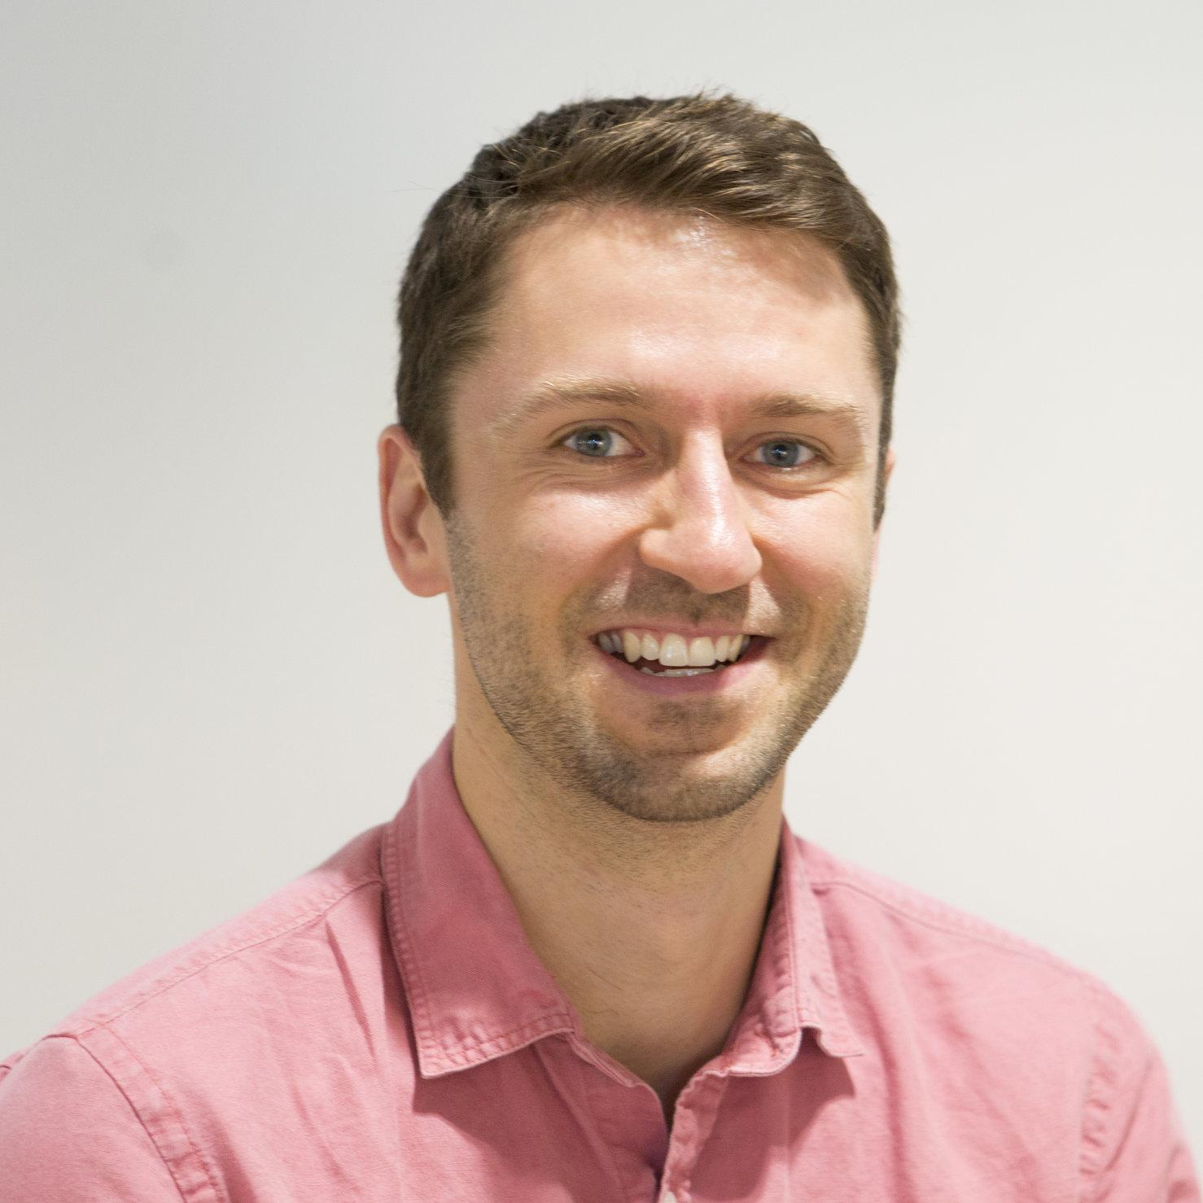
HELLO!
Alex Mitchell
CPO - ICX Media
4x Product Leader + Founder
More from me
@amitch5903
Medium
www.alexmitchell.co
Newsletter: bit.ly/gotechyourself
Books on Amazon

Slide 3
What We’ll Cover in This Course
15 Stages of the Product Life Cycle
What to do/not do in your first 90 days
Identifying/Understanding the Right Problem to Solve
Communication with Stakeholders
Building vs. Buying
How to Gather Feedback

Slide 4
What We’ll Cover in This Course
7. Defining the Minimum Viable Product (MVP)
8. Tracking the Right Metrics
9. MVP → Mature Product
10. Promoting Your Product Release
11. Defining Goals and Sharing Success

Slide 5
What We’ll Cover in This Course
12. Creating a Product Roadmap
13. How to Build Your Product Manager Brand
14. Communicating to Non-Technical Stakeholders
15. Agile Development Definitions

Slide 6
What We’ll Cover in This Course
16. A/B Testing
17. 5 Different Types of PMs
18. Applying the AARRR Funnel
19. Writing Effective User Stories
20. Competitive Analysis and Strategic Positioning

Slide 7
Also, this course includes:
Bonus Resources + Videos
Case Studies
Development Checklist
Videos on Remote Product Management and Other Topics
Books, Podcasts, Blog Posts You Need to Listen To/Read!

Slide 8
Let’s Get Started!
What are you waiting for?

