Slide 1
Cash Out On Cannabis
Session 6

Slide 2
Protecting Your Profits
Market orders cannot be accepted outside of market hours or when trading in a particular stock is halted or suspended. Limit orders allow you to set a maximum purchase price for your buy order, or a minimum sale price for your sell orders. If the market doesn't reach your limit price, your order will not be executed.

Slide 3
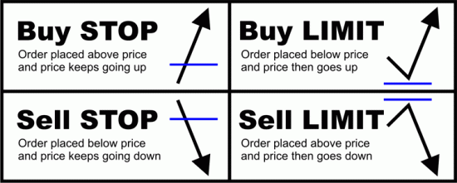
Protecting Your Profits
Stop Loss Orders

Slide 4
Limit Orders
A limit order is an order to buy or sell a stock at a specific price or better. A buy limit order can only be executed at the limit price or lower, and a sell limit order can only be executed at the limit price or higher. A limit order is not guaranteed to execute.

Slide 5
Putting It All Together
Invest In Our Funds For The Long Haul
Buy Stocks When They Are Undervalued
Sale Stocks When They Are Overvalued

Slide 6
Where Can I Place An Limit Order?
Fidelity
Robinhood

Slide 7
Stocks Can Always Be Bought Back When They Are Undervalued Again

Slide 8
Thank You For Completing Our
Cash Out On Cannabis Course
www.ccimonecasson.com
C Cimone Casson

