Slide 3
Average life span 79.5 years (954 months)
Sleeping – 318 months
Studying – 43 months
Working – 128 months
On your phone/Ipad/computer – 150 months
A_______ , W_________, F__________
Eating – 72 months
Toilet/bathing – 14 months
Waiting – 60 months
Housework – 12 months
Entertainment – 60 months
97 months – 8.1 years left
2956 days – 70956 hours

Slide 4
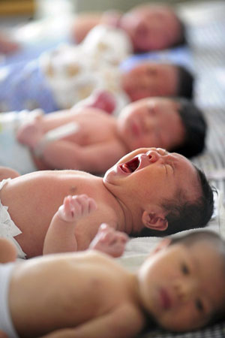
PHYSICAL BIRTH
SPIRITUAL BIRTH

Slide 5
John 1:12-13 (KJV)
¹² But as many as received him, to them
gave he power to become the sons of God,
even to them that believe on his name
¹³ Which were born, not of blood,
nor of the will of the flesh
nor of the will of man,
but of God.

Slide 6
WHAT IS THE NEW BIRTH?
Your Sins are Forgiven
To become “sons of God” (v13)
To have a personal and intimate relationship with God the Father

Slide 7
WHY NEED THIS NEW BIRTH?
Because Sins Separate us from God
Sins places ENMITY
between us and God
Jesus said “Peace be with you!”
- John 20:19
CANCELLED
Friend
(at Peace with GOD!)
Enemy
(of God)

Slide 8
WHY NEED THIS NEW BIRTH?
we cannot save ourselves
born not of blood (v13) - relationship
nor of will of the flesh (v13) - sinful self
or will of Man (v13) - decision of others
But of God (v13)

Slide 9
WHAT IS MAN’S PROBLEM?

Slide 10
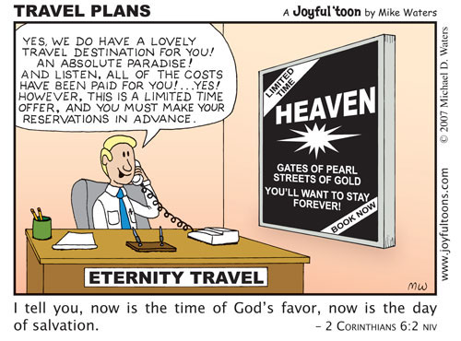
HOW TO RECEIVE THIS NEW BIRTH?
Admit and Repent
Believe
Come by Faith

