Slide 1
HOW TO RESEARCH blog post ideas

Slide 2
Why research matters

Slide 3
Research helps you follow through with your content plan and social media calendar.

Slide 4
Research helps you follow through with your content plan and social media calendar.
You will create content that is truly valuable and solves a problem for your audience.

Slide 5
Research helps you follow through with your content plan and social media calendar.
You will create content that is truly valuable and solves a problem for your audience.
You’ll create content that is catered to what people are searching for and what they are already sharing.

Slide 6
Research helps you follow through with your content plan and social media calendar.
You will create content that is truly valuable and solves a problem for your audience.
You’ll create content that is catered to what people are searching for and what they are already sharing.
Keywords, keywords, keywords!!

Slide 7
Research helps you use words and phrases that connect with your audience, which is so crucial to:

Slide 8
Research helps you use words and phrases that connect with your audience, which is so crucial to:
Get people to click on your post or video
Get people to visit your sales page
Convince people buy a product, download a freebie, etc.
You’ll get more traffic and sell more stuff!!

Slide 9
Research helps you use words and phrases that connect with your audience, which is so crucial to:
Get people to click on your post or video
Get people to visit your sales page
Convince people buy a product, download a freebie, etc.
You’ll get more traffic and sell more stuff!!
Create the foundation of a sales funnel – in order for people to buy from us, they have to want what we have, and in the online space, a click means “I want”.

Slide 10
What’s Our Research Strategy?

Slide 11
We’re going to find content that is popular with your audience.
Social media
Search engines

Slide 12
We’re going to find content that is popular with your audience.
Social media
Search engines

Slide 13
We’re going to find content that is popular with your audience.
Social Research
Keyword Research

Slide 14
We’re going to find content that is popular with your audience.
Social Research
Keyword Research
BuzzSumo

Slide 15
We’re going to find content that is popular with your audience.
Social Research
Keyword Research
BuzzSumo
Tailwind

Slide 16
We’re going to find content that is popular with your audience.
Social Research
Keyword Research
BuzzSumo
Tailwind
Facebook

Slide 17
We’re going to find content that is popular with your audience.
Social Research
Keyword Research
BuzzSumo
Tailwind
Facebook
Reddit

Slide 18
We’re going to find content that is popular with your audience.
Social Research
Keyword Research
BuzzSumo
Tailwind
Facebook
Reddit
Quora

Slide 19
We’re going to find content that is popular with your audience.
Social Research
Keyword Research
BuzzSumo
Tailwind
Facebook
Reddit
Quora
Keyword Planner

Slide 20
We’re going to find content that is popular with your audience.
Social Research
Keyword Research
BuzzSumo
Tailwind
Facebook
Reddit
Quora
Keyword Planner
Search Results

Slide 21
We’re going to find content that is popular with your audience.
Social Research
Keyword Research
BuzzSumo
Tailwind
Facebook
Reddit
Quora
Keyword Planner
Search Results
SearchVolume.io

Slide 22
What will we do with all this research?

Slide 23
Create two or three content buckets.
1
2
3

Slide 24
Create two or three content buckets.
1
2
3
Blogging
Idea 1
Idea 2
Idea 3

Slide 25
Create two or three content buckets.
1
2
3
Blogging
Social Media
Idea 1
Idea 2
Idea 3
Idea 1
Idea 2
Idea 3

Slide 26
Create two or three content buckets.
1
2
3
Blogging
Social Media
Business
Idea 1
Idea 2
Idea 3
Idea 1
Idea 2
Idea 3
Idea 1
Idea 2
Idea 3

Slide 27
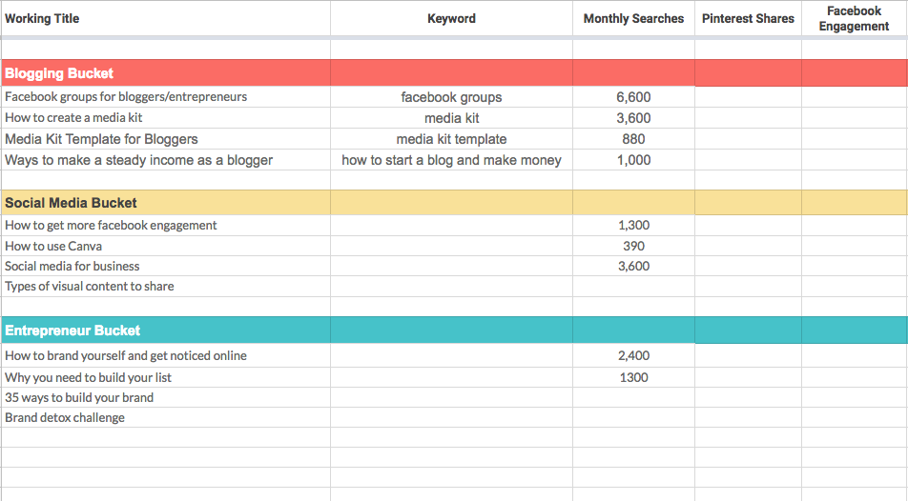
Use the Blog Ideas Worksheet to organize your ideas for each bucket.
Decide which posts, videos, or products to create – and which ideas to drop

Slide 28
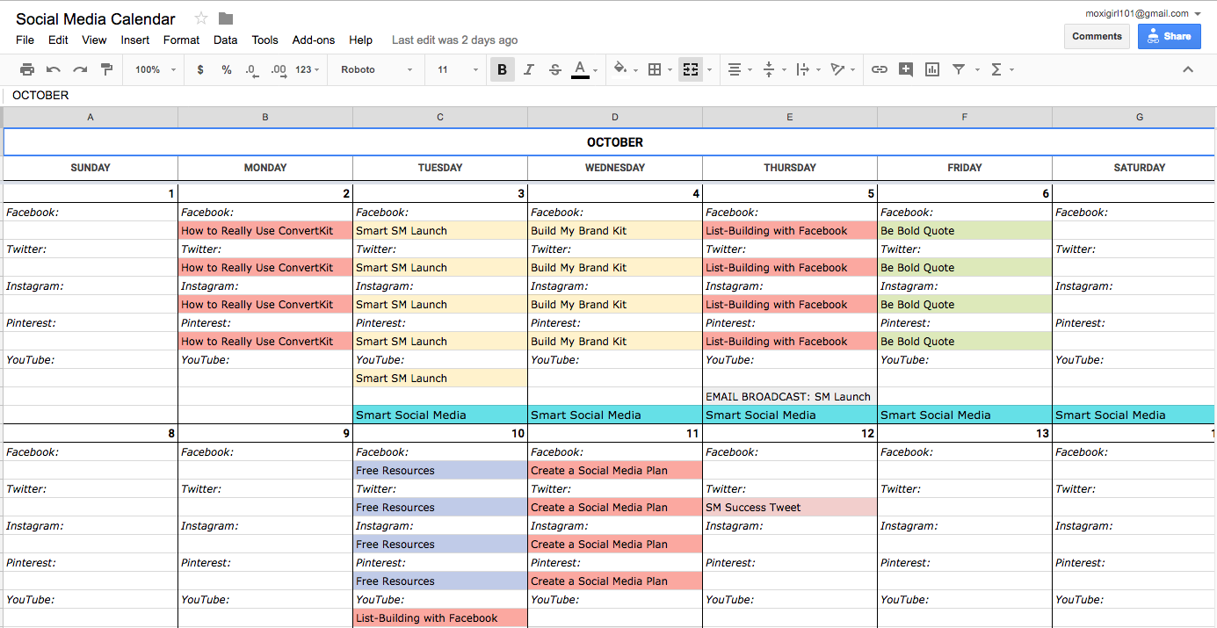
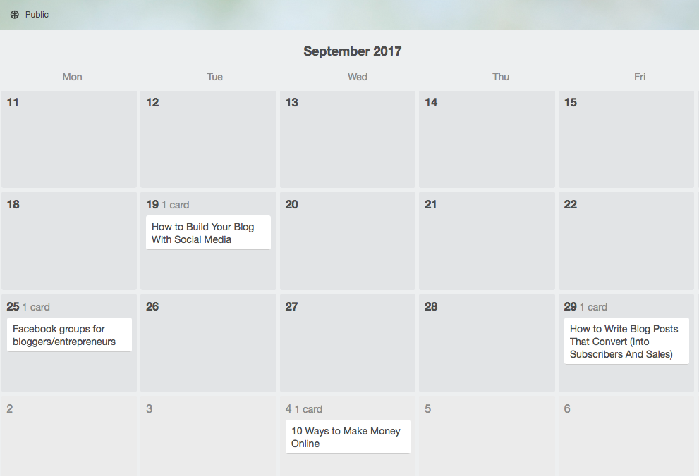
Use the Blog Ideas Worksheet to organize your ideas for each bucket.
Decide which posts, videos, or products to create – and which ideas to drop.
Take the winning ideas and put them on your social media calendar.
Create and share!

