Slide 1
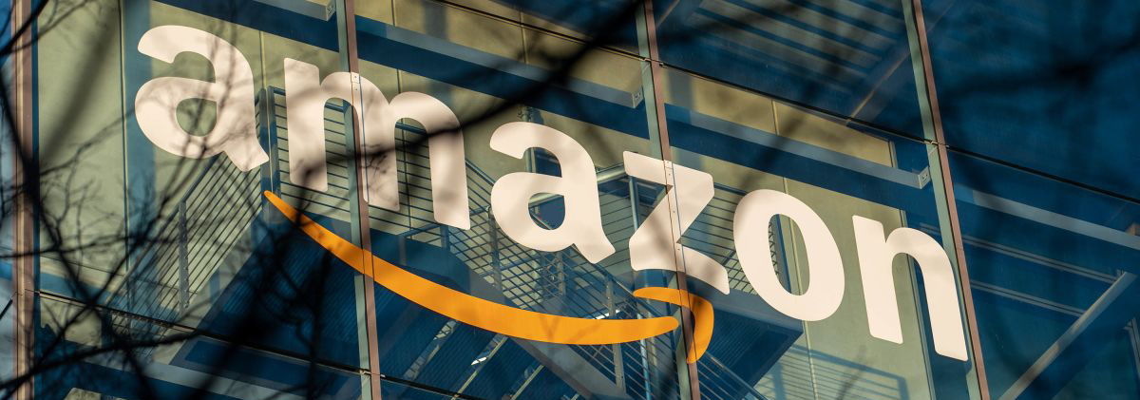
Amazon Training With Chris Turton

Slide 2
Top 6 Things I Knew Before Selling on Amazon

Slide 3
Understanding the difference between selling on both Ebay And Amazon

Slide 4
Understanding the difference between selling on both Ebay And Amazon
Ebay lists every product individually, on Amazon you are all competing for the same product listing.
With only 1 product listing for one barcode – only 1 seller gets the coveted “buybox”, Amazon decide which seller appears next to the “add to cart” option.
Customers have a more “focused” range of products
End of 2019 there are 150 million prime members.

Slide 5
Lack Of Support From Amazon

Slide 6
Lack Of Support From Amazon
Even though Amazon has a seller support system including live chat, phone and email support, in our experience it is not as good as Ebays.
We believe that high pressure on seller support agents means there is sometimes a lack of understanding from their perspective of issues
We pre-empt certain questions and common hurdles to make sure we get answered faster

Slide 7
Understanding Very Strict Rules

Slide 8
Understanding Very Strict Rules
Amazon suspensions are common
From setting up an account, to making a mistake, Amazon are very very strict on customers adhering to rules.
You have to roll with the punches!

Slide 9
The real costs of running your Amazon Account

Slide 10
The real costs of running your Amazon Account
There are multiple fees involved with Amazon, from the referral fee (eg a sale which usually ranges between 10 – 15% depending on your category)
Fees that Amazon may retain if you are doing well
Advertising Fees
Fees if you decide to send stock into Amazon also called Fulfilled by Amazon or FBA

Slide 11
Amazon Obsession For Customer Service Above ALL Else

Slide 12
Amazon Obsession For Customer Service Above ALL Else
Whilst this sounds like a fantastic business model, it has some negative impacts on sellers
Amazon typically will go in the customers favour for any decision including disputes on receiving orders and refunds
If you’re an industry with high returns such as clothing think about adding more to your margin to cover returns.
We typically see high return rates for “prime” orders, particularly if you are sending them straight into Amazon under its FBA programme.

Slide 13
ROI takes time

Slide 14
ROI takes time
So many sellers get into Amazon to make a quick buck
Results take time – typically 3 to 6 months depending on industry

