Slide 1
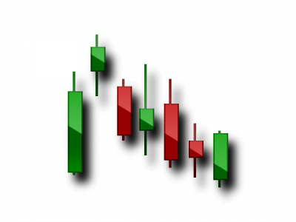
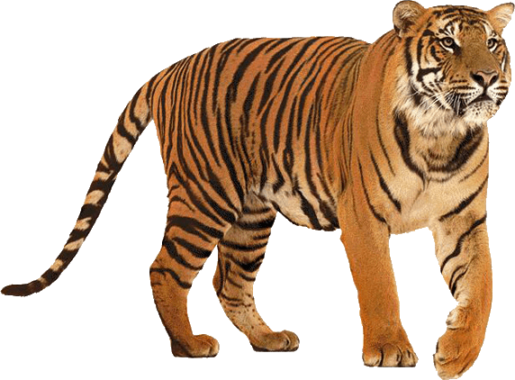
TIGER IYE
EDUCATION PART 3
INSTRUCTOR
QUENN V. GARRIS JR.

Slide 2
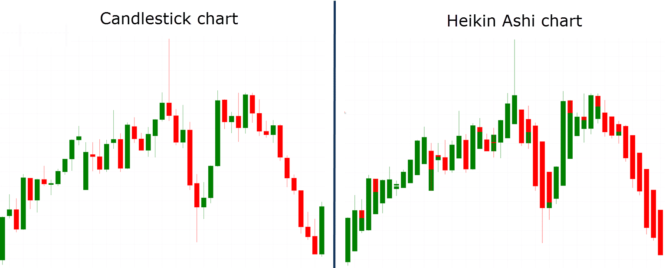
CANDLES
REGULAR CANDLES
SHOWS THE EXACT PRICE MOVEMENT IN A GIVEN TIME PERIOD.
OPEN, CLOSE, LOW, & HIGH
HEIKIN ASHI (FAVORITE)
JAPANESE CANDLESTICK BASED ON AVG. PRICE
SHOWS PRICE WITH MOMENTUM
GET’S RID OF MARKET NOISE
SMOOTHER PRICE ACTION

Slide 3
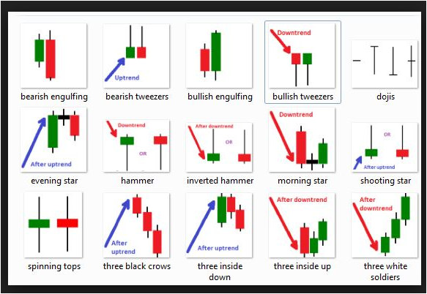
CANDLESTICK PATTERNS TELL A STORY OF WHAT THE BUYERS AND SELLERS ARE DOING IN THE MARKET!!!
PAY ATTENTION! PRICE NEVER LIES
HERE’S SOME OF OUR FAVORITES!

Slide 4
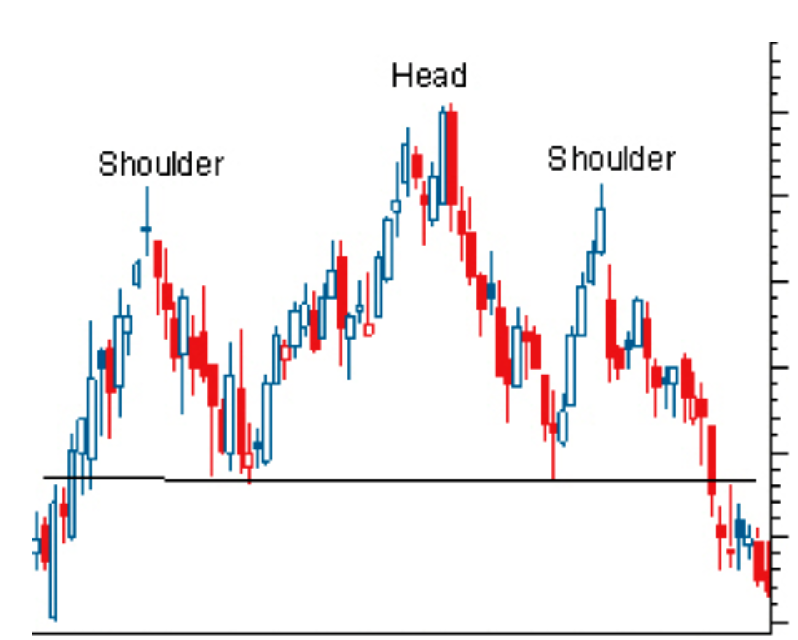
HEAD & SHOULDERS
Forms a neckline with 3 peaks.
Each peak on both sides are lower than the HEAD.
The neckline is the peak of the shoulders
Sells should be taken at right shoulder
(Try to catch the head though)
THIS CAN ALSO BE UPSIDE DOWN, INVERTED HEAD & SHOULDERS TO BREAK INTO AN UPTREND!

Slide 5
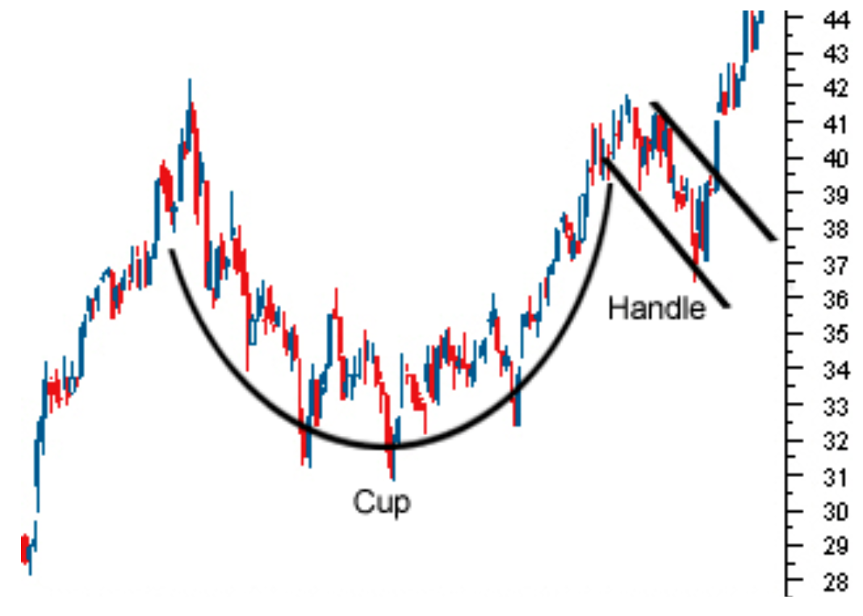
CUP & HANDLE
U shaped body
Little handle (pullback) before continuing an uptrend.
BUY inside the handle (pullback)
BUY once it breaks the top for conformation
OFTEN TAKES A WHILE FOR THIS TO FULLY PLAY OUT! STAY PATIENT!

Slide 6
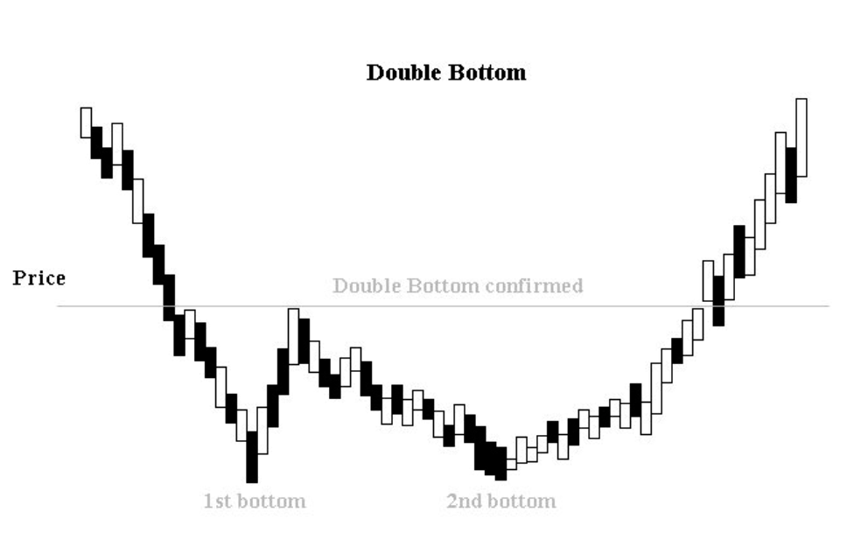
Double Bottom
Price finds support (twice) at or near the same level.
Look for reversals near price of the first bottom.
BUY once you see reversals and set a SL below ALL PRICE ACTION!
STRONGEST ON A SUPPORT LINE OR WITH INCREASING VOLUME!

Slide 7
90%
OF TRADERS LOSE BECAUSE OF THIS ONE SIMPLE THING….

Slide 8
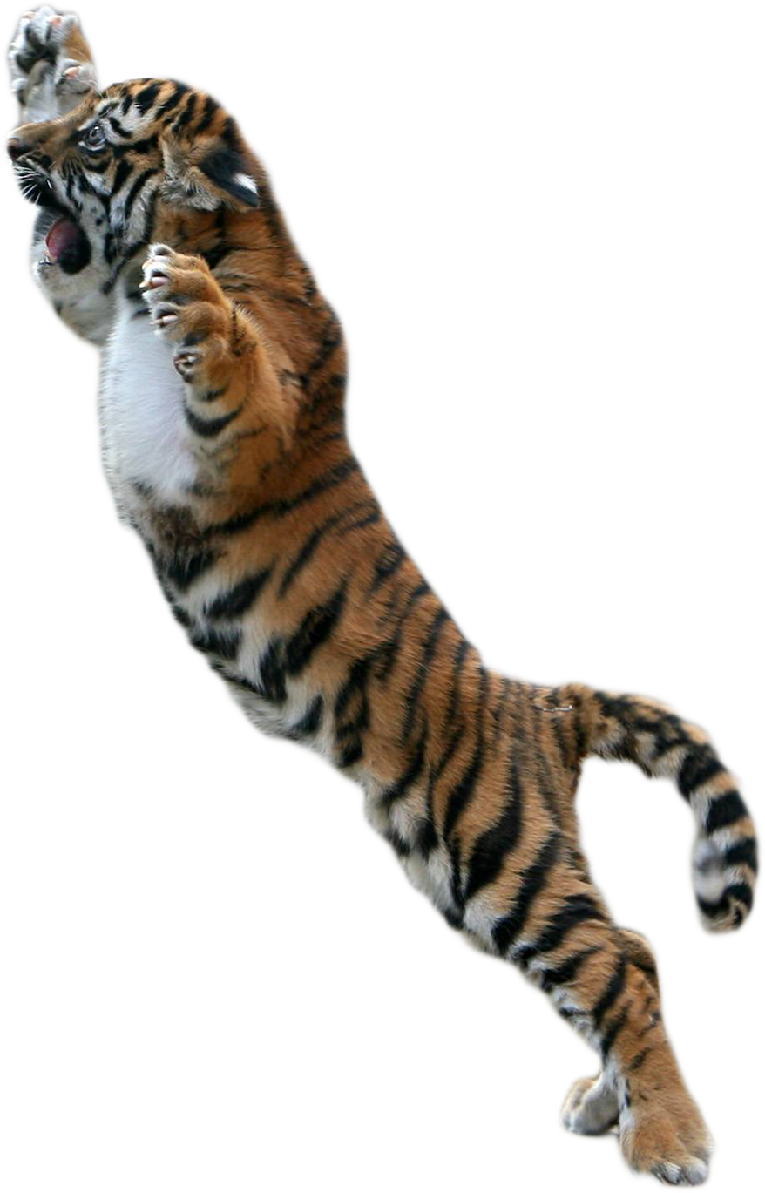
GO TO PART 4 TO FIND OUT!!
DON’T FORGET TO ENROLL!! GET ALL YOUR TRADING NEEDS AT TIGER IYE
COUPON CODE LETTER: Y

