Slide 1
PATH:
PLANNING ALTERNATIVE TOMORROWS WITH HOPE

Slide 3
Schein (2017) Framework of Organisational Culture
Using expertise to be useful
Being the expert
Practice
Person centred ways of practicing. Use of tools like PATHs. Working with people and their strengths.
System oriented ways of practice: reports, meetings and panels. Working for and ‘doing to’ people.
Beliefs and Values
Listening to people. Embracing hope, uncertainty and commit to learning.
The system is the way of solving problems. Accountability culture. ‘Oven-ready’ solutions.
Assumptions
People are experts in their lives and have agency to help resolve their problems
People are/have problems that need to be fixed
Listening and doing
Person Centred Mindset
Service Centred Mindset

Slide 4
A PATH is useful when:
Situations are complex
Concerted action is required over a long period of time
You want to plan a collective response using people and resources
There is an important vision you want to make real
It is a visual and collective approach to ‘person centered’ planning.
A radical way of promoting inclusion – Meeting the Gold standard ordinary needs
Pearpoint, Forrest & John O'Brien, 1991

Slide 5
Preparing for a PATH
Ideally 2 x facilitators – 1 Chairperson and 1 scribe (or this could be done collectively)
People identified by the person or people, as important in their lives (and a large enough space to accommodate these people or online space)
prepared translator, and clear ground rules for working with translators
Large pieces of paper or a template, and felt tip pens
Creative and open mind
A commitment to actively listen

Slide 7
The Facilitator
Help the group move between the stages – in order
Be aware of time
Have a good feel for the room
(Active listening)

Slide 8
Managing highly emotional conversations in meetings
Actively listen
Regulate - Try to make them feel safe
Relate – Ensure that you are there to support them and listen
Reason – Think about the logistics of where things go next

Slide 9
The Scribe
Capture what has been said by writing or drawing directly on the PATH
Checking for understanding
Active listening

Slide 10
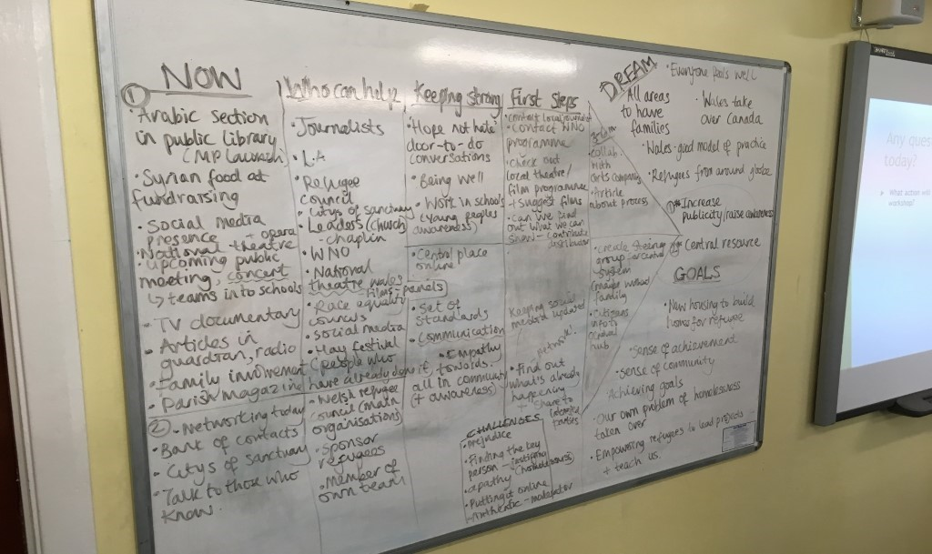

Slide 11
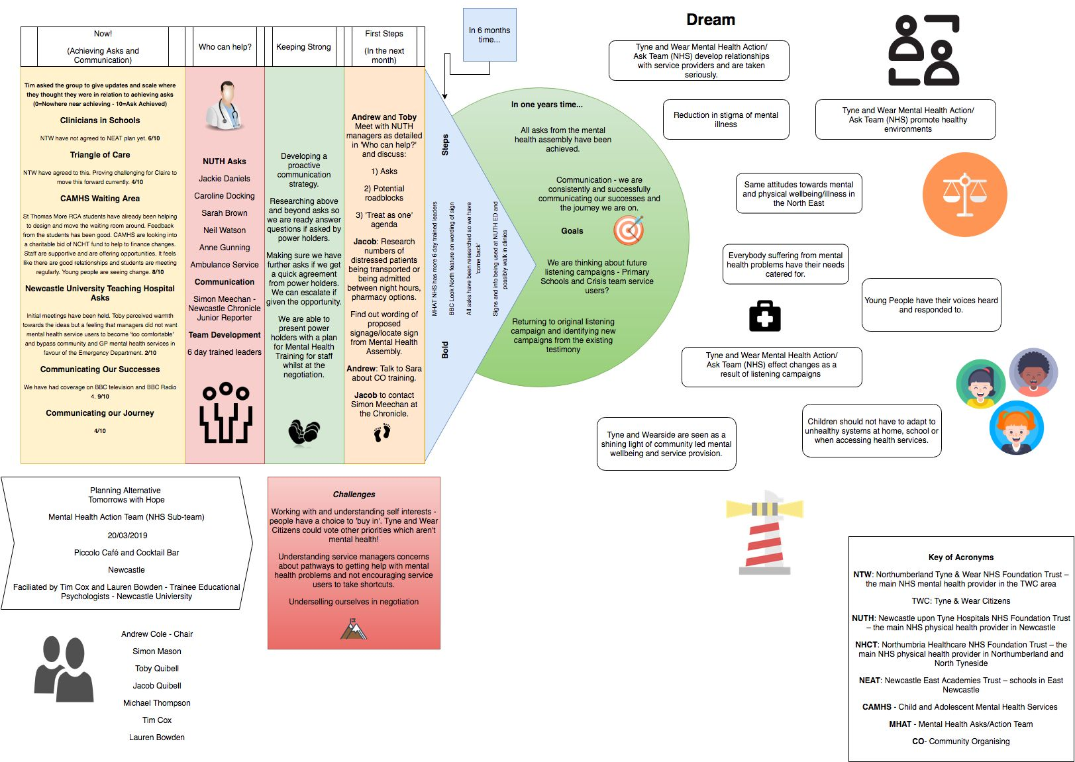

Slide 12
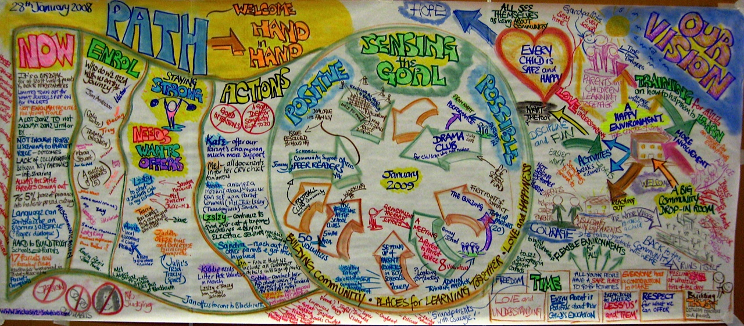

Slide 13
Other Attendees
Empathy
Being Genuine
Positive regard for others

Slide 14
Using an interpreter
Check that the person/people the PATH is for are happy for an interpreter to be there
Brief the interpreter ahead of time
Outline ‘ground rules’ – e.g. one person to speak at a time, no private side conversations without translation
Always look at the person you’re talking to (not the interpreter)
Take your time (allow space for active listening!)
Make it visually accessible (prepare ahead of time – universal visuals)
Have the PATH translated
Allow extra time, or, split the PATH across two sessions (Dream and Goals together)

Slide 15
Who else to invite?
identified BY THE PERSON WHO IS DOING THE PATH, rather than the group
People who care about the person/people involved – ORDINARY/NATURAL supports

Slide 16
You
Exchange
You
Participation
You
Exchange: Paid supports – e.g. teachers, social workers
Participation: e.g. colleagues,
people go to mosque with
Friendship: close friends
Intimacy: closest relationships, e.g. parents, siblings, partners, children
Friendship
You
Intimacy
You

Slide 17
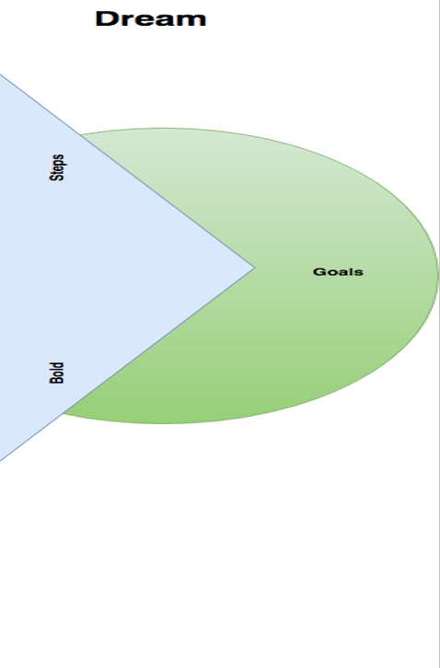
Stage 1 -The Dream
People
Place
Activities
Values

Slide 18
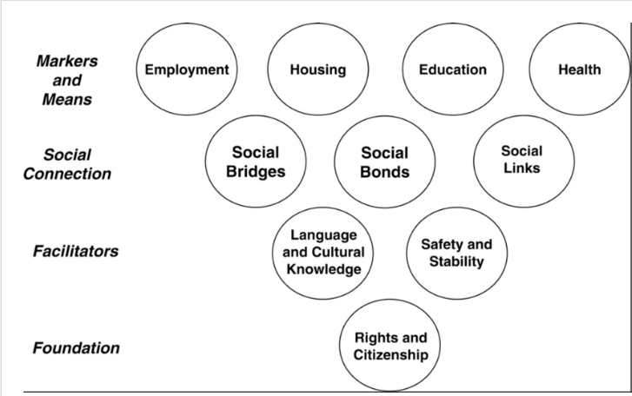
Two frameworks for wellbeing
These can help and act as prompts when defining the dream
Gold Standard
Ordinary
Needs
Contributing
Having choice & control
Belonging
Sharing ordinary places
Being someone

Slide 19
Stage 2 – Sensing the goal
In one year’s time…
What will have changed?
Possible and Positive!
Try to make this SMART

Slide 20

Stage 3 – What is happening now?
In relation to the goals that have been set…
Facts and figures
Positive and Negative
Grounding in reality

Slide 21

Stage 4 – Who can help?
Name
How specifically they help
Role

Slide 22

Stage 5+6 – Challenges and Keeping Strong
What challenges might you face?
How will we deal with these challenges? Be specific
What does this say about the values that are important to this team/person?
Challenges

Slide 23
Stage 7 – Bold Steps
Steps that you’d like to take in the next 3/6 months
SMART

Slide 24
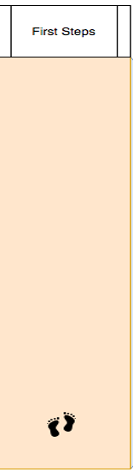
Stage 8 – First Steps
What can we do in the next month?
SMART
Perhaps talking about the plan should be a goal

