Slide 1
The 12 Common Archetypes
For Actors

Slide 2
The Universal Essence
of Your Character

Slide 3
Archetypes
for Actors

Slide 4
Actions
Thoughts
Words
Why

Slide 5
Their Inner Being

Slide 6
Motto
Motifs
Dreams
Fears
Strategy

Slide 7
There are many character Archetypes
But there are a few that are the most common and dominant

Slide 8
Knowledge of your character Archetype
is very useful when building a role.
It allows you to connect deeply in a fundamental manner with your character and
almost instantly.

Slide 9
You learn about their universal character traits, their motivations, their mission,
their fears, their dreams, and their
strategy to get all they want in life.

Slide 10
While working on your characters and monologues during Monologue Mastery pay special attention to your Archetype using their characteristics as your starting point
in the process of becoming One.

Slide 11
The Innocent
Free to be you and me
Naive
Mystic
Saint
Romantic
Dreamer

Slide 12
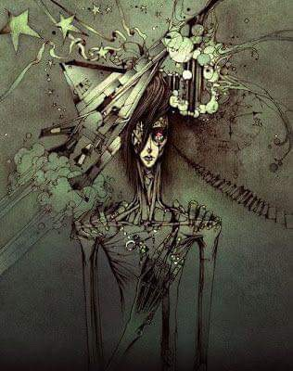
The Orphan
All Men and Women are Created Equal
Regular Person
Good old boy
Everyman
Realist
Working Stiff

Slide 13
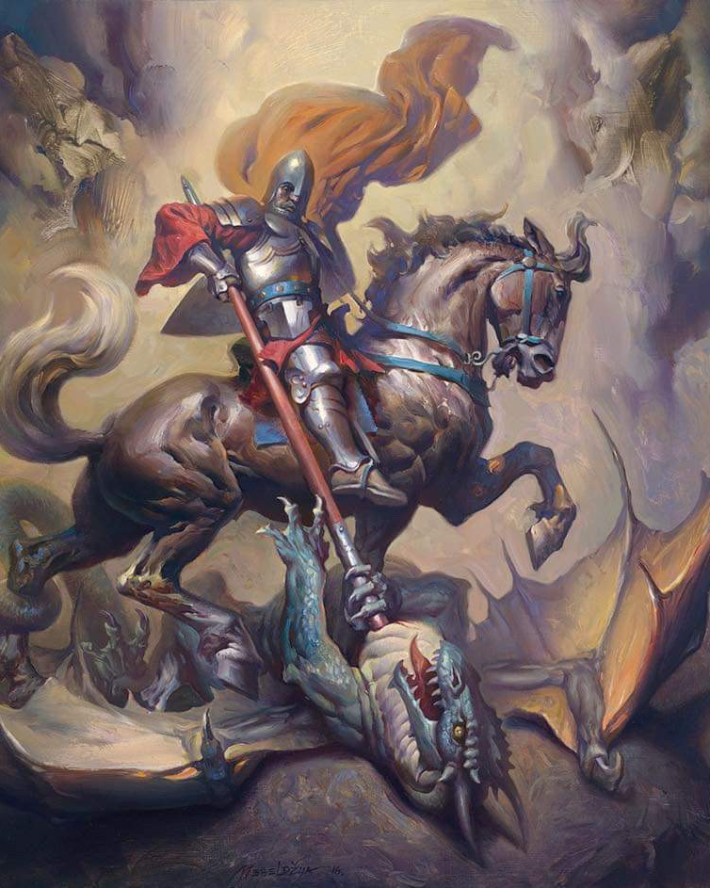
The Hero
Where there is a Will there is a Way
Warrior
Crusader
Rescuer
Winner
Dragon Slayer

Slide 14
The Caregiver
Love your neighbour as yourself
Altruist
Parent
Helper
Supporter
Saint

Slide 15
The Explorer
Don’t Fence Me in
Seeker
Wonderer
Iconoclast
Individualist
Pilgrim

Slide 16
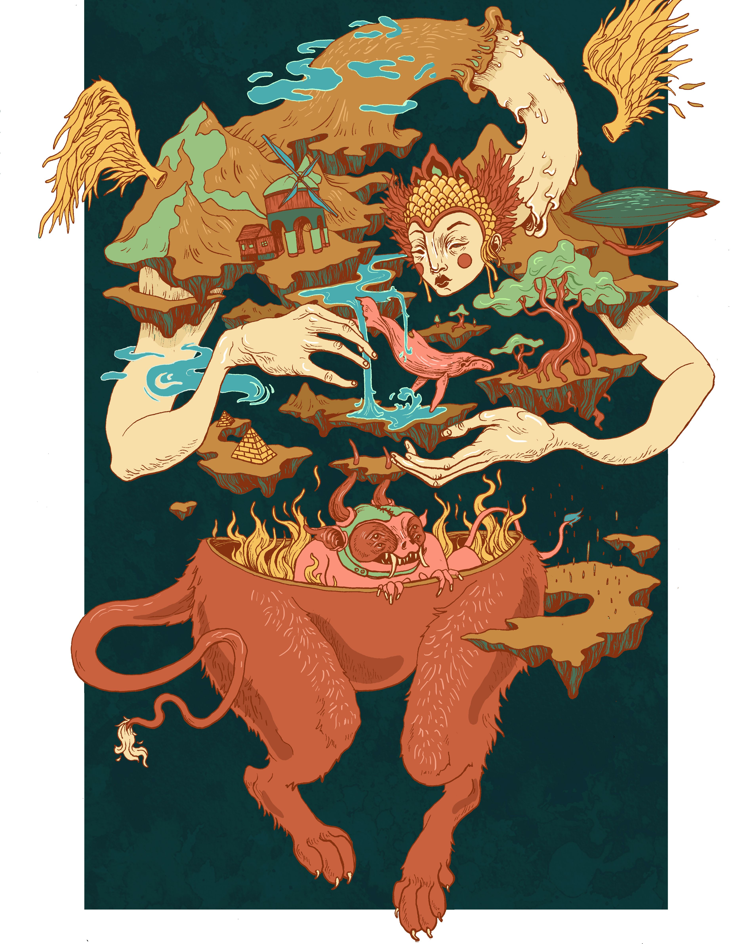
The Rebel
Rules are Made to be Broken
Revolutionary
Wilde Man
Misfit
Iconoclast

Slide 17
The Lover
You are the Only One
Partner
Friend
Sensualist
Intimate
Enthusiast

Slide 18
The Creator
If you can Imagine it, it can be done
Artists
Inventor
Innovator
Writer
Dreamer

Slide 19
The Jester
You Only Live Once
The Fool
Trickster
Joker
Comedian

Slide 20
The Sage
The Truth will Set you Free
Expert
Scholar
Detective
Advisor
Thinker

Slide 21
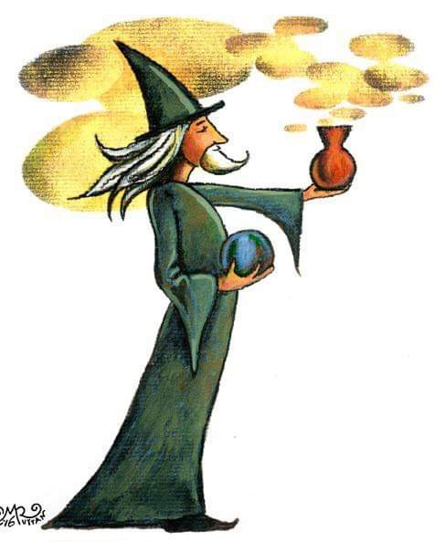
The Magician
I make things Happen
Visionary
Catalyst
Inventor
Charismatic
Leader

Slide 22
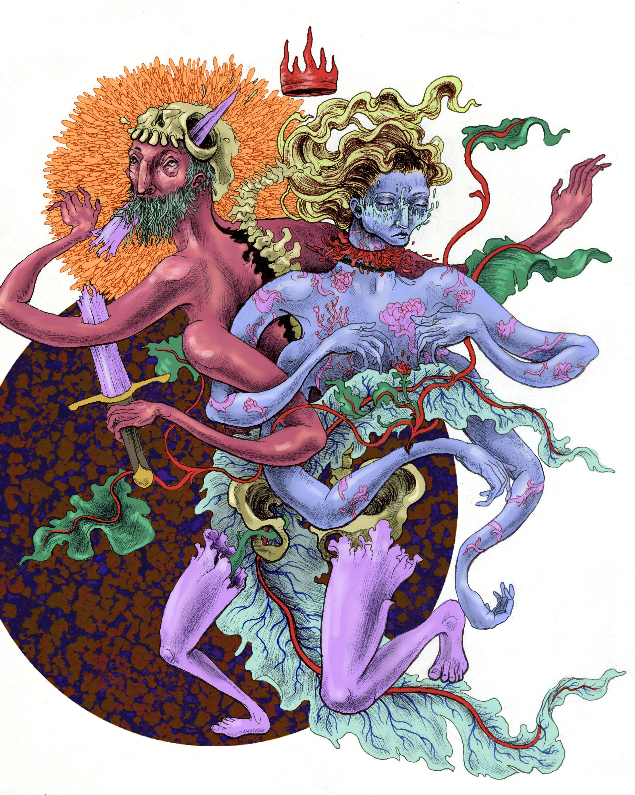
The Ruler
Power Isn’t Everything is the Only thing
Boss
Leader
King
Queen
Politician

Slide 23
The 12 Common Archetypes
By Sylvia Love Johnson

