Slide 1
Developing Your Sales Process
Presented by: Chuck Wiercinski

Slide 2
Developing Your Sales Process: Lesson 1
This course will walk you through your current, home services sales process. Along the way, you will define, organize, prioritize, and improve your sales process. This will result in a more complete customer experience and equip you with a documented and teachable process to aid you in the growth and scaling of your business.

Slide 3
Included with this course
Presentation deck
Worksheets & homework
Lesson audio & video files when available
Facebook Group Access
Money back guarantee!
Simply contact me within 30 days of course completion, and if we can’t resolve the issue, we will issue a full refund.
Notes:
Click to activate guarantee badge when talking about guarantees

Slide 4
StoryTime
Story Topic

Slide 5
Lesson 1, Part 1: Introduction
4 Lessons
Introduction: Overview and baseline assessment
Customer Origination: Setting a great first impression
Offering Solutions & Shipping the Work: Creating and delivering your promise
Customer for Life: Keeping the customer engaged after the sale (and if they don’t buy)

Slide 6
Lesson 1, Part 1: Introduction
Why define or redefine your sales process?
Understand your customers’ journey
Walk in their shoes
Create your process and improve the parts
Your knowledge and charisma won’t scale
Plug the holes in your sales funnel

Slide 7
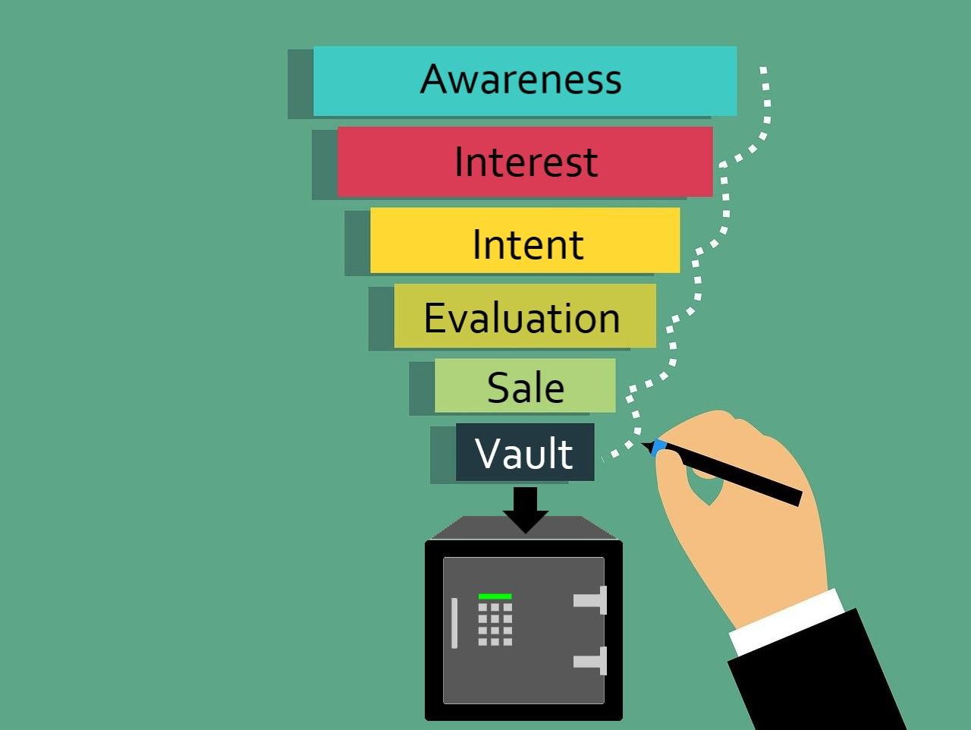
Lesson 1, Part 1: Introduction

Slide 8
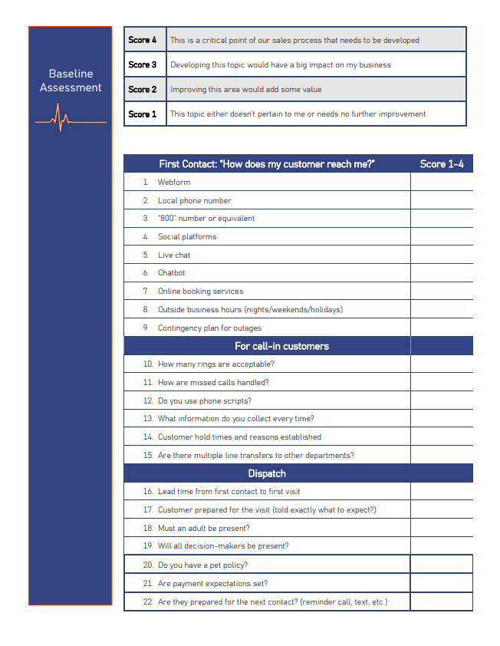
Self Assessment
Sales Process Baseline Assessment Worksheet (.docx or .pdf)
https://level2consulting.com/resources/
Notes:
Available in Digital Downloads on Teachable, or on the resources page of level2consulting.com

Slide 9
Lesson 1, Part 2: Define Your Baseline
In a world of variables, you must create standards and processes wherever you can
Start with your sales goals
Walk through your current sales process
Take a moment and write out from beginning to end, what your sales process consists of today
Take the baseline assessment
Look for your highest impact points or biggest holes in your funnel
Set your KPI’s and create dashboards

Slide 10
Homework
Before you fill out the questionnaire, write down your current sales process.
Include:
What methods the customer uses to find your company
How you handle the initial contact(s)
How information flows from CSR to technician
Briefly describe the first visit
What happens with a sale
What happens with NO sale
Follow up?
After the sale

Slide 11
Homework
Sales Process Baseline Assessment Worksheet (.docx or .pdf)
https://level2consulting.com/resources/
Notes:
Fill out the sales process baseline worksheet and follow the directions
Directions:
Go through each line in the worksheet and assign a number 1 through 4
After going through all of the questions and identifying your highest impact points, look back over lines 1-30.
Which lines did you label a 4?
Pick your top 3-5 priorities in this category and write out the current state of this point and if what it would look like if resources were not a concern.

Slide 12
Homework
Example:
#7 Online booking services- “Currently, we do not have any form of online booking services. Several customers and friends have told me they love this feature and would use it if we offered it. I love being able to book dinner reservations without disrupting what I am doing. In an ideal world, the customer would be able to look us up on Google and click for available appointment slots and easily pick a time that works for them.”
Notes:
Fill out the sales process baseline worksheet and follow the directions
Directions:
Go through each line in the worksheet and assign a number 1 through 4
After going through all of the questions and identifying your highest impact points, look back over lines 1-30.
Which lines did you label a 4?
Pick your top 3-5 priorities in this category and write out the current state of this point and if what it would look like if resources were not a concern.

