Slide 1
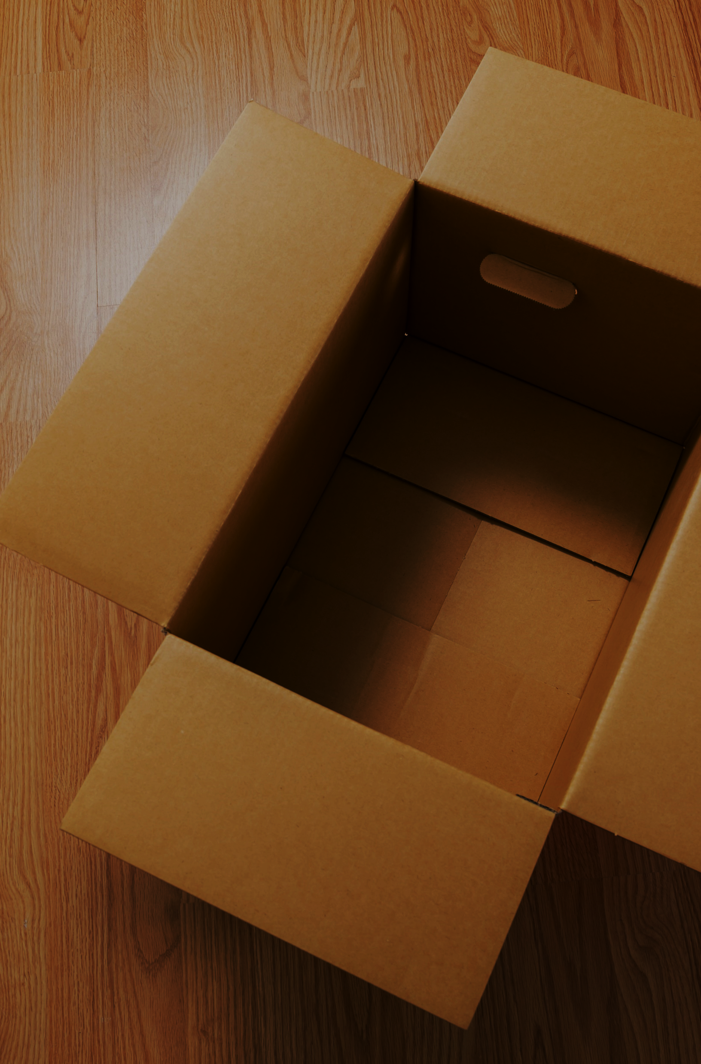
Kintsugi Course
How to make a simple Muro
Discover the best Mentors & institutions
Caution1
Caution2
Urushi lacquer can not dry without appropriate humidity and temperature. Keep the temperature of 24–28 °C and humidity of 75–85%.
Ultraviolet radiation should be avoid before drying Urushi lacquer.
Caution3
Be sure to select a box that can avoid ultraviolet radiation and dust.

