Slide 1
Dealing With Difficult People
Advanced Ideas Presents:

Slide 2
Won’t you please give a warm welcome to –
Mr. Paul Cline

Slide 3
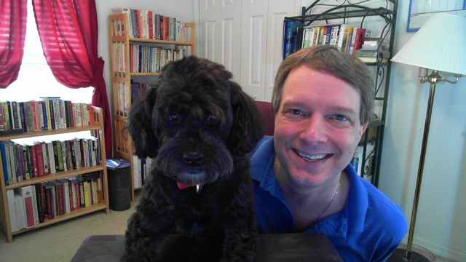
Prof. Paul J. Cline
(And Corporate Mascot “JJ”)

Slide 4
Goals For This Training: 1) Gain An Increased Understanding Of Ourselves And WHY We Get So Angry At Others 2) How To Gain Control Of Others – By Gaining Control Of Ourselves 3) General Tips For Dealing With Problem People And Anger 4) How To Deal With Specific Types Of Problem People 5) HAVE FUN!!!!! ☺

Slide 5
You Don't Get Mad For The Reasons You Think!

Slide 6
So Why Do You Get Mad?

Slide 7
I'm Glad You Asked!

Slide 8
You Get Mad for
3 Main Reasons …
Resistance
to Reality
2) Negative Self-Talk
3) You Care!

Slide 9
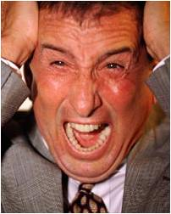
Frustration =‘s Resistance to Reality
Your Frustration Will Be Equal To Your Resistance To Reality

Slide 10
How Do We Stop Resisting Reality?
By Gaining Self-Control
And
Letting Go Of Misconceptions

Slide 11
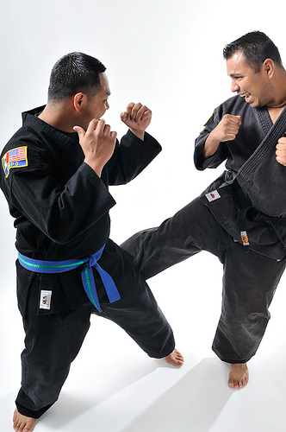
“Don’t Wish The Other Person Would Get Better…
Wish You Had More Skill”
- Jim Rohn

Slide 12
“All Control Starts With Self-Control”
Everyone Thinks
Eliminating Frustration
Is About Controlling The
OTHER Person
… It Really Starts With Controlling Yourself.

Slide 13
How Do I Control Myself?
You Start By Letting Go Of Your
Crazy Ideas!

Slide 14
Crazy Ideas:
1) People Should Have The Same Beliefs And Values I Do
2) People Should Do What I Want Them To Do
3) People Shouldn’t Act In Ways That Upset Me
4) People Should Care About The Things I Care About
5) People Shouldn’t Get In My Way
6) People Should Always Treat Me With Kindness & Respect

Slide 15
(Still More) Crazy Ideas:
1) People make me Angry, Upset, Sad, etc.
2) People should understand me
3) I feel Guilty when______________________.
4) People should be there for me when I need them
5) Inanimate objects are out to get me
6) Life should be Fair
“Insert Neurosis Here”

Slide 16
1) Dispute Them 2) Replace Them 3) Let Them Go!
How Do We Get Rid
Of These Ideas?

Slide 17
If You Don't Control Your Mind … Who Does?
“The First & Best Victory Is To Conquer Self.
To Be Conquered By Self Is, Of All Things, The Most Shameful & Vile”
- Plato

Slide 18
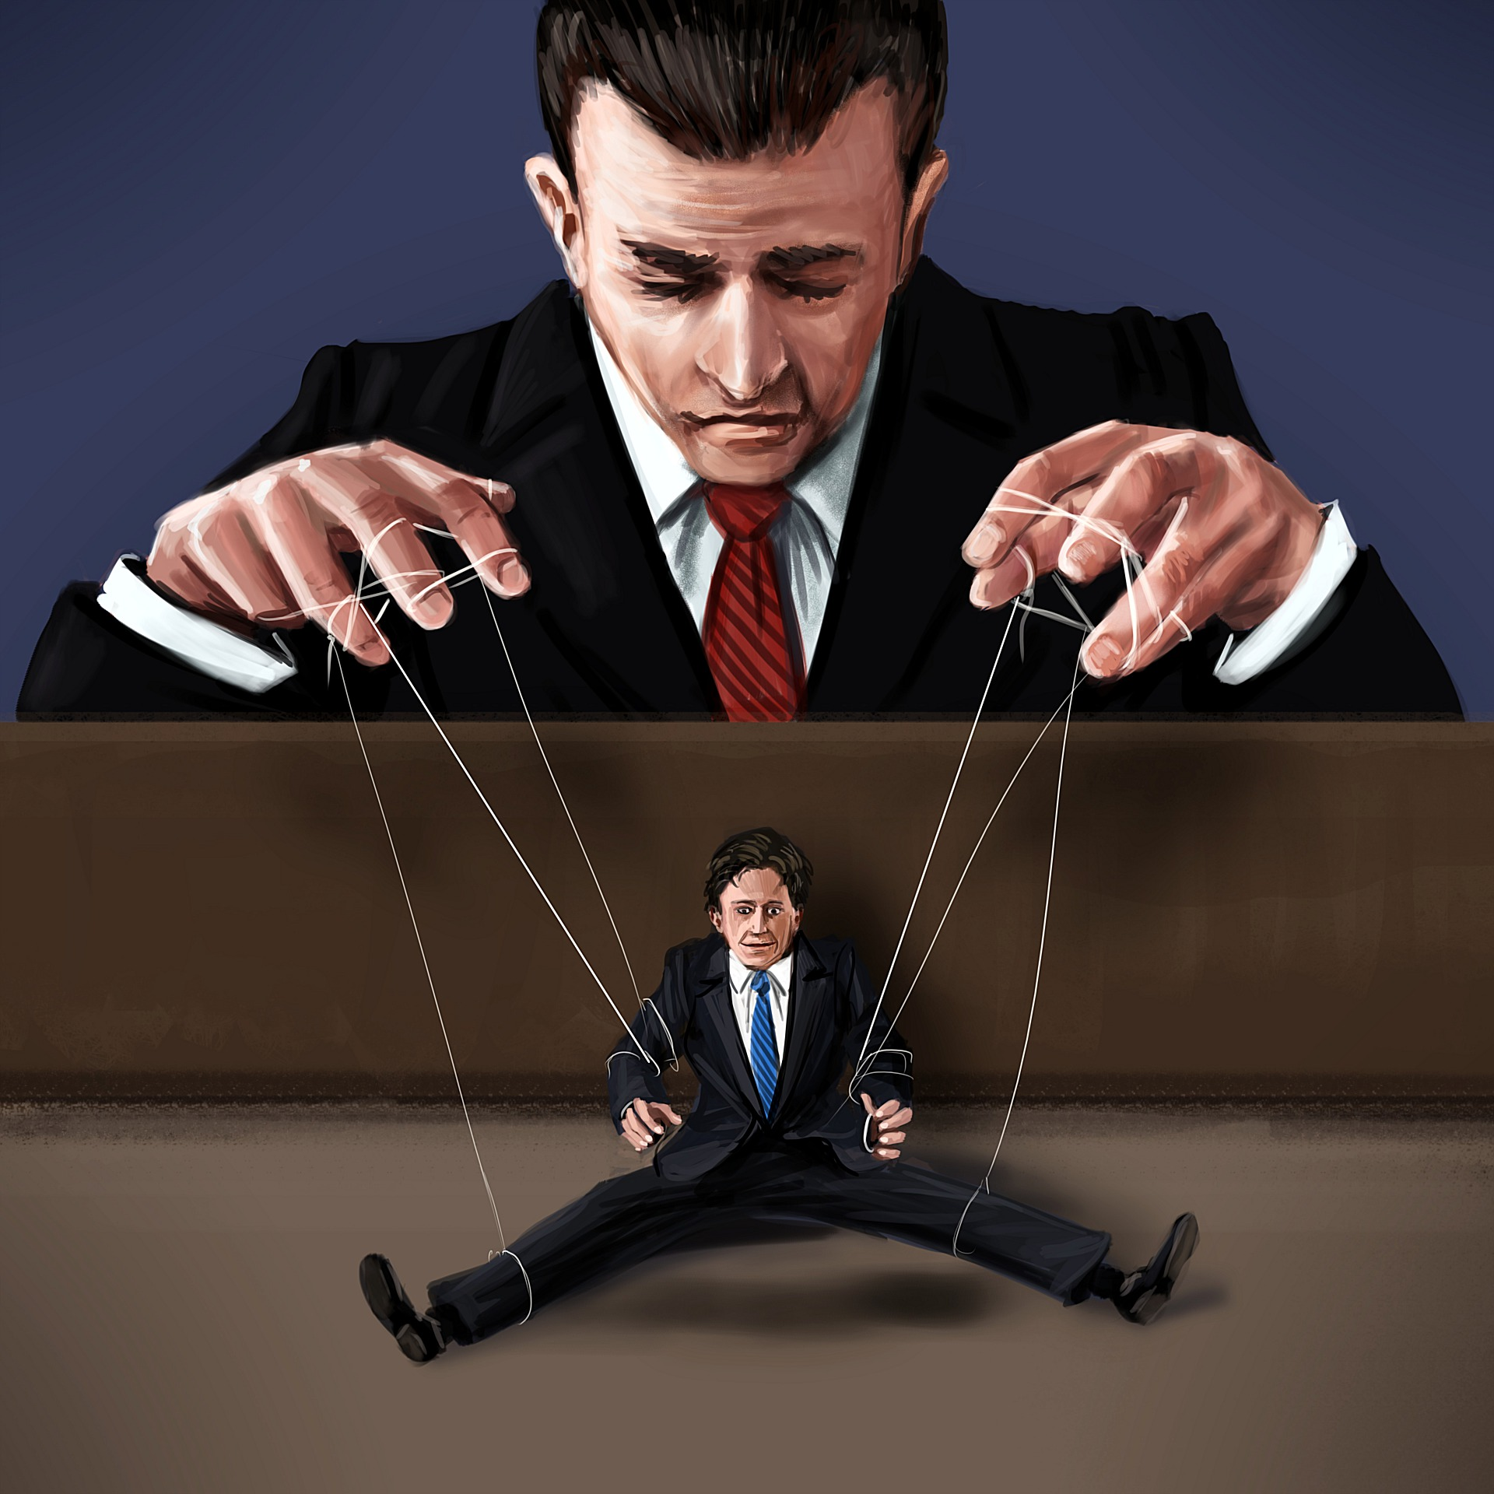
Remember:
No One Controls You … Unless You Allow It

Slide 19
How Do I Practice
Self-Control?

Slide 20
By Practicing!
(Duh!)

Slide 21
Don’t Worry…
Life Will Give You Lots Of Chances To Practice!

Slide 22
Some Ways We Allow
People To Control Us:
Guilt – We have been taught to feel bad about ourselves from childhood if we don’t do for others.
Resentment – When others hurt us … we carry the hurt for free! Why?
Love – When does Love become Manipulation?
EGO – We are our greatest Strength & Weakness

Slide 23
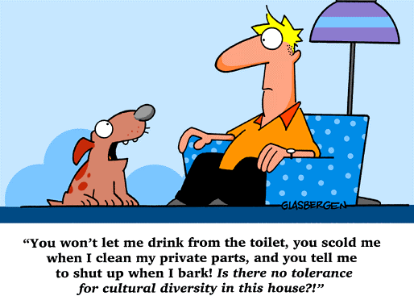
Allow People To Be Themselves
(People Are Always Perfectly Being Themselves!!)

Slide 24
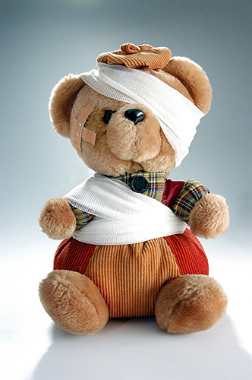
See Angry People As “HURT” Not
“BAD”

Slide 25
Sometimes They Are Just Going Through A Difficult Time:
Divorce or Break-up
Unemployment
Death
Mental Illness
Sick Child or Parent
Injury
Cancer
Other????

Slide 26
“If We Could Read The Secret History Of Our Enemies We Would Find In Their Lives Sorrow & Suffering Enough To Disarm All Hostility”
- Henry Wadsworth Longfellow

Slide 27
REALITY CHECK!
People are NOT going to change because you WANT them to or because they SHOULD!

Slide 28
Our Control Lies in
Changing our
EXPLANATORY STYLE
and Our
RESPONSES

Slide 29
EXPLANATORY
STYLE:
“The Way In Which We
EXPLAIN
Things To Ourselves”

Slide 30
It Is IMPOSSIBLE To Be Disrespected!!!
Respect Is INTERNAL Not EXTERNAL!
Can You Spot The Jerk In This Picture???

Slide 31
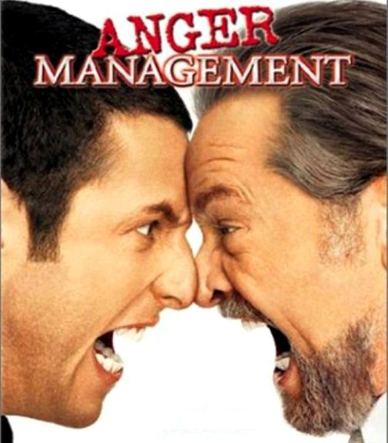
Can You Spot The Jerk in
This Picture???

Slide 32
Have A Little Compassion Because We Too Have Bad Days …
… And Not Always All That “Loveable”

Slide 33
You Care!
I Feel Much Better Since I Gave Up HOPE!
Bumper Sticker

Slide 34
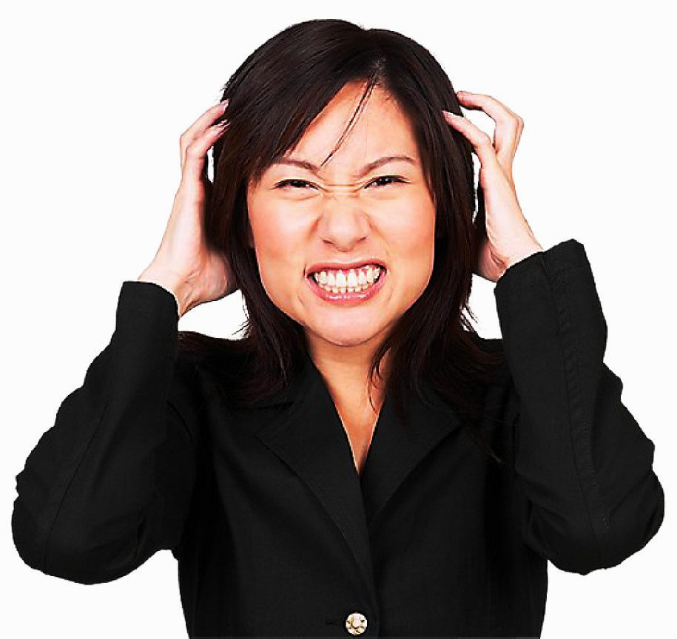
Most Of Our “Reasons’” For Getting Mad Are EXCUSES.
WE Lack Self-control & Blame The Other Person For OUR Weakness!

Slide 35
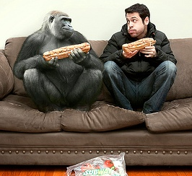
Take Responsibility!
Wasn’t Me!
How Are You:
1) Attracting This
Behavior
2) Causing This
Behavior
3) Allowing This
Behavior
Who Ate My Sandwich?

Slide 36
Be Friendly
Be Positive
Give Sincere Compliments
Share Praise
Seek Ways To Help
Give Attention
Share
Listen Well
Express Liking

Slide 37
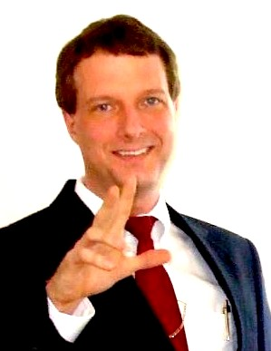
Get Paul’s
Trainings On:
REBT
ZEN Therapy
NLP
Coping Skills
Persuasion Strategies

Slide 38
The Moment You’ve All Been Waiting For…

Slide 39
BRING IT ON!!!
Problem Solving!!!
Specific Techniques!

Slide 40
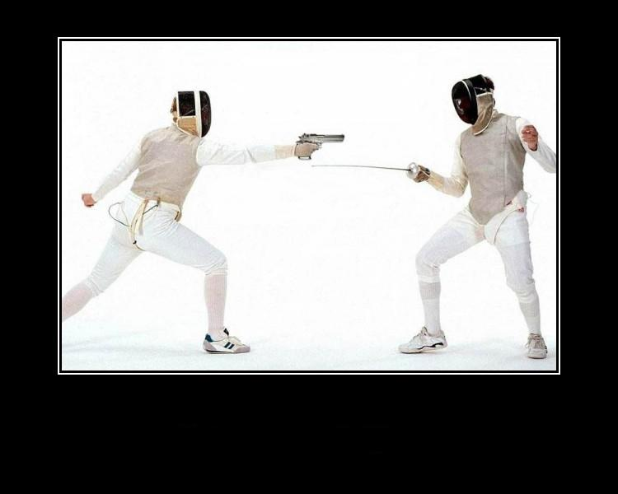
The Most Important Part Of Solving Problems Is To Start With A GREAT Strategy!

Slide 41
Relationships

Slide 42
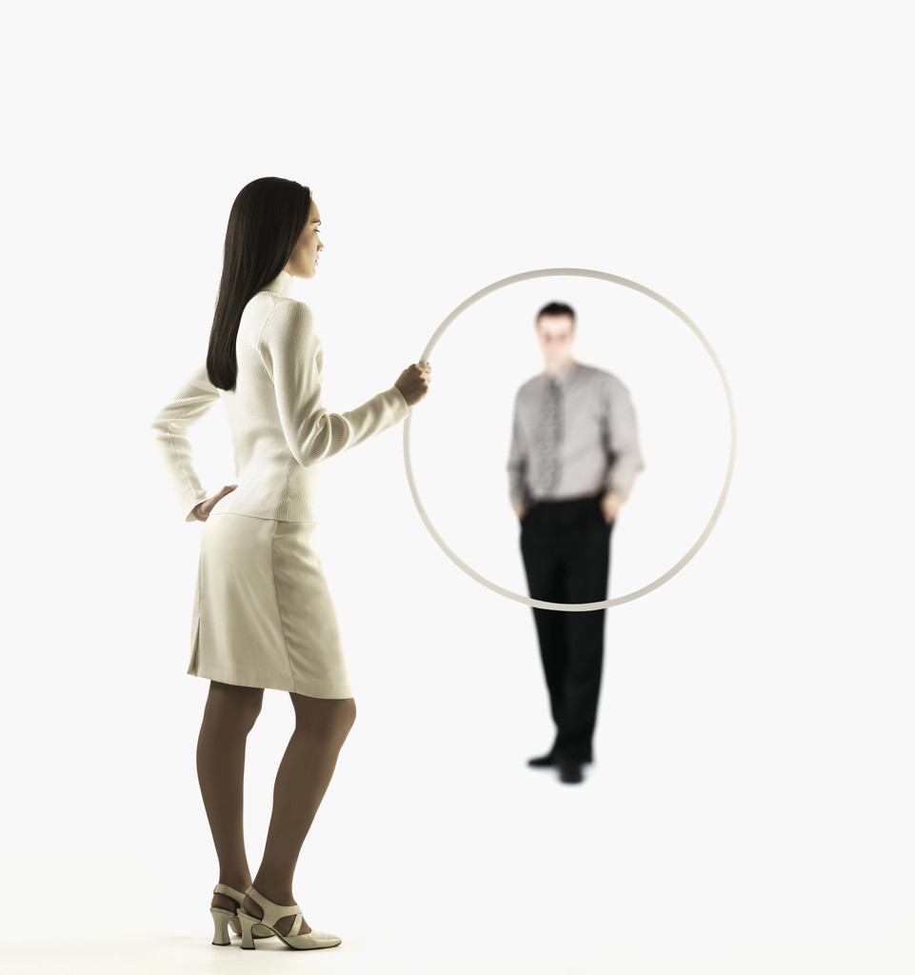
This Isn’t A Relationship
… It’s A Disaster!!

Slide 43
Negotiating Relationships
People Do What Works!
Whether or Not You Reward, Punish or Accept Their Behavior Impacts Their Future Actions

Slide 44
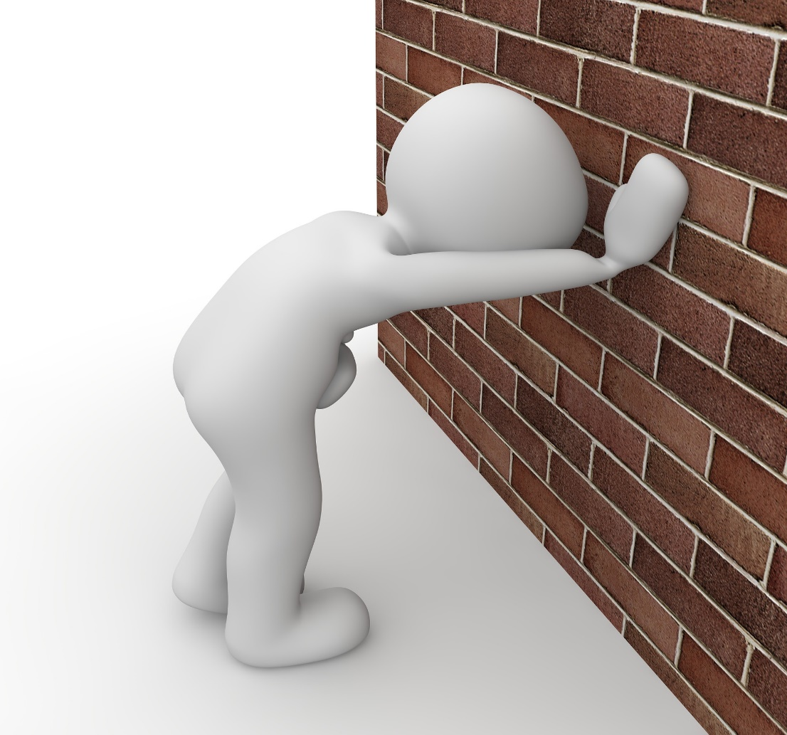
Limit-setting & Boundaries
“Boundaries empower us to determine how we will be treated by others”
- Anne Katherine

Slide 45
Basics Of a Healthy Relationship
1) Allow People To Be Themselves
2) Mutual Respect
3) Trust
4) Kindness & Concern
5) Helping Each Other (NOT Enabling)
6) Being Responsible For Your Actions

Slide 46
How To Be Less
Of A Target!

Slide 47
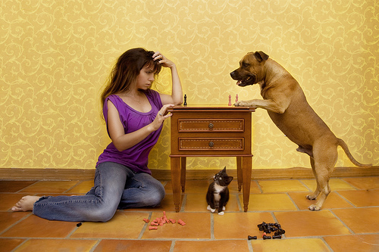
Make A Friend!
“Do I Not Destroy My Enemies When I Make Friends Of Them?!”

Slide 48
WHY Do People “Poop” On You?
Because They Can!!!!

Slide 49
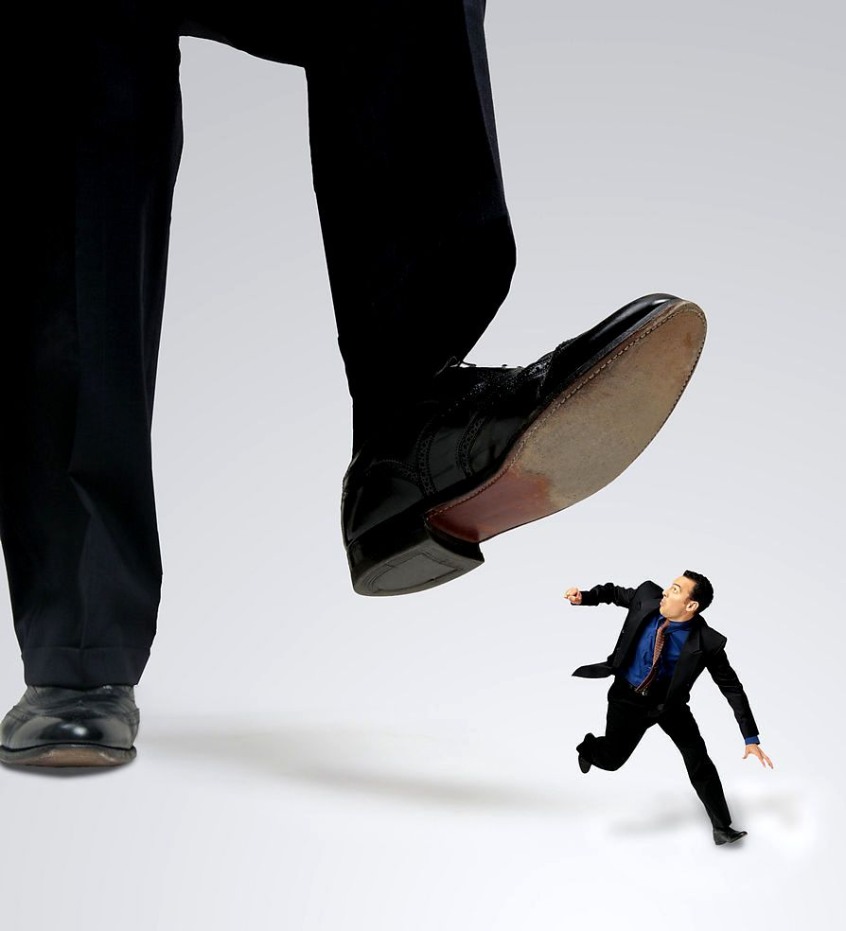
… So Don’t Let People Step On You!

Slide 50
Specific
“Problem People”

Slide 51
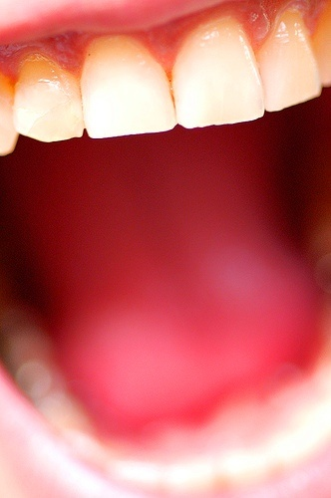
Problem…
Know Someone Who Likes To Bitch, Whine & Complain?

Slide 52
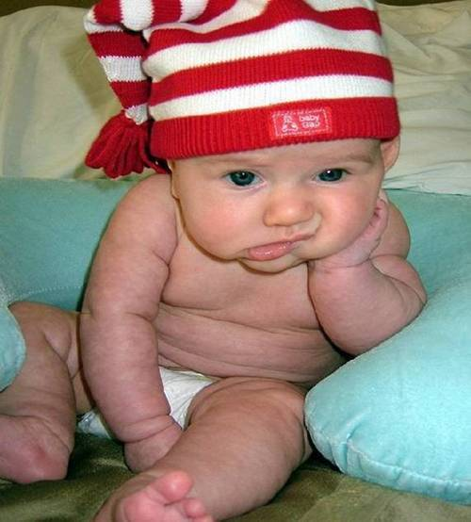
“Any Fool Can Whine, Bitch & Complain…
And Most Fools DO!”

Slide 53
SOLUTION!
Ask Them How They Are Going To Solve The Problem?

Slide 54
SOLUTION!
Walk
Away!
(And Avoid Them In The Future)

Slide 55
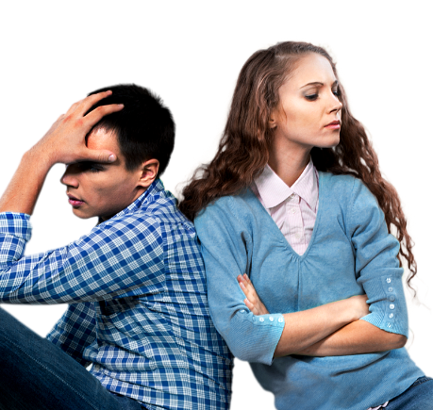
SOLUTION!
Try Ignoring Them
(This Has Worked For Women For Thousands Of Years!)

Slide 56
Problem…
Trouble With A Bossy or Aggressive Type Person?

Slide 57
SOLUTION!
Befriend Them!
Friends Don’t Attack Friends … Problem SOLVED!

Slide 58
SOLUTION!
Squeeze Them Out By Hanging With Positive People Who Support You!

Slide 59
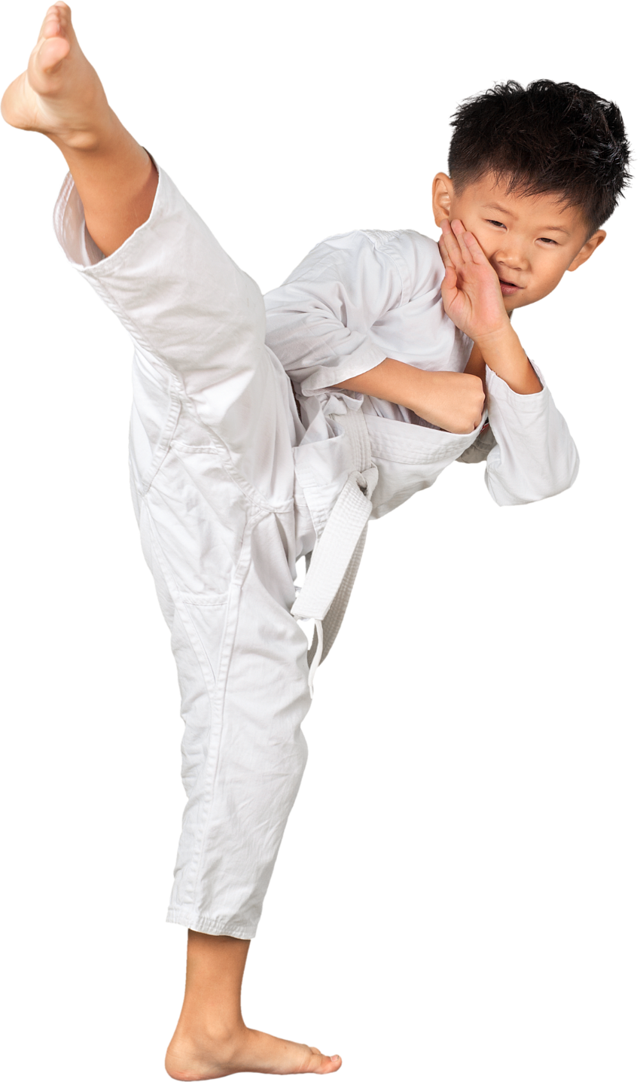
SOLUTION!
Kick Their Butt!

Slide 60
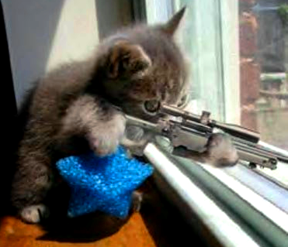
Problem…
Dealing With A “Sniper”?
(Passive/Aggressive)

Slide 61
SOLUTION!
Take Them Aside & Let Them Know That Their Comments Are Not Okay & Need To Stop

Slide 62
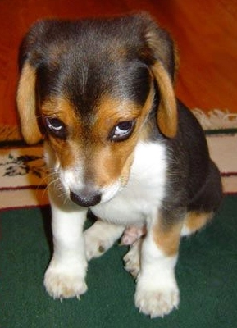
SOLUTION!
Ask Publicly: “You Didn’t Mean To Hurt/Disrespect Me When You Said That …
Did you?”

Slide 63
SOLUTION!
Have A Conversation With Their “Boss”

Slide 64
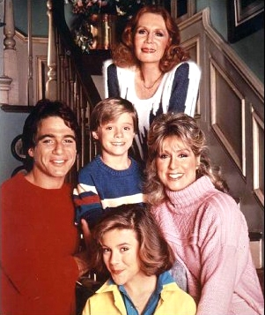
“Who’s The Boss?”
Anyone Who Can Influence Them!

Slide 65
Problem…
Trouble With An Angry Person?

Slide 66
SOLUTION!
Angry People Usually Just Need Someone To Listen to Them

Slide 67
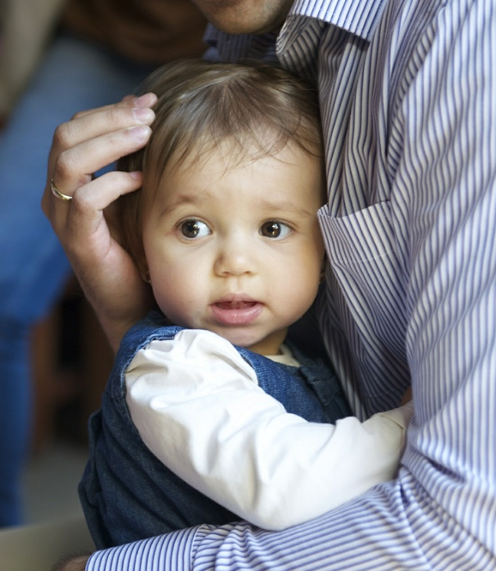
SOLUTION!
1) They Need Empathy
2) They are Hurt

Slide 68
SOLUTION!
Ask Them What It Would Take To Solve The Problem

Slide 69
SOLUTION!
Kick Their Butt!
Back Them Down!

Slide 70
SOLUTION!
Walk
Away!
(And Avoid Them In The Future)

Slide 71
SOLUTION!
Give Them A Gift Or Do Them A Favor!

Slide 72
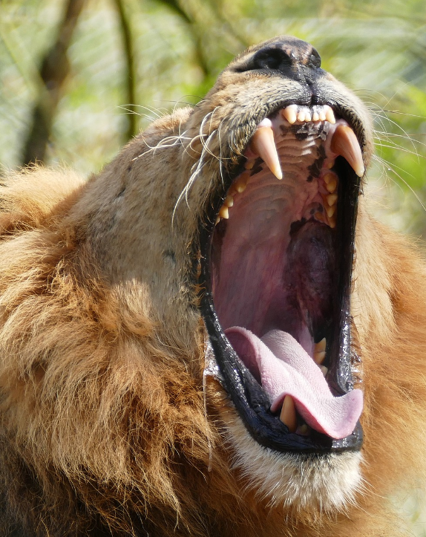
Problem…
Trouble With a
“Chatter-box”?

Slide 73
SOLUTION!
Run
Away!

Slide 74
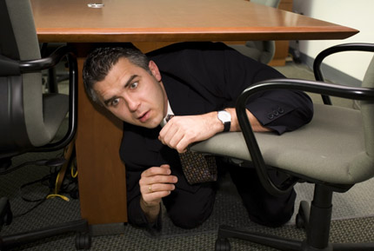
SOLUTION!
HIDE!

Slide 75
SOLUTION!
Start Working…
Most Chatter-Boxes are AFRAID Of Work!

Slide 76
SOLUTION!
Try The Old
“Fake Phone Call” Trick!

Slide 77
SOLUTION!
Apply Duck Tape!

Slide 78
Problem…
Dealing With A
Know-It-All?
I Know Everything …
Just Ask Me & I’ll Tell You!

Slide 79
SOLUTION!
Ask Them For A TON Of Information That Is Too Much WORK!
Or … Ask Them To PROVE It!

Slide 80
SOLUTION!
Agree With Their Point … But Help Them See A New Perspective!
(Shows them they DON’T know it all)

Slide 81
SOLUTION!
Let Them Know They Are Bugging You … And You May Swat Them!

Slide 82
SOLUTION!
Use The “Proximity Rule”
THEM
YOU
Get FAR Away From Them!

Slide 83
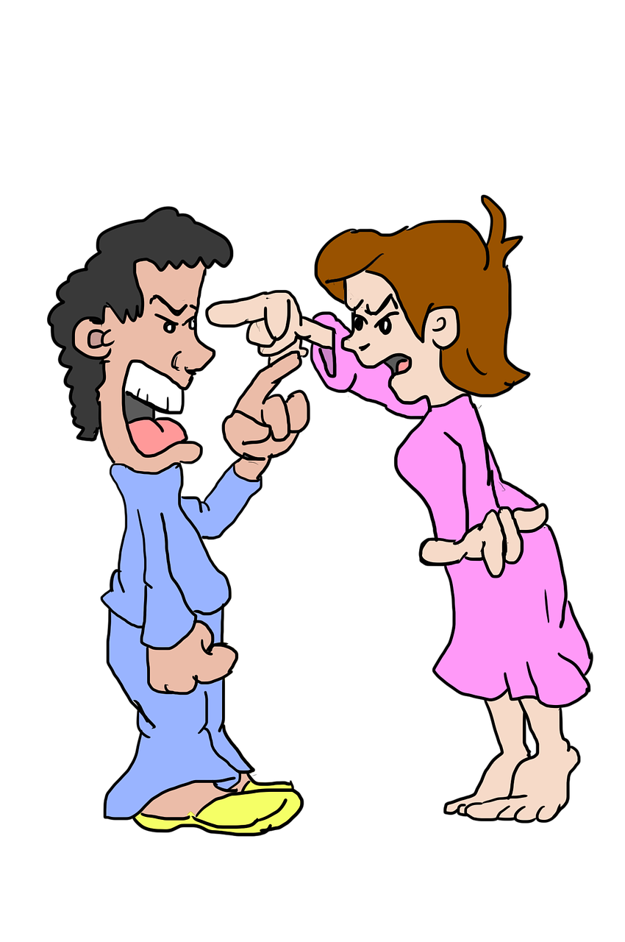
Problem…
Trouble With a Nagging
Spouse?
Boyfriend?
Girlfriend?

Slide 84
SOLUTION!
Realize They Are Probably Having An Emotional Problem & Try to Help

Slide 85
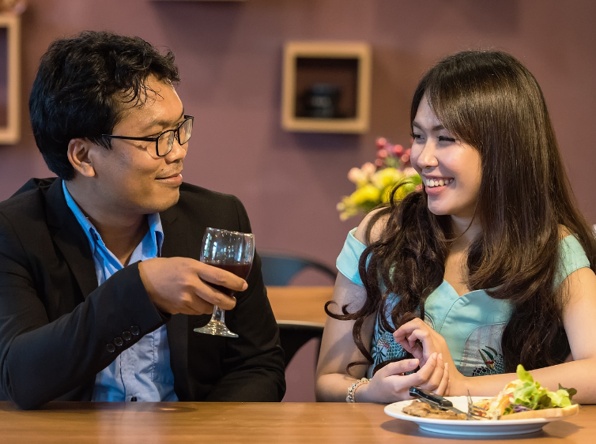
SOLUTION!
“Talk it Out”
…But Focus On Solutions … NOT Problems!

Slide 86
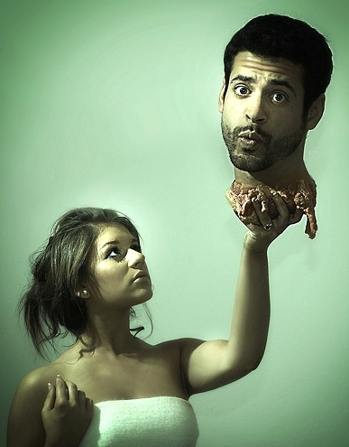
SOLUTION!
“Hand Them Their Head!”
Sometimes You Just Need To Set Boundaries!

Slide 87
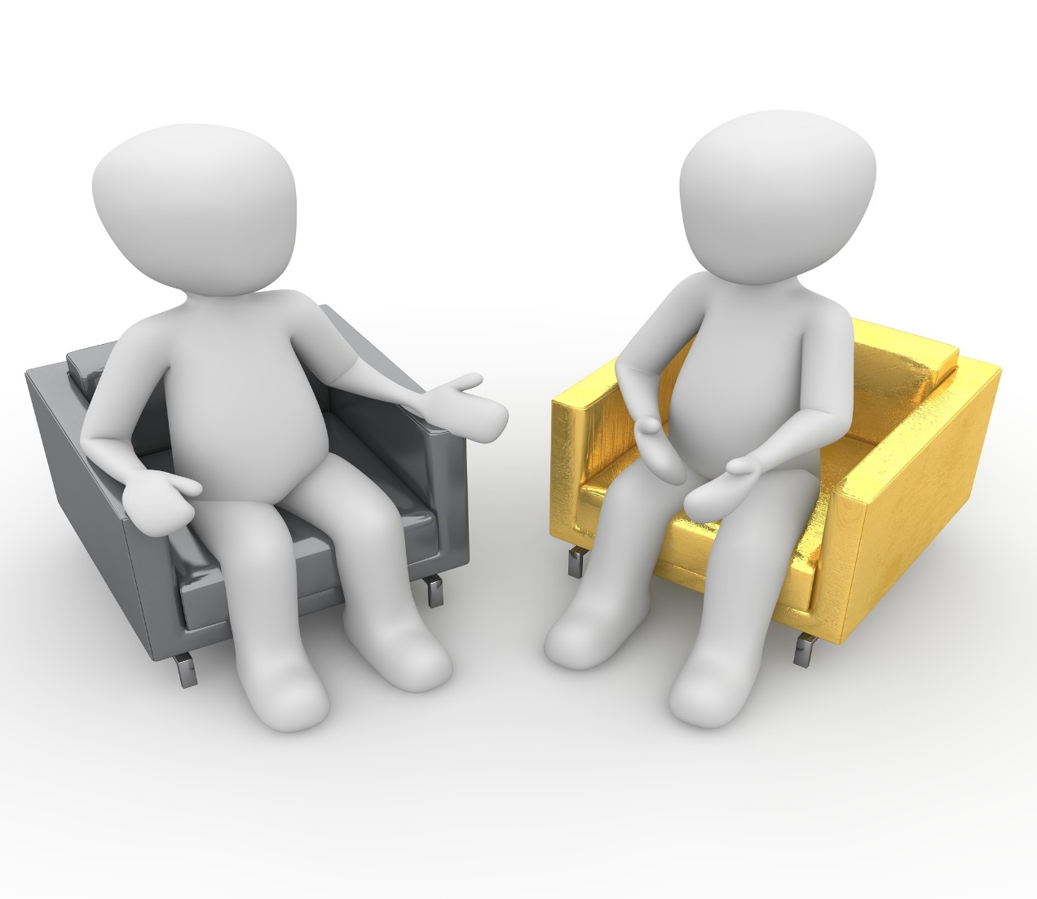
SOLUTION!
Try Counseling…
It Works!!!!

Slide 88
Final Tips!!!

Slide 89
Let Go Of RESENTMENTS!
Definition:
“To Re-Sense Or Re-Feel”
“Don’t Replay The Old Movies In Your Head!”

Slide 90
ULTIMATE
SOLUTION!
Read This Book Over & Over Again!!!

Slide 91
Other Reading Recommendations:
“Coping With Difficult People” – Robert Branson
“Angry All the Time: An Emergency Guide to Anger Control”
– Ronald T. Potter-Efron

Slide 92
Other Reading Recommendations:
“Your Erroneous Zones”
– Dr. Wayne Dyer
“The Power Of NOW”
– Eckert Tolle
“You Can Be Happy No Matter What”
– Richard Carson

Slide 93
Final Recommendation:
PUSH
“If You Don’t Want People To Push Your ‘Buttons’ … REMOVE Them!”

Slide 94
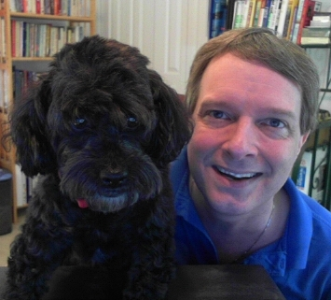
Thanks For Joining Us Today!
Paul J. Cline
www.MyAdvancedIdeas.com

