Slide 1
Calendar Skills

Slide 2
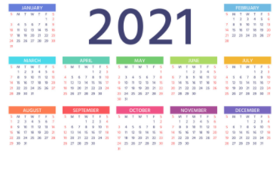
This is a calendar. A calendar displays the months and days of the year.

Slide 3
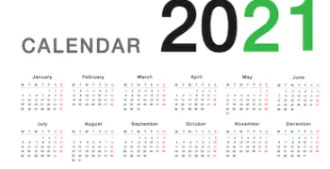
Calendars are helpful resources to keep track of the days, months, and seasons. It also allows you to keep track of holidays, special events, and a daily schedule.

Slide 4
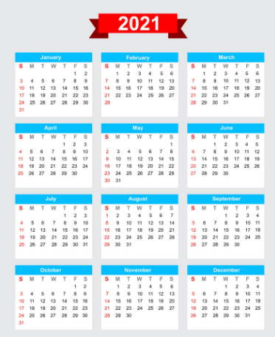
There are 12 months in a year. Do you know what they are?

Slide 5
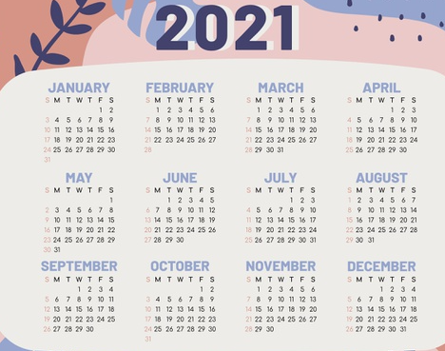
Every month has 30 or 31 days. February is the only month that has 28 days, but every 4 years, it has 29 days! That year is called a leap year.

Slide 6
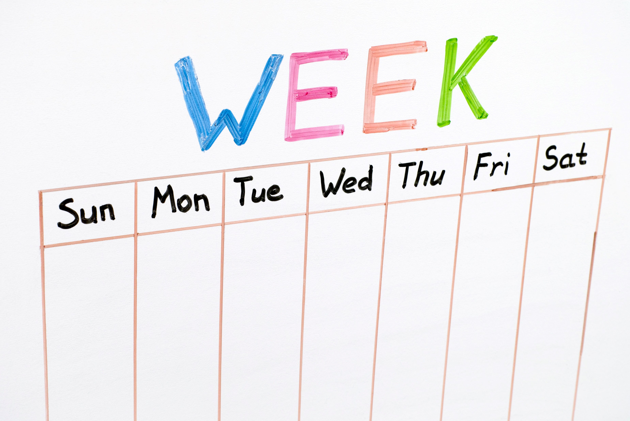
Every week has 7 days in it. Do you know the order of days?

Slide 7
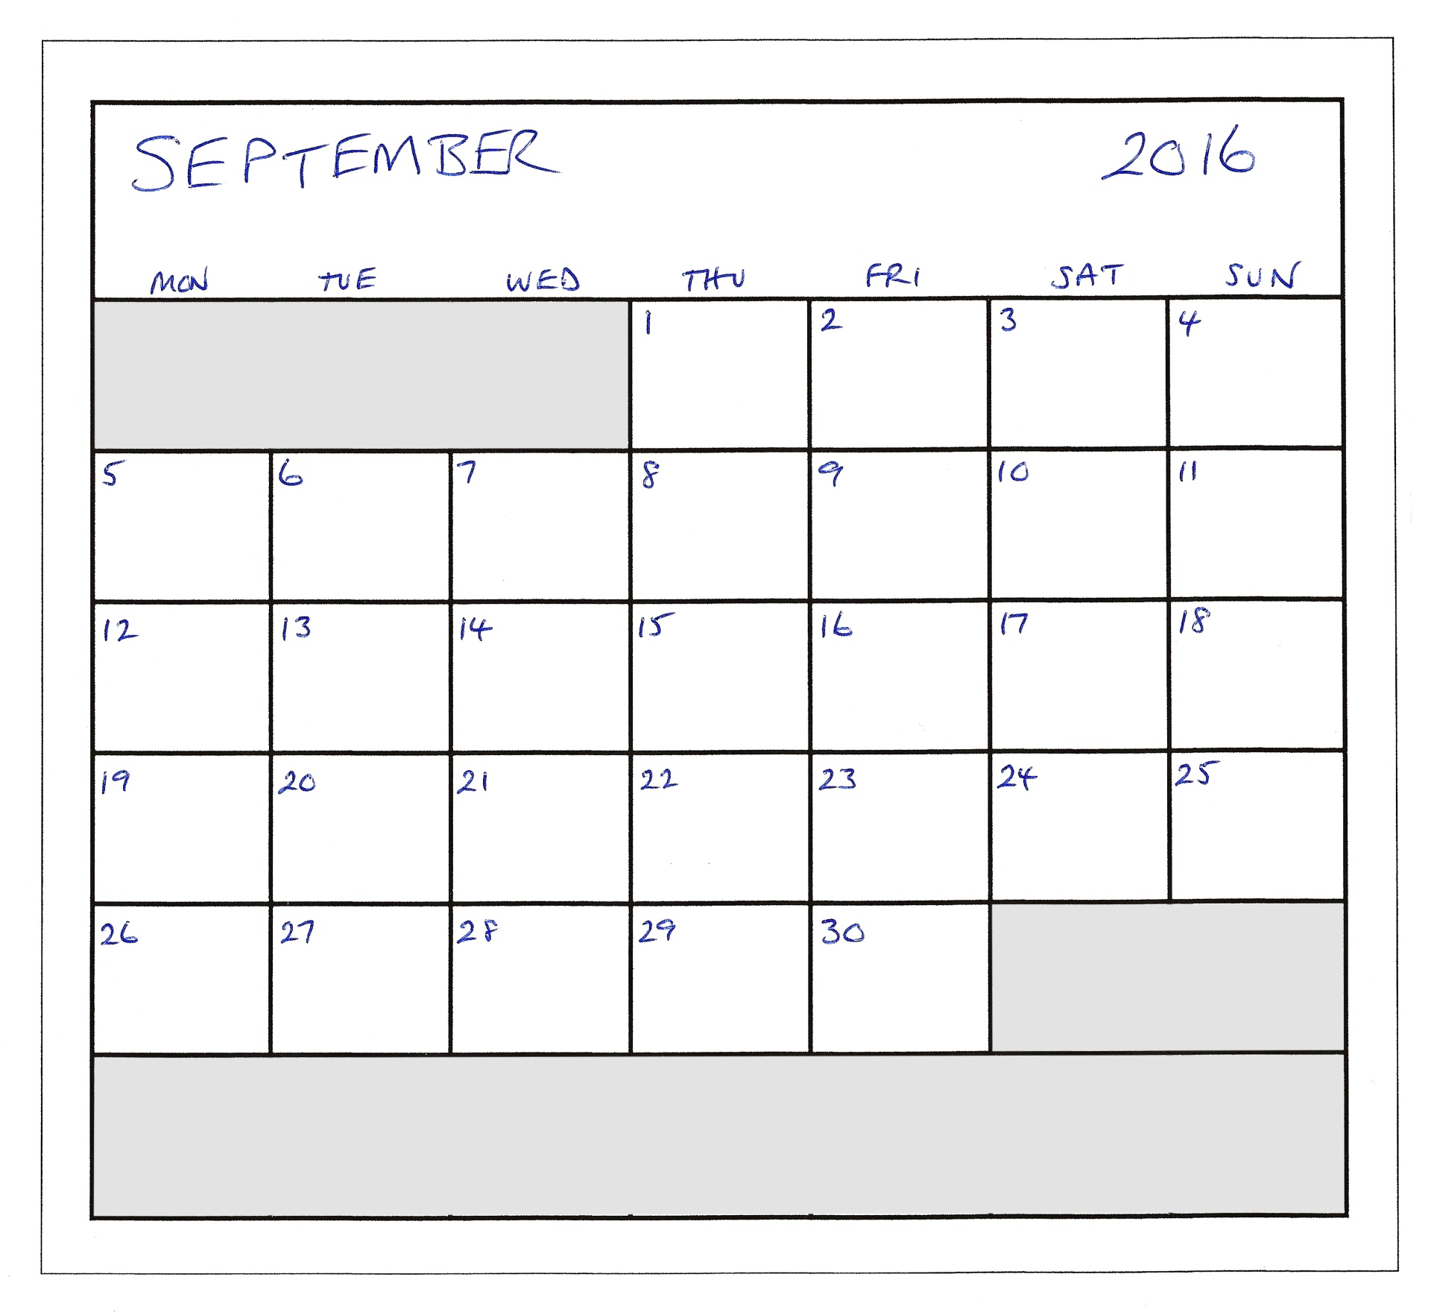
Look at this month and let’s answer some questions.
What month and year is it here?
How many days are in this month?
What day does the 14th fall on?
How many Mondays are in this month?
What day does the last day of the month fall on?
What month comes next?

Slide 8
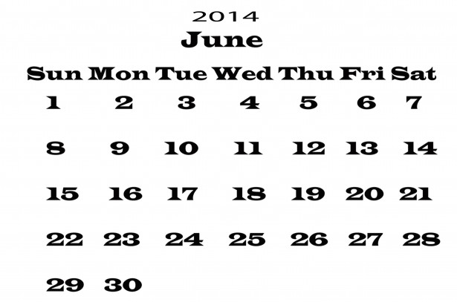
Look at this month and let’s answer some questions.
What month and year is it here?
How many days are in this month?
What day does the 20th fall on?
How many Fridays are in this month?
What day does the first day of the month fall on?
What month comes next?

Slide 9
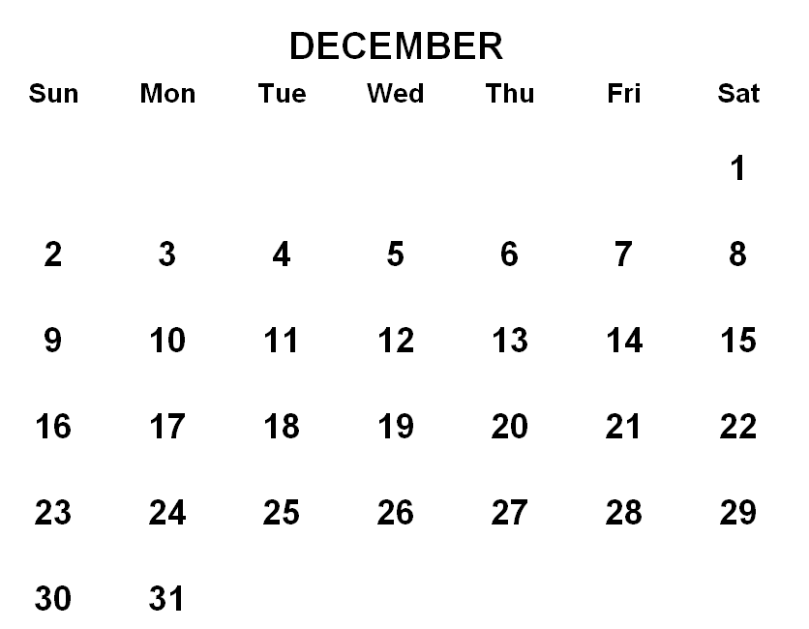
Look at this month and let’s answer some questions.
What month is it here?
How many days are in this month?
What day does the 21st fall on?
How many Wednesdays are in this month?
What day does the last day of the month fall on?
What month comes next?

Slide 10
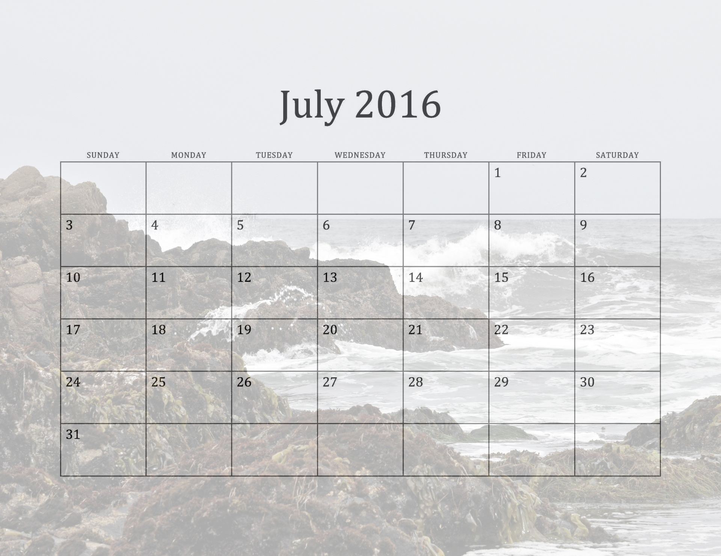
Look at this month and let’s answer some questions.
What month and year is it here?
How many days are in this month?
What day does the 8th fall on?
How many Thursdays are in this month?
What day does the first day of the month fall on?
What month comes next?

Slide 11
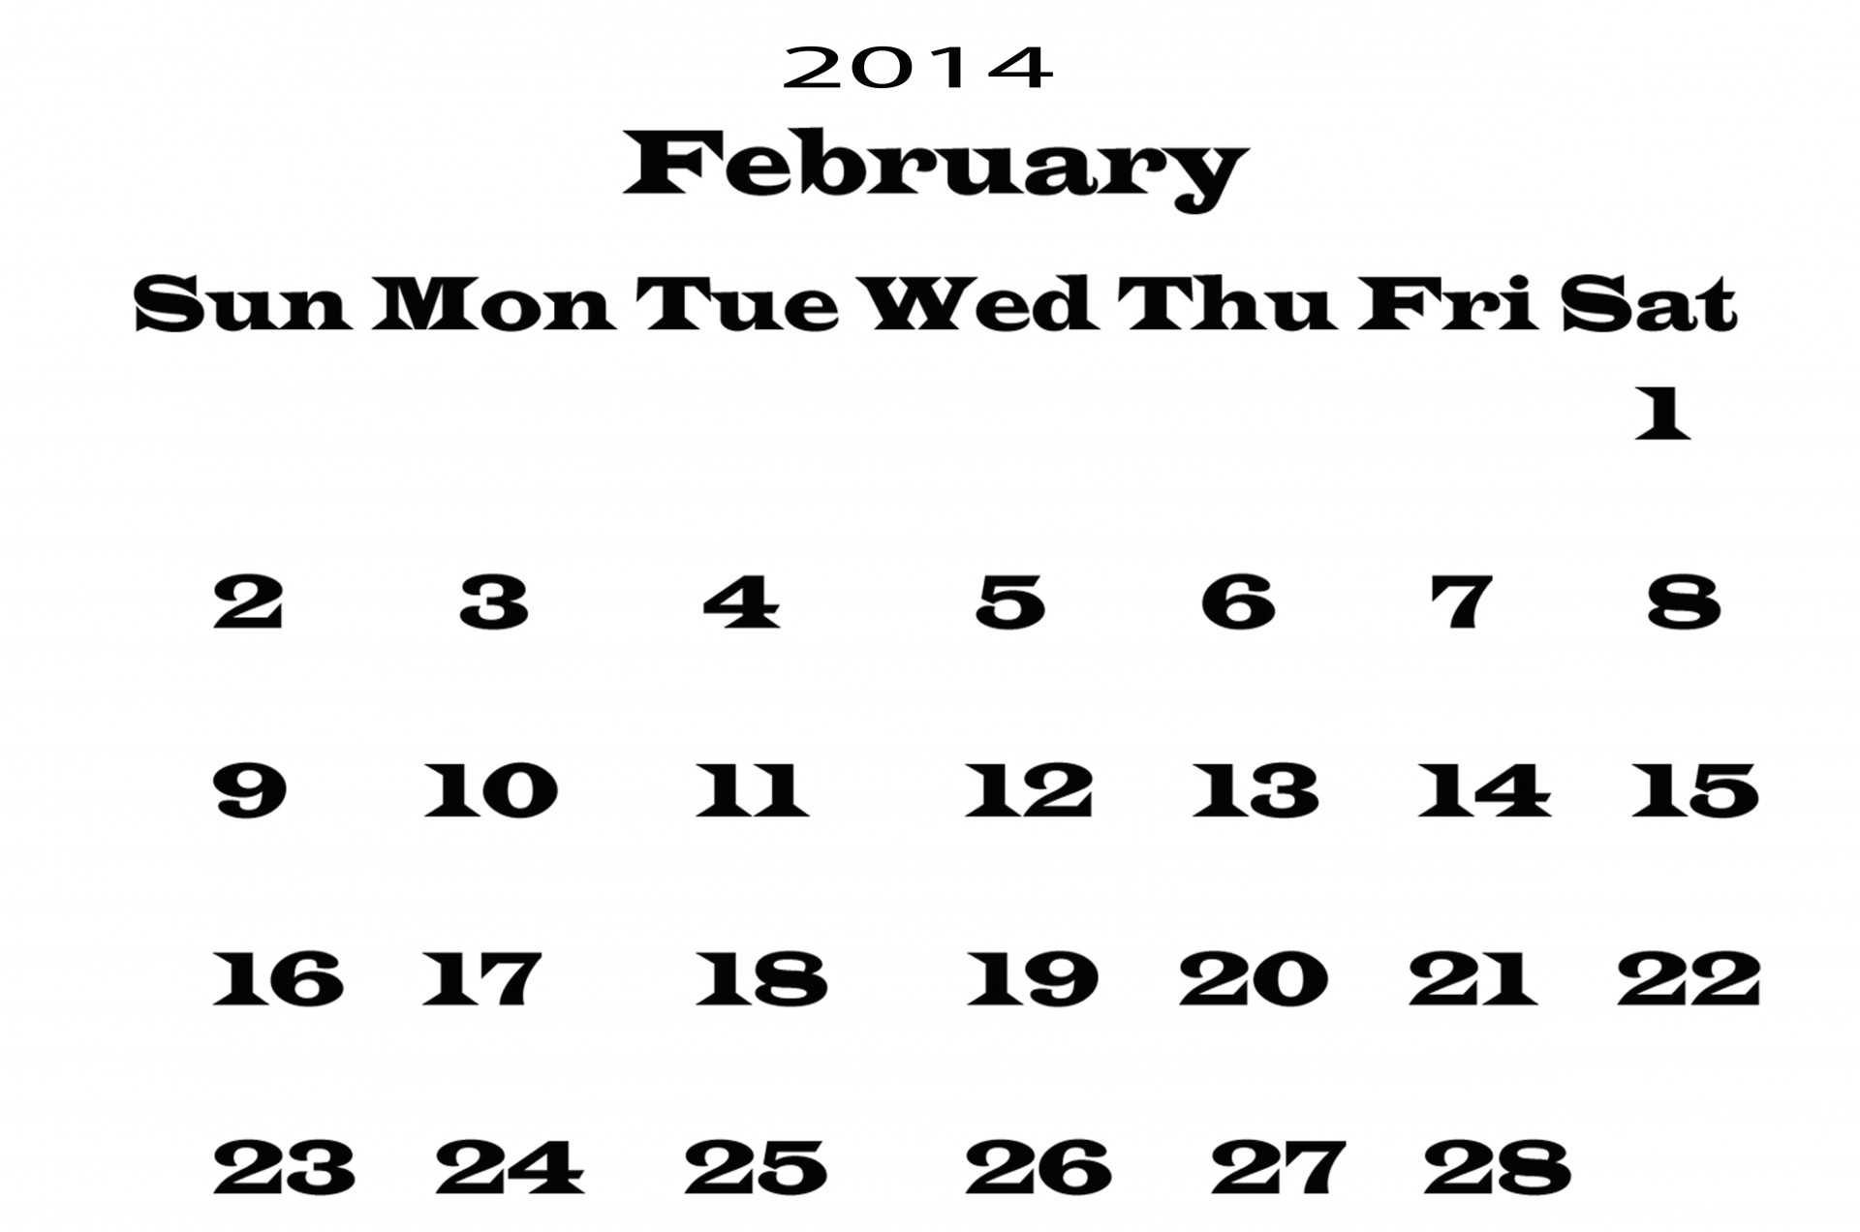
Look at this month and let’s answer some questions.
What month and year is it here?
How many days are in this month?
What day does the 28th fall on?
How many Tuesdays are in this month?
What day does the last day of the month fall on?
What month comes next?

Slide 12
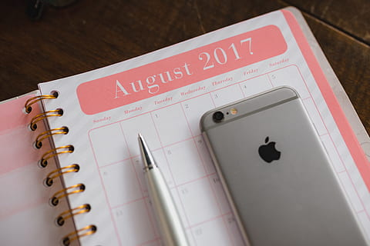
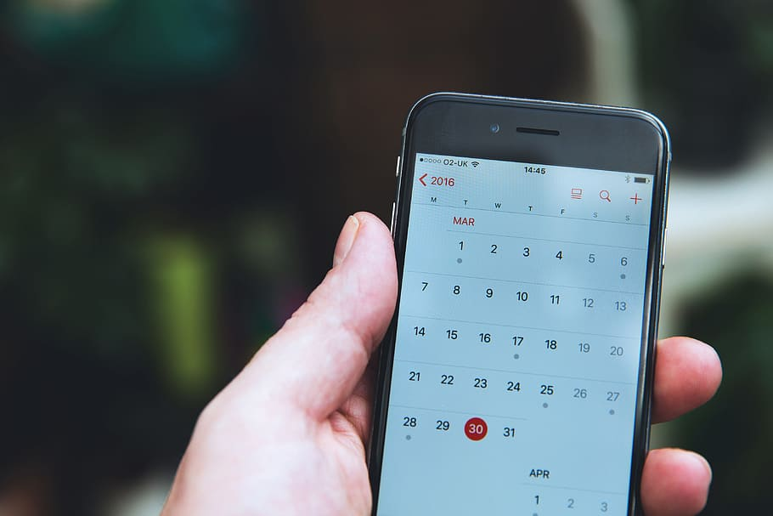
Do you have a personal calendar? Many people use the calendar on their phones or use a small pocket calendar to keep track of their schedules.

Slide 13
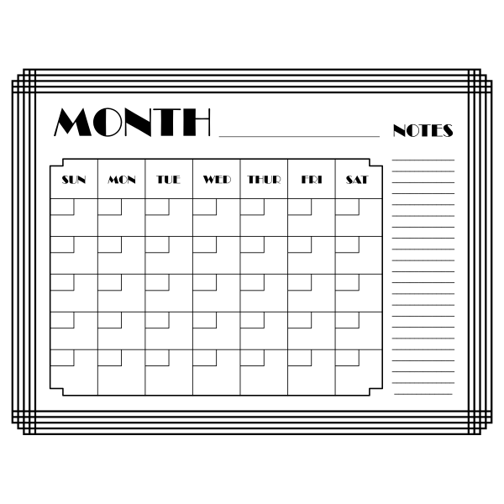
Review: What is a calendar & why do we use one?

