Slide 1
Funding Your Busine$$
$ecuring Capital to Tran$form the Dream into Reality
By Lynita Mitchell-blackwell

Slide 2
$et it Up
If you want to be taken seriously in BUSINESS, then you actually have to have a BUSINESS!
Incorporate
INC
S CORP
LLP / LP
LLC
PC
Tax consequences are significant
Talk with BOTH and attorney and accountant

Slide 3
$et it Up
Open and USE a Business Account
Obtain an EIN from www.irs.gov (it’s free)
Set up the account in your BUSINESS’ name
Set up both a savings AND checking account
Obtain a debit card for the account
Obtain a credit card for the account
Obtain your DUNS number from
www.dnb.com (it’s free)
Establishing business credit is critical to your ability to grow!
YOUR COMPANY
TODAY
$$$$

Slide 4
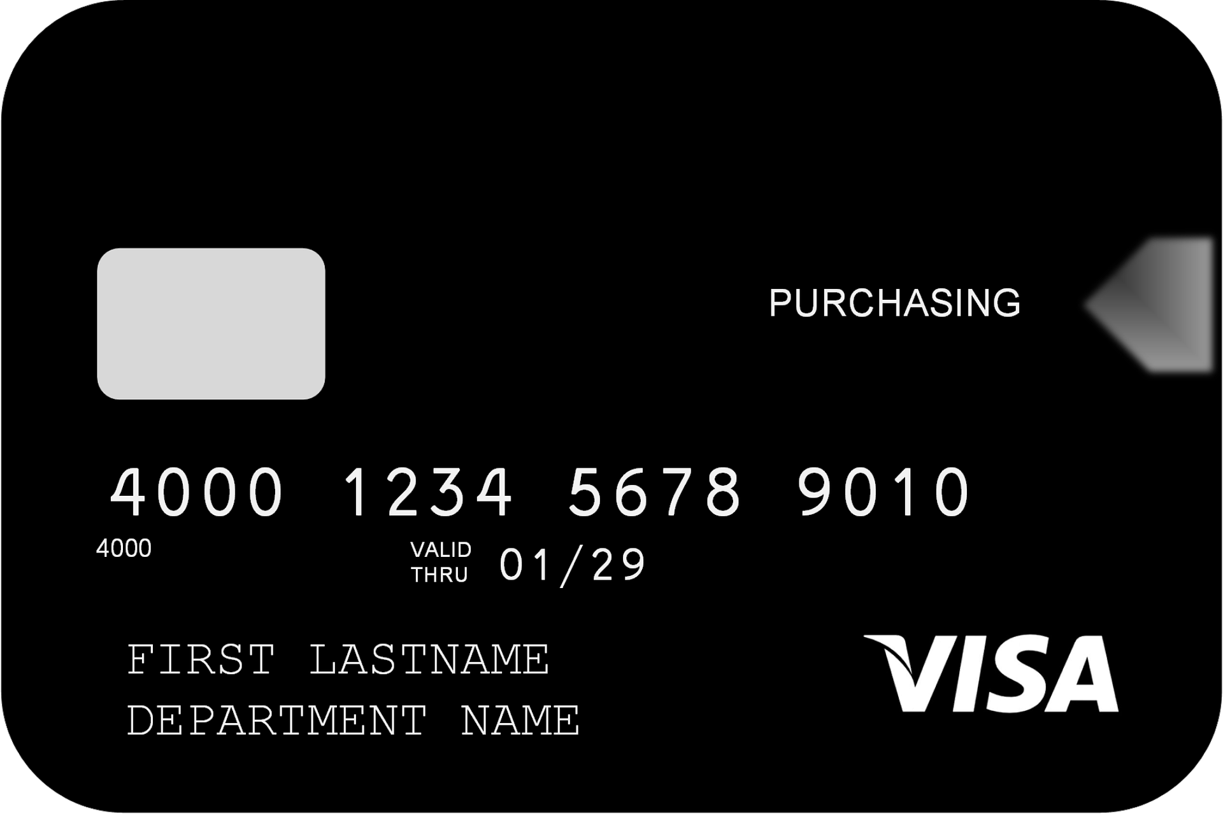
$et it Up
Set Up PAYMENT Options
Establish your policies: cash, check, credit card
Decide
When people need to pay: before work begins, at project completion
Will you offer payment plans, and if so, what terms (half now, half at completion; 3 months, 6 months; depends on project/item value?
People spend up to 3 times more when they can use a card
Make it easy to buy by using trusted sources: PayPal, Cash App, Square, Stipe
Establish how you will account for sales
Quickbooks, Peachtree, Spreadsheet (Excel, Google Sheets)
Link your accounting software to your bank account for easy reporting

Slide 5
Get it Done
Unique Selling Position
Yes, THAT again! ☺
MEMORIZE what makes your product/service different from everyone else’s
THIS is going to be the determining factor when people decide whether to loan you money for expansion, inventory purchases, and operations (banks, investment firms, and other lending institutions are run by PEOPLE who make the decisions)

Slide 6
Get it Done
Funding Sources
There are a PLETHERA of sources available to you – even if you don’t have “perfect” credit
Credit Cards
Kabbage
PayPal Working Capital
Angel Investors
Your Bank / Credit Union
Your 401K / IRA
CERTAIN family members and friends (you can’t share your blessings with everyone!)

Slide 7
Get it Done
Save and Invest
NEVER spend every dime you make
Save 10%
Invest 10%
Donate 10%
Operate your business on the remaining 70%

Slide 8
Lynita
Mitchell-Blackwell
770-766-3152
info@leadingthroughliving.com
www.LeadingThroughLiving.com

