Slide 1


Clinical Services & Quality Management
DBH Effective Documentation 2021
Behavioral Technicians, Counselors, & Milieu Support
Nursing
Clinical
Medical
SUD Division

Slide 2
Table of Contents & Guide
*Instructions: Please locate your appropriate role and click on the link to access the relevant training*
Part I: Effective Documentation for DBH
All Roles
Documentation Do's & Don't
All Roles
Suicide Protocols & Your Role
All Roles
Part II
SUD Behavioral Health Technicians
SUD Nursing
SUD Clinical
    Golden Thread
    Group Notes
    The Problem List
    Treatment Plan
    Discharge Planning
    References & Resources

Slide 3
Part I:
Effective Documentation for DBH
SUD Division

Slide 4

Purpose and Objective of Annual Effective Documentation:
Reinforce the importance and role of Documentation and Medical Records
Provide you with clear instructions and resources to make your job easier and more efficient!
Provide a user-friendly resource for you to download and reference, as needed
Reduce confusion with documentation requirements
Provide examples of documentation requirements for each role
Improve clinical quality, which improves patient engagement¹
Increase understanding of expectations to improve staff engagement
¹ Stanhope, V., et al., (2013)

Slide 5
The Role and Importance of Documentation
Potential consequences of an incomplete medical record:
is used to support allegations of negligence
is used to support allegations of fraud
Can cause a provider to lose their license
cause lost revenue/reimbursement
result in poor patient care by other healthcare team members
result in inappropriate billing leading to charges of fraud
interfere with patient-related studies
compromise safe patient care
decrease reimbursement/gross revenue
"Good documentation is important to protect your patients. Good documentation promotes patient safety and quality of care. Complete and accurate medical recordkeeping can help ensure that your patients get the right care at the right time. At the end of the day, that's what really matters" (Taitsman, 2011).
Myth: Detailed documentation should be avoided because “lawyers can hang you with it.”
Rebuttal: Good care combined with high quality documentation is the surest way to avoid being a defendant in a malpractice action. Documentation is key when reviewing a potential case (Simpson, S., J.D, 2015).

Slide 6



Clinical Documentation and Medical Records
Medical/Clinical Records are:
Legal documents
Evidence of services provided by staff within the scope of practice of the individual delivering service
Substantiation of medical necessity and appropriate level of care
Data that relates to the clinical goals and/or links to Diagnosis/es and/or Patient Needs
Communication with outside readers (e.g., providers, payers, court of law, etc.)
Clinical documentation in behavioral health care tells a story. That story recounts the entire process of care, treatment, or services for an individual served, including any transfer or discharge. The story must be founded on timely, complete, accurate data continuously collected and analyzed. This enables appropriate assessment of needs and an individualized plan for care, treatment, or services that reflects the individual’s progress.

Slide 7

Documentation Do’s:
Document all attempts for Coordination of Care!
  Give yourself credit for your hard work; include Contact or Communication Notes when reaching out to outside providers, family, social support, collateral, or requesting medical records
Document so that the record flows logically
Assume another person will be reviewing the record; follow the logic and flow of the Golden Thread Treatment Path
Collaborate with patient and document with them!
  Include patient in the treatment planning or discharge planning process. View the training on Collaborative Documentation for more information on how to reduce clinician burnout and improve patient engagement!
“Verba volant, scripta manent”
(spoken words fly away, written words remain)
- Caius Titus

Slide 8
Documentation Do’s:
DO use abbreviations that are consistent with Discovery Behavioral Health’s Abbreviation Use and Elimination Policy (IM-002) Policy.
  e.g.: “This writer spoke to patient’s boyfriend (bf) on the phone regarding her recent verbal altercation with
  staff. Bf shared with writer an incident from weekend.”
DO include Job Title, Credentials, and License Number in EMR Signature/Title Line, (when applicable)
  Staff without a license or discipline must include a job title:
    (e.g., Sandy Stone, Behavioral Health Technician)
  Staff must include a license or designation, when applicable:
    (e.g., Peter Roberts, Licensed Clinical Social Worker #12345 (TX)
DO Sign your full name legibly!
  Signatures that are illegible and ‘scribbled’ are unacceptable
  Initials or incomplete names are unacceptable
DO utilize the Annotation feature, when necessary:
  Use as an annotation to include an addendum when a form is closed (e.g., clarification, late entry, error).
    e.g.: Shift note was performed and completed at time dated above. Signature late due to Technician error.
    e.g..: Late entry for service provided on x/x/xx due to crisis in milieu that required writer’s attention..
  Use as evidence of additional reviewer (e.g., Physician indicating they reviewed patient’s lab results. Physician can add annotation to document or upload stating, “Reviewed”.

Slide 9
Documentation Don’ts!
Don’t use judgmental or opinionated language e.g.: “It seems like she doesn’t know how to listen or follow program guidelines.”
    Alternative: "Patient appears to be having a difficult time following program guidelines, as evidenced by......."
Don’t use jargon/subjective language/opinions of patient e.g.: “Patient looked irritated, is OCD about her clothes and seems rude to everyone.”
    Alternative: "Patient was visibly upset, as evidenced by expressing feelings of discomfort related to her attire while interrupting peers during group."
Avoid labeling or identifying the patient that may negatively impact them if reviewing their chart. e.g.: “Patient is a cutter and a purger.”
    Alternative: “Patient reported purging and engaging in self-injurious behavior.”
Don’t write “N/A” when it IS “A”!
  ‘N/A’ should be reserved for when the response is Not Applicable (e.g., “How old are your children?” If patient does not have any children, ‘N/A’ would be an appropriate response.
  If a patient discharges against treatment advice (ATA), avoid using ‘N/A’ as a response in the aftercare appointment section of the Discharge Plan. Rather, indicate the circumstance (ATA) and give yourself credit; write out all attempts to make appointments and/or discuss aftercare with patient prior to them leaving ATA.

Slide 10

Documentation Don’ts!
Don’t copy and paste into patient’s record- Each note needs to be specific to the service provided
Don’t write another patient’s name in the chart
Don’t use stigmatizing language
  Payors have identified this as “cloning” and are prepared to reject claims with cloned documentation
  If another patient must be identified, use initials. Avoid names of family and friends, rather, refer to the relationship (e.g., mother, friend)
  WORDS MATTER¹! Avoid words that can be stigmatizing. Instead of:
            “Clean” use “currently abstaining”
  Psychotic use “experiencing psychotic symptoms or psychosis”
¹In a study performed by Beach, M.D. MPH, research found that physicians-in-training who read stigmatizing patient chart notes were significantly more likely to have a negative attitude toward the patient than those who read the chart containing more neutral language (2018).

Slide 11
Part II
SUD Behavioral Technicians
SUD Nursing

Slide 12

Nursing and Medical Documentation: (1 of 3)
Face-to-Face Nursing Evaluation - The Face-to-Face Evaluation is considered a pre-admission document to determine level of care. This form must be signed by Nurse prior to patient’s admission date and time.
Nursing shift notes:
  Be mindful that start and stop times do not overlap with other services (e.g., Group sessions, clinical sessions; the patient cannot be in two locations at once!)
  Ensure appropriate follow through on patient reports (e.g., Pain, suicidality, chest pains, etc.) > document the plan of action and/or referral provided.
Pain Screen/Assessment - Included in the Face-to-Face Evaluation, evaluation for Pain begins as a Screen and expands to an Assessment, as necessary, based on responses. Please make sure there is appropriate follow through based on responses (e.g., documented pain reassessment in 72 hrs., referral to physician for further evaluation, and/or pain clinic, inclusion in clinical treatment plan on how pain will be co-managed¹, etc.)
¹ (TJC, 2018). Pain, especially chronic pain, frequently occurs together with mental and/or substance use disorders. These conditions must be co-managed to achieve progress in treatment for the affected individuals

Slide 13


Nursing and Medical Documentation: (2 of 3)
COWS/CIWA - A score below 11 is considered stable on either scale. If a patient is stable CWS and/or CIWAS will be repeated every 4 hours for the duration of detoxification or per physician orders. [Policy: SUD 010 Detoxification Protocol in SUD Programs]
Medication Identification:
  Individual medications brought into the facility will be identified and verified by a Nurse using the Epocrates pill identification service and documented in the patient's medical record. [Policy: MS 002 Medication Management]
Medication Destruction:
  Medications > 14 days expired, discontinued, and/or unclaimed must be stored separately from active medications.
  Ensure appropriate forms are completed and signatures (+ witness signatures) are captured (e.g., Medication Destruction Form. [Policy MS 003 Medication Destruction Policy]

Slide 14
Nursing and Medical Documentation: (3 of 3)
Controlled Med Counts:
Must be counted at each shift, until destroyed
Must be accurate
Must be double signed
Follow program policies to ensure compliance with state specific regulations
Physician’s orders:
Orders must have matching results (e.g., Labs, vitals, increased frequency of COWS/CIWAS, safety observations, etc.) If there is a physician’s order, please make sure there is documentation to back it up!
Verbal Orders
  Must be documented in Physician’s Orders Tab by the staff recording the order
  Must be read back for confirmation by the prescribing doctor
  Document Read Back and Verified by choosing from the drop-down menu option in EMR
  Physician orders must be signed by the prescribing doctor within 72 hours
Labs: Make sure labs/tests are appropriately uploaded into the patient record
  Including urinalysis samples, any Lab panel, tests (EKG)
Vitals- Reach out to physician if vitals are out of range and document action steps

Slide 15





Shift Notes:
Record observations on patient behavior and interactions during shift.
Include mental and physical status, including:
Appearance (e.g., level of engagement with staff and peers, grooming, attitude: cooperative, uncooperative)
Behavior (e.g., eye contact: poor, good; psychomotor activity: handwringing; coping skills employed)
Presentation of mood (e.g., sad, angry, elated; self-report congruent or incongruent with observations)
Speech pattern (e.g., rate: increased/decreased, volume: loud, soft)
High-risk behavior (e.g., agitation, impulsivity, violence, self-injurious behaviors)
Include any safety concerns observed and action completed to ensure safety
For 1:1 observations, complete a one-to-one Safety Attestation Shift Note at the end of each 1:1 shift

Slide 16


Rounds:
Rounds:
Rounds are performed every 15-60 minutes
Rounds should be documented in real- time, (or as close to when the round was made as possible).
Vitals can be performed and recorded during rounds, (if ordered by physician)
Additional observations can be included in the Rounds feature
Rounds provide:
  an environment of patient safety
  accuracy of patient’s location
  an opportunity to connect with patient and assess any needs
Rounds must be consistent with clinical and/or physician orders and documentation.

Slide 17
Group Notes: Documentation
Group Description: Include objective of group and evidence-based interventions performed (e.g., CBT, DBT). Group descriptions do not include patient specific information.
Individual Assessment/Intervention:
  Must be individualized and demonstrate quality (e.g., not copied and pasted /cloned)
  Individual goals are strongly encouraged (e.g.: “Patient's goal is to practice assertiveness in interpersonal relationship this weekend during visiting hours and report experience in next week's group.”)
  Include patient reports (e.g., urges/cravings, rating of mood)
  Brief observations of mental and physical status:
    Appearance (e.g., level of engagement with staff and peers, grooming, attitude: cooperative, uncooperative)
      Behavior (e.g., eye contact: poor, good; psychomotor activity: handwringing; coping skills employed)
      Presentation of mood (e.g., sad, angry, elated; self-report congruent or incongruent with observations?)
      Speech pattern (e.g., rate: increased/decreased, volume: loud, soft)
      High-risk behavior (e.g., agitation, impulsivity, violence, self-injurious behaviors)
Every effort should be made to complete notes on the same day as the session! Refer to division specific policies for specific timeframes.

Slide 18

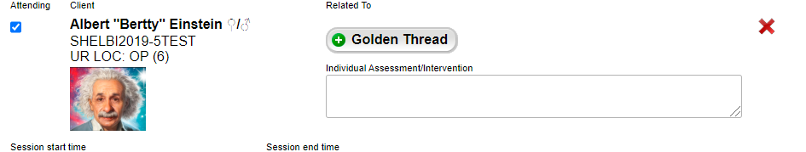
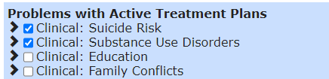
Group Notes: How to incorporate the Golden Thread
Golden Thread function:
Use the Golden Thread feature to identify which Problem, Objective, and intervention is being addressed in the group - (it can be one Problem, or it can be all Problems) - whichever is accurate. i.e., do not click all Problems, if only “Suicide Risk” and “Substance Misuse” were addressed in that specific group.

Slide 19
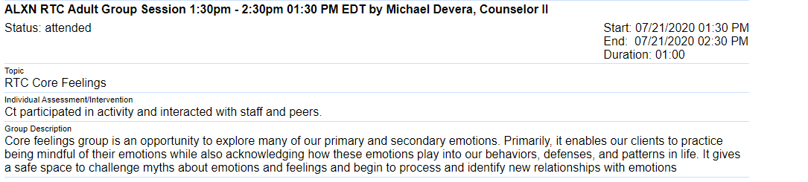
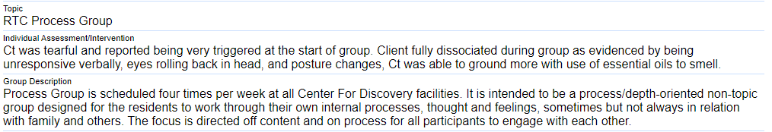
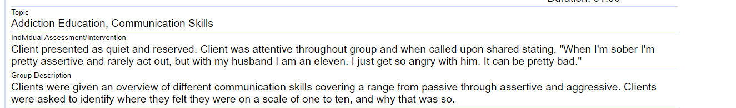
Group Notes: Content
Requires Improvement Individual Assessment is generic, does not include any subjective data on patient, does not reference Problem and/or Group Topic. Improper use of abbreviations.
Good Individual Assessment , provides brief mental status, observation of patient’s behavior, and how the patient responded to activity. Missing Problem that is being addressed and/or how it relates to Group Topic. Improper use of abbreviations.
Excellent Individual Assessment provides brief mental status, observation of patient’s behavior, quote, how patient responded to prompt and connects back to SUD Problem and Group Topic. No abbreviations used.

Slide 20


Suicide Protocols and Your Role
“Suicide is a shared problem of humanity”
– Dr. Kelly Posner, Founder and Director, The Columbia Lighthouse Project, 2021
Q: Who can perform the Suicide Assessment?
A: A clinician trained on the assessment, that can apply clinical judgment.
“Asking people about their thoughts and behaviors to assess their risk for suicide is the first, critical step in suicide prevention.”
The Columbia Lighthouse Project, 2020
Familiarize yourself with the Suicide Assessment Policy and flowchart
          *Requirements (and best practices) are different at Outpatient versus Residential
          Patients identified as moderate and high-risk level will require increased observations, suicide reassessment and safety planning
          For patients identified as high risk, you will communicate with the entire team by creating and documenting an Urgent Issue in the EMR
When clinical staff are available, (e.g., onsite), you are the initial point of contact for staff. When clinical staff are unavailable, (e.g., offsite), reassure staff that they can seek direction and support from their supervisor and/or on-call clinician
Q: Who can perform the Suicide Reassessment?
A: Any level staff that has completed the C-SSRS training sent to all staff via the learning management system.

Slide 21


Suicide Prevention Protocols and Policy:
Responding to Suicidal Behavior: If a patient reports suicidal thinking or behavior or information is obtained through collateral sources (e.g., a family member), you will want to:
  Complete a Suicide Reassessment with the patient and determine risk level based on patient’s answers and key provided in the Suicide Reassessment.
    Complete a Safety Plan.
⋆ If the Suicide Assessment or Reassessment determines patient is a high-risk level, and/or you have concerns about the patient's safety, and patient refuses to formulate a safety plan, ensure patient is placed on one-to-one staff observation and contact your supervisor for further direction
Document, document, document!
* If patient stabilizes and remains in treatment, ensure their treatment plan is updated and accurate to reflect recent behavior

Slide 22
SUD Clinical

Slide 23
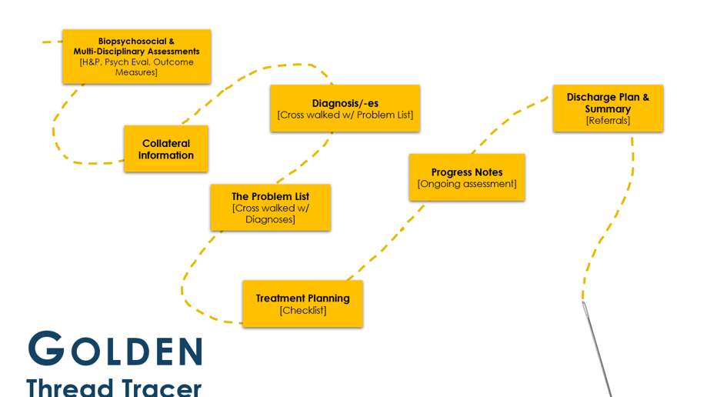
The Golden Thread
Q: Is Golden Thread synonymous with Treatment Plan?
A: No, it is not, it expands beyond the treatment plan! See below for clarification.
Golden Thread is a behavioral healthcare best practice of consistently and accurately aligning clinical information throughout the care continuum and related documentation. More specifically, the Golden Thread is a feature within the EMR that links (or threads) the patient’s episode of care from admission to discharge. Joint Commission’s individual Tracer refers to a similar process, whereby the patient’s care is traced. As part of the DBH Clinical Philosophy and Supervision Framework, this process is being internally referred to as The Golden Thread Tracer.

Slide 24
Group Notes: Documentation
Group Description: Include objective of group and evidence-based interventions performed (e.g., CBT, DBT). Group descriptions do not include patient specific information.
Individual Assessment/Intervention:
  Must be individualized and demonstrate quality (e.g., not copied and pasted /cloned)
  Individual goals are strongly encouraged (e.g.: “Patient's goal is to practice assertiveness in interpersonal relationship this weekend during visiting hours and report experience in next week's group.”)
  Include patient reports (e.g., urges/cravings, rating of mood)
  Brief observations of mental and physical status:
    Appearance (e.g., level of engagement with staff and peers, grooming, attitude: cooperative, uncooperative)
      Behavior (e.g., eye contact: poor, good; psychomotor activity: handwringing; coping skills employed)
      Presentation of mood (e.g., sad, angry, elated; self-report congruent or incongruent with observations?)
      Speech pattern (e.g., rate: increased/decreased, volume: loud, soft)
      High-risk behavior (e.g., agitation, impulsivity, violence, self-injurious behaviors)
Every effort should be made to complete notes on the same day as the session! Refer to division specific policies for specific timeframes.

Slide 25
Group Notes: How to incorporate the Golden Thread
Golden Thread function:
Use the Golden Thread feature to identify which Problem, Objective, and intervention is being addressed in the group - (it can be one Problem, or it can be all Problems) - whichever is accurate. i.e., do not click all Problems, if only “Suicide Risk” and “Substance Misuse” were addressed in that specific group.

Slide 26
Group Notes: Content
Requires Improvement Individual Assessment is generic, does not include any subjective data on patient, does not reference Problem and/or Group Topic. Improper use of abbreviations.
Good Individual Assessment , provides brief mental status, observation of patient’s behavior, and how the patient responded to activity. Missing Problem that is being addressed and/or how it relates to Group Topic. Improper use of abbreviations.
Excellent Individual Assessment provides brief mental status, observation of patient’s behavior, quote, how patient responded to prompt and connects back to SUD Problem and Group Topic. No abbreviations used.

Slide 27



Identification of Problem List
Related assessments reviewed for data:
( e.g., H&P, psych eval,dietary assessment, outcome measures, collateral records, etc.)
Biopsychosocial
Assessment
The Problem List

Slide 28

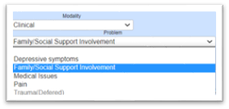
Identification of The Problem List
The Problem List
Defer
Not a current focus of treatment, a/o requires further assessment
(EMR will not generate a TP¹)
Refer
Out of scope, a/o requires specialist
Treat
Active Treatment Plan
The Problem List¹ may continue to develop as the patient moves through treatment
  New problems may be added as conditions change
The Problem List must address all Diagnosis/es (but the Problem List may be more Comprehensive than the Diagnosis Form, as it also includes identified Problems that do not meet diagnostic criteria)²
  Example: If a diagnosis for PTSD is present, then Trauma must be included on the Problem list
  Alternatively, if a Problem is identified for Disordered Eating, then there should be an Eating Disorder diagnosis, OR a "Rule/Out” OR a "Provisional" diagnosis” for Eating Disorder. (It's not comprehensive to identify that an area is a Problem in a patient's life, yet not demonstrate how this will be managed diagnostically)
The Problem List includes information collected from all assessments and patient concerns (e.g., “Problems”) that have been identified.
The Problem list and treatment plan(s) should be developed based on a multidisciplinary assessment and “may include, diagnoses, medical conditions, functional limitations, living environment, and/or symptoms” (AHIMA, 2020).
2
1Problem List if often referred to as the patient's "Needs" List.

Slide 29
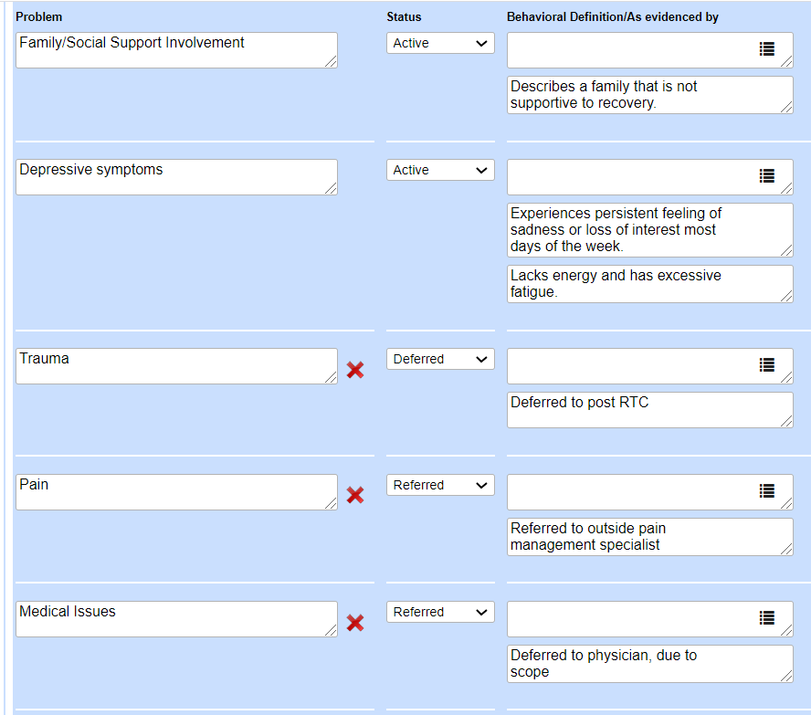
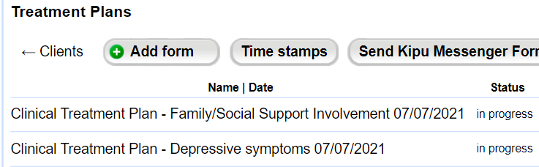
Problem List versus Treatment Plan
The Problem List must include any significant issues reported by the patient, even if they are not a focus of treatment:
The Treatment Plan(s) must include any significant issues reported by the patient that are a focus of treatment:
Not a Focus of Treatment BUT, identified in assessments as Problems
Focus of Treatment
=
1. Depression
2. Family Involvement
Notes:
Since you already know the requirements (e.g. family conflict for RTC and PHP, suicide risk/ideation for high risk), then it is recommended you obtain a goal in the patient’s words during the intake process.
It is important understand that the Problem List can be broader, as it identifies what the patient reports. A good example is Chronic Pain. This may be a problem that is included on the Problem List but has a status of Referred (to MD).

Slide 30




Treatment Planning: Snapshot of Requirements (1 of 3)
Signatures:
Signatures must be captured within 5 days of admission
    (patient, therapist, clinical supervisor)
Needs Assessment:
Treatment plans MUST include language from the Needs, Strengths, Preferences, Goals (NSPG) section of Patient BPS (Recommended to include in Goals section)
Outcome Measures:
Treatment plans (TPs) MUST include a treatment Objective that focuses on outcome measures (PHQ-9) and how the score informs treatment planning.
  I.e., including the score without any context of what the score means for the treatment plan is insufficient.
    Is the PHQ-9 score increasing? Does that indicate that the current treatment plan needs to be revisited and likely requires an adjustment? Perhaps a referral to a Psych, and additional CBT assignments.
    Is the PHQ-9 score decreasing and as a result, does this evidence that the current treatment plan is effective, and no changes are indicated at this time? Great! Write that!

Slide 31



Treatment Planning: Snapshot of Requirements (2 of 3)
Goals:
Include at least one goal stated in the patient’s words for each Problem
Highly recommend to also include the Clinical Interpretation of the goal
Statuses and Status Updates:
Initial Status must be added to each intervention when the Treatment Plan (TP) is created. This allows for you to enter a Target Date for each intervention
Patient can sign the initial TP & Statuses (as one signature) via The Golden List Thread View
Treatment Plan Reviews (e.g., Status Updates) are required (at a minimum) 14 days from admission date and every two weeks thereafter
Patient must sign at each Status Update.
  Status Updates allow you to update the Target Date, enter commentary on patient’s progress, and change the Status from the drop-down menu (if applicable)
Clinically Relevant Treatment Plans:
Primary Diagnosis/Presenting Problem: e.g., Substance use Disorder/Substance Misuse Problem/TP
Secondary and Tertiary Diagnoses: e.g., PTSD, Mood Disorder (Trauma, Depressive symptoms, Problem/TP
Common clinically relevant focuses of treatment: Aftercare Planning/ Family Conflicts a/o Social Support Involvement
Suicide Risk a/o Safety Related TP:
RTC > High-risk level, requires a Problem & TP for Suicide Risk (Moderate risk - suicidal risk mitigation
strategies in another TP
PHP/IOP > Moderate AND High-risk level, requires a Problem & TP for Suicide Risk OP Care Plan

Slide 32
Treatment Planning: Personal check-off list (3 of 3)
Signatures | 𐄂 Patient 𐄂 Therapist 𐄂 Clinical Supervisor or 𐄂 N/A
Needs Assessment | 𐄂 Included language from the Needs, Strengths, Preferences, Goals (NSPG) section of Patient BPS
Outcome Measures | 𐄂 Included a treatment objective that focuses on outcome measures (PHQ-9) 𐄂 Included how the score informs treatment planning
Goals | 𐄂 Included at least one goal stated in the patient’s words for each Problem Highly recommended: include the Clinical Interpretation of the goal
Statuses and Status Updates | 𐄂 Initial Status added to each intervention when the Treatment Plan is created (w/ target date entered) 𐄂 Status Updates made 14 days from admission date and every two weeks thereafter 𐄂 Patient signature at each Status Update
Clinically Relevant Treatment Plans | 𐄂 Primary Diagnosis/Presenting Problem 𐄂 Secondary and Tertiary Diagnoses 𐄂 Family Conflicts/Social Support Involvement 𐄂 Suicide Risk a/o Safety Related Treatment Plans

Slide 33


Progress Notes: (1 of 2)
Reminders!
Use the Golden Thread to identify which Problems, Objectives, and Interventions were addressed in a specific session (Remember, you only want to check off the ones that were addressed in the session!)
Make sure the times do not overlap with other sessions (patients can’t be two places at once)
For conjoint sessions, only one clinician should document a note. E.g., if a therapist and case manager hold a conjoint session with a mutual patient, only one clinician is to write a note and can document that the case manager was present. Duplicate notes can be viewed as “double billing”. Using this example, the case manager can write a “contact note”, indicating the conjoint session (non-billable) by emphasizing the coordination of care
Include any safety concerns observed and actions completed to ensure safety
If patient reports suicidality, the Suicide Reassessment (Frequent Screener) should be completed
If client is on a 1:1 observation, and accompanied by another staff member in session, please document that

Slide 34



Progress Notes: (2 of 2)
Tips for Telehealth!
Make sure to identify Telehealth sessions appropriately!
Here are a few scenarios to help:
Therapist and patient are physically present in therapist’s Discovery Behavioral Health company office and patient’s family “zoom in” for a session, due to being outside the geographic area of the treatment center = Family and/or Collateral session
Therapist is in their Discovery Behavioral Health company office and receives a call that her patient is feeling symptomatic and is unable to make it to session, but is requesting a virtual session (from home if outpatient, from room if residential) = Telehealth
Both Therapist and patient are in their respective homes, due to a “stay-at-home” order and are meeting virtually via Zoom = Telehealth

Slide 35

Discharge Plan and Discharge Summary: (1 of 2)
Discharge Plan
(For the patient)
Is for the patient (and for the clinical record)
Is completed throughout treatment and functions as an evolving document/process
Includes Safety Plan/Crisis Management Plan
Includes specifics of aftercare appointments (e.g., Full Name and Address of Provider, Date and time of initial appt.
Referrals provided
Discharge Plan must be signed by the patient, and staff member responsible (counselor, therapist, case manager, discharge planner, etc.) prior to the patient discharging! For unexpected discharges, send the patient the discharge summary via secure email or patient portal.
Discharge planning must be initiated within 24 hours of admit!
Discharge Summary
(For the clinical record)
Is for the clinical record
Is completed upon patient’s discharge containing all relevant clinical information
Discharge summary must be signed by the therapist and clinical supervisor, (if applicable).
Discharge summaries MUST include:
  Reason patient sought treatment
  Treatment Summary
  Clinical recommendations
  Condition upon discharge
  Summary of Treatment goals
  Prognosis
  Accurate Discharge Type
  Evidence of referrals
*NEW*: A Discharge Statement can now be completed in lieu of a Discharge Plan & Summary, WHEN: Patient discharges ATA within < 72 hrs. of admission, OR, for internal DBH transfers. [Refer to Policy: DC 001]

Slide 36
Discharge Plan, Summary and Referrals: (2 of 2)
Discharge Plan
A Discharge Plan and Referrals:
Must include specifics of appointments for Problems Addressed (e.g., Substance use disorder)
  “TBD” is insufficient
Must include follow-up appointments for medication management; please ensure patient has sufficient medications to bridge the gap from discharge and their first follow-up appointment w/ psych a/o physician
Must include follow up appointment within 72 hrs. for patients determined to be high-risk level
Must include referral list for Problems not addressed (e.g., If Trauma was identified as a Problem, but “Deferred”, the discharge plan should include (3) referrals for a trauma-focused therapists
Discharge Summary
A Discharge Summary and Referrals:
Must include a summary of appointments arranged for: Problems Addressed (e.g., Substance use disorder), follow-up for relevant medication management and follow-up appointment within 72 hrs. for high-risk patients, and general referral list provided for Problems identified, but not addressed
Must include evidence referrals were provided:
  Referrals include both aftercare appointments (within DBH and outside of DBH), as well as general referral lists
  If you are unable to provide one of the above two mentioned options, you will want to document that referrals were not provided (due to patient refusal, ATA, etc.) You would then include action steps, (e.g., sent a referral list via secure email, snail mail, or patient portal)
If patient was in our care for a brief period and you are unable to sufficiently complete items on the DC summary, indicate that (e.g., “Patient left against treatment advice and as a result did not set up aftercare appointments. Referrals have been sent to patient via …” Remember, while YOU may know what the circumstances of patients admit and sudden discharge are, it needs to be clear to a reader six months after patient’s discharge!

Slide 37
Suicide Awareness and Prevention: References & Resources
John Hopkins Medicine, Words Matter, (2018). Retrieved at: https://www.hopkinsmedicine.org/news/newsroom/news-releases/words-matter-stigmatizing-language-in-medical-records-may-affect-the-care-a-patient-receives
Joint Commission Resources: Documentation in CTS: Behavioral Health Care: 2020, Retrieved at: https://store.jcrinc.com/assets/1/14/ebbh18samplepages.pdf
Joint Commission Resources: R3: Pain assessment and management standards for behavioral health care (2018). Retrieved at: https://www.jointcommission.org/-/media/tjc/documents/standards/r3-reports/r3_20_pain_standards_bhc_12_21_18_final.pdf
Rothera-Delaney, A, RN, BS (2020). Exploring Nursing Documentation. Retrieved at:
https://www.myfreece.com/Applet/Course/BrowseCourse2.aspx?SiteCourseId=9342&CourseScheduleId=%E2%80%8B
Simpson, Skip, J.D., et al, ZERO SUICIDE Retrieved at:
https://zerosuicide.edc.org/sites/default/files/Legal%20and%20Liability%20Issues%20in%20Suicide%20Care%205.27.16%20PPT%20Transcript.pdf
Stanhope, V. (2013) The Impact Of Person-Centered Planning and Collaborative Documentation on Treatment Adherence. Retrieved at: https://doi.org/10.1176/appi.ps.201100489
Taitsman, J., Chief Medical Officer for the US Department of Health and Human Services. The Importance of Documentation. (2011). Retrieved at:
https://oig.hhs.gov/newsroom/podcasts/2011/heat/heat09-trans.asp
Columbia Suicide Severity Rating Scale
Safety Planning Intervention: A Brief Intervention to Mitigate Suicide Risk
Joint Commission Resources: National Patient Safety Goals
ZERO Suicide Model - A model for reducing suicide in United States behavioral healthcare
Disaster and Distress emergency resources for patients,families and employees

