Slide 2
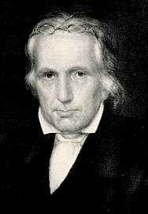
A Man with Unity on His Mind
Thomas Campbell 1809
His Life
His Plan

Slide 3
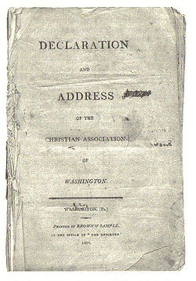

Slide 5
Today
The culture
The style
The content

Slide 6
**

