Slide 1
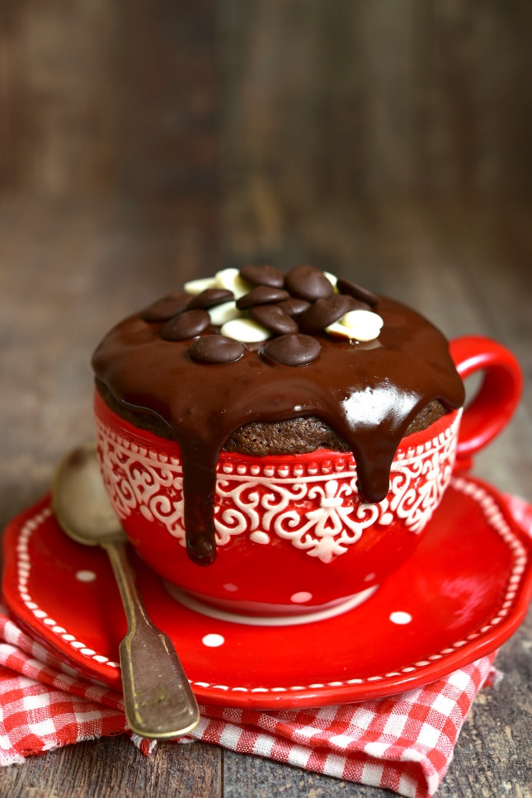
Brownies in a Mug

Slide 2
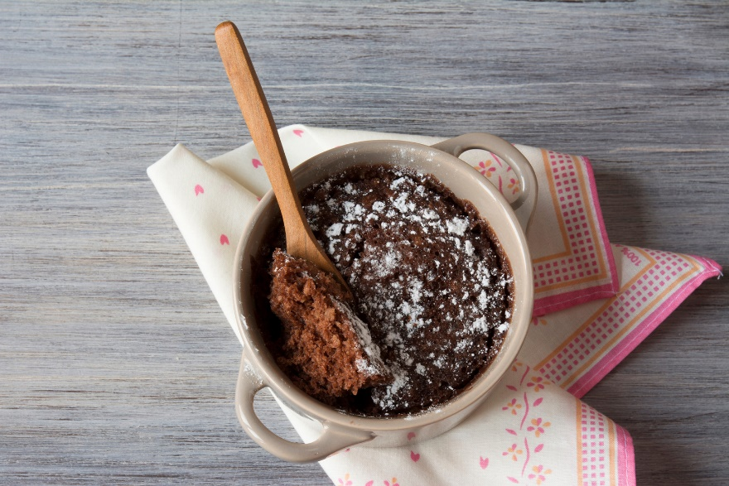
Ingredients:
Ceramic mugs
3 tablespoons granulated sugar
3 tablespoons all purpose flour
1 ½ tablespoons cocoa powder
Pinch of salt
2 tablespoons chocolate chips
1 ½ tablespoons vegetable oil or melted butter
3 tablespoons milk
¼ teaspoon vanilla extract
Powdered sugar, whipped cream, OR ice cream, if you want.

Slide 3
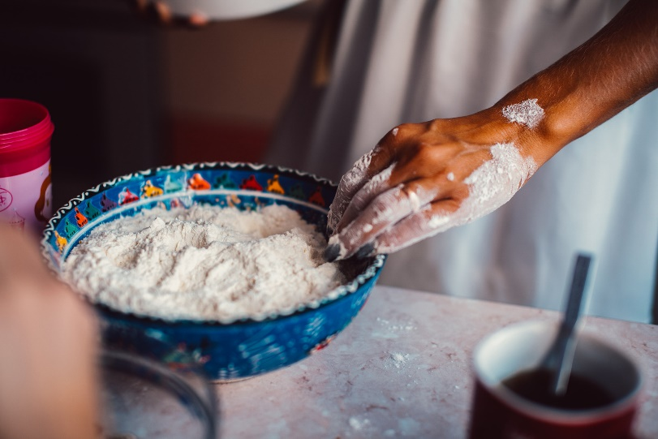
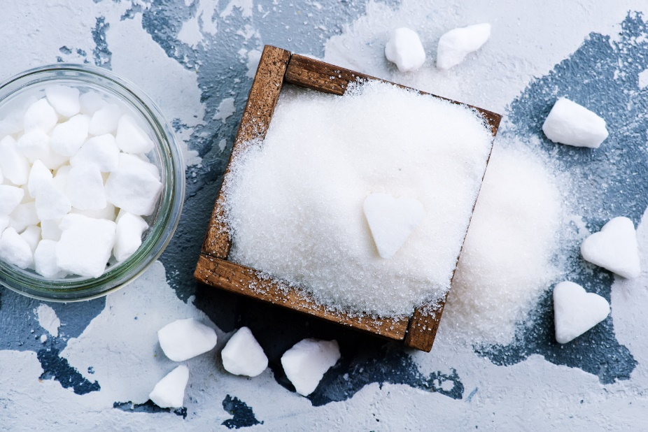
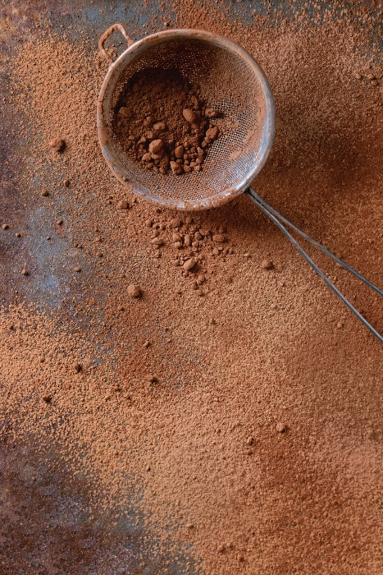
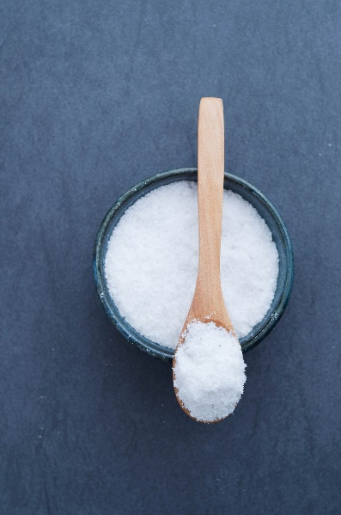
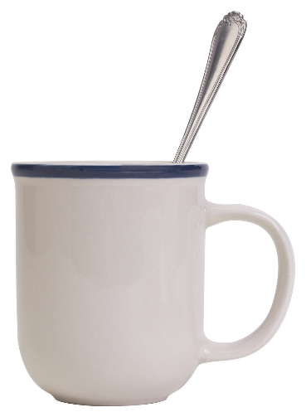
1. Put sugar, flour, cocoa powder, and salt in a mug.

Slide 4
2. Use fork to stir ingredients so it is smooth.

Slide 5
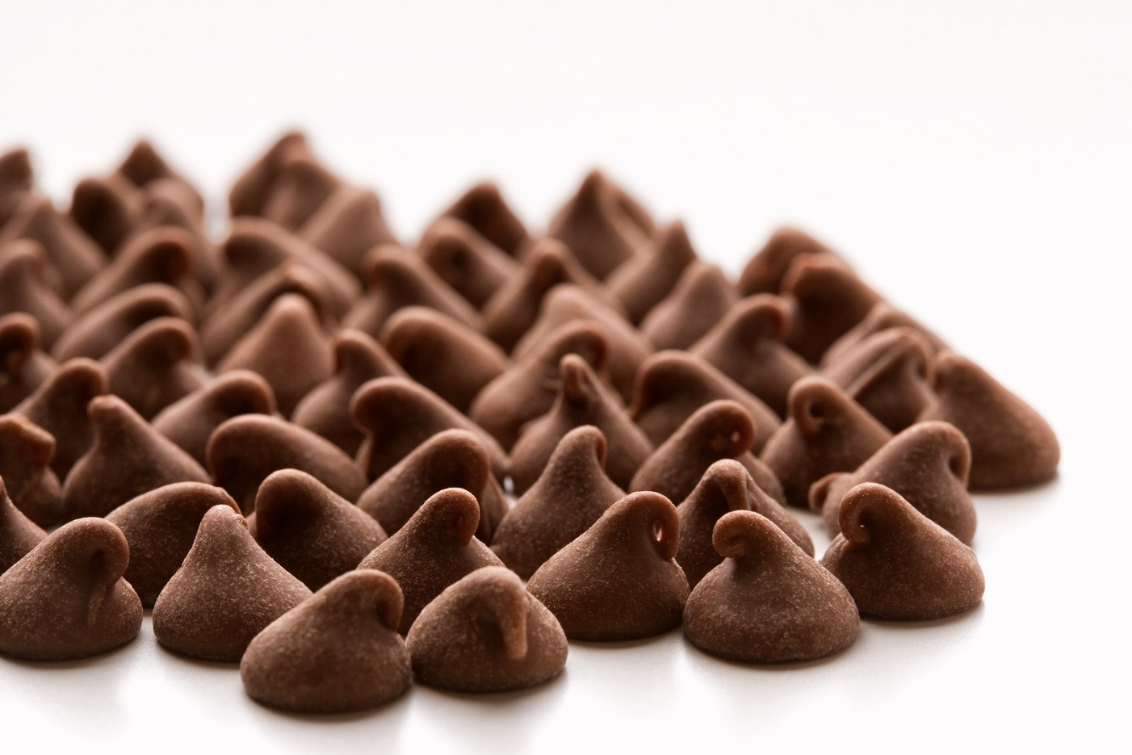
3. Stir in chocolate chips.

Slide 6
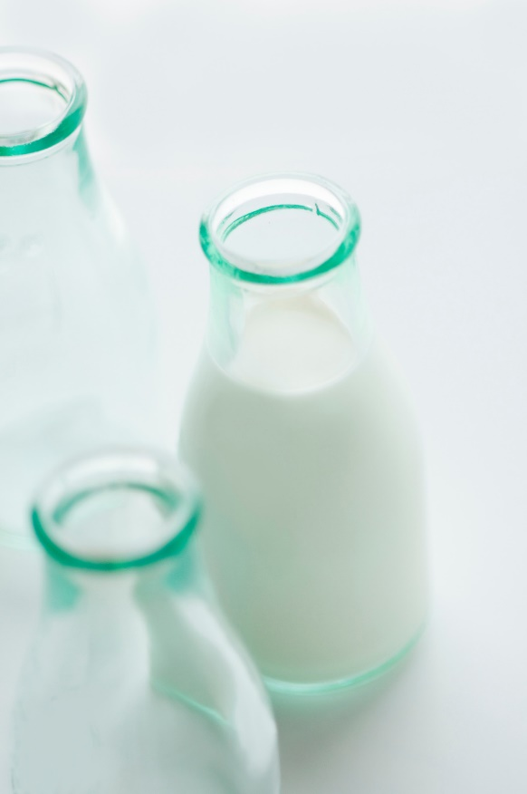
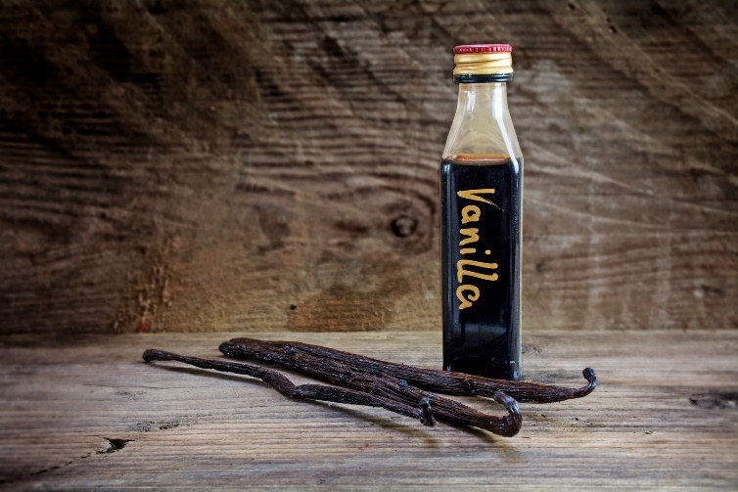
4. Add oil, milk and vanilla extract. Stir with a spoon until combined (do not over stir).

Slide 7
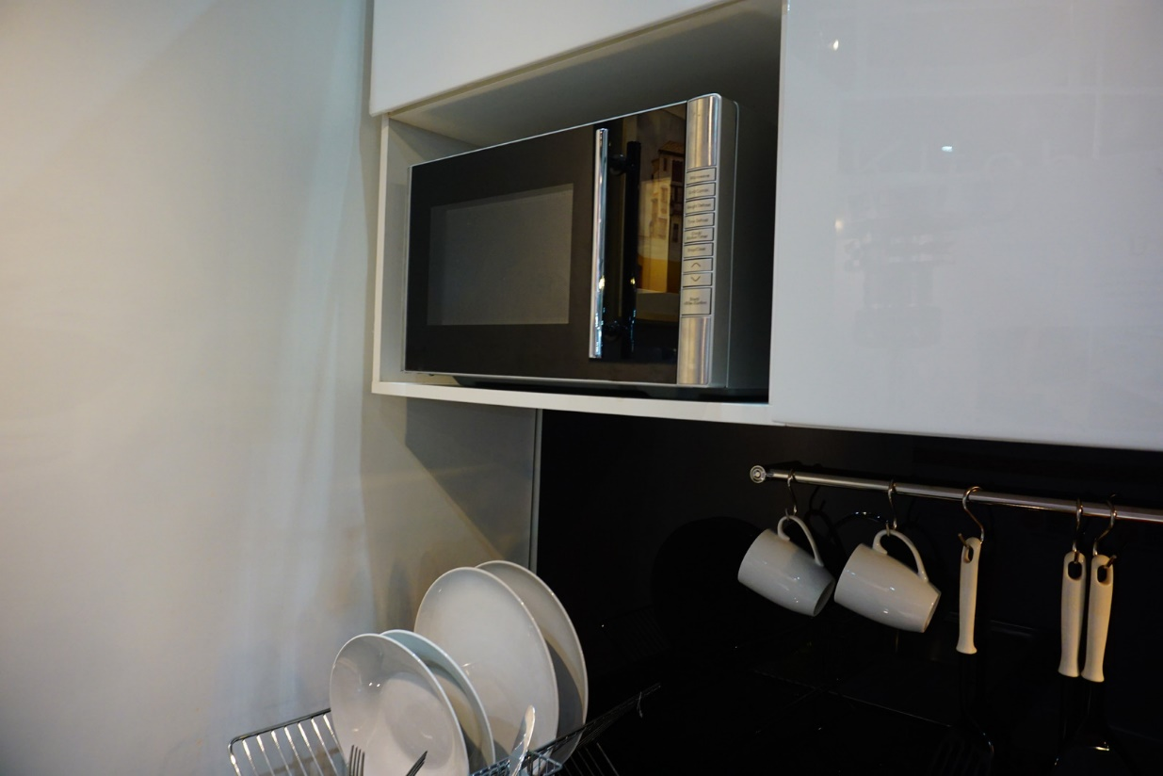
5. Put in the microwave for 90 seconds.

Slide 8
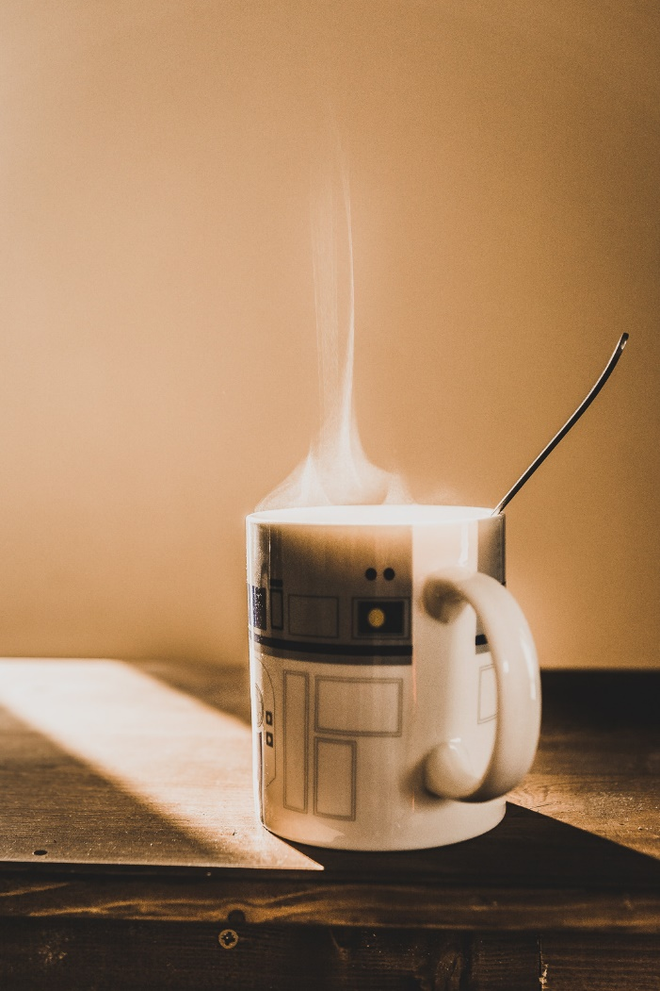
6. Take out of microwave. Be careful, it’s hot!

Slide 9
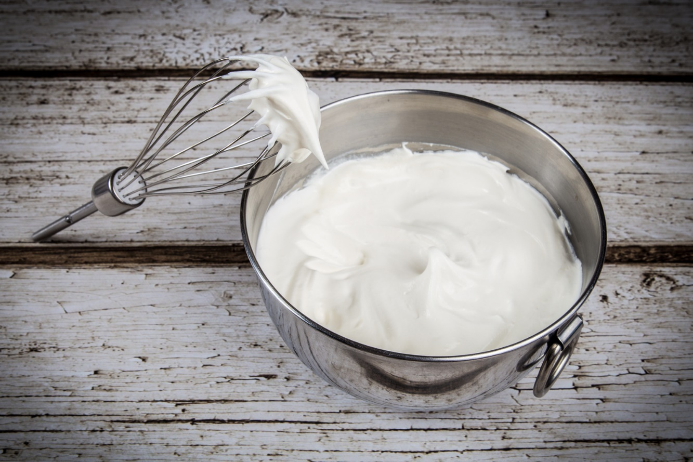
7. Add extras, if you want.

Slide 10
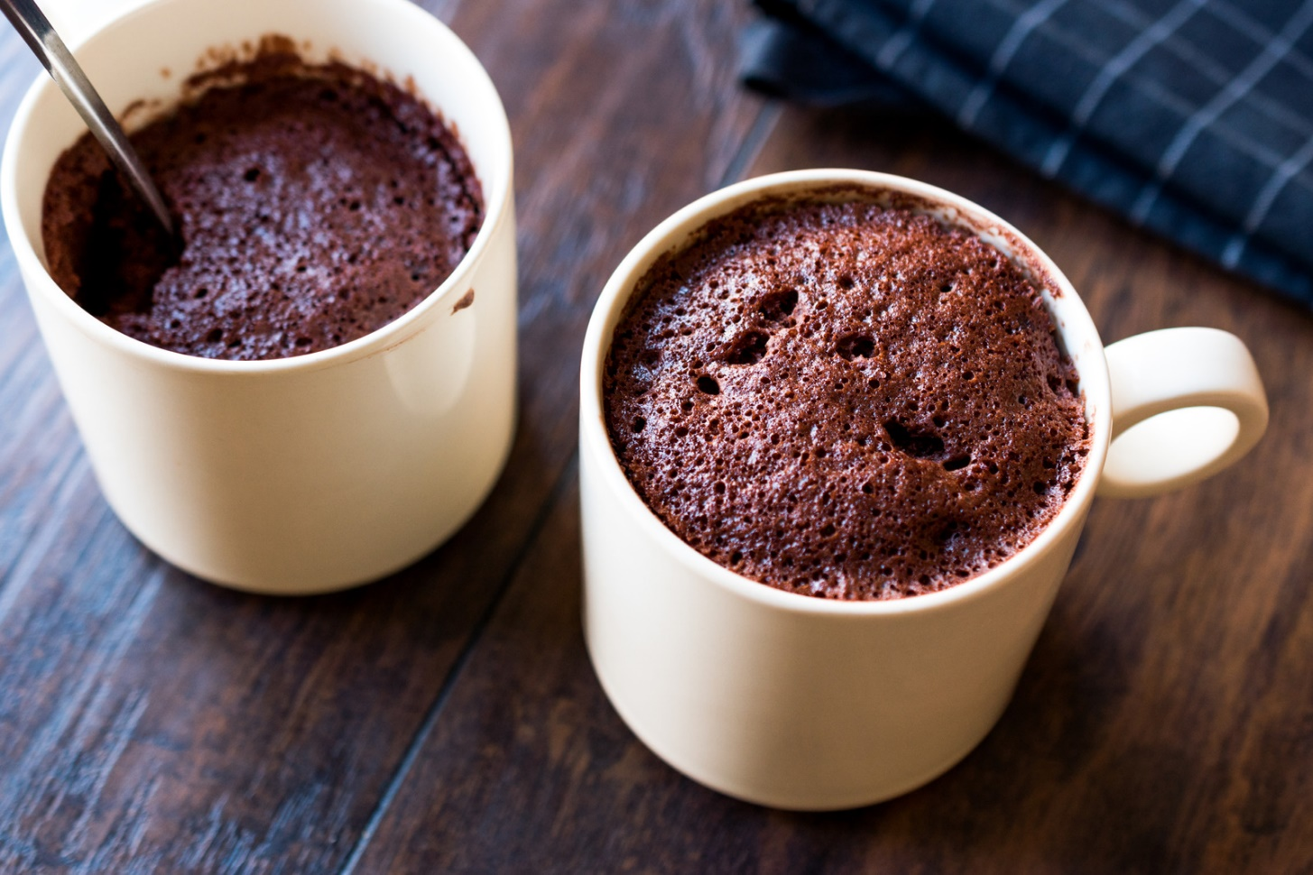
8. Eat and enjoy!!!!

Slide 11
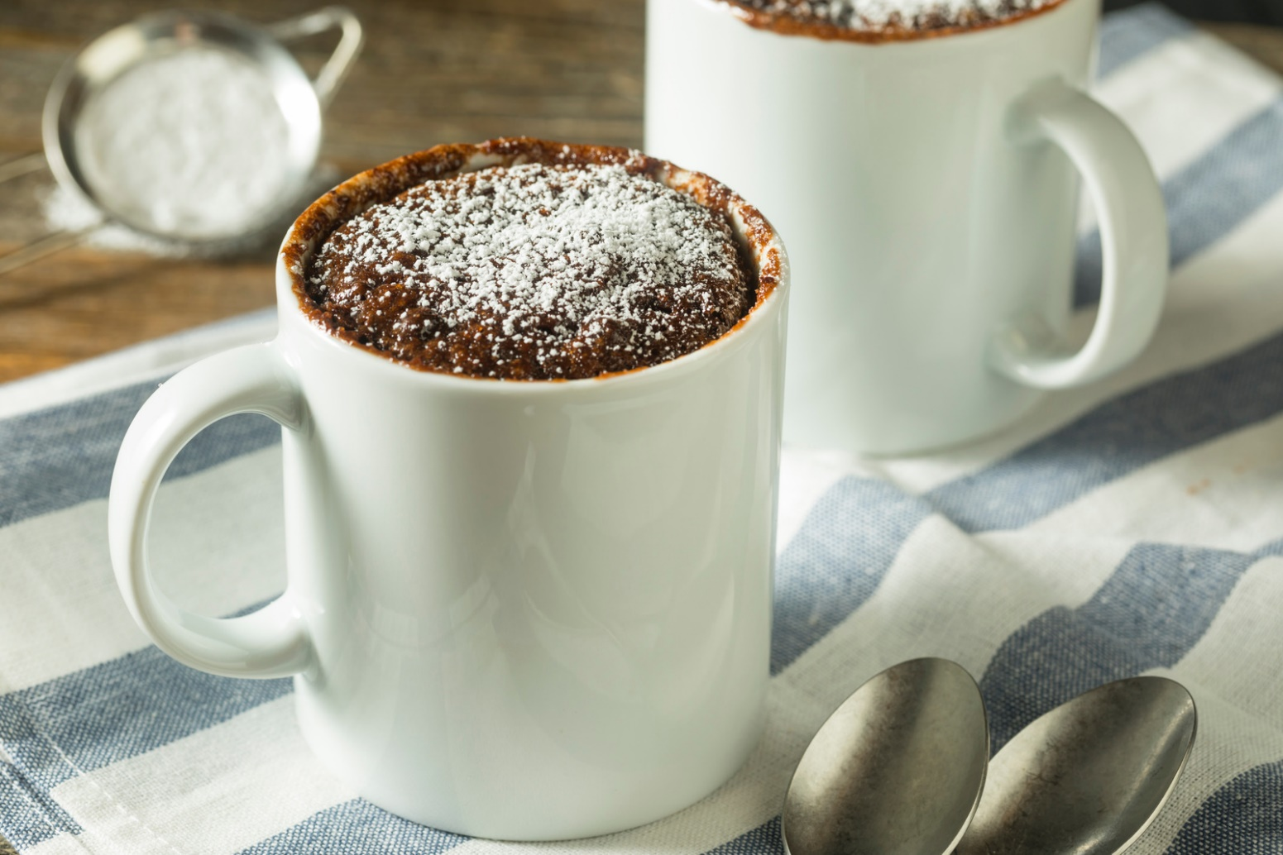
Review: How did you make it? Did you like it?

