Slide 1

Why do this course
Pastoral leadership styles, skills and behaviour

Slide 2
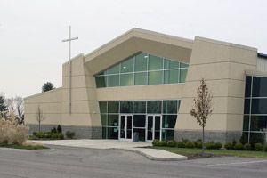
Church life
The structure and pattern of church life stemmed up from the meeting of people

Slide 3
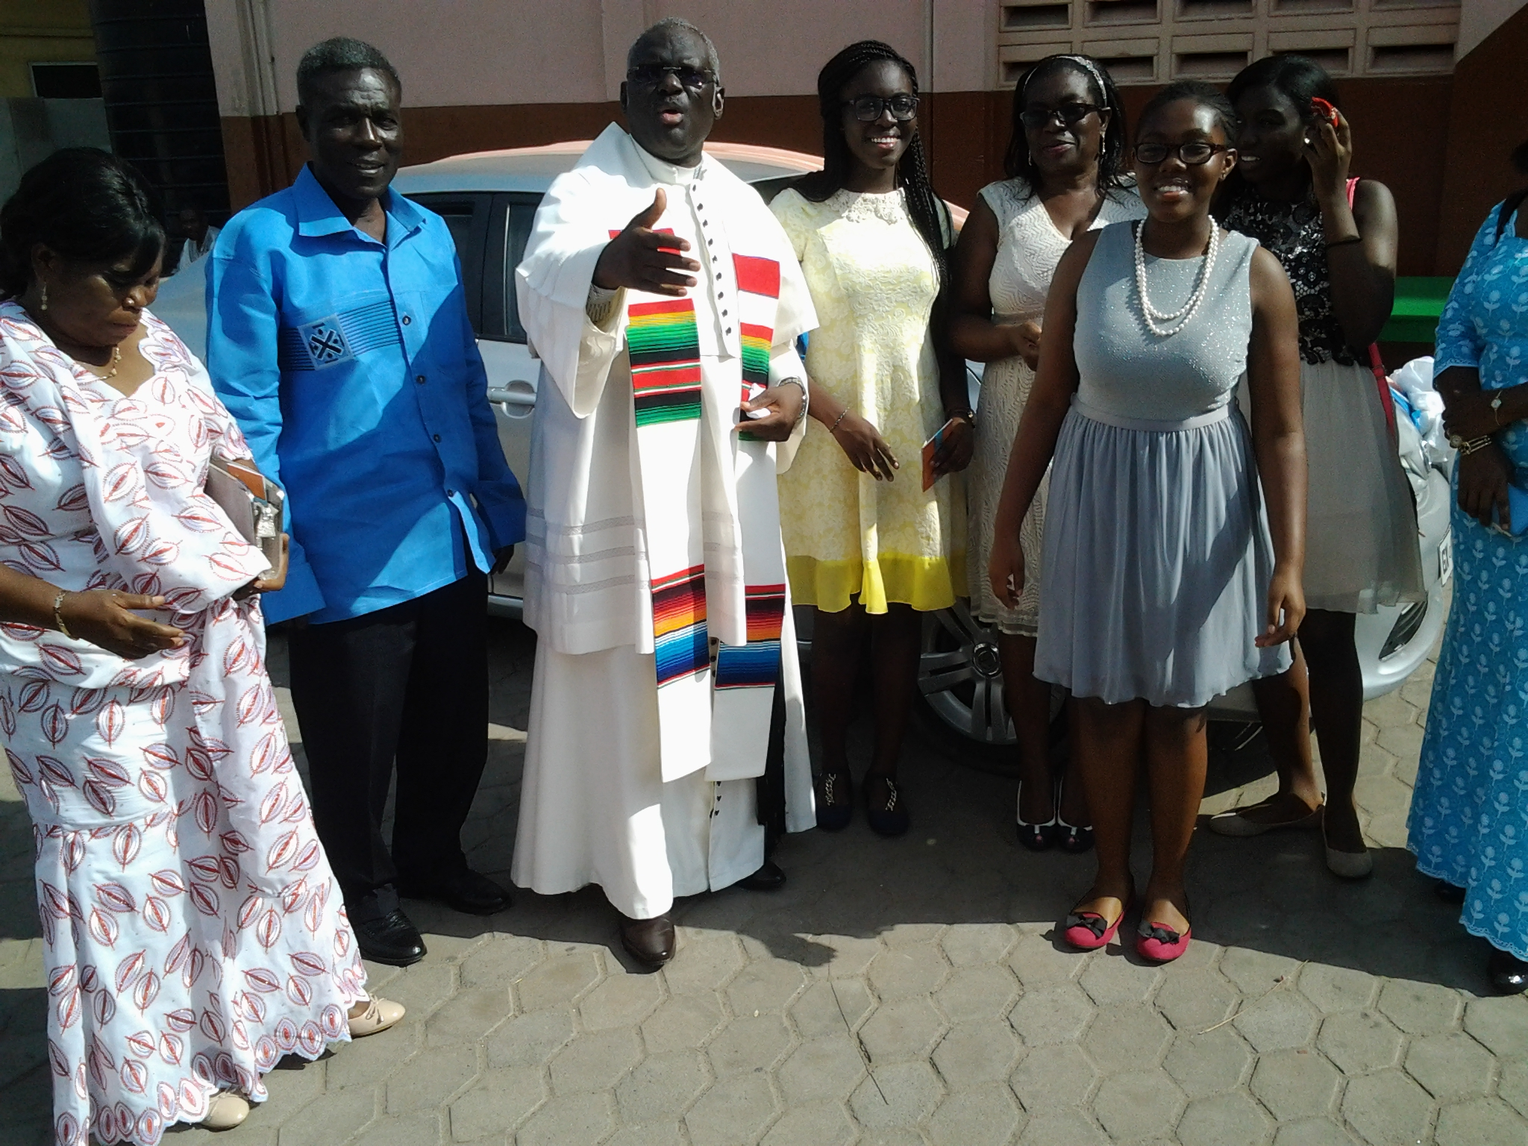
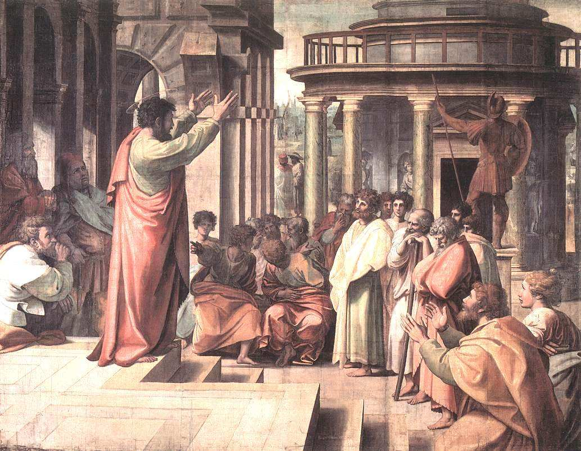
Teaching and fellowship

Slide 4

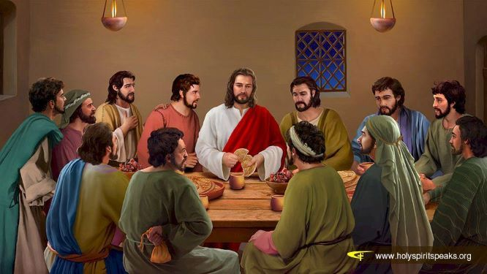
Breaking of bread and
Prayer

Slide 5



Strategic and Transformational leadership
Strategic
transformational
As the vision owner he or she must be able to share the strategic vison with his or her management team.
He or she must play God a bit and see beyond the existing, or the current or the now.
The effective pastor is the one who can appeal to the moral values of followers in order to mobilise them for reforms.

Slide 6


Servant and spiritual leadership
What we will consider include the influencing process that enhances the intrinsic motivation of followers.
There must be transcendence and fellowship.
Servant
Pastoral leadership is one of service and fellowship.
The course will help build your capacity to influence while remaining a servant pastor.
spiritual

Slide 7
ethical and authentic leadership
Leaders must have a high self-awareness about their own values, beliefs, emotions, self-identity and abilities.
The course will help you to understand and apply authentic leadership.
ethical
The knowledge gained in doing this course will help you apply ethics and ensure you and your followers use power wisely and well.
authentic

Slide 8
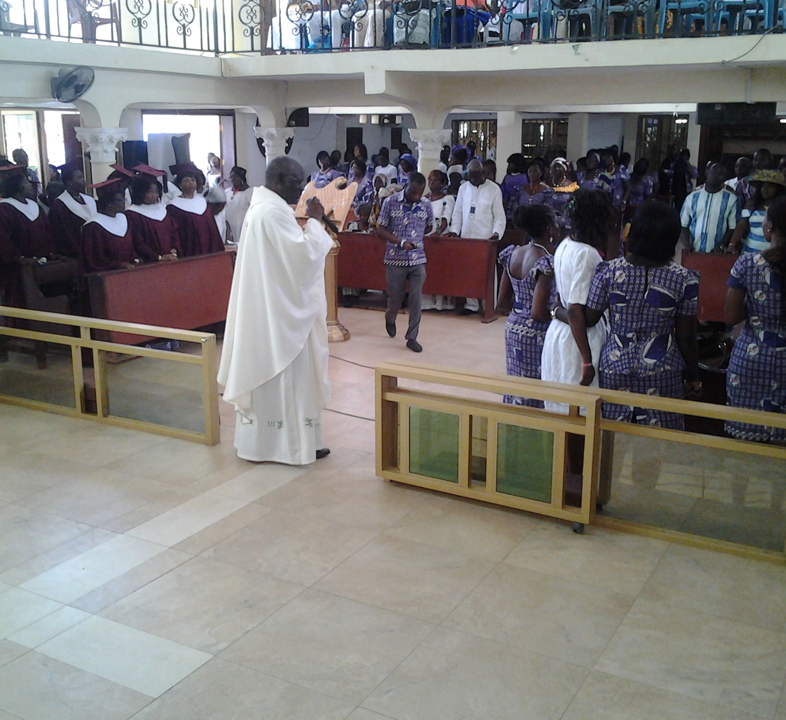
Charismatic leadership
The term charisma is very much used in the church.
According to Weber charisma occurs when a leader can offer a solution to crisis.
Weber asserts that followers then get attracted to believe in the vision of the leader.

Slide 9
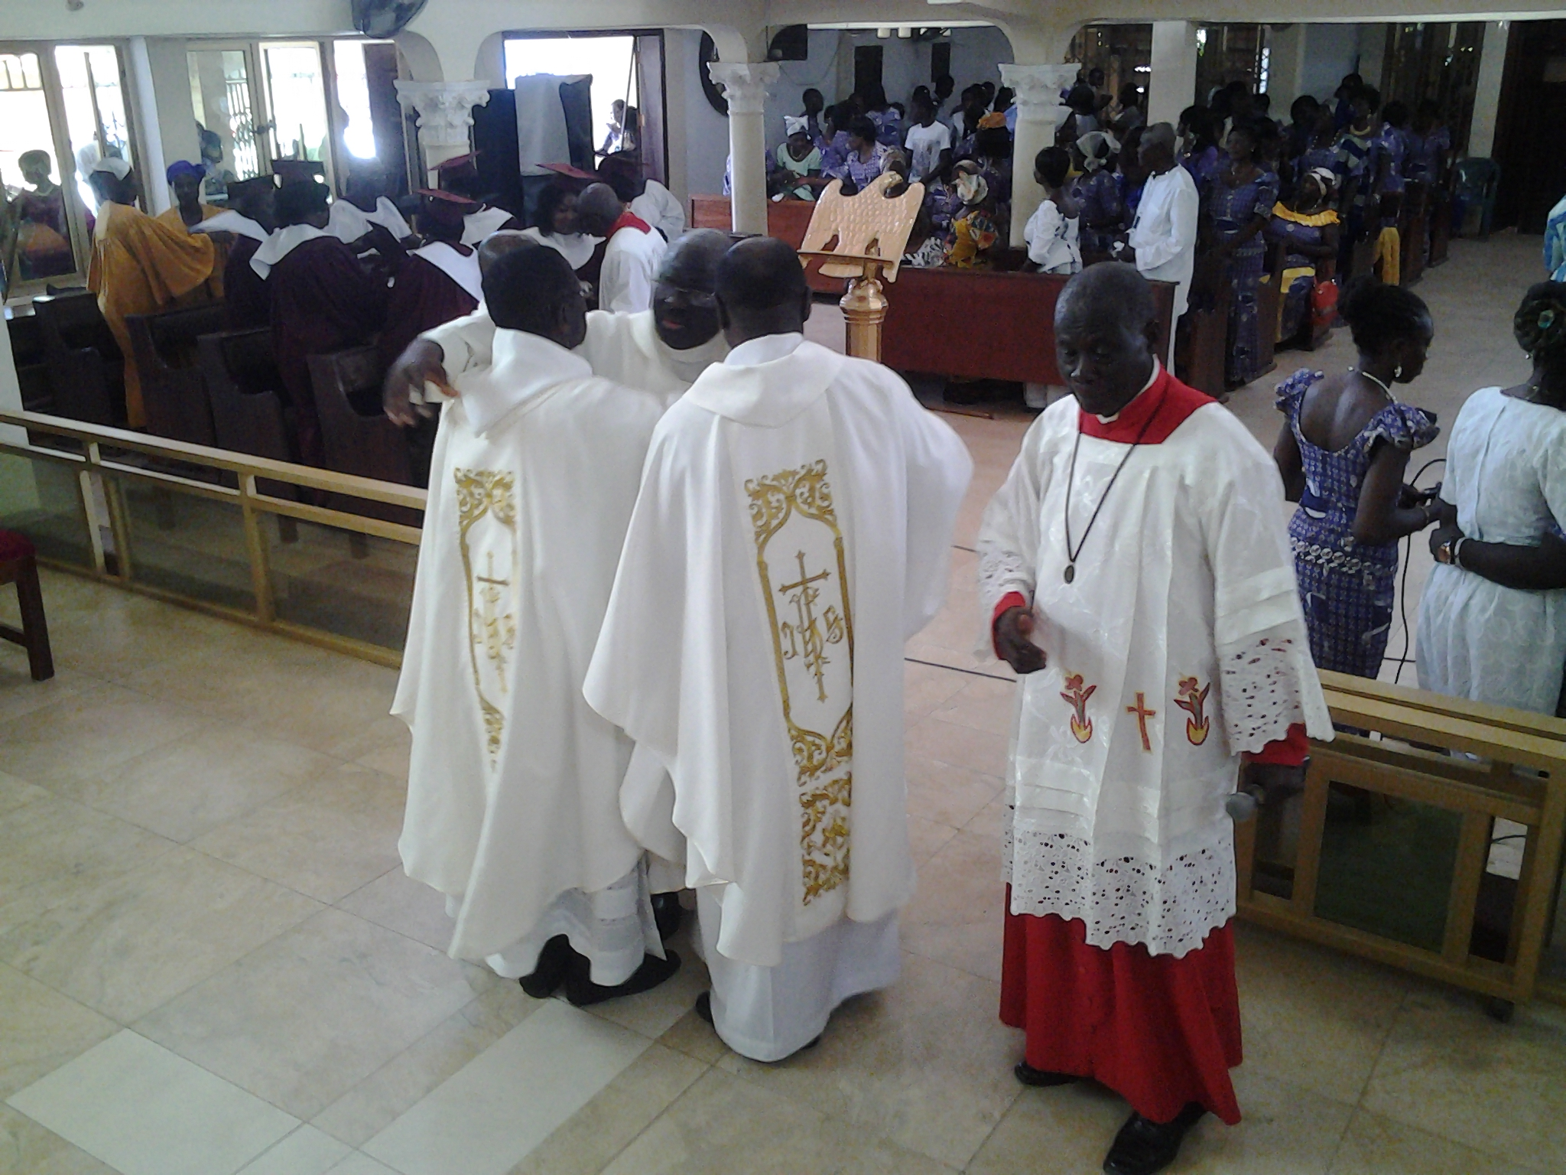
Skills and competencies
Doing this course will make you know what you can do to get your followers attracted to believe in your ideas.
You will become an expert in influencing people for the transformation of your church.

Slide 10
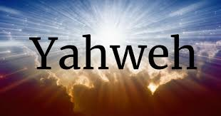
Thank you
revfrmartey@yahoo.co.uk
http://www.holyspiritonlinegh.thinkific.com

