Slide 1

SHADOWWORK
Where there is light, there is darkness
Workshop with Nina
@starseed_yoga

Slide 2

What is the ‘Shadow’?
The shadow is a psychological term for everything we can’t see in ourselves. It is the dark side of our personality because it consists of negative human emotions and impulses like rage, envy, greed, selfishness, desire and the striving for power. The dark side of someone’s personality and what is dark is always known only indirectly through projection, so often behaviour that annoys us about others – Carl Jung
What we deny in ourselves, becomes part of the shadow. Anything we believe to be incompatible with our conscious attitude relegates to this dark side
The personal shadow is basically the disowned self. It represents the parts of us we no longer claim to be our own, including positive qualities
Although we deny them in our attempt to cast them out, we don’t get rid of them. By repressing them, they become part of our unconscious
One does not become enlightened by imagining figures of light, but by making the darkness conscious. – Carl Jung

Slide 3
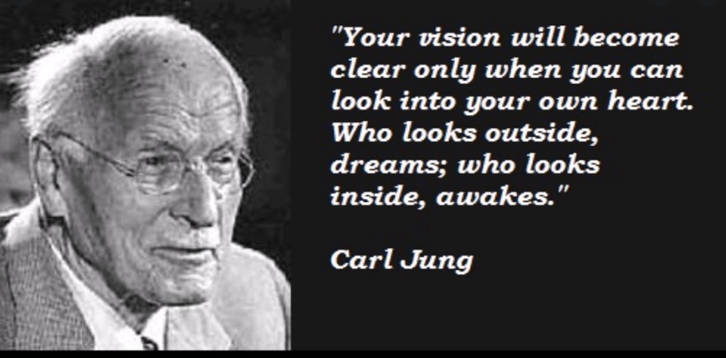
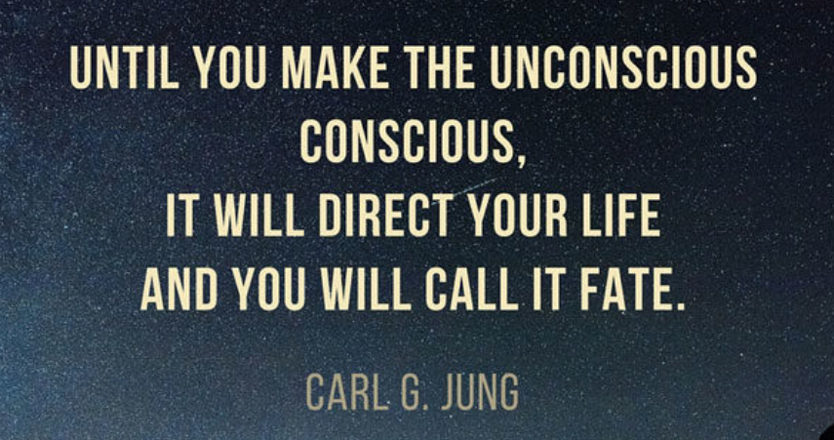
It all started with Carl Jung
Carl Jung was a Swiss Psychotherapist & Psychiatrist who founded analytical psychology
Carl Jung was one of the first to mention the term ‘shadow’ based on his work and his patient findings
He understood that we all have hidden aspects of ourselves, based on human conditioning
His studies and research also showed that these hidden aspects, our shadow aspects, also have light aspects which are no longer accessible by the conscious due to the denial of our shadows
Jungian Psychology also developed the 12 Jungian archetypes (feel free to do more reading on this)

Slide 4
What is Shadow-Work?
Bringing awareness to the hidden and wounded aspects of ourselves that developed through or during trauma and wasn’t looked at when it happened
These aspects were developed in order to protect us and it did at one point. So rather than shaming these parts of ourselves, we reveal them, allow them to be seen, give them love and integrate them.
As we move into this new paradigm and way of being, these aspects (shadows) of ourselves are no longer necessary in the way they used to function before.
We do shadow work so that we can tap into our greatest potential and become the full embodiment of our true selves.

Slide 5
What is Shadow-Work?
The shadow-self is the version of you that gets emotionally triggered and reacts in ways that are not of the true self
These emotions are often anger, jealousy, guilt, victimhood, checking out, and any emotional charge that leads to self-sabotage
The shadow-self desires to stay hidden as often there’s a disassociation with the shadow self
This prevents us from processing and the gift that was supposed to be revealed through the situation before the shadow aspect took over
There’s actually a great gift awaiting you within your shadow self, but it must be brought to light.

Slide 6
Acknowledge
Bring awareness at the moment you are triggered, and observe the emotions that arise within you. Rather than reacting, take yourself away (physically or mentally) and speak to yourself out loud to unravel what needs to be expressed.
It’s important to allow yourself time to express this so you can do so within as well as with whoever is involved.
Accept this part of yourself without judgement, as it is used to functioning that way and give it the love it needs. Accept it.
Take a few moments, deep breaths, walk in nature and perhaps utilize one of your self care practices before continuing on.

Slide 7
De-Identify
Once you’ve taken care of yourself and given the aspect of you what was wounded love and compassion through time and self-care, you are ready to do some introspective work to get to the root cause of what is initiating the triggers.
We invoke a new perspective, as if you are an avatar receiving information when feeling and purposed to transmute it into harmony. Rather than identifying with the emotions as a part of you, you realise they are simply programs and functions.
There is a new way to operate, and you have the choice - if you so choose. We then decide to focus on how we desire to be instead, and thus build the foundation so that we are capable of doing so.

Slide 8
De-Identify: Introspective Work
Time to journal
IDENTIFY THE TOXIC EMOTIONS THAT ARE COMMON AND COME UP FOR YOU. WRITE ABOUT THE WAY YOU USUALLY DEAL WITH IT. LIST EVERYTHING HONESTLY, AND DO NOT JUDGE ANYTHING THAT IS WRITTEN.
Begin to journal:
Emotional Triggers are …
Bonus: A helpful meditation to do is to visualize in your third eye, the scene playing out as a movie and simply observe it without any negative charge.

Slide 9
Subconscious
Now that you know which emotions influence you, we can dive into the sub-conscious.
Emotions often arise from our everyday thoughts. They have energetic charges and form around our auric field.
As they build up, they manifest into beliefs that create external experiences through projection of energy.
Take a moment to remember that you are not your thoughts or beliefs, and you have the ability to change them.
Though they influence your reality, they do not control you. In fact, you train them. Sit with your SELF and bring awareness to your daily thoughts, and how you talk to your inner being. How is your tone, your mood, frequency and acceptance levels?

Slide 10
Subconscious: Introspective Work
Time to journal
Sit with your SELF and bring awareness to your daily thoughts, and how you talk to your inner being. How is your tone, your mood, frequency and acceptance levels?
Begin to journal:
Daily thoughts and beliefs are…
Bonus: A helpful exercise is to visualize yourself in a sphere of golden light when unwanted thoughts arise with intention to clear them from your being and your auric field.
Everything we shut our eyes to, everything we run away from, everything we deny, denigrate, or despise, serves to defeat us in the end. What seems nasty, painful, evil, can become a source of beauty and joy, and strength, if faced with an open mind.

Slide 11
Personal Entrappings: Introspective Work
Time to journal
From the list of your emotions, thoughts and beliefs, let’s explore the sabotages that have formed and been imprinted, and their spectrum of influence. Where are you self-sabotaging, preventing yourself from having your needs met, and staying in victimhood?
TRAPS are ‘I don’t have enough’, ‘I am not good enough’
NEEDS are love, compassion, resources, safety, support, relationship, community, self recognition, being seen by others, passion, purpose, authentic expression
Begin to journal:
WRITE OUT any unmet needs and how you can alter and supplement things in your life to meet yourself.

Slide 12
Rewrite YOUR story: Introspective Work
Time to journal
Now that we have tracked daily surfacing thoughts and how they have manufactured belief systems within us, it is time to dismantle them. Bring awareness to the past stories that come up attached to these functions and rewrite the story. Choose an alternative ending. It is not over, for you are the continuously breathing embodiment of all. Let go of the stories that no longer serve you and embrace and repurpose the ones that gifted you new tools. Locate the positive message and growth derived from these chapters and send them gratitude.
Begin to journal:
REWRITE YOUR STORY: What happened or perhaps what did you take from past stories from the view of this higher self-perspective?
BONUS: Visualize with creativity, a new story to your personal movie. Rewriting the past not by bypassing but by repurposing the happenings. Simple shifts redefine worlds.

Slide 13
The Ego: Connecting with the Ego
In identifying the unmet needs of self and how they circulate in relation to the thoughts and beliefs, we can now look to the functionality of the Ego.
The Ego is the one responsible for instructing the shadow aspects and holds a tight grip on its standing.
The purpose is not to kill or destroy the ego, but more to dismantle the parts of it that operate out of distortion and alchemize its functions to work in harmony with the being.

Slide 14
Connecting with your Ego: Introspective Work
Time to journal
Take a moment to identify where your Ego likes to hold you back from your greatness or true emotion, or where it likes to control, hurt, or perform out of pride.
JOURNAL:
Have a conversation with your Ego and ask the following questions:
Are these functions serving us?
Does it feel good to operate this way?
Would we prefer to operate differently? How so?
What fears lie underneath these reactions?
How can we supplement new habits so that we don’t feel the need to react or project or retract in such a way?

Slide 15
Re-Patterning: Introspective Work
Now that we have revealed all, it is time to begin implementing new patterns. We do so with intention, repetition, and trust. It is necessary to be consistent in reframing and retraining, as the old functions hold familiarity, and the system is shifting into a new energetic movement and rhythm.
Take up a journaling practice or a verbal chanting ritual where you affirm new positive beliefs into your field. You can begin by affirming what you want to call more of in, or by identifying what you fear you lack, and affirming the opposite of it.
JOURNAL: Personal affirmations, I AM statements or personal mantras
Bonus: Meditation is another POWERFUL way to retrain your nervous and reactive system, as well as access and connect with the deep inner source within you.
Binaural beats are also extremely effective in helping to rewire inner neurological circuitry and can be found on Youtube.

Slide 16
Visualisation
With these divine and unique affirmations, chants and new belief system foundations, we can step into our multi-dimensional selves and begin visualization.
Visualization is a powerful way to create desired realities by experiencing them before they happen.
Take a moment to sit with yourself, and envision the things you wish to experience and feel. Not only material objects, but the actual emotions that will truly satisfy you. You can stay general, and imagine all situations in your life working out best case scenario, and if you are clear on exactly what you want GET DETAILED.
When you imagine, intentionally excite yourself as if they are already happening. Move energy through your body and be GRATEFUL for the manifestation. Experience what you wish and it shall be SO.

Slide 17
Completion Decree: Read out loud
I open up to allow the release of all negative patterning within my being that does not serve me.
I call back and reclaim my personal power from all time, space, realms, dimensions, incarnations, people, places, ideas and stories. I complete all inharmonious situations, stories, contracts and agreements in this moment now, with gratitude, forgiveness and contentment.
I allow all personal and ancestral patterns of lack, abuse, neglect and co-dependency from all lineages to be released and forgiven now. I release all negative and toxic energies that encourage me to neglect or abuse, from my subconscious, conscious, energetic and physical bodies of self. I allow myself to be fully cleared and cleansed of all lower versions of self, and shifted into this higher state of awareness that I have chosen.
And within this moment, I declare that I am completely free from any ties and cords that kept me bound to my past lower versions. I am liberated into sovereignty. I open up to allow my new perspectives, re-written stories, and affirmation rituals to shift and restructure the functioning of my inner and outer being.
I acknowledge and give gratitude for my wholeness, safety, fulfilment, abundance, joy and inspiration, as my new consistent experiences and the theme of my reality.
I attract and create blissful experiences that benefit me as a whole. I declare that this rings true for all moments across all time + space dimensions. I acknowledge this to be the weavings of my new me. And so it is.

