Slide 1
Scoliosis, Yoga Therapy & the Art of Letting Go
By Rachel Krentzman PT,
E-RYT, C-IAYT

Slide 2
“All Life is Yoga” – Sri Aurobindo
How can we approach Scoliosis from a Yoga Therapy perspective?
Find the ‘ease’ instead of ‘fighting’ the body.
Respect the organic nature of body.
Approach Yoga as an Act of Kindness to Self.
Remove obstacles to balance.
Notes:
Yoga Therapy – means not just asana to normalize curve, but an entire approach to scoliosis that incorporates all 8 limbs
Emphasize acceptance and love for self.
Guide the body towards balance, avoid attitude of aggression and forcing.

Slide 3
The Ten Step Approach
Release muscular tension
Address imbalance in your hips and pelvis
Find your mountain pose
Strengthen the convex side
Lengthen the concave side
Create length and symmetry
Traction your spine
Practice acceptance and surrender
Quiet your mind
Rest when you need it

Slide 4
Anatomy of the Curve
Functional vs. Structural Scoliosis
C Curve vs. S Curve
Thoracic vs. Lumbar as the primary curve
Right vs. Left – naming the curve
Understand the rotational component in Scoliosis
Shortened and tight muscles (concave side) vs. overstretched and weak muscles (convex side)

Slide 5
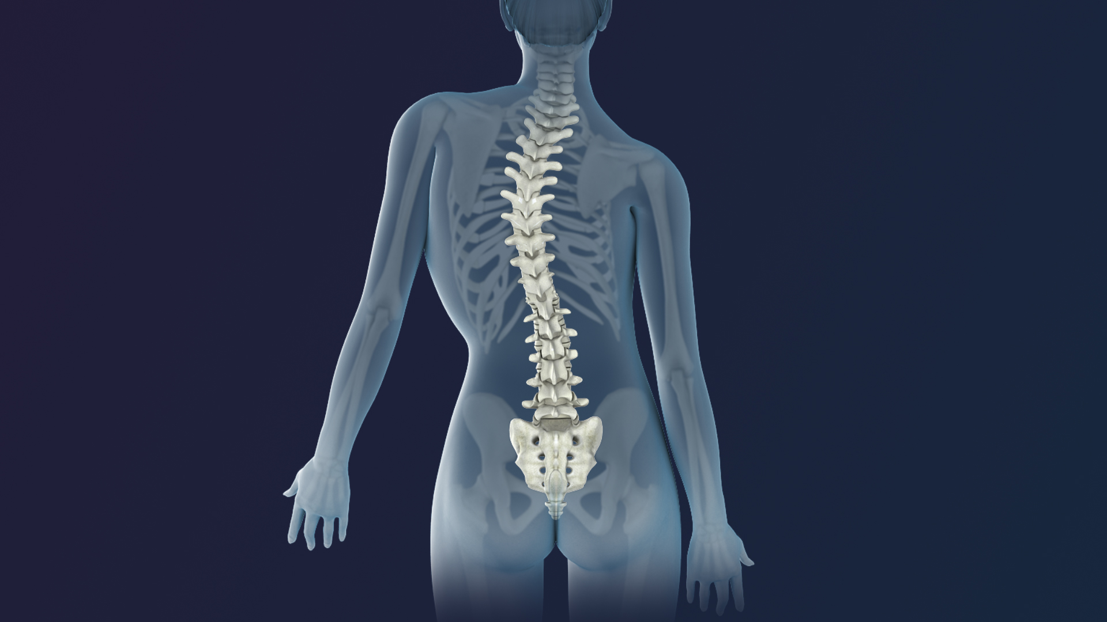
Clinical Presentation
One shoulder higher than the other
Difference in distance of arm to waist
Rib hump on convex side
Rotation of spine towards convex side
Pevic assymmetry

Slide 6
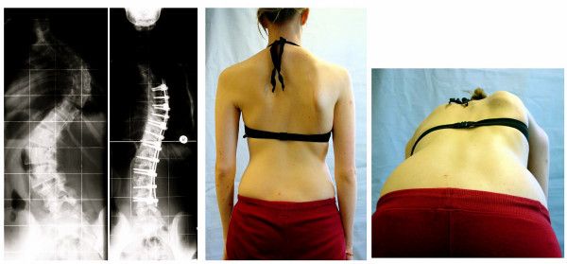
Right thoracic left lumbar scoliosis

Slide 7
Releasing Muscular Tension The Purna Yoga Morning Series

Slide 8
Morning series (cont’d)

Slide 9
Iliopsoas Release
Internal Rotation (Duryodhanasana)

Slide 10
Strengthen the Convex Side
Fishman et al. (2014) –average 32% improvement of Cobb angle
Vasisthasana (side plank) 1-1.5 min. 5-7 days a week for 6 months

Slide 11
Side Plank Variations

Slide 12
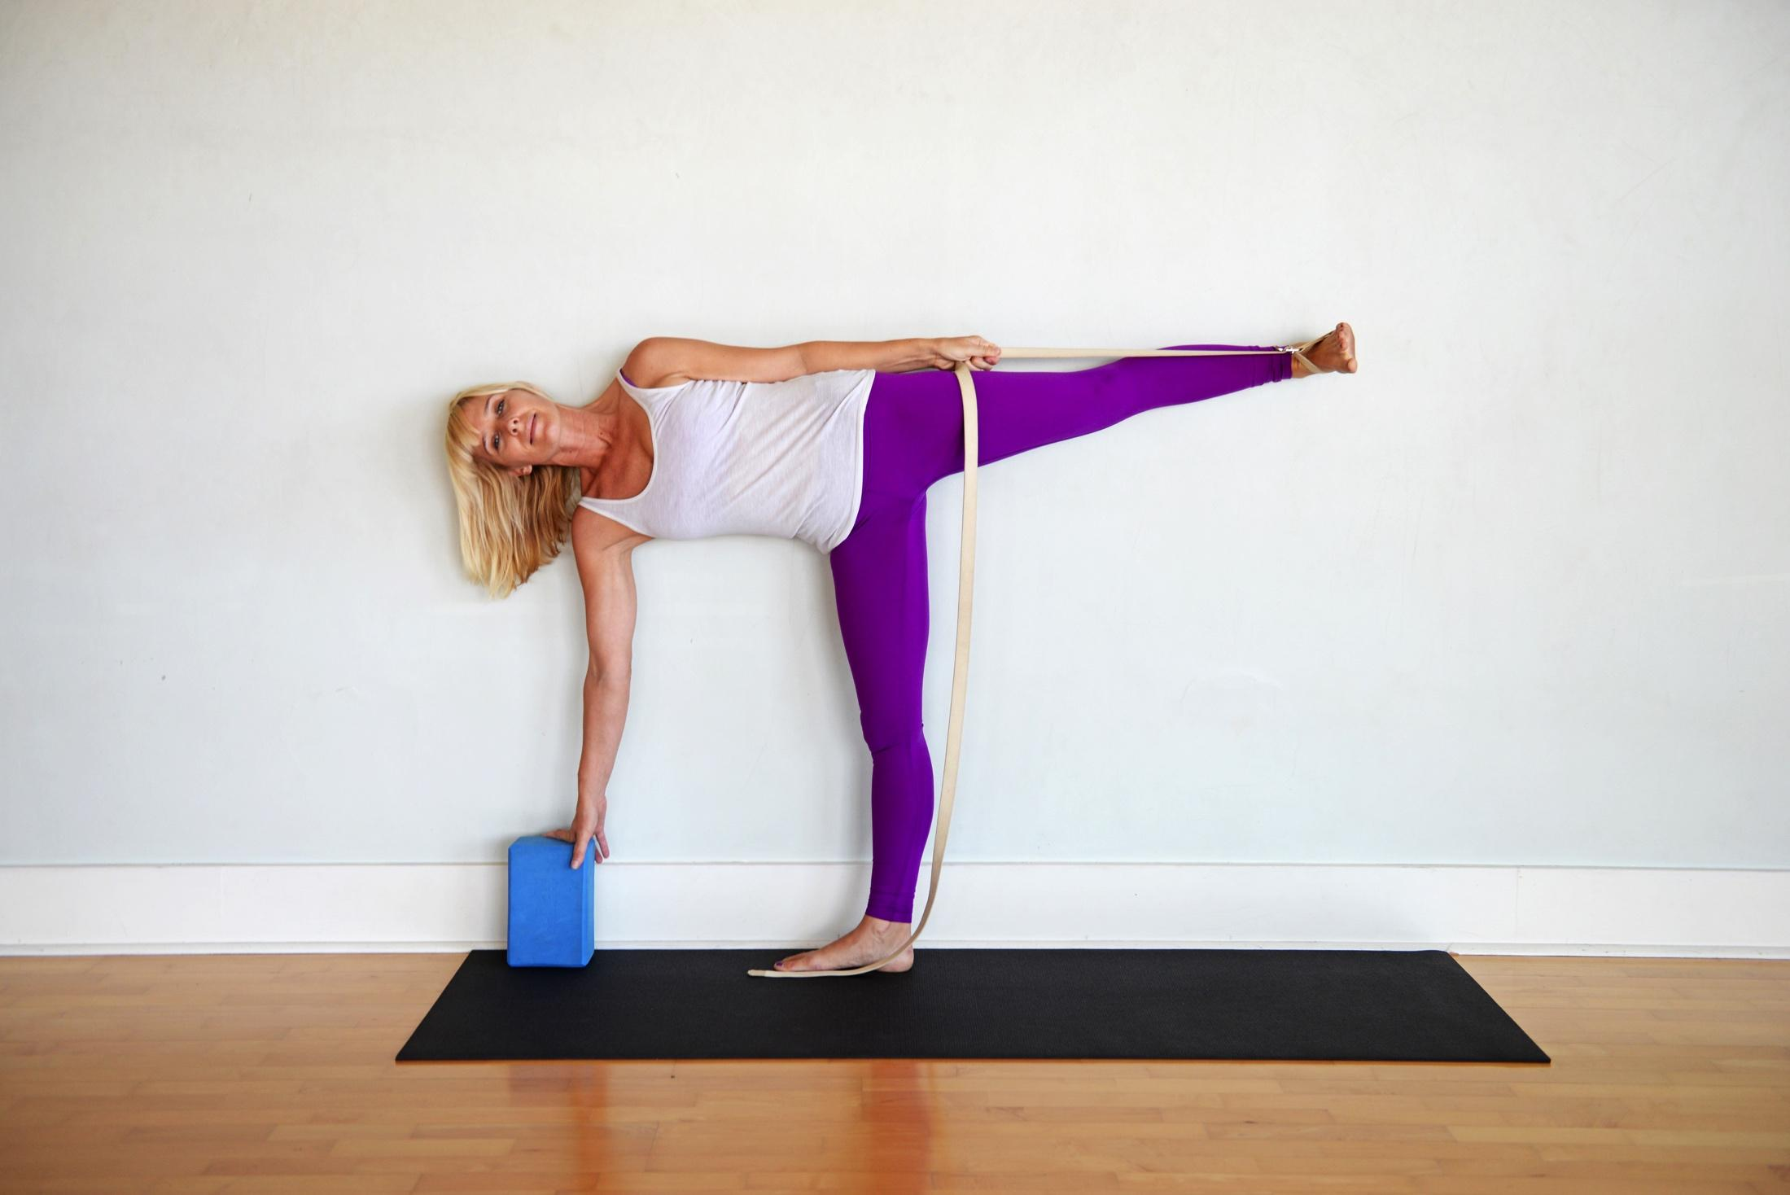
Ardha Chandrasana (Half Moon Pose)
2 methods for contracting the convex side of the curve

Slide 13
Lengthening the Concave Side – Lateral Flexion with Contralateral Rotation
Need to work assymmetrically with scoliosis

Slide 14
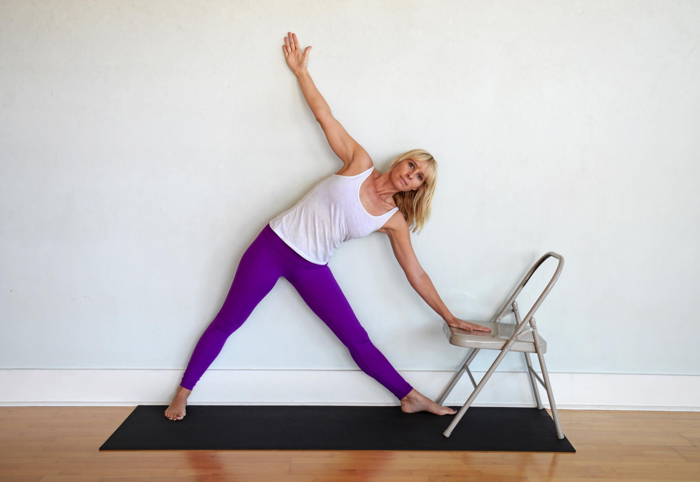
Trikonasana for right scoliosis

Slide 15
Creating Length and Symmetry

Slide 16
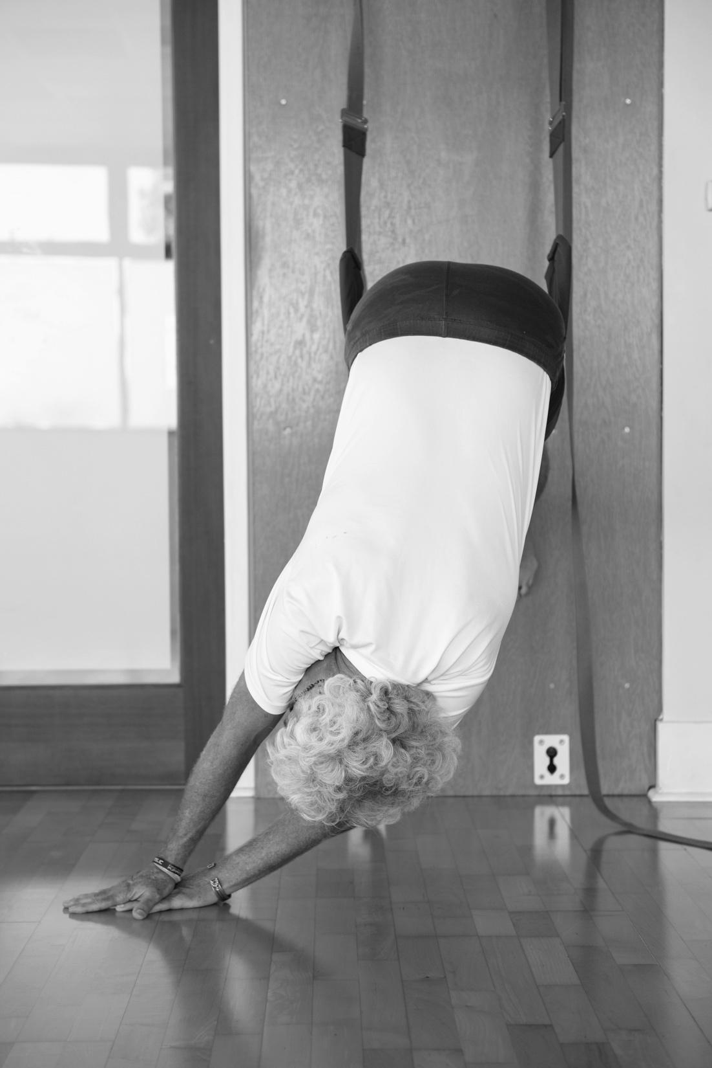
Spinal Traction with lateral flexion

Slide 17
Pranayama and Meditation
“The key to letting go of physical tension is finding a way to be accepting of your body in its current state with an attitude of loving kindness.”
- from Scoliosis, Yoga Therapy & the Art of Letting Go

Slide 18
Pranayama & Meditation
Diaphragmatic Breathing – supine and sitting
Three Part Breathing with expansion into limited rib cage
Mental and Pelvic Centering – coming back to the Heart Center

Slide 19
www.happybackyoga.com rachel@happybackyoga.com

