Slide 1
How to Take Care of Your Tablet

Slide 2
A tablet is a small, flat computer that is operated by touching the screen. They are bigger than cell phones but smaller than a regular laptop.

Slide 3
A tablet allows people to access the internet, check email, watch videos, take pictures, listen to music, and more!

Slide 4
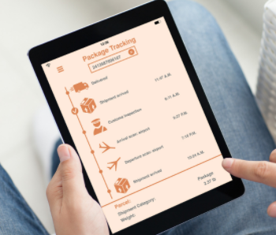
Tablets also allow us to use programs called apps (or applications). What kind of apps do you know?

Slide 5
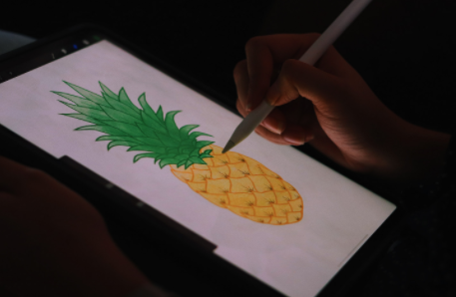
Tablets can also be used with a keyboard or stylus (similar to a pen but has no ink). Most tablets are touch screen and are controlled by finger tips.

Slide 6
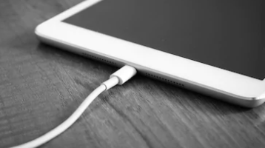
It is important to take care of your tablet to prolong it’s use.

Slide 7
It is your tablet and your responsibility. You need to keep track of where it is and take care of it.

Slide 8
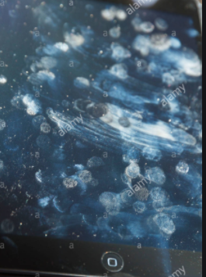
Always make sure your hands are clean when using your tablet, to prevent making the screen dirty.

Slide 9
Do not leave your tablet in direct sunlight or in excessive heat for long periods of time. You should also keep it out of extreme cold as well.

Slide 10
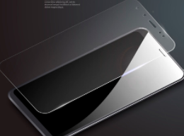
Protect your display screen. Get a screen cover or regularly wipe it with a soft, lint free cloth to protect it and keep it clean.

Slide 11
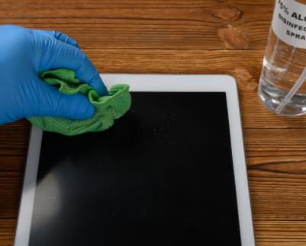
If your screen is very dirty and needs to be sprayed, you should use a specific, special cleaning agent for tablets. Follow those directions closely.

Slide 12
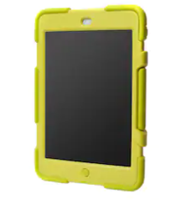
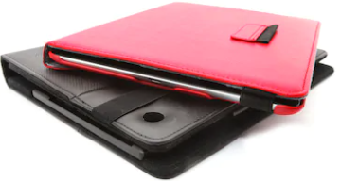
You should keep your tablet in a case. This protects it in case it’s dropped.

Slide 13
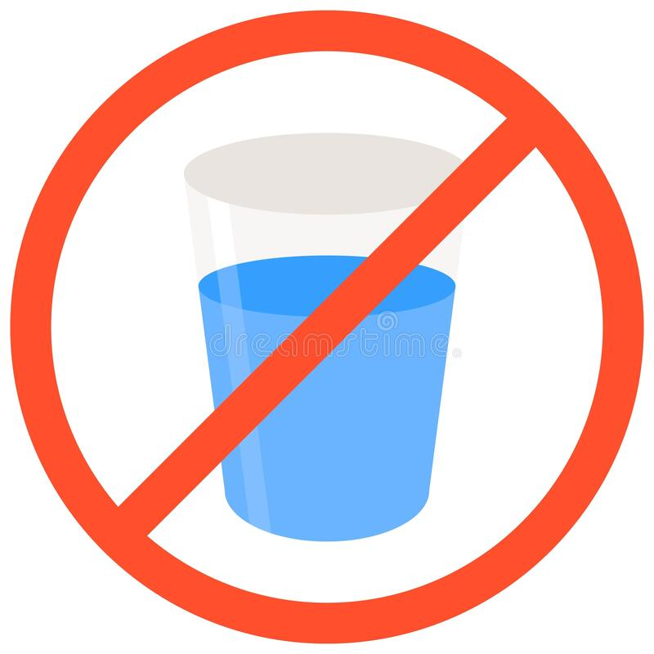
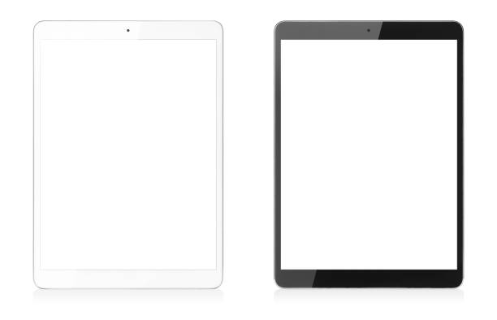
Keep your tablet away from water.

Slide 14
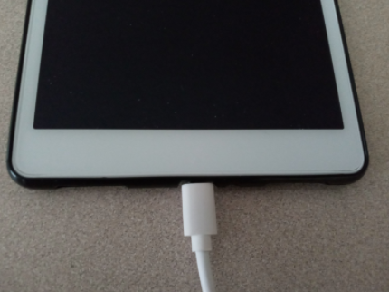
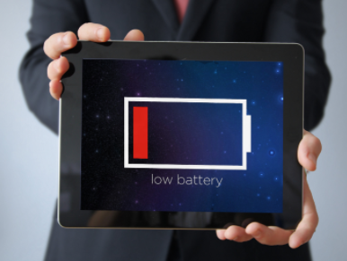
Be sure to pay attention to the battery life in case it needs to get charged. It’s a good idea to charge your tablet at night so it is ready to use in the morning.

Slide 15
Update your tablet when necessary. Updates make sure your tablet is up to date by fixing bugs and making software improvements.

Slide 16
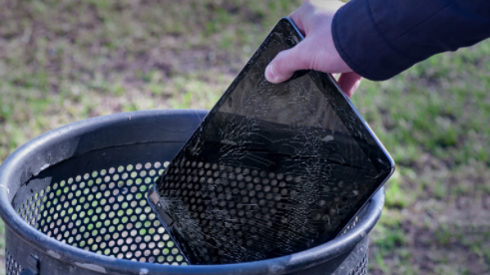
Don’t put anything on your tablet or use it as a table. Don’t’ throw your tablet.

Slide 17
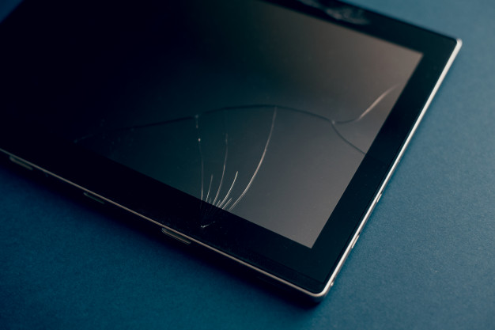
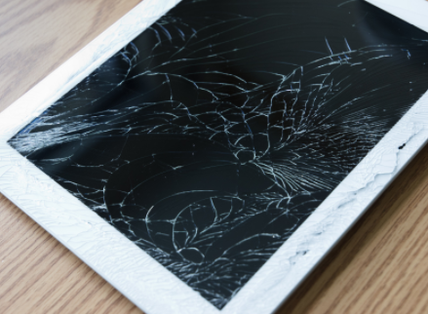
If you’re tablet breaks or the screen cracks, be sure to take it to a store to see if it can be repaired.

Slide 18
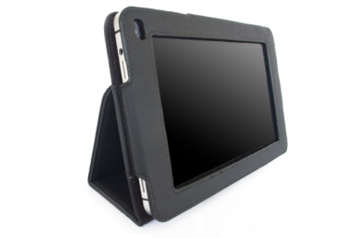
Take good care of your tablet! The better care you take of it, the longer it will last.

Slide 19
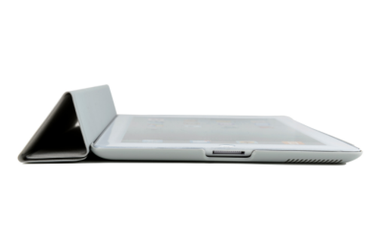
Review: How do you take care of your tablet?

