Slide 1
Job Costing and Construction Accounting in QuickBooks Online (Plus/Advanced)

Slide 2
About Presenter
Hector Garcia, CPA
Advanced QuickBooks ProAdvisor & QuickBooks Solution Provider
Principal @ Quick Bookkeeping LLC in Miami, FL
YouTube Channel: https://www.youtube.com/user/QuickBookkeepingLLC/
Consulting Inquiries & QuickBooks Software Sales 954-414-1524
hector@garciacpa.com

Slide 3
Upcoming Episodes
04/18/2019 – Job Costing and Construction Accounting in QuickBooks Online (Plus/Advanced)
05/16/2019 – Inventory Management in QuickBooks Online (Plus/Advanced)
06/20/2019 – Real Estate Accounting in QuickBooks Online (Plus/Advanced)
07/18/2019 – QuickBooks Online Payroll Deep Dive (Essentials/Plus/Advanced)
08/15/2019 – QuickBooks Online for Legal Professionals / Law Firms (Plus/Advanced)
09/19/2019 – QuickBooks Online Advanced User Permissions (Advanced)
10/17/2019 – Class, Locations, and Customer:Project Reporting Deep Dive in QuickBooks Online (Plus/Advanced)
11/21/2019 – Importing Transactions into QuickBooks Online (Plus/Advanced + Apps)
12/19/2019 – QuickBooks Online Bank Feeds all Editions (Advanced Tips/Tricks)
01/16/2020 – QuickBooks Online Advanced/Custom Reporting (Plus/Advanced)
02/20/2020 – QuickBooks Online for E-Commerce Business (Essentials/Plus/Advanced)
03/19/2020 – QuickBooks Online for Retail/Restaurant Businesses (Plus/Advanced)

Slide 4
About ADVANCEDWEBINARSTM
ADVANCEDWEBINARS is a brand by Hector Garcia, CPA as a platform to deliver multiple educational webinar and webinar series
The first webinar series is on “QuickBooks Online Advanced Training” which will be 2-hours long 1pm to 3pm, every 3rd Thursday, starting 4/18/2019, episodes scheduled through 03/19/2020

Slide 5
About ADVANCEDWEBINARSTM
This webinar will be FREE to attend live (limited to 500 attendees – so login early!) via Zoom
There will not be a recording link or a YouTube version of this
Optional Subscription for $500 per year to access recording, presentation slides, and/or other materials via the portal. Subscribers will also be able to request a CPE certificate
More info, go to http://advancedwebinars.com

Slide 6
About ADVANCEDWEBINARSTM
To Subscribe and become a premium member, go to http://advancedwebinars.com Use Coupon: ADV053119 for $200 off, coupon expires 05/31/2019
Or use direct link: https://quickbooks.teachable.com/p/quickbooks-online-advanced-webinars-premium-archive

Slide 7
About ADVANCEDWEBINARSTM
Benefits of becoming a paid member:
You are supporting Hector Garcia to continue to create ADVANCED/PREMIUM content
Unlimited access to recordings (will not be posted to YouTube or available to non-members)
Access slides and/or other resources mentioned in the webinar (if applicable)
Access to ALL of Hector’s premium/paid content available on the Teachable portal
2-hour CPE Certificates per episode available on-demand for paid members only

Slide 8
About ADVANCEDWEBINARSTM
Other series on QuickBooks Desktop/Enterprise, 3rd Party Apps, Excel, Practice Management, etc… will be developed over time. Actively looking for sponsors and/or monetization options… Stay Tuned, Join our Facebook Group called “QuickBooks Power User community” (Formerly “QB Power Hour”): https://www.facebook.com/groups/QBPowerHour/

Slide 9
Table of Contents
Some notable Intuit/QuickBooks News and Updates (10 mins) FEATURE:
Creating Customer and Sub-customers in QuickBooks Online (10 mins)
Creating Projects in QBO (5 mins)
Projects vs. Sub-customers (10 mins)
Creating Estimates and Progress Invoices (15 mins)
Creating Purchase Orders from Estimates (10 mins)
Creating Bills, Check, and Expenses with Job Costing (15 mins)
Using Timesheets for Job/Project Costing when using outside Payroll (20 mins)
Using Built-in payroll for Job/Project costing (20 mins)
Project/Job Related Reports (15 mins)

Slide 10
Polling Question #1

Slide 11
Intuit/QuickBooks Updates (Q1 2019)
QBO SS/Essentials/Plus - Usage limits: 250+ Accounts, 40+ Class/Locations, and/or 6+ Users will Require QuickBooks Online Advanced (to be implemented through 2019)
QBO Plus/Advanced: Late Fee Charges for overdue invoices (BETA)
QBO Plus/Advanced - Customer, Sub-customer, and Project Profitability with Payroll
QBO Plus/Advanced - Project Profitability with Timesheets (when using outside Payroll)
QBO Advanced - Custom Fields with in header and transaction lines (with dropdown menu options)
QBO Advanced - Custom User Permissions (limiting some access to specific users)
QBO Advanced - Importing Invoices from CSV
QBO Advanced - Batch Invoicing “Multiple Invoicing”

Slide 12
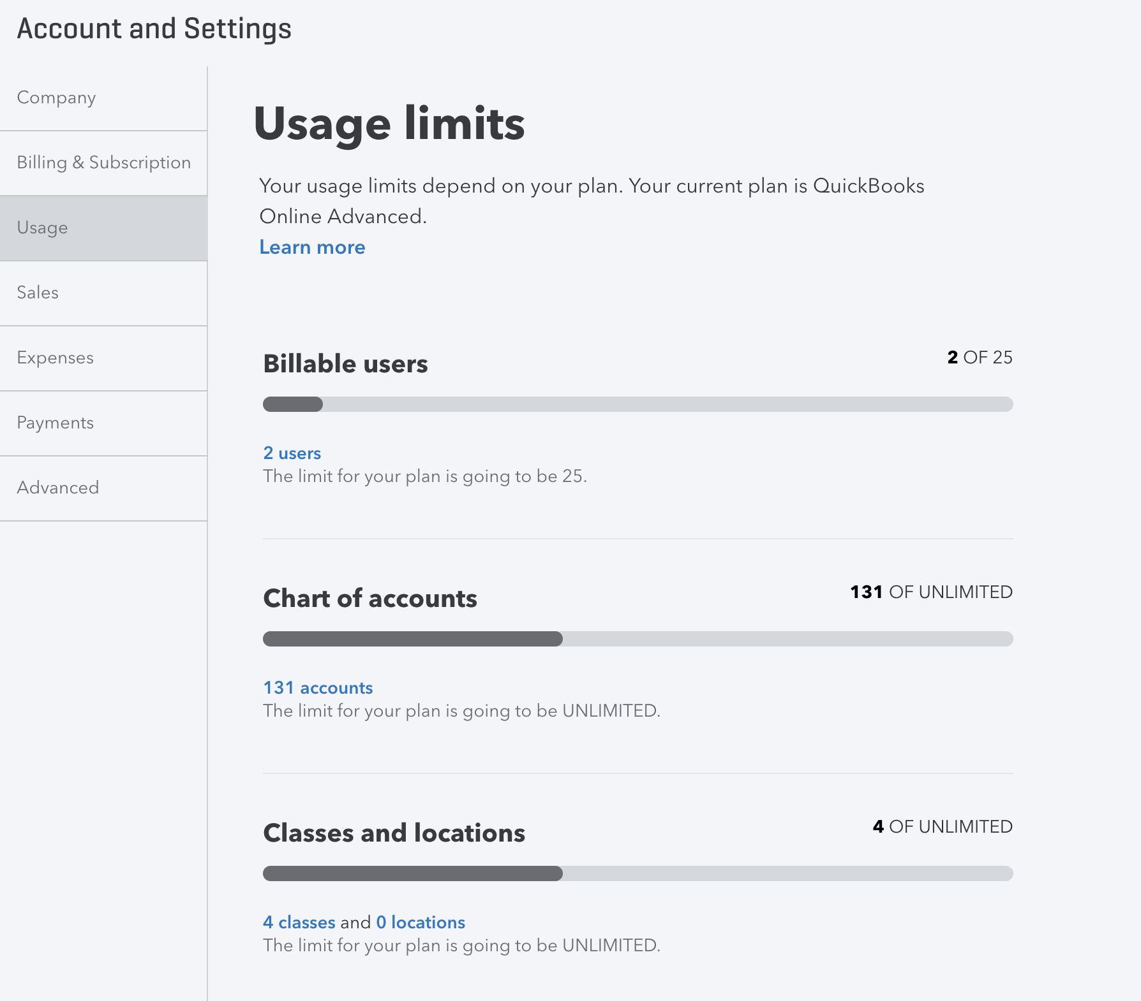
Intuit/QuickBooks Updates (Q1 2019)
Usage Limits

Slide 13
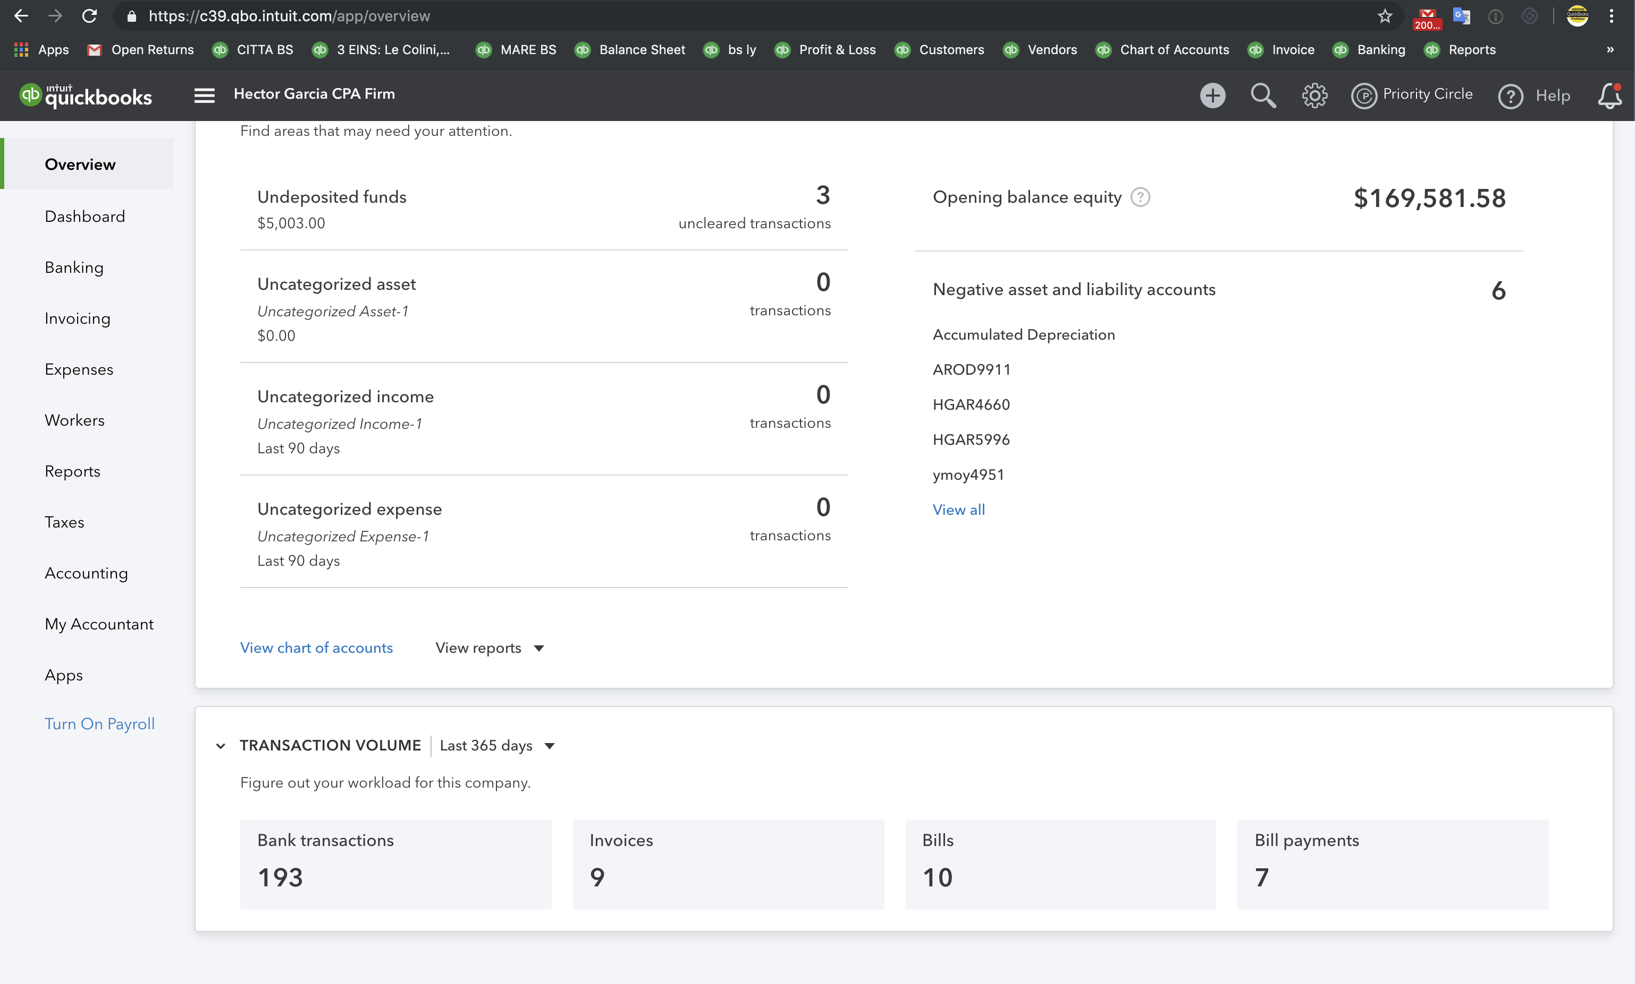
Intuit/QuickBooks Updates (Q1 2019)
For Accountants Only
Usage Overview

Slide 14
Intuit/QuickBooks Updates (Q1 2019)
For ProAdvisors:
Get Re-certified by July 31th , 2019, to avoid being de-listed or lose the Advanced Certification
Moving to annual recertification

Slide 15
Intuit/QuickBooks Updates (Q1 2019)
New QuickBooks Online Test Drive (Demo Company):
https://qbo.intuit.com/redir/testdrive_us_advanced

Slide 16
Webinar Date / Features Disclaimer
This webinar was recorded LIVE on 04/18/2019. All comments about features available and/or not available in QuickBooks Online is within the context of the webinar date. Intuit adds new features almost monthly, so stay tuned for monthly announcements!

Slide 17
Creating Customers and Sub-Customers
When converting from QB Desktop, Jobs come in as “Sub-customers” NOT projects
Projects must be created one by one, there is no importing feature for projects
Sub-customers can be used for different billing address, but avoid using Sub-customers as Projects/Jobs, once Projects feature is turned on
A Sub-customer can have the same name as Project, so it could lend itself to confusion!

Slide 18
Polling Question #1

Slide 19
In-Product Demo

Slide 20
Questions/Comments?
hector@garciacpa.com

