Slide 1
Antenna Types

Slide 2
Different Types of Antennas

Slide 3
Two Main Types of Antennas
In your certification and even for the most part in real world scenarios, depending on your job, you will encounter the following:
Omnidirectional
Directional
Always keep in mind the radiation pattern of your antenna, will determine the outcome of your wireless network.
Meaning, will all my devices be reachable

Slide 4
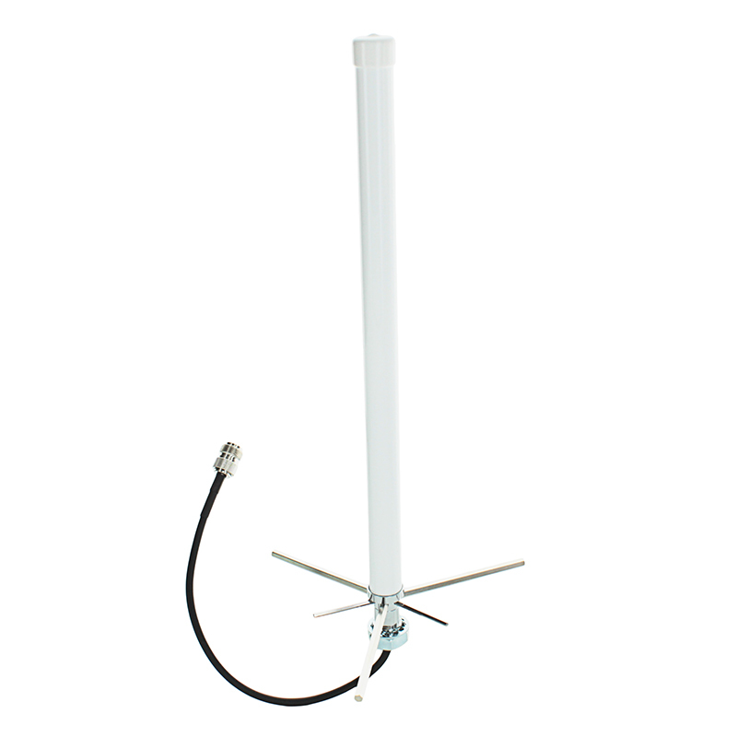
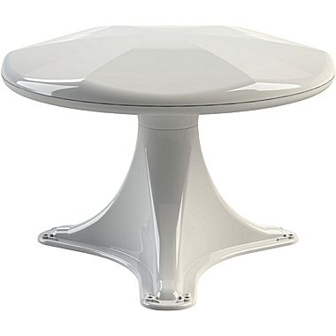
Omni-Directional Antennas

Slide 5
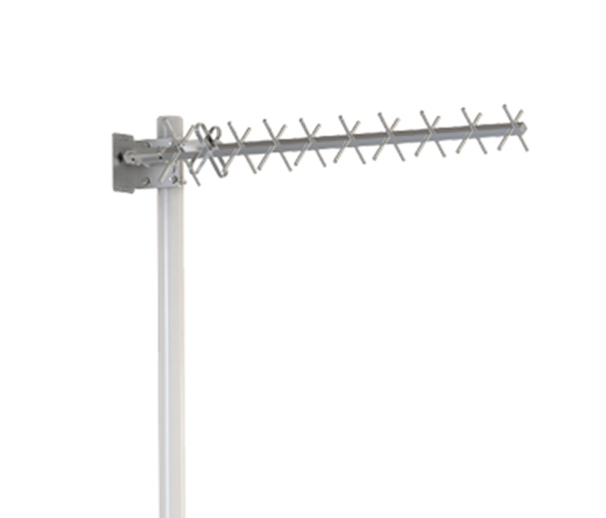
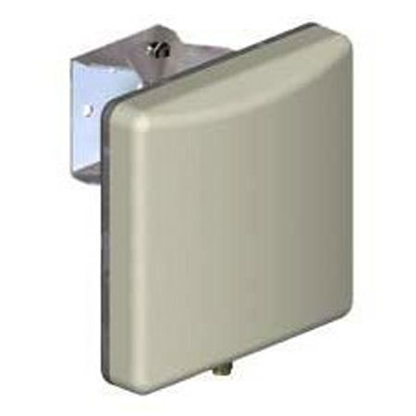
Directional Antennas

