Slide 1
FLM Training
Level 2 Award in Mental Health Awareness

Slide 2
Qualification Structure
Unit 1 – Mental Health Awareness
This will be assessed by way of an online exam through the AIQ Cirrus
platform.
Unit 2 – Mental Health First Aid
This unit is assessed through a separate exam from that of unit 1, again using the Cirrus online platform.

Slide 3
Qualification Overview
Unit 1
This unit will provide learners with an understanding and awareness of mental health, common mental health disorders and issues, and to encourage people to talk about mental health.
Unit 2
Furthermore, this unit should provide learners with the ability to apply their knowledge of mental health through recognising and responding to the signs of mental ill health in themselves and others and be able to offer mental health first aid to people experiencing mental ill health.

Slide 4

Learning Outcomes:
By the end of the session, you will be able to:
Understand mental health
Understand mental health disorders
Understand the main risk factors associated with mental ill health
Understand common treatments and the support and advice available for mental ill health

Slide 5
What is Mental Health?
According to the World Health Organisation, ‘health is a state of complete physical, mental and social well being and not merely the absence of disease or illness’.
‘Mental health is the emotional and spiritual resilience which enables us to enjoy life and survive pain, disappointment and sadness. It is a positive sense of well being and an underlying belief in our own and others dignity and worth’. Health Education Authority 1997.

Slide 6
Mental Health
This past two years or so, the pandemic has led to a focus on mental health. In one respect, it has given people more of a work life balance, but on the other hand, it has also increased isolation, bringing on anxiety.
The following question is being asked more: ‘how do we support everyone’s mental health and wellbeing?’

Slide 7
What do you think of when you hear the words ‘mental health’?
If you think of mental illness and conditions such as anxiety, depression and bipolar, you wouldn’t be alone. All too often, we frame mental health as a negative and forget that health is more than just the absence of illness.
Mental Health is always there and can be positive or negative.
Mental illness affects a person’s ability to function over a long period of time.

Slide 8
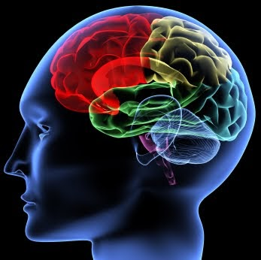
How do you look after your own mental health?
This Photo by Unknown Author is licensed under CC BY-SA-NC

Slide 9
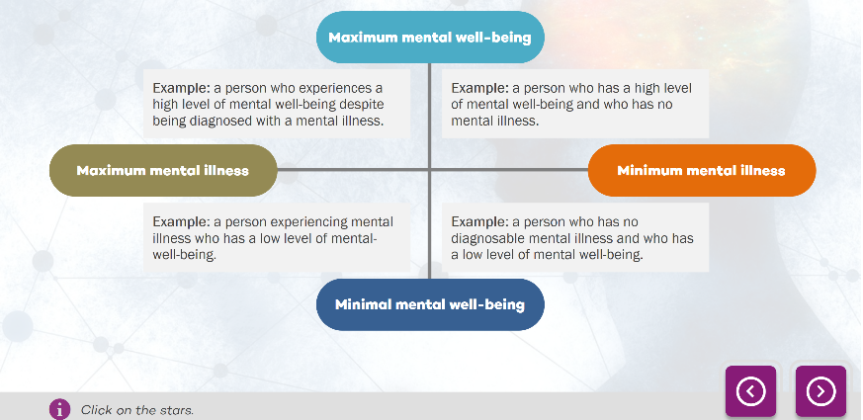
The Mental Health Continuum

Slide 10

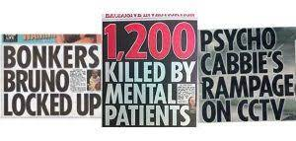
Role of the media in relation to mental health

Slide 11
 | Myth or Fact
1. Mental Health problems are rare
2. One in 4 people experience mental health problems each year
3. You can’t do anything to help someone with mental health problems
4. You can’t recover from mental health problems
5. People with mental health problems are violent
6. People with mental health problems are more likely to be the victims of violence.
7. Mental health problems are a result of bad parenting
8. People with mental health problems can just ‘snap out of it’
9. People with mental illness can’t work
10. Young people just go through ups and downs and puberty, they do not have mental illness

Slide 12
The Duty of Care
A duty of care is the responsibility or obligation of a person or organisation to avoid acts which are likely to cause mental or physical harm to others.
Unless you are legally responsible for the person(s), you have no legal duty of care in such situations, but we should not be fearful of helping. Simply being there for someone, listening to their problems and being able to signpost them to further support is a perfectly good response.

Slide 13
Employers have a legal duty of care to protect the health, safety and well-being of all their employees. The Health and Safety at Work Act (1974) states that as well as having a duty to protect workers from hazards at work, they must be protected from mental health problems.
According to MIND (Fundraiser for Mental Health), as part of an employer’s duty of care, they must have policies in place that promote a mentally healthy workplace and put staff well-being as a priority, tackle work-related mental health problems, and support staff who are distressed. As a result, employers should want to come to work and be able to perform well. A failure to do this is a failure to meet the employer’s duty of care.

Slide 14

Section 2
Awareness of Mental Health Disorders
This Photo by Unknown Author is licensed under CC BY

Slide 15
Stress
Stress is the feeling of being under too much mental or emotional pressure. When you are stressed, your body releases stress hormones such as adrenaline and cortisol.
Stress is your body’s reaction to help you deal with pressure or threats. This is sometimes called a "fight or flight" response.
A small amount of stress can be useful. It can motivate you to act and get tasks completed; it can also make you feel alive and excited.

Slide 16
Depression
Clinical depression and bipolar disorder are examples of mood disorders.
A depressed/low mood or a loss of interest/ pleasure in everyday activities must be experienced for at least two weeks.
In addition to this, at least five more symptoms must also be present (nearly) every day; these symptoms include:
Lack of sleep (insomnia) or too much sleep (hypersomnia).
A change in activity levels.
Loss of energy/fatigue.
Feelings of guilt or worthlessness.
Poor concentration levels, slowed thinking or indecisiveness.
Suicidal thoughts or plans.
Change in weight and/or appetite.

Slide 17

Bipolar Disorder
Manic symptoms of bipolar disorder can include the following:
Feeling happy, excited and/or better about yourself than normal (even when things are not going well).
Having lots of exciting ideas, moving quickly from one idea to another and being easily distracted.
Not being able to or wanting to sleep.
Making big or unusual decisions with little thought.
Engaging in ‘risky’ behaviours, for example:
- spending large amounts of money
- gambling
- using drugs or alcohol.
https://youtu.be/v4zIujG62g4

Slide 18
Anxiety Disorders
Characterised by an excessive fear and worry in relation to a future threat.
Leads to disturbances in behaviour and day-to-day functioning.
A common symptom of many anxiety disorders are panic attacks.
Anxiety disorders can include OCD, PTSD and phobias.
https://youtu.be/g05xSnk9vjs

Slide 19
Phobias
An overwhelming fear which has a negative impact on the person’s day-to-day life and routine.
The person may feel distressed, panicked and anxious if they must encounter their phobia, or even the thought of it may induce such responses.
Specific phobias can relate to an object, animal, situation or activity.
Notes:
Social phobia is social anxiety disorder – avoid social situations, fear of embarrassment, withdraw from social situations

Slide 20
PTSD
PTSD is due to being involved in, or witnessing, a traumatic event. It is commonly associated with war veterans and emergency service workers.
Symptoms of PTSD include:
Flashbacks and/or nightmares about the experience.
Difficulties sleeping.
Feeling ‘unconnected’ from other people.
Avoiding situations that provide a reminder of the event.
Feeling on edge, easily startled and looking out for potential threats.
Ariane Grande & Whoopi Goldberg have been diagnosed with PTSD.
https://youtu.be/2KXtlIX_yUs

Slide 21
Schizophrenia
A psychotic disorder that impacts an individual’s thinking and perceptions.
Symptoms tend to be hearing voices or seeing things that are not real, unusual beliefs and confused thinking.
Schizophrenia does not cause someone to be violent, and people with schizophrenia do not have a split personality.
Notes:
Up 20 yrs less life expectancy, physical effects of mi and side effects of meds. 20% sig improvement, 30% LT recovery

Slide 22
Eating Disorders
Anorexia
The person actively keeps their weight as low as they possibly can.
Severely limiting their food intake and/or exercising excessively with an intense fear of gaining weight.
A lack of recognition of the seriousness of the low weight.
Bulimia
Symptoms include eating very large amounts of food in a short time, often in and out of control way, this is called binge eating, then making yourself vomit, or doing an extreme amount of exercise after a binge to avoid putting on weight.

Slide 23

Addiction and Substance Misuse
A substance is anything which is ingested to affect normal functioning. It may produce a ‘high’ or alter the senses.
An addiction is the loss of control over doing, taking or using something to such an extent that it could become harmful.
Notes:
0.5 million problem gamblers, FOBT – crack cocaine of gambling. Internet addiction disorder (IAD) – use as examples
Over half of people with a substance-related disorder also have the diagnosis of another mental health disorder;
this is most often depression, an anxiety disorder, or a personality disorder.

Slide 24
Signs and symptoms
Financial problems and a change in spending habits.
Relationship problems.
Suspicious movements and keeping secrets.
Difficulties in keeping time and keeping to a routine.
Poor sleep hygiene and diet.
Extreme mood changes, which often include violence, anger, frustration and paranoia.

Slide 25
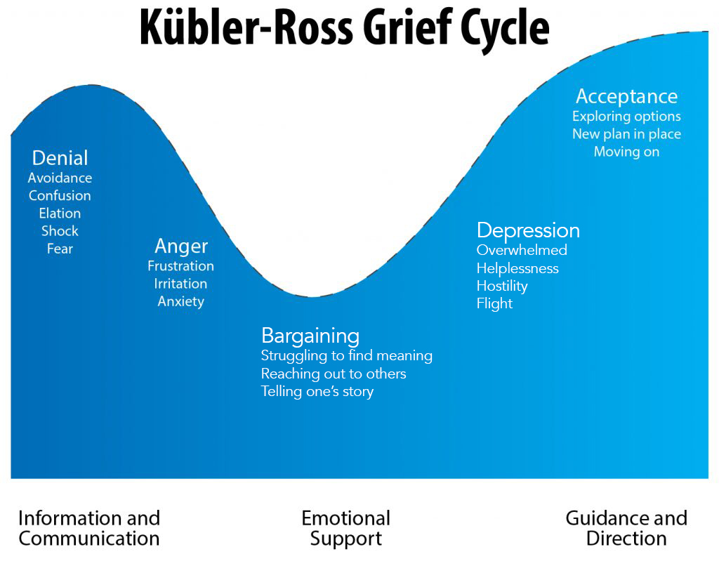
*Bereavement
When grieving, people experience a range of symptoms, which include shock, sadness, despair, guilt and anger. These are all normal when grieving, but if prolonged, then can develop into a mental health problem.
Notes:
A Swiss psychiatrist, Kübler-Ross first introduced her five stage grief model in her book On Death and Dying. Kübler-Ross’ model was based off her work with terminally ill patients and has received much criticism in the years since. Mainly, because people studying her model mistakenly believed this is the specific order in which people grieve and that all people go through all stages. Kübler-Ross now notes that these stages are not linear and some people may not experience any of them. Yet and still, others might only undergo two stages rather than all five, one stage, three stages, etc. It is now more readily known that these five stages of grief are the most commonly observed experienced by the grieving population.

Slide 26
Section 3
Risk Factors Associated with Mental Health

Slide 27
What are Risk Factors?
Risk factors are influences that make it more likely that individuals will develop a mental health problem. They include biological, psychological, or social factors in the individual, family, or community. The more risk factors a person has, the more he/she is at risk for suicide and other self-destructive behaviours, such as substance abuse.

Slide 28
Individual Risk Factors
Mental health problems, including depression, bipolar disorder, and anxiety disorders
Alcohol and other substance use problems
Loss (due to death, relationship, or job)
Feelings of hopelessness, helplessness, or desperation
History of trauma or abuse (e.g. physical, mental, or sexual)
Fascination with death and violence
History of bullying or violence
Confusion or conflict about sexual identity

Slide 29
Family Risk Factors
Family history of suicide
Depressed and/or suicidal parents
Alcoholic and/or drug-addicted parents
Changes in family structure (e.g. death, divorce, remarriage, frequent moves/relocation)
Financial difficulties

Slide 30
Community Risk Factors
Lack of access to helping services
Loss of family, friends, or idols to suicide
Anniversary of someone else’s suicide or other death
Incarceration or loss of freedom; i.e trouble with the law

Slide 31
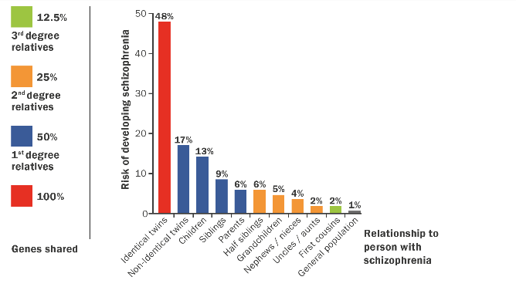
Biological Risk Factors
Genetics:
Twin and family studies such as Gottesman and Shields (1991) have investigated the genetic cause of mental illness.
The research shows evidence for and against this explanation.

Slide 32
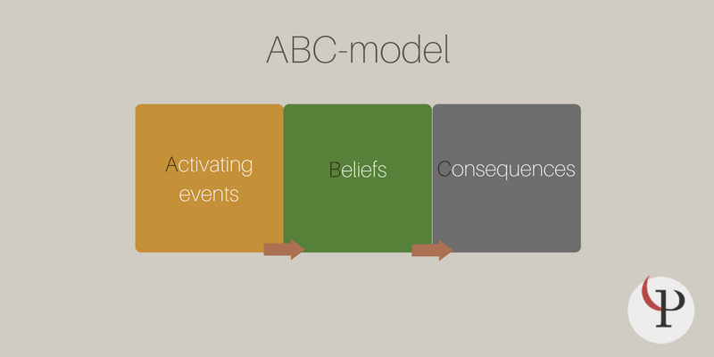
Faulty Thinking
Cognitive Psychologists suggest that mental illness is caused by ‘faulty thinking’
Albert Ellis’s ABC Model

Slide 33
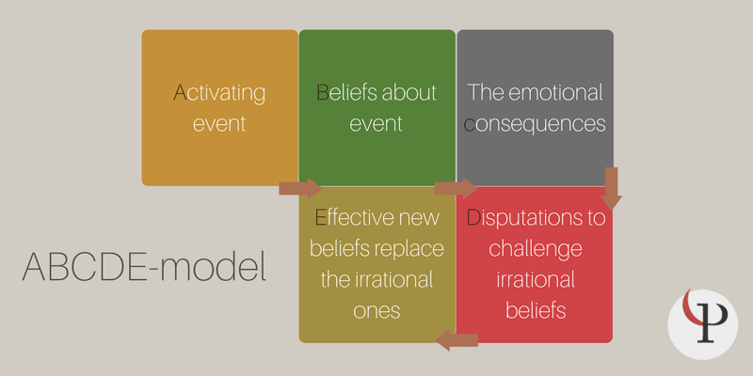

Slide 34
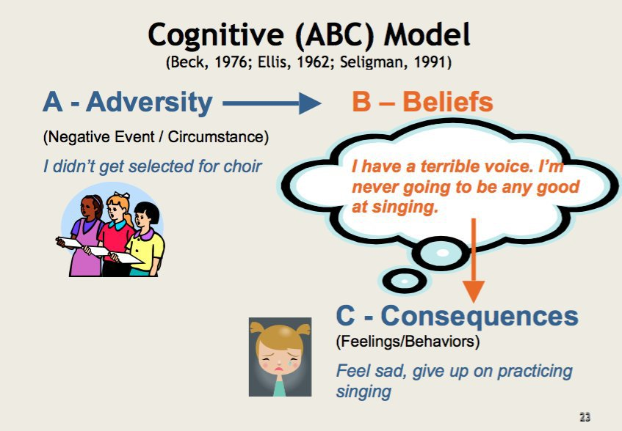

Slide 35
While environmental factors can undoubtedly harm our lives, we do have some control over how we react and respond to those factors. For the most part, the more positively we respond, the more positive our outcomes will be.
This doesn’t mean that no harm can come to someone with a positive attitude, but it does mean that a positive attitude can get someone through rough times quicker and more effectively. Having a positive attitude also does not cost anything, so it cannot hurt to try to keep a positive outlook.

Slide 36




Section 4
Common treatments and understanding the support/advice available for mental ill health
This Photo by Unknown Author is licensed under CC BY-ND

Slide 37
Common treatments
1. Drugs – the most widely biological treatment work under the assumption that there is a chemical imbalance in our brains that affects our thoughts and behaviour.
*Have we heard of dopamine and serotonin?
2. *Psychological treatments - therapy/counsellor/CBT

Slide 38
*Supporting Someone with Mental
Health Issues

Slide 39

*Credible Information
Discuss support options and methods of managing mental health.
Offer to attend appointments with you.
Help with everyday tasks and make suggestions for self-care.
Provide support, encouragement and empathy, and be there to listen to how you are feeling.

Slide 40
Organisations Offering Support Services
GPs: make initial assessment, discusses treatment options and signposts to other services.
Community Mental Health Teams (CMHT): support people with severe and enduring mental health problem to help them to remain living independently within their community. People are normally allocated a ‘key worker’ who coordinates their treatment.
Crisis teams: provide access to support 24 hours a day, usually available via telephone and are sometimes found within A&E departments. The priority being to keep the person safe and to manage their symptoms.
Emergency services: if at risk of harm to self/others.
A&E: if the person has been harmed, keeps them safe.

Slide 41
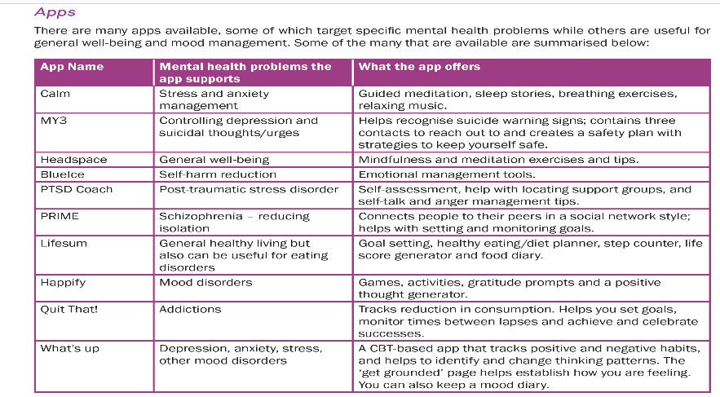
Apps

Slide 42

Further reading
https://www.mentalhealth.org.uk/statistics

Slide 43
Unit One Assessment
The mental health awareness eAssessment consists of 35 knowledge-based questions.
The pass mark is 80% and the time allowed is unlimited.

Slide 44
Review of Learning
You should now be able to:
Understand mental health
Understand mental health disorders
Understand the support and advice available for mental ill health

Slide 45

This Photo by Unknown Author is licensed under CC BY-SA-NC

