Slide 1
The Impact of Child Maltreatment Steven Berkowitz, MD Professor of Psychiatry, University Colorado, School of Medicine Director, Stress, Trauma, Adversity Treatment and Research Center

Slide 2
Objectives
Participants will recognize the range of outcomes associated with child maltreatment
Participants will appreciate child maltreatment’s impact on brain development
Participants will recognize how child maltreatment may be understood through an injury model
Participants will recognize how to manage the emotional issues induced by working with this population

Slide 3
What do we mean by Maltreatment?
Descriptions and effects

Slide 5
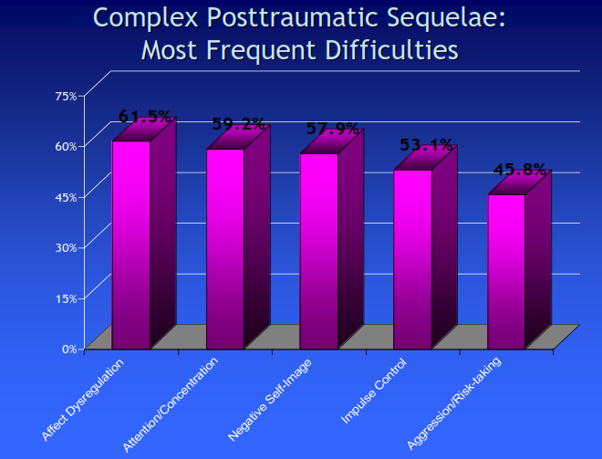
Diagnoses seen in children exposed to trauma from NCTSN data
Notes:
Kids experience a multitude of other psychopathological symptoms – making more systematic description of the sx necessary
Inverse relationship of age of onset of traumatization and severity of symptoms and

Slide 6
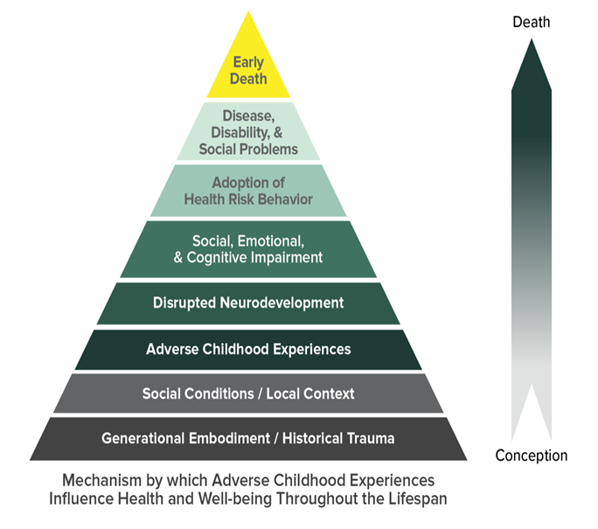
ACE Studies Background
Vincent Felitti, MD & Robert Anda,MD
Kaiser Permanente San Diego Clinic; surveys (wave 1 and wave 2) asking (retrospective) ACEs in 1995-1997 for over 17,000 who received physical exams surveyed.
Matched to health record data and patient report
First wave: 7 items
Physical and Emotional Neglect, Parental Separation and Divorce added later
http://www.cdc.gov/ace/prevalence.htm..
Notes:
STEVE
Retrospective
adults
Limited by what was in database
Based on memory and general questions regarding adverse experiences (e.g. nothing chronicity of DV or nature of physical or sexual abuse
Initial and some still believe that each item in independent-but clearly co-vary in other studies
Gaps starting to be filled in through epigenomics
This pioneering and courageous work by Drs. Felitti and Anda uncovered evidence of the most powerful determinate of the public’s health. It also challenged long held beliefs about pathways to disease and theories about how best to interrupt them. The work was, at first, controversial. Now, it leads strategy at the World Health Organization, many federal agencies, and here in Washington – in state agencies and in communities throughout the state.
n the 1980s, the dropout rate of participants at Kaiser Permanente’s obesity clinic in San Diego was about 50%; but what was perplexing was that all of the dropouts had been successfully losing weight before they left the clinic.[4] Dr. Vincent Felitti conducted interviews with individuals who had left the program, and discovered that a majority of 286 people he interviewed had experienced childhood sexual abuse.[4] The interview findings suggested to Felitti that weight gain might be a coping mechanism for depression, anxiety, and fear.[4]

Slide 7
WHAT ARE THE
ADVERSE CHILDHOOD EXPERIENCES?
Child physical abuse
Child sexual abuse
Child emotional abuse
Physical Neglect
Emotional Neglect
Mentally ill, depressed or suicidal person in the home
Drug addicted or alcoholic family member
Witnessing domestic violence against the mother
Loss of a parent to death or abandonment, including abandonment by divorce
Incarceration of any family member
ACEs are incredibly common – 67 percent of the study population revealed at least one ACEs
12.6 percent of the population had four or more ACEs

Slide 9
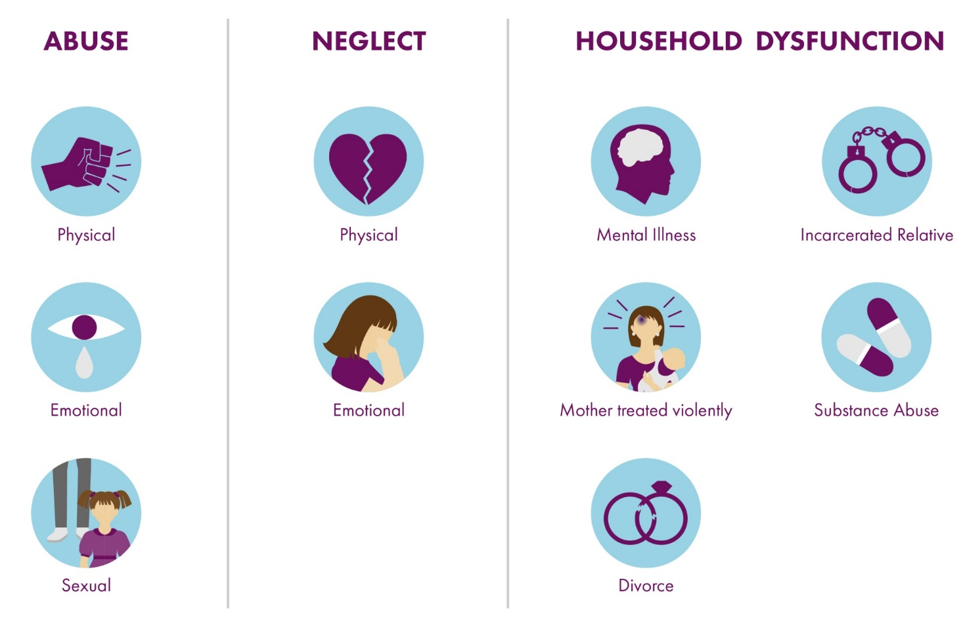

Slide 10
LIFE LONG PHYSICAL, MENTAL & BEHAVIORAL OUTCOMES OF
ACEs/Maltreatment
Alcoholism & alcohol abuse
COPD
Ischemic heart disease
Depression
Fetal death
High risk sexual activity
Illicit drug use
Intimate partner violence
Liver disease
Obesity
Sexually transmitted disease
Smoking
Suicide attempts
Unintended pregnancy
Criminality
The higher the ACE Score, the greater the incidence of
co-occurring conditions from this list.
Notes:
These are the disease and health outcomes known to have a dose response relationship with adverse childhood experience.
If you read the literature, you’ll also find a dose response relationship with 3 or more marriages, skeletal fractures, hallucinations that cannot be attributed to drug use, anxiety and a few others as well.

Slide 11
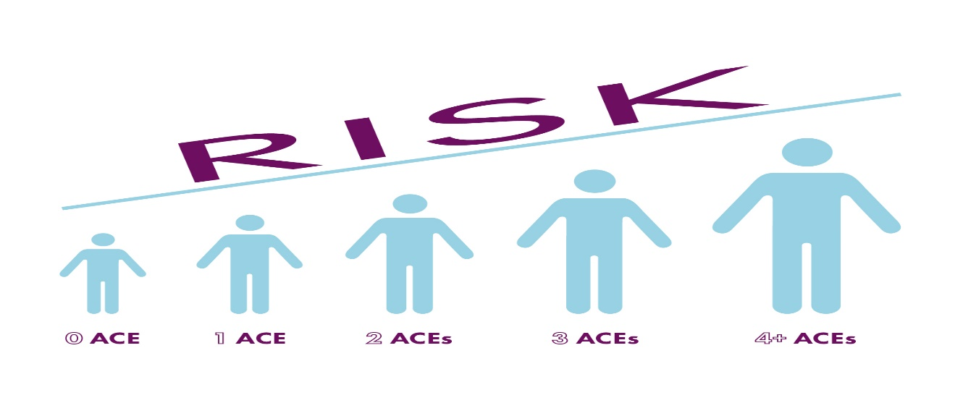
The Impact of ACEs Have a Graded Relationship
As the number of ACEs increase, so do the risk for negative health outcomes.
This cumulative “ACES-effect” occurs at multiple levels from biological markers of stress within a person to population-based markers of health such as rates of childhood asthma in a neighborhood.

Slide 12
Common Symptoms from Maltreatment
Multiple Domains of Difficulty
Self regulatory impairment
Dissociative symptoms
Attachment difficulties
Anxiety and depressive symptoms
Impulse and aggressive problems
Social difficulties
Somatoform issues
Substance Abuse/addictions
Eating problems
Immune system dysfunction
Notes:
9 specific symptom areas that are common
Sino qua non: affect dysregulation, attachment probelms

Slide 13
7 Domains of Impairment in Maltreated Children
1. ATTACHMENT:
Uncertainty about the reliability and predictability of the world
Problems with boundaries
Distrust and suspiciousness
Social isolation
Interpersonal difficulties
Difficulty attuning to other people’s emotional states
Difficulty with perspective taking
Difficulty enlisting other people as allies

Slide 14
Domains of Impairment in Maltreated Children
2. BIOLOGY:
Sensorimotor developmental problems
Hypersensitivity to physical contact
Analgesia
Problems with coordination, balance, body tone
Difficulties localizing skin contact
Somatization
Increased medical problems across a wide span, e.g., pelvic pain, asthma, skin problems, autoimmune disorders, pseudo seizures

Slide 15
Domains of Impairment in Maltreated Children
3. AFFECT REGULATION:
Difficulty with emotional self-regulation
Difficulty describing feelings and internal experience
Problems knowing and describing internal states
Difficulty communicating wishes and desires
4. DISSOCIATION:
Distinct alterations in states of consciousness
Amnesia
Depersonalization and derealization
Two or more distinct states of consciousness, with impaired memory for state-based events

Slide 16
Domains of Impairment in Maltreated Children
5. BEHAVIORAL CONTROL:
Poor modulation of impulses
Self-destructive behavior
Aggression against others
Pathological self-soothing behaviors
Sleep disturbances
Eating disorders
Substance abuse
Excessive compliance
Oppositional behavior
Difficulty understanding and complying with rules
Communication of traumatic past by reenactment in day-to-day behavior or play (sexual, aggressive, etc.)

Slide 17
Domains of Impairment in Maltreated Children
6. COGNITION:
Difficulties in attention, regulation and executive functioning
Lack of sustained curiosity
Problems with processing novel information
Problems focusing on and completing tasks
Problems with object constancy
Difficulty planning and anticipating
Problems understanding own contribution to what happens to them
Learning difficulties
Problems with language development
Problems with orientation in time and space
Acoustic and visual perceptual problems
Impaired comprehension of complex visual-spatial patterns

Slide 18
Domains of Impairment in Maltreated Children
7. SELF-CONCEPT:
Lack of a continuous, predictable sense of self
Poor sense of separateness
Disturbances of body image
Low self-esteem
Shame and guilt

Slide 19
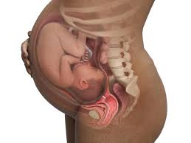
Caveat: In Utero Exposures
The incidence rate of FASD is unusually high among the U.S. foster care population.
It is estimated that almost 70% of the children in foster care are affected by prenatal alcohol exposure in varying degrees.
Neurodevelopmental issues can be caused by multiple exposures that often co-vary with ELS
Other Drugs
Lead, etc.
Tobacco
Senturias, Yasmin Suzanne N. "Fetal alcohol spectrum disorders: an overview for pediatric and adolescent care providers." Current problems in pediatric and adolescent health care 44, no. 4 (2014): 74-81.

Slide 20
Early Life Stress Influence on
Human development
INDIVIDUAL
Edgy
Hot temper
Impulsive
Hyper vigilant
“Brawn over brains”
And/or
Withdrawn
Moody
“Avoid”
OUTCOME
Individual & species survive the worst conditions.
BRAIN
Hormones, chemicals & cellular systems prepare for a tough life in an evil world
SEVERE STRESS
Assume NEUTRAL START
INDIVIDUAL
Laid back
Relationship-oriented
Thinks things through
“Process over power”
OUTCOME
Individual & species live peacefully in good times; vulnerable in poor conditions
BRAIN
Hormones, chemicals & cellular systems prepare for life in a benevolent world
Notes:
20

Slide 21
Diagnoses

Slide 22
Common Symptoms and Related Diagnoses
Trauma Induced Difficulties | Possible Related Diagnoses
Self regulatory impairment | ADHD, ODD, DMDD, CD, Personality D/Os, BPAD, SUD
Dissociative symptoms | Dissociative D/Os, ADD, Psychotic D/Os
Attachment difficulties | RAD, Separation Anxiety D/O, ASD
Anxiety and depressive symptoms | Persistent depressive D/O, MDD, Bipolar, Anxiety Disorders
Impulse and aggressive problems | ADHD, ODD, DMDD, CD, Personality D/Os
Eating problems | Binge Eating Disorder, obesity

Slide 23
PTSD
Is a particular set of symptoms caused by a particular type of traumatic experience/s
Requires: the person was exposed to: death, threatened death, actual or threatened serious injury, or actual or threatened sexual violence, in the following way(s): Direct exposure. Witnessing the trauma. Learning that a relative or close friend was exposed to a trauma.
PTSD is not the most common traumatic reaction
Many will have some symptoms
Most Common Diagnoses
Substance Use Disorders
Depression
Anxiety
Disruptive Behavior Disorders (e.g ADHD)

Slide 24
The Impact on Brain Development

Slide 25
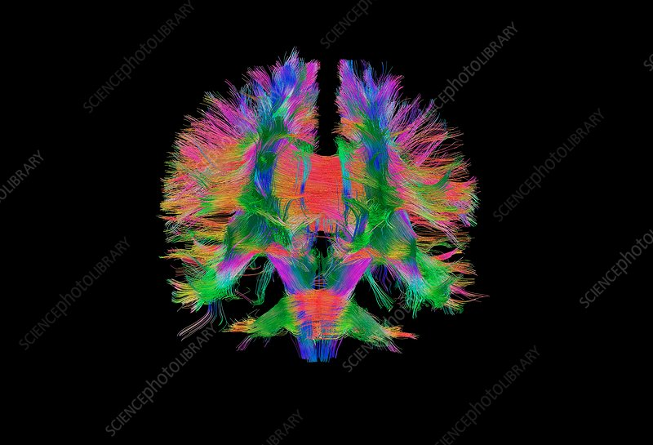
Imaging Young Adult Brains Exposed to ELS
Young Adults with histories of
maltreatment yields important
information about effects of ELS
on brain structure and function.

Slide 26
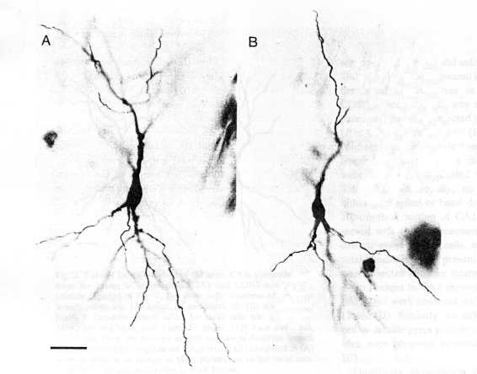
Non-Stressed
Stressed
Stress results in decreased dendritic branching of neurons in the region of the hippocampus (Woolley et al. 1990)
Notes:
26

Slide 27
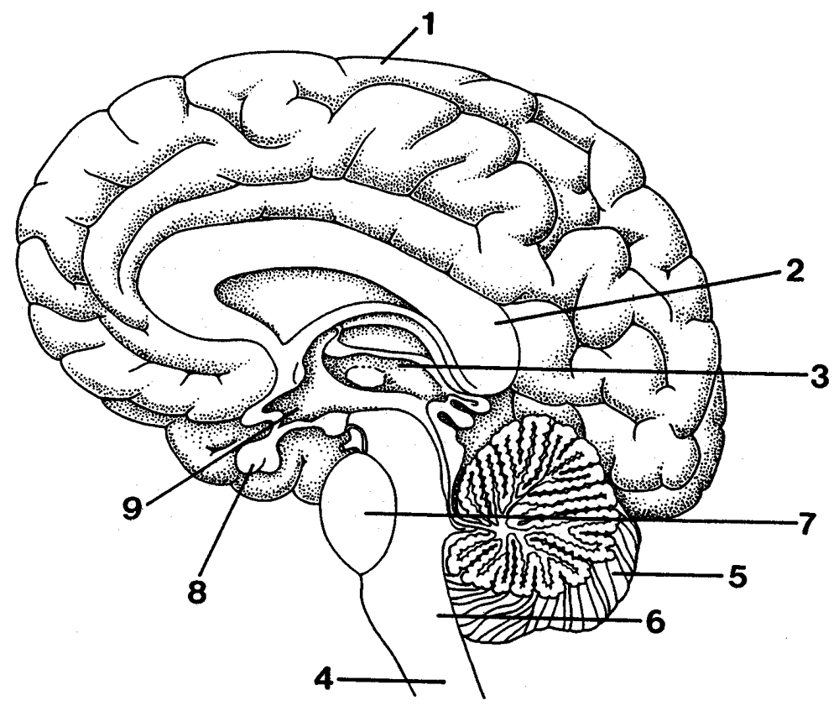
Maltreatment: Enduring Effects on Brain Structure and Function
Teicher et. al. in a review of multiple neuroimaging studies reported:
Maltreatment Is Associated with Reductions in Volume of Key Brain Structures
Hippocampus (particularly in adults)
Anterior Cingulate Cortex (ACC)
Ventromedial and Dorsomedial Cortices
Maltreatment Affects the Development of Key Fiber Tracts
Corpus Callosum
Superior Longitudinal Fasciculus
Uncinate Fasciculus and
Cingulum Bundle
Maltreatment appears to alter the development of sensory systems that process and convey stressful experiences.
Teicher, M. H., et.al. (2016). The effects of childhood maltreatment on brain structure, function and connectivity. Nature Reviews Neuroscience 17(10):652-66.

Slide 28
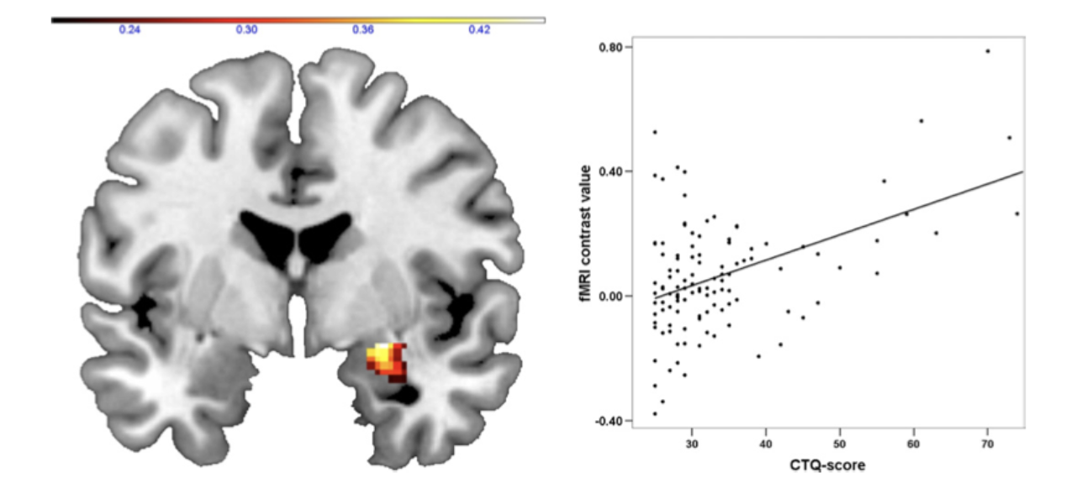
Maltreatment has Enduring Effects on Brain Structure Even in Psychiatrically Well Adults
Right amygdala responsiveness to negative facial expressions is modulated by Childhood Trauma Questionnaire (CTQ) scores (r=.456, p<.0001).
Dannlowski, U. et al. Limbic scars: long-term consequences of childhood maltreatment revealed by functional and structural magnetic resonance imaging. Biol. Psychiatry 71, 286–293 (2012).

Slide 29
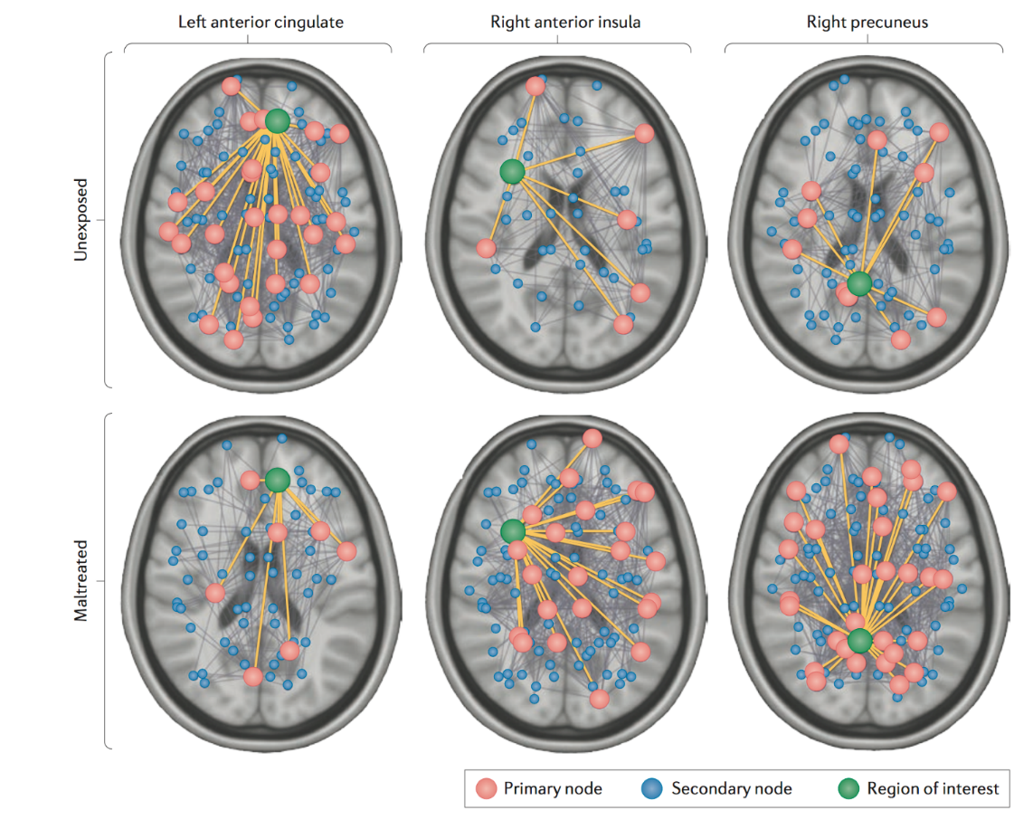
Maltreatment: Enduring Effects on Brain Structure and Function
Young adults with (n=142) and without (n=123) histories of childhood maltreatment.
UNEXPOSED
Maltreatment associated with changes in structural connectivity at the network level.
MALTREATED
Teicher, M. H., et.al. (2016). The effects of childhood maltreatment on brain structure, function and connectivity. Nature Reviews Neuroscience 17(10):652-66.

Slide 30
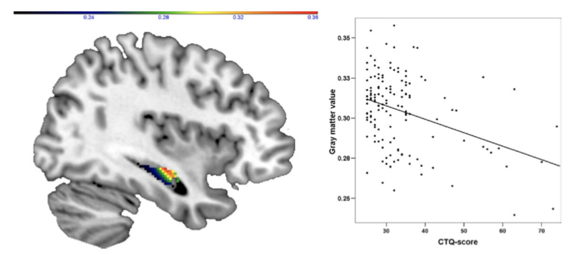
Maltreatment has Enduring Effects on Brain Structure Even in Psychiatrically Well Adults
Right hippocampal gray matter volume is negatively associated with with Childhood Trauma Questionnaire (CTQ) scores (r=-.365, p<.0001).
Dannlowski, U. et al. Limbic scars: long-term consequences of childhood maltreatment revealed by functional and structural magnetic resonance imaging. Biol. Psychiatry 71, 286–293 (2012).

Slide 31
Psychological Trauma as Injury

Slide 32
Rethinking “Trauma”: Injury
Trauma is ancient Greek for wound or injury
Traumatic and Stress reactions, symptoms and impairment should be conceived as injuries rather than disorders
Psychological Trauma is any experience or experiences that causes a deleterious change in function
.

Slide 33
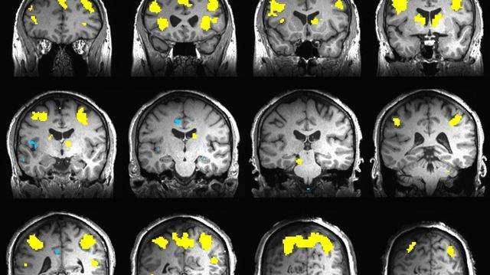
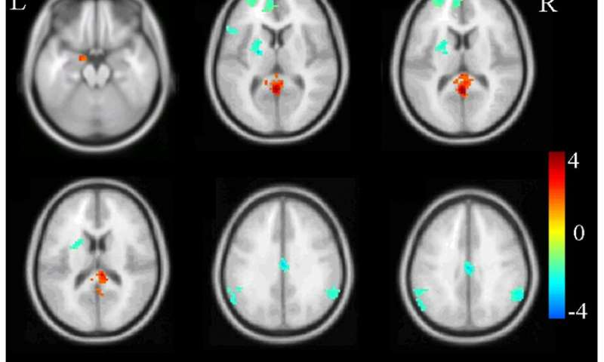
Traumatic Brain Injury: Acute
Post-Concussion Syndrome
Dizziness, Fatigue, Irritability, Anxiety, Insomnia, Loss of concentration and memory, Ringing in the ears, Blurry vision, Noise and light sensitivity
Single Incident Traumatic Response
Traumatic Stress Symptoms including:
Fatigue, Irritability, Anxiety, Insomnia, Loss of concentration and memory

Slide 34
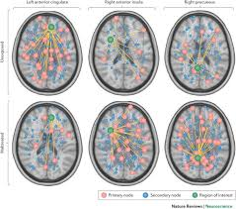
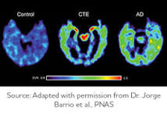
Traumatic Brain Injuries: Chronic
Chronic Traumatic Encephalopathy (CTE)
Memory loss, Confusion, Impaired judgment, Impulse control problems, Aggression, Depression, Anxiety, Suicidality, Parkinsonism, and, eventually, progressive dementia
Child Maltreatment
Self-regulation, Dissociation, Attachment issues, Anxiety, Depression, Impulsivity, Aggression, Social, Somatoform, Substance Abuse, Eating , Memory issues and Immune system dysfunction

Slide 35
Impact on Attorneys
Understanding trauma also means recognizing that our personal traumatic experiences or the stress associated with working in law may impact our emotional and physical well being as well as our work success and satisfaction
Patients may trigger our own reactions due to our experiences.

Slide 36
Taking Care
Support and discussions among ourselves is essential
Create a group among colleagues, office staff
Discuss difficult cases, situations and reactions
If we can’t support each other, who can?

Slide 37
SLEEP
EAT WELL
MOVE

