Slide 1
AWS Security Configuration and Automation
Current AWS Security Landscape
Introduction to AWS Security Hub and AWS Config

Slide 2
AWS Security hub
AWS Security Hub serves as a centralized platform, providing a comprehensive view of your security alerts and compliance status across your AWS environment.
It aggregates, organizes, and prioritizes security findings from various AWS services such as Amazon GuardDuty, Amazon Inspector, and AWS IAM Access Analyzer, among others.
Centralized approach not only simplifies the monitoring of security alerts but also enhances the ability to take swift, informed actions to safeguard your infrastructure.

Slide 3
AWS Security Hub
Centralized Security Dashboard
Automated Compliance Checks
Integration with other AWS Services
Actionable Insights and Remediation
Compliance / Security Standards:
AWS Foundational Security Best Practices (FSBP) v1.0.0
Centre for Internet Security (CIS) AWS Foundations Benchmark v1.2.0
Centre for Internet Security (CIS) AWS Foundations Benchmark v1.4.0
Payment Card Industry (PCI) Data Security Standard (DSS) v3.2.1

Slide 4
AWS COnfig
AWS Config is a service focused on enabling you to assess, audit, and evaluate the configurations of your AWS resources.
Acts as a guardian, continuously monitoring and recording your AWS resource configurations and allowing you to automate the evaluation of recorded configurations against desired configurations.
With AWS Config, you can review changes in configurations and understand relationships between AWS resources, ensuring that all changes adhere to your internal guidelines and compliance requirements.

Slide 5
AWS Config
Configuration Management and Compliance
Continuous Monitoring and Auditing
AWS Config Rules
Automated Remediation

Slide 6
Misconfigurations
LAPSUS$
Matching Misconfigurations
03:19:50 AWS console sign-in
03:20:02 Get billing info
03:20:02 Describe EC2
03:20:27 Delete load balancer
03:22:39 Delete databases
03:23:34 Terminate all instances
Credential rotation
Enable MFA
Enable GuardDuty
Create custom controls/runbooks
Database Delete protect
Create custom controls/runbooks

Slide 7
Integration and Automation
Combining Security Hub and AWS Config
Security Hub ASR (Automated Security Response)

Slide 8
Benefits of auto-remediation
Do more with fewer staff
Less noise
Eliminate alert fatigue
Remediate once!
Happier teams
More valuable junior staff
Mitigation of handover risks
Continuous compliance…

Slide 9
AWS Security Hub Automated Security Response
AWS Security Hub Integration
Automation Framework and Runbooks
Open Source
GitHub
aws-solutions/automated-security-response-on-aws

Slide 10
What is security hub automated security response?
AWS-native tools
Ready-to-deploy automation framework
A library of automated runbooks that resolve common misconfigurations
Remediation runbooks simply perform best practice remediations steps
>600 enterprises use ASR globally

Slide 11
HOW security hub ASR works
AWS Security Hub
AWS Config
Step Functions
IAM Roles
EventBridge rules
Systems Manager

Slide 12
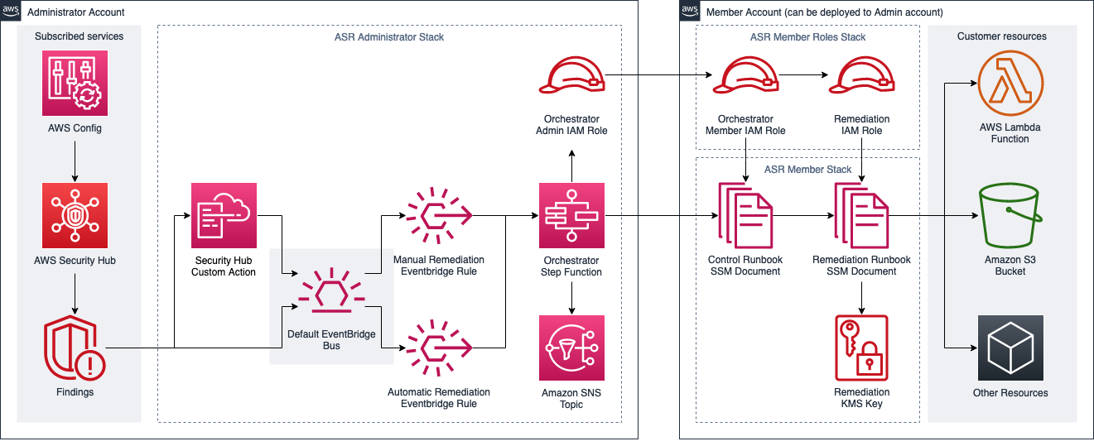
SECURITY HUB ASR ARCHITECTURE DIAGRAM

Slide 13
How to install ASR
Enable AWS Security Hub/Config and Consolidated Findings
Deploy the SHASR Admin account stack (aws-sharr-deploy)
installs the core components of the solution
configures the security standards
creates integration with AWS Security Hub’s custom action
allows users to select findings for remediation
installs the remediation using an AWS Step Functions
ASR Member stack (aws-sharr-member)
installs the security standards
installs AWS Systems Manager runbooks
ASR Member Roles stack (aws-sharr-member-roles)
installs the cross-account roles and permissions
assigns granular access policies and permissions to services
Or just follow the AWS ASR Deployment Guide:

Slide 14
Q&A and Conclusion
In conclusion, Security Hub, Config and other AWS security services are great resources to continuously monitor your AWS environment.
There is lots of support for automation and custom remediation.
This is extremely important to ensure that you stay ahead of active cyber threats in the cloud and that you stay continuously compliant.
Questions?

