Slide 1
Investing in 2024
Make Long Term Decisions
That Will Get You to Financial Independence Years Sooner

Slide 2
Investing in 2024
Investing Opportunities in 2024
You have a multi decade horizon,
and stock market volatility helps grow wealth faster
If stocks fall, you can save money on taxes for years. If they rise, you make money.
Older workers retiring will make room others willing to take career risks

Slide 3
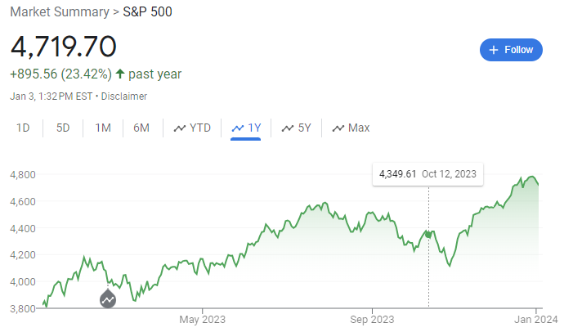
Investing in 2024
S&P 500 Index
PAST 1 YEAR
Source: Google.com

Slide 4
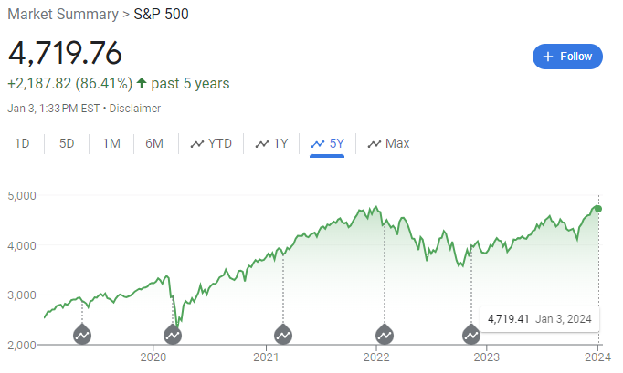
Investing in 2024
S&P 500 Index
PAST 5 Years
Source: Google.com

Slide 5
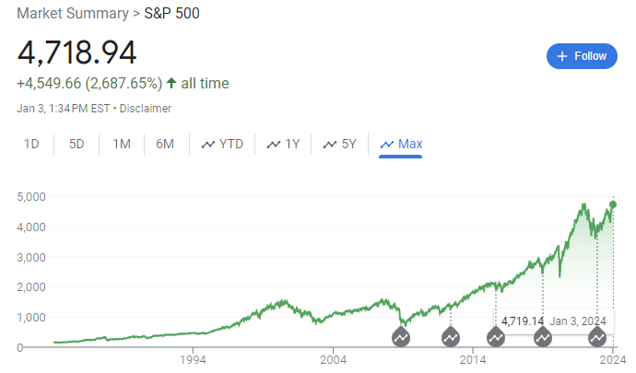
Investing in 2024
S&P 500 Index
PAST 40 Years
27x price returns
Source: Google.com

Slide 6
Investing in 2024
S&P 500 Index
PAST 40 Years
27x price returns
66x total returns
including
dividends
Source: Google.com

Slide 7
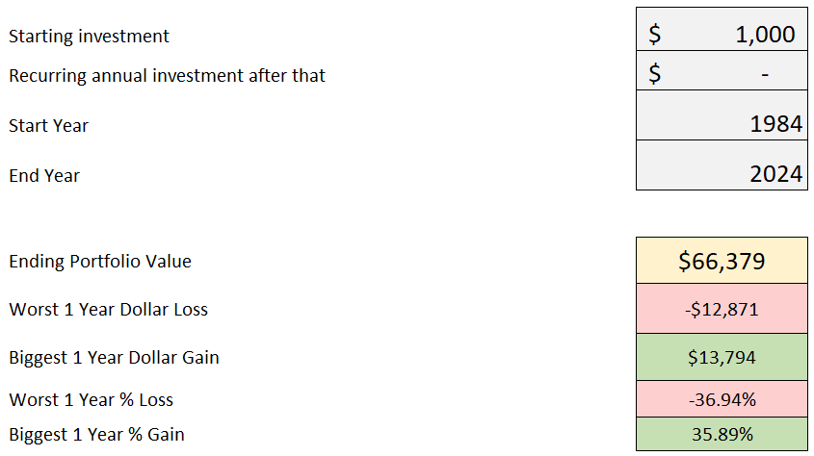
Investing in 2024
S&P 500 Index PAST 40 Years WITH DIVIDENDS
66x returns !!!
Source: Studentloanplanner.com calculations

Slide 8
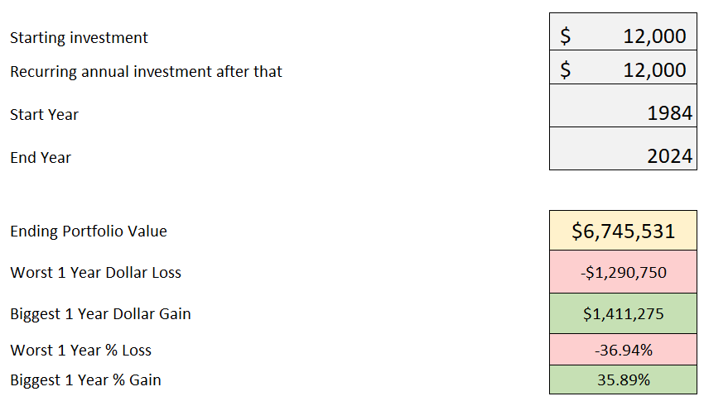
Investing in 2024
If you had invested $1,000 a month in the S&P 500 over the past 40 years, today it would be worth
over $6.7 million dollars
Source: Studentloanplanner.com calculations

Slide 9
Investing in 2024
What is a Harmonic Mean?
Q: If you buy $20 of gas at $1 a gallon, and $20 of gas at $2 a gallon,
what’s the average price per gallon?
A: $1.33 (not $1.50)
$20/$1 = 20 gallons
$20/$2 = 10 gallons
$40/30 gallons = $1.33

Slide 10
Investing in 2024
How Regular Investing Helps You Win
Q: If you buy $1,000 of stock at $50 and $1,000 of stock at $40,
what’s the average price per share?
A: $44.44 (not $45)
$1,000/$50 per share = 20 shares
$1,000/$40 per share = 25 shares
$2,000/45 shares = $44.44, not $45

Slide 11
Investing in 2024
How Regular Investing Helps You Win
Q: If you buy $1,000 of stock at $80 and $1,000 of stock at $10,
what’s the average price per share?
A: $17.78 (not $45)
$1,000/$80 per share = 12.5 shares
$1,000/$10 per share = 100 shares
$2,000/112.5 shares = $17.78, not $45

Slide 12
Investing in 2024
How Regular Investing Helps You Win
$923 a paycheck maxes a 401k (which has a cap)
Then put as much as you can into a
Non-retirement account (that has no cap)
If stocks go down, save money on taxes through tax loss harvesting
If stocks go up, you make money (long term they almost surely will)
IT’S A WIN-WIN. The only way you LOSE is by NOT INVESTING

Slide 13
Investing in 2024
Where to invest?
You like learning and want to manage it: Vanguard, Schwab, Fidelity
- Vanguard has a digital advisor that’ll do it for you
You want a high service fiduciary planner: slpwealth.com/BOOK

Slide 14
Investing in 2024
What’s the yearly cost?
Do it yourself (Vanguard.com) = $0.70 (70 cents) per $1,000 of what you have invested
Cheaply have someone do it (SLP Wealth) = $4.90 per $1,000 of what you have invested
Typical financial advisor / salesperson = $10-$20 per $1,000 of what you have invested
All these options are dirt cheap compared to not investing!

Slide 15
Investing in 2024
Investing Opportunities in 2024
You have a multi decade horizon, and stock market volatility helps grow wealth faster
If stocks fall, you can save money on taxes for years.
If they rise, you make money.
3. Older workers retiring will make room others willing to take career risks

Slide 16
Investing in 2024
Tax Loss Harvesting Example at Vanguard.com
Value Before Crash
Value After Crash
Exchanged into this fund after market crash
Why do this? You got a $6,000 Loss to use
against your taxes.

Slide 17
Investing After the Pandemic in 2023
Wait 30 DAYS!!! Pretend Stocks Went Up A Bit. Now Switch Back
Value 30 Days After the Market Crash
Exchanged 30 Days After the Crash
You moved back into original investments, $2,000 gain is offset by $6,000 loss,
for net loss of $4,000

Slide 18
Investing in 2024
You Get to Write Off $3,000 Against Your Active Income Each Year
This Example: $3,000 * 40% tax rate = $1,200 in tax savings compared to doing nothing
Other $1,000 in Losses You Can Carry Forward to Future Years
BUT… YOU DIDN’T LOSE ANY MONEY!!!
LOSSES WERE ONLY ON PAPER, AND YOU’RE INVESTING LONG-TERM

Slide 19
Investing After the Pandemic in 2023
Investing Opportunities in 2024
You have a multi decade horizon, and stock market volatility helps grow wealth faster
If stocks fall, you can save money on taxes for years.
If they rise, you make money.
3. Older workers retiring will make room others willing to take career risks

Slide 20
Investing in 2024

Slide 21
Investing in 2024

Slide 22
Investing in 2024
PRICE INCREASES
QUANTITY DECREASES

Slide 23
Investing in 2024
What it means:
You Have More Leverage
In the Labor Market
USE IT!!!

Slide 24
Investing After the Corona Recession in 2021
Investing in 2024
Biggest Caution Signs for the Market in 2024 and Beyond
Stocks Shiller P/E ratio is very high,
meaning stocks are highly valued after a year with 26% returns
Economic uncertainty could spark a recession
Home prices could fall significantly

Slide 25
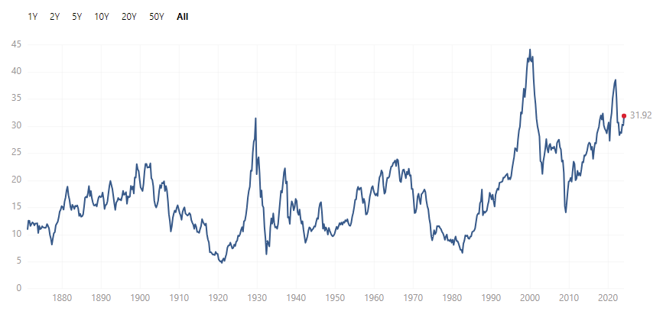
Investing in 2024
Shiller P/E Ratio: 31 at the beginning of 2024
Source: multpl.com

Slide 26
Investing in 2024
US Stocks Dropped 90% from 1929 to 1932
Japanese Stocks Dropped 80% from 1989 to 2009
This is why
diversification matters!!!

Slide 27
Investing in 2024
Put 5% to retirement and $100 a month outside retirement no matter what
Then once you have no “bad debt”, a 6-month emergency fund,
and all short-term goals saved for,
then invest A LOT more on per month
automatically

Slide 28
Investing After the Corona Recession in 2021
Investing in 2024
Biggest Caution Signs for the Market in 2024 and Beyond
Stocks Shiller P/E ratio is very high,
meaning stocks are highly valued after a year with 26% returns
Economic uncertainty could spark a recession
Home prices could fall significantly

Slide 29
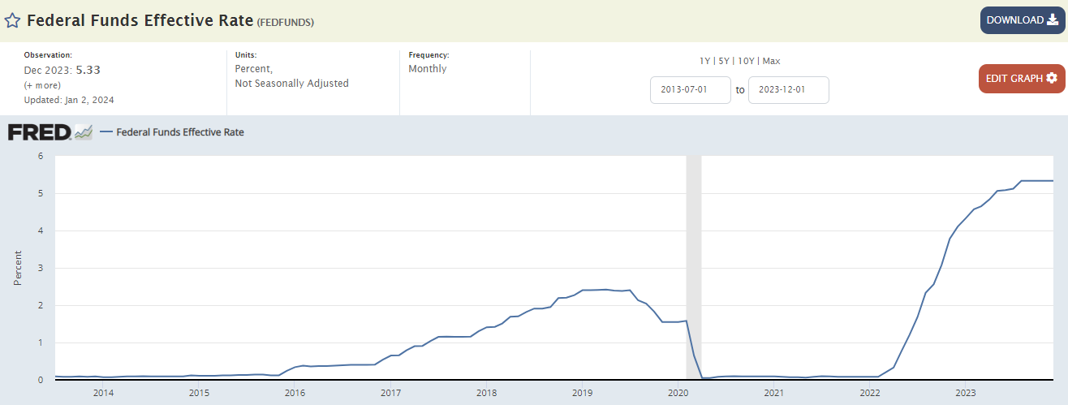
Investing After the Corona Recession in 2021
Investing in 2024
Federal Reserve is forecasting rate cuts in 2024, but the economic pain already in the system could potentially cause a recession

Slide 30
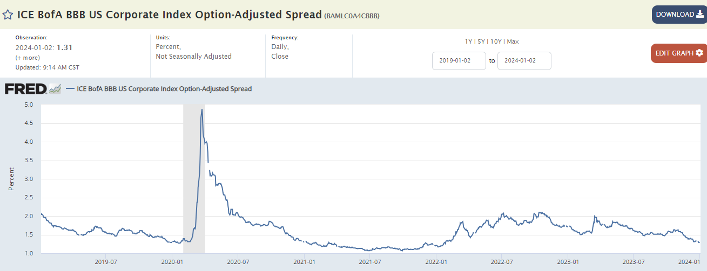
Investing After the Corona Recession in 2021
Investing in 2024
This shows how much extra yield corporations with BBB credit rating must pay to borrow. It shows that credit risk fears are ultralow. But that could change

Slide 31
Investing After the Corona Recession in 2021
Investing in 2024
Biggest Caution Signs for the Market in 2024 and Beyond
Stocks Shiller P/E ratio is very high,
meaning stocks are highly valued after a year with 26% returns
Economic uncertainty could spark a recession
Home prices could fall significantly

Slide 32
Investing in 2024
The Bearish Case for Housing Prices
Mortgage rates are causing payments to become unaffordable
The huge run up in prices is subject to reversion to the mean
The Fed could have to pull back on their 2024 rate cuts
A boom in new construction could cause existing homeowners to have to discount their prices more to sell
Consumers might start be willing to move again, which could trigger a surge in home inventory

Slide 33
Investing in 2024
Why hasn’t housing fallen more?
We still have a very strong job market
Home builders didn’t go as crazy as they did in the 2000s
Most homeowners have a mortgage rate below 4%. When will this become less important? (probably if we see a similar rate environment)
Recency bias and anchoring bias leads both home owners and home buyers to have confidence that prices should be high

Slide 34
Investing in 2024
Why would a fall in housing prices affect stocks?
Homeowners tap their home equity for a huge percent of spending
If credit conditions tighten and home prices decline, banks won’t give home equity loans
Consumer spending could fall because of the wealth effect
Psychology: when homeowners become nervous about the value of their homes, it can lead to momentum for a recession

Slide 35
Investing in 2024
But Remember!!
S&P 500 Index
PAST 40 Years
27x price returns,
66x total returns
including
dividends
Source: Google.com

Slide 36
Investing in 2024
5 Action Steps to Take Now
1. Start with 5% into employer retirement plan and $100 a mo into taxable account
Then get 6 months of cash expenses + save for short term goals (also no credit card debt)
Then max out retirement account. Typically go with default investment option (target date fund)
Then increase taxable account contributions OR start paying
down loans that need to get paid off. Either one is ok.
Then try to increase income and invest more to reach financial freedom sooner
or optimize your lifestyle now

Slide 37
Investing in 2024
Tips for Getting the Most Out of the Course
ASK QUESTIONS in each comment section
Join live webinars when we offer them, and listen to old ones when we post them
Actually take the time to watch the course videos
THANKS!

