Slide 1
What Worked and Didn’t Work Before What Didn’t Work?
Software programs
Apps
Personal Excel spreadsheets
Accounting books
Keeping everything in your mind

Slide 2
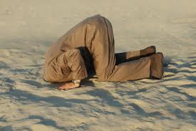
“HELP!!!”

Slide 3
What DID Work?

Slide 4
From Chaos to Peace of Mind

