Slide 1
iCanWrite Screenplays
THREE
COMMONALITIES
OF A
COMPELLING
CHARACTER
(‘FOR MY GIRLS’ AS A CASESTUDY)
Twitter: @icanwritehub Email: icanwritehub@gmail.com

Slide 2
In the previous section, we stated that characters are the lifeblood of any story or screenplay.
However, populating your story with a hundred ineffective characters is as bad as having no characters at all. Even the zombies in a zombie movie have a system to their madness which make them compelling.

Slide 3
The three commonalities of a compelling character are:
Distinction (What makes them tick?)
Empathy (Relatability/Humanity)
Impetus (For Action)

Slide 4
DISTINCTION

Slide 5
Distinction is essentially ‘differentness.’ Is that a word? Who knows? What is different about your character? What sets him apart from every Obi, Emily, John and Ifeoma on the road? Does he stammer? Does he have a foot-fetish? Is she an obsessive-compulsive? Has she always wanted to own her own design company? Does she know to dance atilogu? Does the character have a marked flaw, a vice or a fear? Creating a marked distinction about your characters compels your audience to want to learn more about the character.

Slide 6
Why does an overtly religious man like to sniff women’s feet in the midnight hour? I would like to know this! Adanne, the protagonist in ‘For my Girls’ wears an eye-patch. Why? Distinct characteristics amongst your characters draws the audience in and drives them to seek an answer.

Slide 7
EMPATHY

Slide 8
The character must be distinct but she must also possess a humanity or frailty that ensures that the audience can relate with her struggles and challenges. An empathetic character ensures that the audience can connect with and experience the character’s feeling. The character must possess a sense of humanity, must fail and succeed, triumph, be defeated, achieve, suffer setbacks and see the light at the end of the tunnel which is a potpourri of life and living.

Slide 9
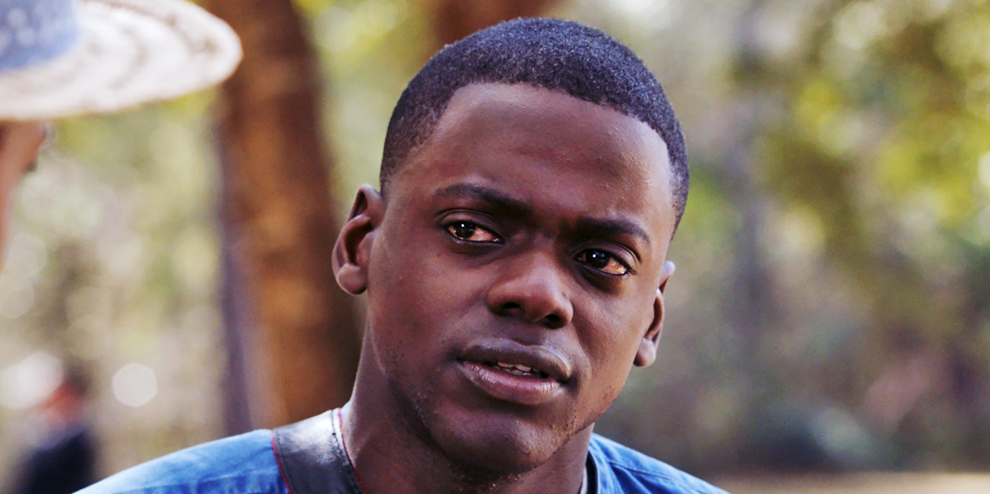
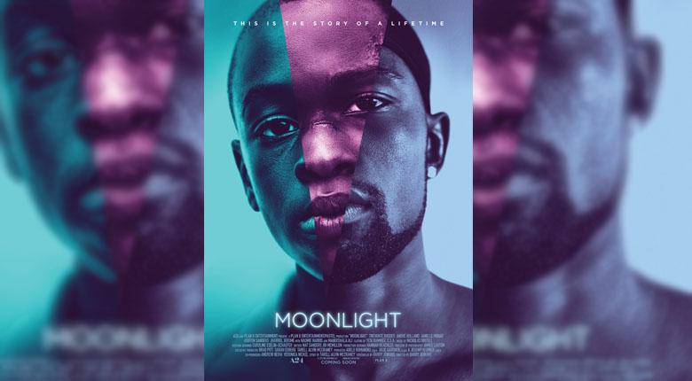

Slide 10
From the previous slide:
We empathize with the protagonist in ‘Getout’ who faces relatable prejudice from his girlfriend’s ‘white’ family.
We empathize with the ‘Black Swan’ as she strives to peak at her career even as it drives her to the edge of madness.
We empathize with the protagonist in ‘Hacksaw Ridge’ who must choose whether to compromise his faith in the face of immense pressure.
We empathize with the ‘protagonists’ in ‘Moonlight’ as they battle bullying, abusive parents , sexuality and other myriad issues.

Slide 11
The character must have desires and make sacrifices and we must feel deeply enough to cry or cringe at these sacrifices and desires.
In ‘For my Girls’ quite a few members of the audience admitted that they cried as they suffered through Adanne’s travails with her because they could relate to being in similar situations and having to bear similar sacrifices.
According to Robert Mckee’s ‘Story’,
“The audience’s emotional involvement is held by the glue of empathy.”

Slide 12
IMPETUS

Slide 13
What is your character’s driving force and motivation? As discussed previously, your protagonist’s ‘why’ is perhaps the most essential part of your story. What is his internal and perhaps unspoken desire? Why does a character make the decisions or the choices that they do? The character’s impetus may be told through a backstory, dialogue, foreshadowing or a reaction to the results of the choice.

Slide 14
A character’s impetus may change or vary in degree as your story progresses and as the forces of antagonism throw bigger and more difficult obstacles in their path. In ‘For My Girls’ the protagonist’s impetus changes from her desire to help her family financially to the struggle to stay alive despite the forces of antagonism.

Slide 15
WE LEARN TO WRITE BY WRITING!
1.Rework your short story if necessary and ensure that the three commonalities of a compelling character are CLEARLY evident. What is different about your character? Why should we care about your character’s journey? What is your character’s impetus for the decisions they have made?
2. Did you read the screenplay ‘For My Girls’? If yes, why does the protagonist wear an eye patch?
Send stories, feedback, commentary and writework to icanwritehub@gmail.com

Slide 16
WE LOOK FORWARD
TO RECEIVING YOUR ‘WRITEWORK’ AND QUESTIONS
ABOUT THE LESSONS IN THIS SECTION.
THANK YOU!

