Slide 1
F.Y.R.e*SyStem*
Fuel Your Rise, eleVate
Manage emotions and Navigate change with Optimism!
Annette F. McGee/possibilitiesingrowth.com

Slide 2
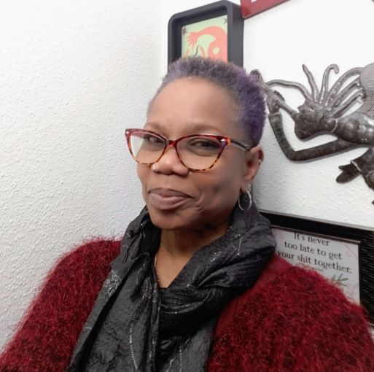
Meet Your Imagineer
Annette F. McGee – Course Creator & Joy Wrangler
I’m on a mission to help women to choose joy and begin the journey to live emotionally and spiritually well. My vision is to encourage emotional authority for many people one thought at a time.
A short story…
I was in a prison of my own making, literally and figuratively, living as an emotional trainwreck filled with fear, hurts, and hang-ups. I had to accept responsibility to see the condition my condition was IN!
So, the “FYRe System” was born to create a simple system to manage emotions and navigate change with optimism to experience more joy, peace & balance! Please allow me to offer insights, information, and optimism! That’s All Folks!
“Right thinking plus right action equals right results.” ~ Dr. MaryAnn Diorio
F.Y.R.e*System*

Slide 3
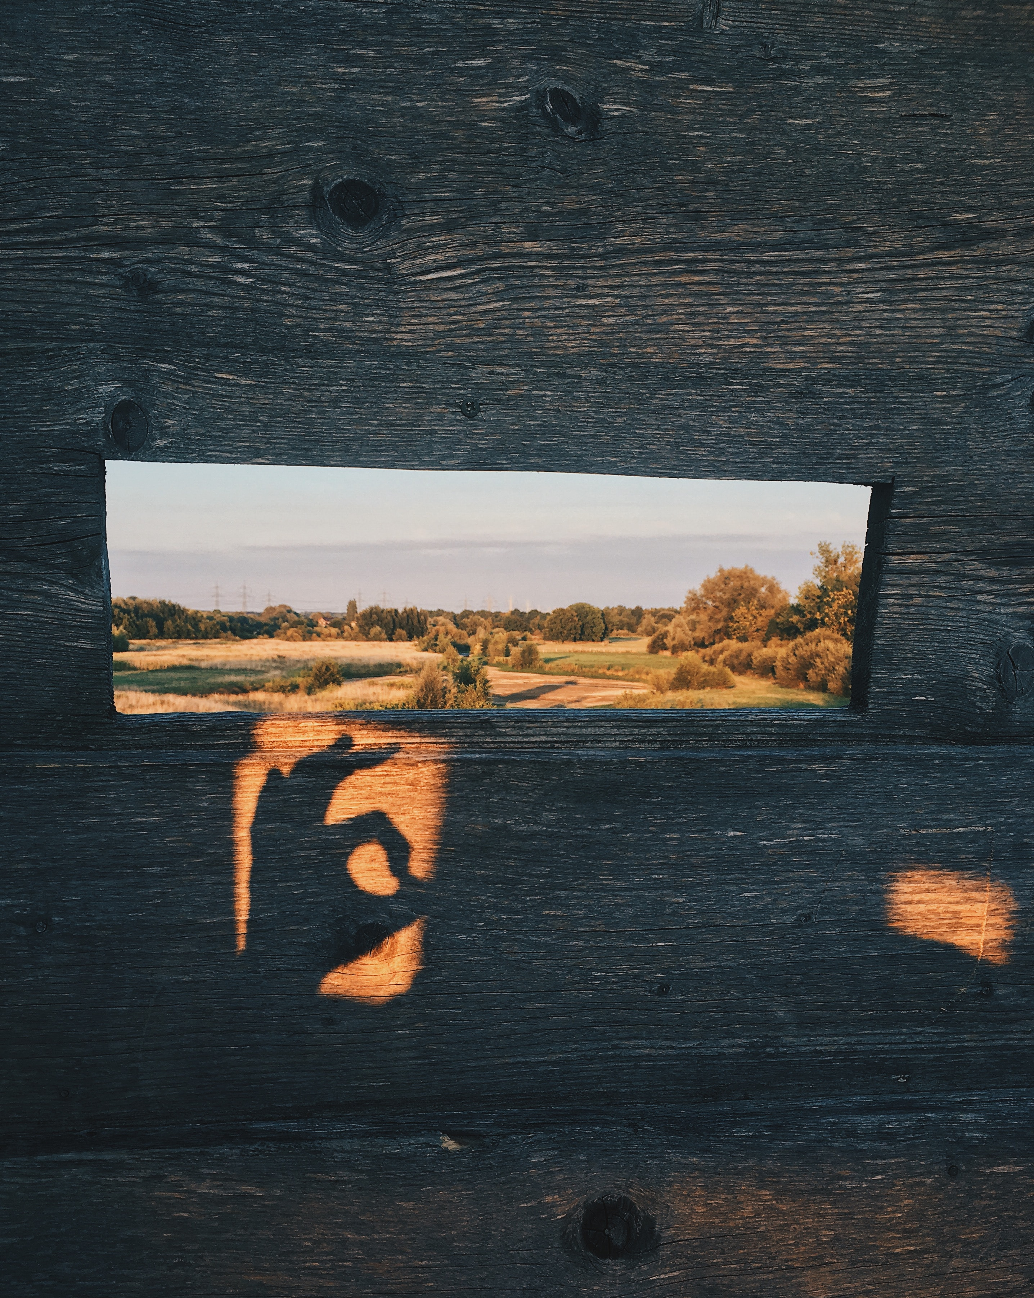
Emotional Integrity Overview
😬
Choose Courage!
Explore and Ask Question?
🤨 Choose Confidence
Begin the Journey!
😌
Choose to be Present!
Self-Aware.
F.Y.R.e*System*

Slide 4
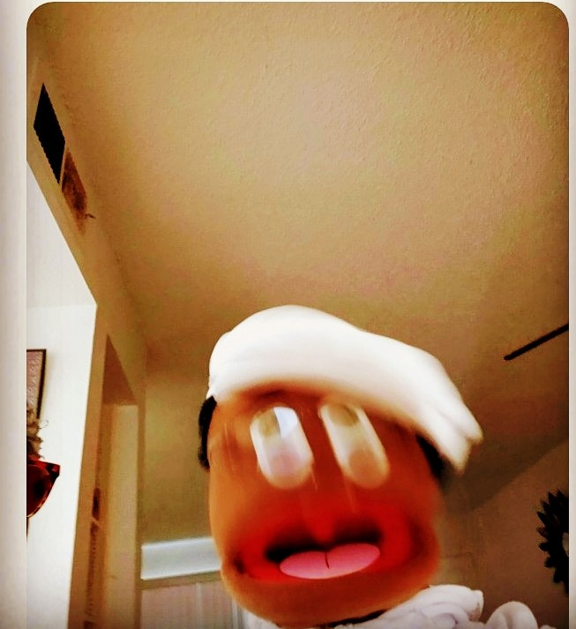
Struggles
Why do we fail at achieving to live with joy, peace, and balance!
One - Defiant and Indifferent
Self-Sabotage!! There is a deeply rooted belief that life and love must be a struggle. This notion is generally from conditioning in our environment that has beaten us down and left us discouraged to live joyfully.
Two - Frustration
We make a choice out of fear to not live and maintain a life that is small, co-dependent and unfulfilling.
Three - Fearful
Our inner world is in a state of confusion and chaos, and this hinders us taking responsibility for our feelings, decisions, actions. All this ungrounded emotional energy is creating imbalances that show up in our physical world as DRAMA!
Fear and Faith cannot co-exist. Choose JOY 2 Live Well!
F.Y.R.e*System*

Slide 5
Phase I Outline
3 clear steps to help achieve more joy, peace & balance!
Step 1
Step 3
Emotional Intelligence
Emotional Autonomy
This step will help you to understand how emotions affect decisions and personal agreements with self
Is the freedom to think and feel what you think and feel and learn to voice them
Step 2
Emotional Integrity
A responsibility to one’s feelings, to analyze and understand personal biases and perspectives with better clarity
FF.Y.R.e*System*

Slide 6
Phase I – The Focus: Emotional Integrity
“Imagine if through gaining information, confusion gives way to more emotional intelligence and autonomy to help navigate and handle life’s twists and turns.”
F.Y.R.e*System*

Slide 7
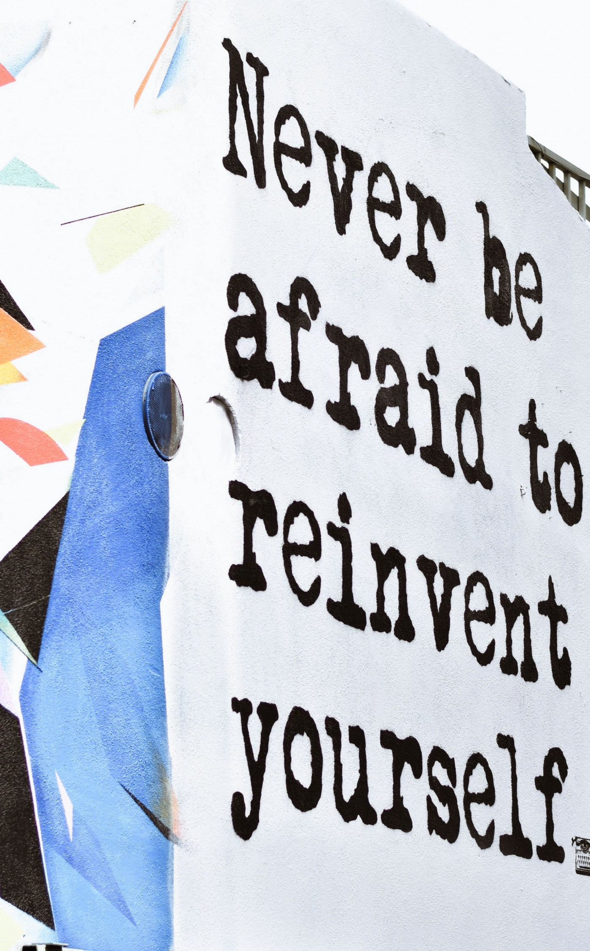
Emotional Integrity Goals
Go from drowning in confusion to an understanding of how emotions drive decisions, then choose a different outcome…
CHOOSE JOY! MAKE THIS THE LAST YEAR YOU STRUGGLE WITH EMOTIONS!
F.Y.R.e*System*

Slide 8
Decision?!
YOU CAN…Do what you’re doing or act and begin to manage emotions and navigate change with optimism!
F.Y.R.e*System*

Slide 9
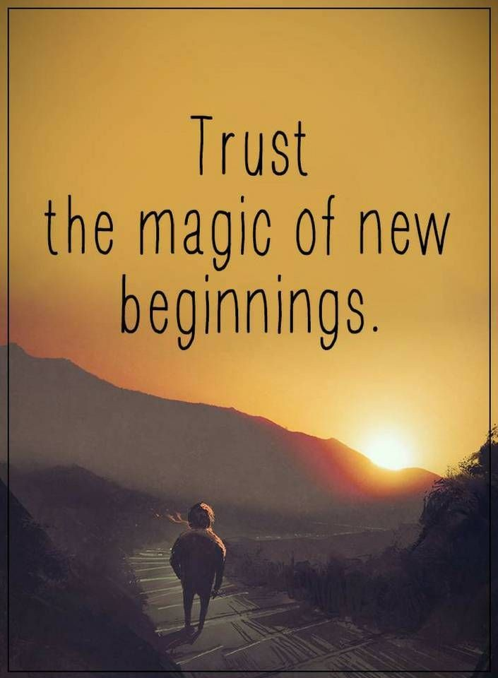
F.Y.R.eSystem: Phase I – Emotional Integrity. The Dawn of A New Attitude!
F.Y.R.e*System*

