Slide 1
The TCP/IP Model

Slide 2
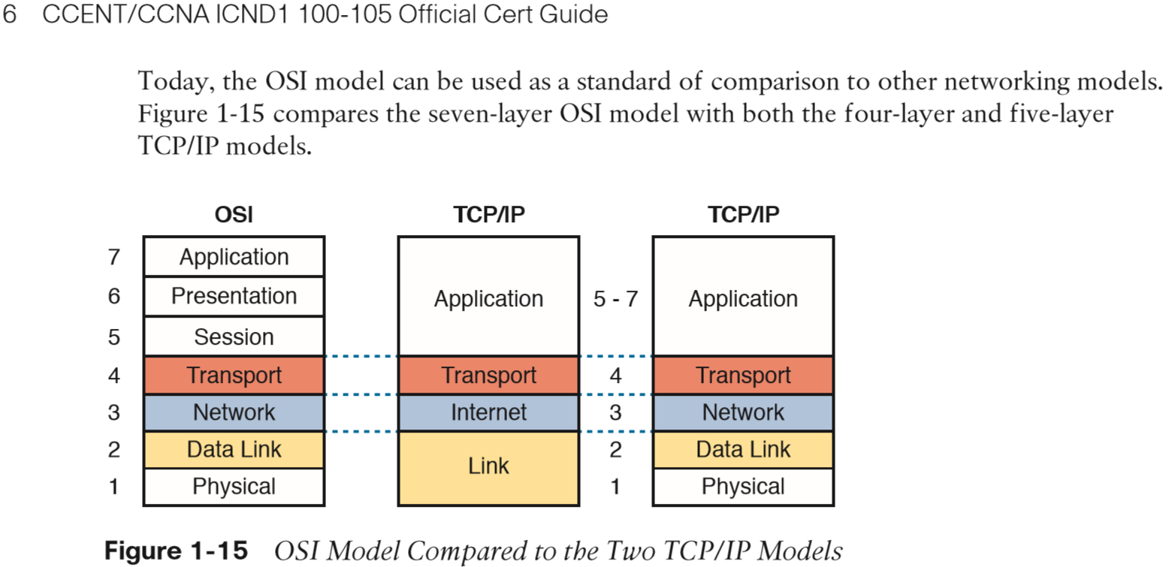
Visualization of the TCP/IP model

Slide 3
Protocols on the TCP/IP model
Process/Application
Telnet FTP LPD SNMP
TFTP SMTP NFS XWINDOW
HOST TO HOST
TCP UDP
INTERNET
ICMP ARP RARP
NETWORK ACCESS
ETHERNET FASTETHERNET GIGABITETHERNET 10 GIG ETHERNET

