Slide 1
DEPRESSION, A CRITIQUE OF THE PREVAILING VIEW:
(Section Two)
DEPRESSION: A CHEMICAL IMBALANCE?
Dr. Terry Lynch,
physician, psychotherapist, author
www.doctorterrylynch.com
info@doctorterrylynch.com

Slide 2
Section One
X 50 years
Brain chemical imbalances
Known feature
Depression
Main drivers:
Medical profession
Pharmaceutical industry
Psychology
Psychotherapy
Counselling
PERSUASION
Social work
Other mental health professionals
Occupational therapy
Psychiatric nursing
PERSUASION
GENERAL PUBLIC
Art therapy
Social care workers
Etc.
Mental health organisations
Recipients
Peer workers
Governments

Slide 3
The truth
No brain chemical imbalances
Ever identified
In
depression
Mass delusion:
Brain chemical imbalances are known to occur in depression
These brain chemical imbalances probably cause depression

Slide 4
Before any claims of chemical imbalances should be made
An actual existing chemical imbalance has to have been established
Common sense
Good practice

Slide 5
Chemical imbalance illnesses
Diabetes
Hypothyroidism
Depression
Pituitary disease

Slide 6
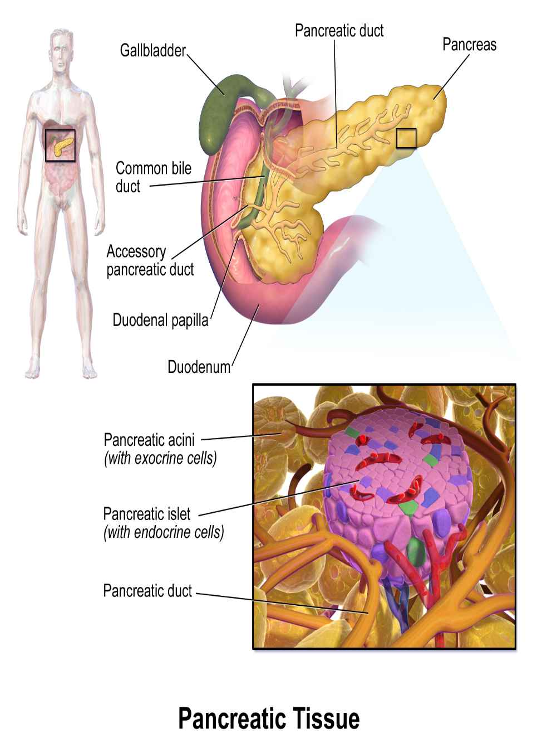
Diabetes
Organ:
Pancreas
Pathology:
Structure:
Islets of Langerhans
Function:
Insulin production
Chemical imbalance:
Raised blood glucose
Symptoms:
Signs:
Investigations:
Raised blood glucose levels
(3.0 – 5.5 mmol/l)
Diagnosis:
Rock solid scientifically

Slide 7
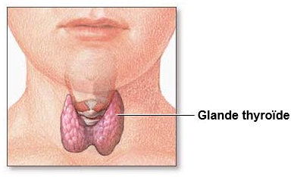
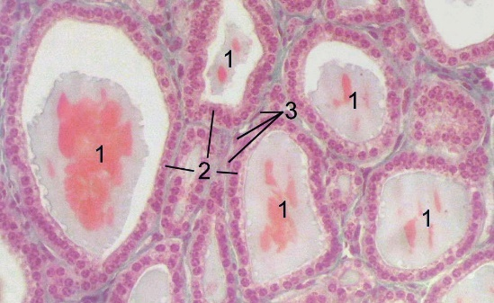
Hypothyroidism
Organ:
Thyroid
Pathology:
Structure:
Follicular cells
Function:
thyroid hormone production
Chemical imbalance:
levels of thyroid hormone
Symptoms:
Signs:
Investigations:
thyroid hormone levels
(Normal = 4.6-12 ug/dl)
thyroid Stimulating Hormone levels (TSH)
(Normal = 0.4-4.5 µIU/mL)
Diagnosis:
Rock solid scientifically

Slide 8
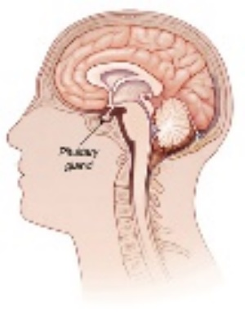
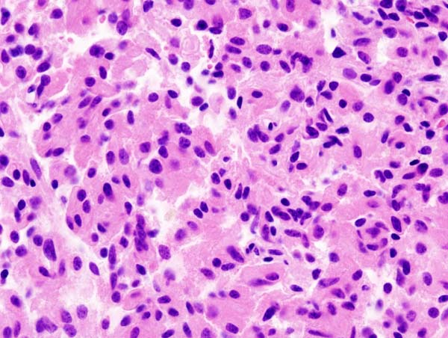
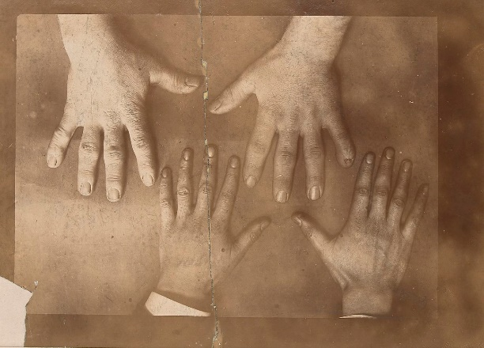
Pituitary disease
Several chemical imbalances
Several medical problems
PITUITARY ADENOMA
e.g. Growth Hormone overproduction
Organ:
Pituitary gland
Pathology:
Structure:
Abnormal + increased proliferation of pituitary cancer cells
Function:
levels of Growth Hormone
Chemical imbalance:
Symptoms:
Signs:
Giantism
Acromegaly
Investigations:
Growth Hormone levels
< 226 pmol/L
Diagnosis:
Rock solid scientifically

Slide 9
Chemical imbalance illnesses - characteristics
Imbalanced chemical:
Identified scientifically
Function of chemical:
Known
Normal range:
Known
Abnormal levels:
Known
Pathology:
Known
STRUCTURE abnormality
FUNCTION abnormality
Diagnostic test:
Available
Diagnosis:
Laboratory confirmation always required
Treatment:
Linked to + guided by ongoing lab tests
Replacing like with like:
Insulin;
Thyroid Hormone;
Growth Hormone;

Slide 10
Depression
Organ:
Brain
Pathology:
Structure:
None identified
Function:
None identified
Chemical imbalance:
None identified
“Imbalanced chemical not even identified
Symptoms:
Experiences and behaviours reclassified as “symptoms”
Signs:
None specific for depression
Investigations:
No part
No depression investigations exist
Diagnosis:
No basis whatsoever in science

Slide 11
Chemical imbalance illnesses – characteristics:
Depression
Imbalanced chemical:
Identified scientifically
Function of chemical:
Known
Normal range:
Known
Abnormal levels:
Known
Pathology:
Known
STRUCTURE abnormality
FUNCTION abnormality
Diagnostic test:
Available
Diagnosis:
Laboratory confirmation always required
Treatment:
Linked to + guided by ongoing lab tests
Replacing like with like:
Insulin;
Thyroid Hormone;
Growth Hormone;

Slide 12
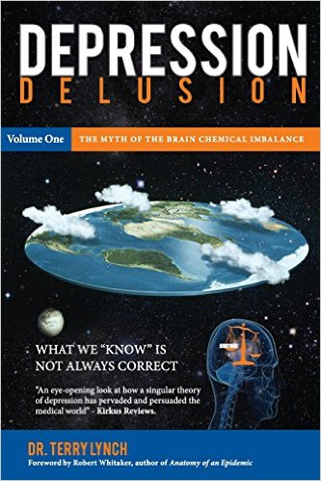
Depression Delusion, Volume One:
The Myth of the Brain Chemical Imbalance

Slide 13
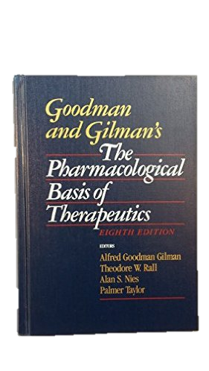
The Pharmaceutical Basis of Therapeutics
1990
A. Gilman, T. Rail, A. Nies, and P. Taylor, P (eds.), Goodman and Gilman’s The Pharmacological Basics of Therapeutics, 8th edition, New York: Pergamon Press, 1990,
p. 1811.
Two years after Prozac
Data for the neurotransmitter hypothesis
of mood disorders such as depression:
“Are inconclusive and have not been consistently useful either diagnostically or therapeutically.”

Slide 14
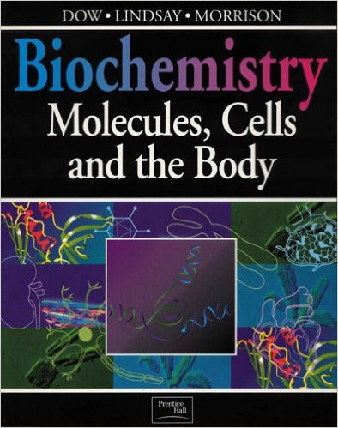
Biochemistry: Molecules, Cells and the Body
1995
Jocelyn Dow, Gordon Lindsey & Jim Morrison, Biochemistry: Molecules, Cells and the Body, Harrow: Addison-Wesley, 1995.
Seven years after Prozac launch
Medical textbook
592
pages
Depression not mentioned anywhere in book
No index entry for depression
1 for serotonin
(Depression)
0 for antidepressants
Diabetes:
3 pages on biochemistry of diabetes
Four index entries for diabetes
19 for glucose
10 for insulin

Slide 15
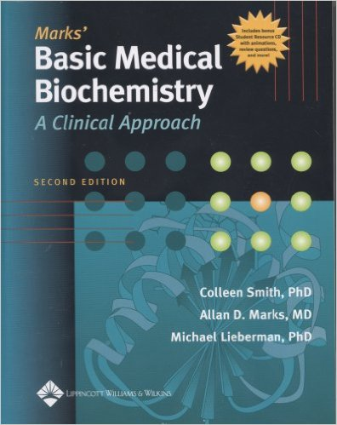
Mark’s Basic Medical Biochemistry: A Clinical Approach
2005
Allan D. Marks, Michael Lieberman & Coleen Smith, Mark’s Basic Medical Biochemistry: A Clinical Approach, 2nd edition, Lippincott, Baltimore: Williams & Wilkins, 2005.
Medical textbook
977
pages
Index:
5 entries for diabetes
19 for blood glucose
42 for insulin
0 entries for depression
1 for serotonin
(Depression)

Slide 16
Histology and Cell Biology: An Introduction to Pathology
Abraham L. Kierszenbaum and Laura L. Tres, Histology and Cell Biology: An Introduction to Pathology, 3rd edition, Philadelphia: Elsevier Saunders, 2012.
2012
Medical textbook
688
pages
32-page chapter on brain + nerve tissue + illnesses
Depression
22-page chapter
on neuro-endocrine system
Depression
Index:
0 entries for depression
3 for diabetes
12 for insulin
Serotonin: 1 mention
neurotransmitter
0 references in book
Brain neurotransmitter imbalances/abnormalities

Slide 17
Principles of Anatomy and Physiology
Gerard J. Tortora & Bryan Derrickson, Principles of Anatomy and Physiology, 11th edition, New Jersey: John Wiley & Sons, Inc, 2006, p. 429.
2005
Medical textbook
1,264
pages
Depression:
“A downward movement of a part of the body”
One index entry for serotonin:
Serotonin deficiency
Serotonin abnormality
Depression

Slide 18
1978
Dr. L. Ratna
Psychiatrist
“Although it is stated by practically all the (psychiatric) textbooks
that the aged are more prone to depression of an endogenous nature,
we believe that the unhappiness
which is misdiagnosed and treated as an endogenous illness
is a legitimate response to the plight that many of the aged find themselves in
The so-called depression therefore,
is not primarily due to a biochemical upset
but an understandable reaction
to the alienation, rejection, isolation and social stress that the aged are subject to”.
L. Ratna, “Crisis Intervention in Psychogeriatrics: A Two-Year Follow-up Study”, in L. Ratna, L., (ed.),
The Practice of Psychiatric Crisis Intervention, 1978, Hertfordshire: League of Friends, Napsbury Hospital, UK.

Slide 19
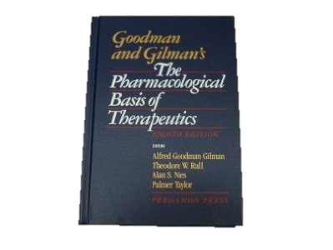
Solomon H. Snyder “Book Review—Goodman and Gilman’s The Pharmacological Basis of Therapeutics”, New England Journal of Medicine, 28 February 1991; 324:636-637, http://www.nejm.org/doi/full/ 10.1056/NEJM199102283240919, accessed 18 May 2014.
1990
“A ‘bible’ . . . a most valued volume”
The data for the neurotransmitter hypothesis
of mood disorders such as depression:
“Are inconclusive and have not been consistently useful
either diagnostically or therapeutically.”
Published two years after Prozac
A. Gilman, T. Rail, A. Nies, and P. Taylor, P (eds.), Goodman and Gilman’s The Pharmacological Basics of Therapeutics, 8th edition, New York: Pergamon Press, 1990, p. 1811.

Slide 20
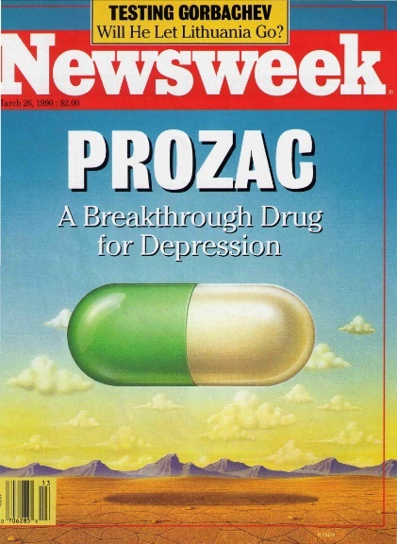
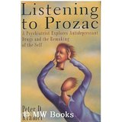
26th March 1990
1992
“They work
by correcting
an underlying
brain chemical imbalance”
“Better than well”

Slide 21
1992
“The Biology of Mental Disorders”, U.S. Government Printing Office, 1992.
The U.S. Congress Office of Technology
“Prominent hypotheses concerning depression
have focused on altered function of the group of neurotransmitters called monoamines,
particularly norepinephrine and serotonin
. . . studies . . . have found no specific evidence of an abnormality to date.
Currently, no clear evidence links abnormal serotonin receptor activity
in the brain to depression . . .
the data currently available do not provide consistent evidence
either for altered neurotransmitter levels or for disruption of normal receptor activity”.

Slide 22
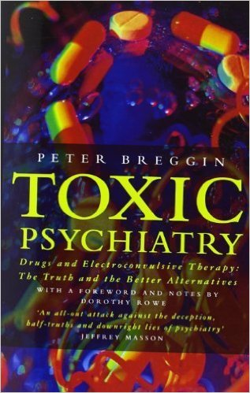
1993
Dr. Peter Breggin
American psychiatrist
“Scientific reviews of the biochemistry of depression
have failed to identify a consistent biochemical basis.
The most recent psychiatric textbooks review the biochemistry of depression,
sometimes in detail,
as if a great deal must be known about the subject;
but they end up admitting that the theories are conflicting and remain speculative.”
Peter Breggin, Toxic Psychiatry, London: HarperCollins, 1993, pps. 173-5.

Slide 23
1995
Dr. Colin Ross
American psychiatrist
“There is no scientific evidence whatsoever
that clinical depression is due to
any kind of biological deficit state”.
Colin Ross, Pseudoscience in Biological Psychiatry, New York: John Wiley & Sons, 1995, p. 111.

Slide 24
1997
. A. Nierenberg, “Antidepressants: Current Issues and New Drugs”, Harvard Medical School/ Massachussetts General Hospital Conference of Psychopharmacy,
17-19 October 1997.
Dr. Andrew Nierenberg
Professor of Psychiatry, Harvard Medical School
Harvard Medical School conference
“The dark side of all this
is that we have many elegant models
but the real fact is,
that when it comes to the exact mechanisms by which these things work,
we don’t have a clue.”

Slide 25
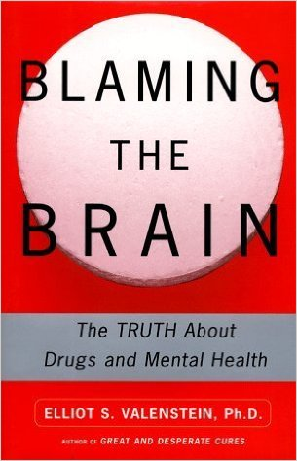
1998
Dr. Elliot Valenstein
Professor Emeritus of Psychology and Neuroscience
University of Michigan
“It may surprise you to learn
that there is no convincing evidence
that most mental patients have any chemical imbalance.
Yet many physicians tell their patients they are suffering from a chemical imbalance
despite the reality that there are no tests available
for assessing the chemical status of a living person’s brain.
The truth is that we still do not know what causes any mental disorder
Yet, despite this,
the theory that mental disorders arise from biochemical imbalance
is widely accepted”.
Elliot S. Valenstein, Blaming the Brain: The Truth About Drugs and Mental Health, New York: The Free Press, 1998.

Slide 26
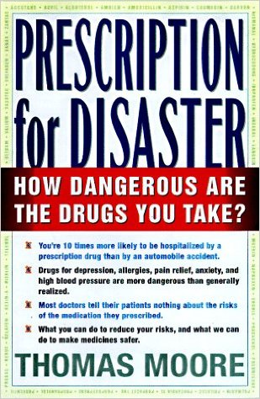
1998
Thomas J. Moore
Senior Fellow in Health Policy
George Washington University Medical Centre
“The chemical imbalance theory
has not been established by
scientific evidence”.
Thomas Moore, Prescription for Disaster: The Hidden Dangers in your Medicine Cabinet, Dell, 1998,
http: //www.bible.ca/psychiatry/psychiatry-mental-illness-myths-chemical-imbalances.htm, accessed 27 February 2014.

Slide 27
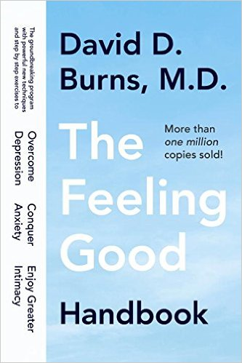
1999
Dr. David D. Burns
Clinical Associate Director of Psychiatry
and Behavioural Sciences
Stanford University Hospital of Medicine
“Some psychiatrists appear to confuse theory with fact.
They tell depressed patients that they have chemical depressions
that must be treated with antidepressants.
I would prefer that psychiatrists not do this,
because it creates an impression of certainty in the patient’s mind
that is not justified by current scientific evidence”.
David D. Burns, The Feeling Good Handbook, New York: Plume, 1999.

Slide 28
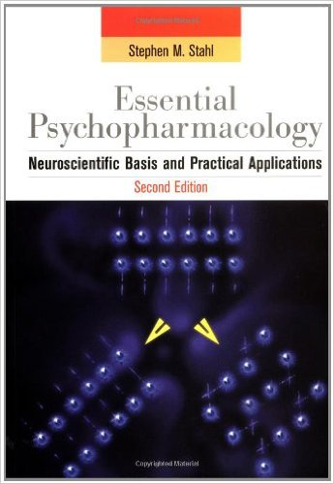
2000
Professor Stephen M. Stahl
Psychiatrist
“So far, there is no clear and convincing evidence
that monoamine deficiency accounts for depression;
that is, there is no “real” monoamine deficit.
Stephen M., Stahl, Essential Psychopharmacology: Neuroscientific Basis and Practical Applications, Cambridge: Cambridge University Press, 2000, p. 601.

Slide 29
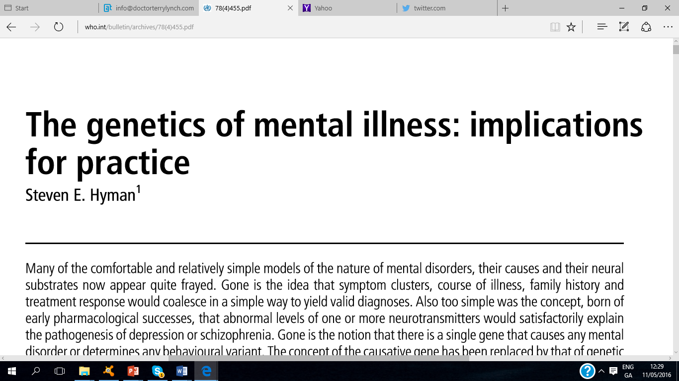
2000
Dr. Steven Hyman
American psychiatrist
Director, National Institute of Mental Health (NIMH)
World Health Organisation
Stephen E. Hyman, Bulletin of the World Health Organization, 2000, 78 (4), http://www.who.int/bulletin/archives/78(4)455.pdf, accessed 01st May 2016).

Slide 30
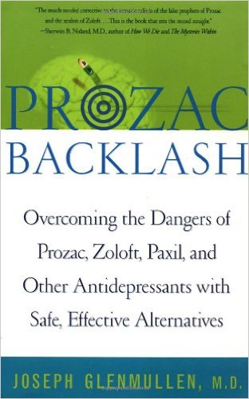
2001
Dr. Joseph Glenmullen
American psychiatrist
Harvard Medical School
“A serotonin deficiency for depression has not been found
There has been no shortage of alleged biochemical explanations
for psychiatric conditions.
Not one has been proven.
Quite the contrary.
In every instance where such an imbalance was thought to have been found,
it was later proven false.
Still, patients are often given the impression
that a definitive serotonin deficiency in depression is firmly established.”
Joseph Glenmullen, Prozac Backlash: Overcoming the Dangers of Prozac, Zoloft, Paxil and Other Antidepressants with Safe, Effective Alternatives, Simon & Shuster, 2001.

Slide 31
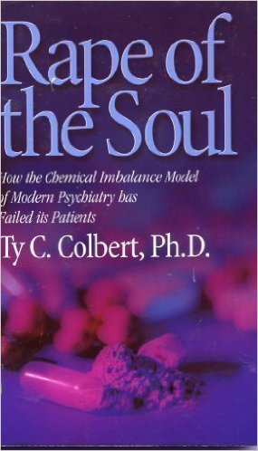
2001
Ty C. Colbert, Ph.D.
Clinical psychologist and author
“Biopsychiatrists have created the myth
that psychiatric ‘wonder’ drugs correct chemical imbalances.
Yet there is no basis for this model
because no chemical imbalance has even been proven
to be the basis of a mental illness.”
Ty Colbert, The Rape of the Soul: How the Chemical Imbalance Model of Psychiatry has Failed its Patients, California: Kevco Publishing, 2001, p. 79.

Slide 32
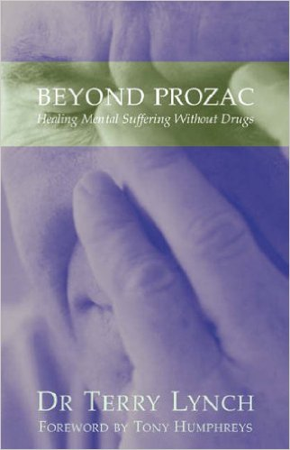
2001
Dr. Tony Humphreys
Irish psychologist and author
“In spite of 200 years of research,
no enduring evidence has emerged to substantiate
the medical model of psycho-social distress.
Indeed, there is no evidence that conditions such as
bipolar depression, schizophrenia, personality disorder,
obsessive-compulsive disorder and endogenous depression
have any biochemical, biological or hereditary basis.”
Dr. Tony Humphreys, in foreword to Beyond Prozac: Healing Mental Suffering Without Drugs,
Dublin: Marino Books, 2001, p. 11.

Slide 33
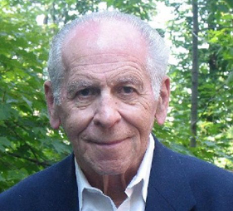
2002
Thomas Szasz, in “Psychiatric Hoax: The Subversion of Medicine”, Citizen’s Commission on Human Rights, 2002.
Dr. Thomas Szasz
Professor Emeritus of Psychiatry
New York University Medical School, Syracuse
“There is no blood or other biological test
to ascertain the presence or absence of mental illness,
as there is for most bodily diseases.
If such a test were developed,
then the condition would cease to be a mental illness
and would be classified, instead, as a symptom of bodily disease.”

Slide 34
2003
Patient information leaflet
Seroxat (Paxil)
“Works by bringing serotonin levels back to normal”
“There is no scientific investigation to measure
what are normal serotonin levels
in the human brain receptors.
As such, claiming that a particular medicinal product works
by bringing serotonin levels back to normal is not accurate”
http://www.cmaj.ca/content/174/6/754.2, accessed 26 February 2014.

Slide 35
2002
Seroxat (Paxil) patient information leaflet:
“The Irish Medicines Board has been reviewing this matter with its experts for some time,
and is in agreement that the statement that SSRIs
‘work by bringing the levels of serotonin back to normal’
is not consistent with the literature.
The company has been asked to review the patient information leaflet accordingly.
Thank you for your interest in this matter.”
Letter from Irish Medicines Board to me, November 2002.

Slide 36
2003
Bruce Levine, Ph.D.
American psychologist & author
“No biochemical, neurological, or genetic markers have been found
for attention deficit disorder, oppositional defiant disorder, depression, schizophrenia,
anxiety, compulsive alcohol and drug abuse, overeating, gambling
or any other so-called mental illness, disease, or disorder.”
Bruce Levine, Commonsense Rebellion: Taking Back your Life from Drugs, Shrinks, Corporations, and a World Gone Crazy, Bloomsbury Academic, 2003.

Slide 37
2003
Dr. David D. Burns
Clinical Associate Director of Psychiatry
and Behavioural Sciences
Stanford University Hospital of Medicine
“I spent the first several years of my career
doing full-time brain research on brain serotonin metabolism
but I never saw any convincing evidence that any psychiatric disorder,
including depression,
results from a deficiency of brain serotonin.
In fact, we cannot measure brain serotonin levels in living human beings
so there is no way to test this theory.
Psychiatrist David Burns, when asked about the scientific status of the serotonin theory in 2003, in J. R. Lacasse and T. Gomory, “Is graduate social work education promoting a critical approach to mental health practice?”
J Soc Work Educ 2003, 39: 383–408.
.

Slide 38
2004
Jonathan Leo
Professor of Neuroanatomy
“Never has a theory with so little scientific evidence
been so well accepted by the American public.”
If a psychiatrist says you have a shortage of a chemical,
ask for a blood test and watch the psychiatrist’s reaction.
The number of people who believe
that scientists have proven that depressed people have a low serotonin
is a glorious testament to the power of marketing.”
Jonathan Leo, “The Biology of Mental Illness” Society, July/August 2004, Volume 41, Issue 5, pp. 45-53, http://link.springer.com/article/10.1007%2FBF02688217#page-1, accessed 19 August 2014.

Slide 39
Dr. Ron Leifer
New York psychiatrist
“There’s no biological imbalance.
When people come to me and they say,
‘I have a chemical imbalance’,
I say,
‘Show me your lab tests’.
There are no lab tests.
So what’s the chemical imbalance?
There is no such thing as a chemical imbalance,
and any psychiatrist that you talk to,
if you ask them that question,
they’ll all admit it in private but they won’t admit it in public.
It’s a scandal.”
Ron Leifer, http://www.anxietycentre.com/downloads/Chemical-Imbalance-Theory-is-False. pdf, accessed 28 February 2014.

Slide 40
2004
Dr. Darshak Sangavi
Clinical fellow at Harvard Medical School
“Despite pseudoscientific terms like ‘chemical imbalance’,
nobody really knows what causes mental illness.
There’s no blood test or brain scan for major depression.”
Darshak Sanghavi, “Health Care System leaves Mentally Ill Children Behind”, Boston Globe, 27 April 2004, accessed 12th May 2016.

Slide 41
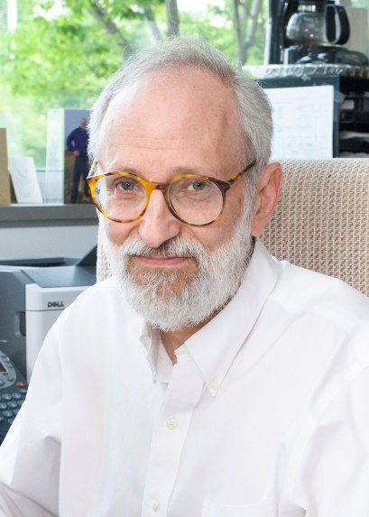
2005
Dr. Kenneth Kendler
American psychiatrist
co-editor-in-chief of Psychological Medicine
“We have hunted for big simple neurochemical explanations for psychiatric disorders
and have not found them”.
Kenneth S. Kendler, M.D., “Towards a Philosophical Structure for Psychiatry”, American Journal of Psychiatry, 01 March 2005, 162:433-440. Doi:1176/appi.ajp.162.3.433, accessed 18 February 2014.

Slide 42
2005
Dr. Joanna Moncrieff
Senior lecturer in psychiatry at University College, London
“The pharmaceutical industry has managed to convey a misleading picture.
I speak to quite a few journalists,
and they are quite shocked to hear
that the link between serotonin and depression is very tenuous
and the research conflicting and not convincing.
The psychiatric profession and academic researchers are probably also partly to blame
for glossing over the weakness of the research.”
Joanna Moncrieff, quoted in “Advertisements for SSRIs May Be Misleading”, by Laurie Barclay, MD, Medscape, 08 November 2005, http://www.medscape.com/viewarticle/516262, accessed 02 June 2014.

Slide 43
2005
Jonathan Leo
Jeffrey Lacasse
Professor of
Neuroanatomy
Professor of
Social Work
“During the past fifty years, a steady stream of researchers
have attempted to identify direct evidence for the monoamine theory of depression,
of which the serotonin hypothesis is one aspect.
They have consistently failed to do so.
Indeed, as many scientific researchers have demonstrated,
most of the evidence they found
either directly contradicted or did not support this theory.
In fact, there is no scientifically established ideal ‘chemical balance’ of serotonin,
let alone an identifiable pathological imbalance”.
J.R. Lacasse & J. Leo, “Serotonin and depression: A Disconnect between the Advertisements and the Scientific Literature”, PLoS Med: 2(12) e392, 08 November 2005, accessed 18 February 2014.

Slide 44
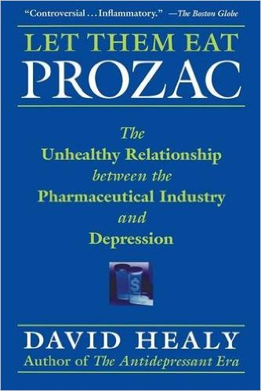
2006
Professor David Healy
Psychiatrist and psychopharmacologist,
University of Wales
British Association for Psychopharmacology
Historian of psychiatric drugs
“It is now widely assumed that our serotonin levels fall when we feel low
but there is no evidence for any of this, nor has there ever been
No abnormality of serotonin in depression has ever been demonstrated.”
David Healy, Let them Eat Prozac: The Unhealthy Relationship between the Pharmaceutical Industry and Depression, New York: New York University Press, 2006.

Slide 45
2006
Dr. David D. Burns
Clinical Associate Director of Psychiatry
and Behavioural Sciences
Stanford University Hospital of Medicine
I am not aware of any studies that have validated the chemical imbalance theory.
If I tell you that your depression or your panic attacks
result from a chemical imbalance in the brain,
then I’m telling you something that cannot be proven,
because there is no test for a chemical imbalance in the human brain.”
David Burns, When Panic Attacks: The New Drug-Free Anxiety Therapy that can Change your Life, Harmony, 2006.
.

Slide 46
2007
Dr. Peter Breggin
American psychiatrist
“Despite more than two hundred years of intensive research,
no commonly diagnosed psychiatric disorders have been proven to be
either genetic or biological in origin, including major depression.
At present there are no known biochemical imbalances
in the brain of typical psychiatric patients.”
Peter Breggin, Centre for the Study of Psychiatry and Psychology, http://www.alex-sk.de/mirror /braindis.html, 2007, accessed 27 November 2013.

Slide 47
2008
Professor Ivor Browne
Irish psychiatrist
“It was experiences like this which taught me
how bogus is the concept of ‘clinical depression’.
The idea that there is a chemically mediated form of depression
which is an “illness”,
quite separate from the sadness and depression
which are part of the slings and arrows of ordinary life,
is manifest nonsense.”
Ivor Browne, Music and Madness, Cork: Cork University Press: Cork, 2008, p. 121.

Slide 48
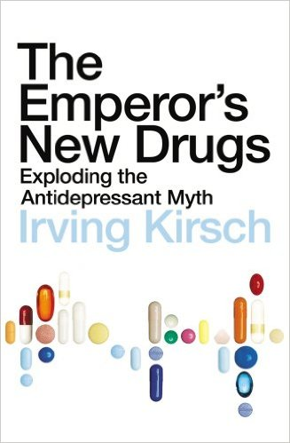
2009
Professor Irving Kirsch
Psychologist, researcher and author
“During the last 50 years,
researchers have tried to find more direct evidence
for the monoamine theory of depression,
but by and large they have failed.
Instead of finding confirmation,
much of the evidence they have found
is contradictory or runs counter to the theory.”
Irving Kirsch, The Emperor’s New Drugs: Exploding the Antidepressant Myth,
London; Random House, 2009, pps.90-93.

Slide 49
2009
Dr. Marcia Angell
American physician and author
Former Editor-in-chief of the New England Journal of Medicine
“The theory that psychiatric conditions
stem from a biochemical imbalance
is used as justification for their widespread use,
even though the theory has yet to be proved.”
Marcia Angell, “Drug Companies and Doctors: A Story of Corruption”, New York Review of Books, 15 January 2009.

Slide 50
2010
Jonathan Rottenberg Ph.D
Associate Professor of Psychology,
University of South Florida
“As a scientific venture,
the theory that low serotonin causes depression
appears to be on the verge of
collapse.”
Jonathan Rottenberg, “The Serotonin Theory of Depression is Collapsing”, Psychology Today, 23 July 2010, accessed 03 January 2014.

Slide 51
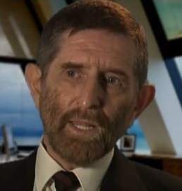
2010
Dr. Niall McLaren
Australian psychiatrist and author
“People are being told,
‘You have a chemical imbalance in the brain
which is genetically determined,
and you’ve got it for life.
And there’s nothing you can do about it.’
A catastrophe that needs to be exposed”.
Niall McLaren, http://biopsychiatry.ca/category/radio-show/dr-niall-mclaren/, 9 August 2010, accessed 11 May 2014.

Slide 52
Jerome Wakefield
Professor of Social Work and Psychiatry, New York University
“We’ve thrown tens of billions of dollars
into trying to identify biomarkers and biological substrates for mental disorders
The fact is we’ve gotten very little out of all that.”
In Kirsten Weir, “The Roots of Mental Illness”, American Psychological Association, June 2012, Vol. 43, No. 6, http://www.apa.org/monitor/2012/06/roots.aspx, accessed 26 March 2014.

Slide 53
2012
Vivek Datta
Psychiatrist
“The notion that mental illnesses are caused by chemical imbalances
is neither true, nor helpful . . .
It was supposed to be a beautiful narrative . . .
It is a story where medicine is the hero
and bad biochemistry the villain . . .
It is a story with no basis in reality.”
Vivek Datta, “Chemical Imbalances and Other Black Unicorns”, Mad in America website, 25 June 2012, http://www.madinamerica.com/ 2012/06/chemical-imbalances-and-other-black-unicorns /, accessed 27 February 2014.

Slide 54
2012
Steven Reidbord, “Chemical imbalance—Sloppy thinking in psychiatry 1”, in “Reidbord’s Reflections”, 29 April 2012, http://blog.stevenreidbordmd.com/?p=561, accessed 25 May 2014.
Dr. Steven Reidbord
American Psychiatrist
“Reidbord’s Reflections”
“Chemical imbalance—Sloppy thinking in psychiatry 1”.
“There’s a lot of sloppy thinking in my field.
This troubles me . . .
‘Chemical imbalance’ is a phrase used by psychiatrists and laypeople alike.
When a mental problem seems to arise from within instead of without,
it is said to be due to a chemical imbalance.
In truth, however,
no chemical imbalance, nor any structural abnormality in the brain
has ever been found
to account for anything we currently consider
a psychiatric disorder.”

Slide 55
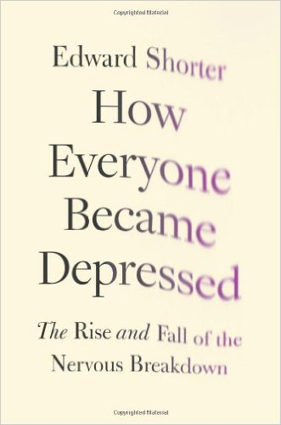
2013
Professor Edward Shorter
Canadian psychiatrist
Historian of psychiatry
“There is no biological marker for depression, major or not.
Nor has any psychiatric illness been convincingly attributed
to a shortage of any particular transmitter.”
i.e. a chemical imbalance
Edward Shorter, How Everyone Became Depressed, Oxford: Oxford University Press, 2013, pps. ix and 154.

Slide 56
2013
Dr. Steven Hyman
American psychiatrist
Former director, National Institute of Mental Health (NIMH)
http://dana.org/Cerebrum/Default.aspx?id=39489, accessed 16th May 2016

Slide 57
2007
Dorothy Rowe
Australian British-based psychologist and author
“There never has been any evidence
that any brain chemical was depleted when a person was depressed.
However, psychiatrists kept hoping that one day
their hypothesis that depression was caused by a chemical imbalance
would be proved to be right.”
Dorothy Rowe, “Real causes of depression”, Saga, February 2007, http://dorothyrowe. com.au/ articles/item/192-the-real-causes-of-depression-february-2007, accessed 24 November 2013.

Slide 58
2007
Dorothy Rowe
Australian British-based psychologist and author
“Now, thirty years after the hypothesis was first introduced,
the Royal College of Psychiatrists and the Institute of Psychiatry
have accepted that depression isn’t caused by a chemical imbalance.
But you will find this out only if you visit their websites.
would be proved to be right.
They haven’t issued a press release saying ‘We were wrong’”.
Dorothy Rowe, “Real causes of depression”, Saga, February 2007, http://dorothyrowe. com.au/ articles/item/192-the-real-causes-of-depression-february-2007, accessed 24 November 2013.

Slide 59
2007
Dorothy Rowe
Australian British-based psychologist and author
“On the Institute of Psychiatry’s website there is a lengthy notice
about an important conference on depression to be held in April 2007.
The preamble to this notice reads,
‘Depression cannot be described any longer as a simple disorder of the brain’.
The website of the Royal College of Psychiatrists
has dropped all references to chemical imbalance causing depression”.
Dorothy Rowe, “Real causes of depression”, Saga, February 2007, http://dorothyrowe. com.au/ articles/item/192-the-real-causes-of-depression-february-2007, accessed 24 November 2013.

Slide 60
Summary
Depression:
No brain chemical imbalances have ever been identified
A long list of highly qualified professionals
have tried to inform
regarding the real facts about depression and brain chemical imbalances.
Therefore
No doctor, mental health professional, mental health organisation
should say otherwise;
should state or imply a connection between brain chemicals and depression;
To do so
To MISINFORM

Slide 61
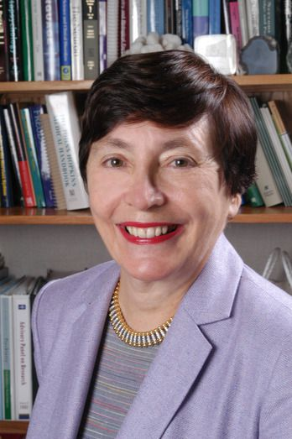
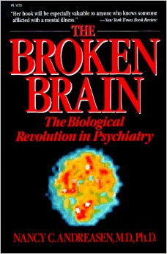
1984
Dr. Nancy Andreasen
American psychiatrist
“One suffers from a serotonin deficiency in the brain, while the other suffers from a norepinephrine deficiency.” (p. 133).
Nancy Andreasen,
The Broken Brain:
The Biological Revolution in Psychiatry,
New York: Harper & Row, 1984
The need for medication
“to correct the underlying chemical imbalance”. (p. 256)

Slide 62
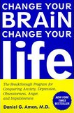
1999
Dr. Daniel Amen
American psychiatrist
“Depression is known to be caused
by a deficit of certain neurochemicals, or, neuro-transmitters
especially norepinephrine (noradrenaline) and serotonin”
Daniel Amen, Change Your Brain, Change Your Life: The Breakthrough Program for Conquering Anxiety, Depression, Obsessiveness, Anger, and Impulsiveness, Harmony, 1999, p. 47.

Slide 63
2001
Dr. Richard Harding
American psychiatrist
President of the American Psychiatric Association
“We now know that mental illnesses
— such as depression or schizophrenia —
are not ‘moral weaknesses’ or ‘imagined’,
but real diseases
caused by abnormalities of brain structure
and imbalances of chemicals in the brain.”
Richard Harding, “Unlocking the Brain’s Secrets”, in Family Circle magazine, 20 November 2001, p. 62

Slide 64
2001
Dr. Muiris Houston
Irish GP
Irish Times medical correspondent
"Depression, in my view, is no different from diabetes.
In one you take insulin
and in the other you take Prozac or some other antidepressant.
Both substances are simply designed
designed to replace natural chemicals missing from the body"
Dr. Muiris Houston, Irish Times, 17 December 2001

Slide 65
2003
Dr. D. Virginia Edwards
Canadian psychiatrist
“The brain has too few neurotransmitters in the gap”
(between nerve cells).
Dr. D. Virginia Edwards, Depression: What You Really Need to Know, London: Constable & Robinson Ltd., 2003, pps. 75-76.

Slide 66
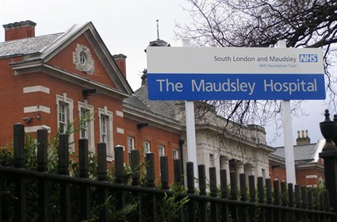
2005
Dr. Sabina Dosani
British psychiatrist
“Low levels of the neurotransmitter serotonin lead to depression . . .
when you’re depressed,
noradrenaline is released from brain cells at a snail’s pace,
so activity levels plummet.”
Dr. Sabina Dosani, Defeat Depression: Tips and Techniques for Healing a Troubled Mind,
Oxford: The Infinite Ideas Company Ltd: 2005, p. 55 and 110

Slide 67
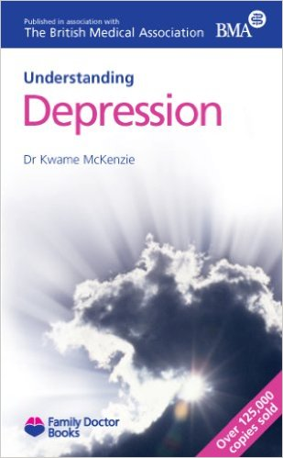
2006
Dr. Kwame McKenzie
Canadian psychiatrist
Professor of psychiatry at the University of Toronto
“The levels of neurotransmitters
are low in depression.”
Kwame McKenzie, Understanding Depression,
Family Doctor Publications in association with the British Medical Association, 2006, p. 72

Slide 68
2006
Dr. Kwame McKenzie
Canadian psychiatrist
Professor of psychiatry at the University of Toronto
“In depression there are physical changes
to the way in which your body works
and antidepressants can help put things back to normal.
The levels of these neurotransmitters are low in depression —
it’s as if the baton were being dropped.”
Kwame McKenzie, Understanding Depression,
Family Doctor Publications in association with the British Medical Association, 2006, p. 72

Slide 69
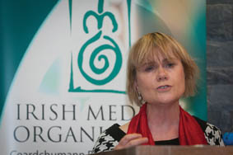
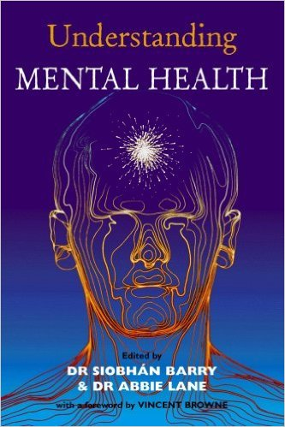
2006
Dr. Siobhan Barry
Irish psychiatrist
“Irregularities in brain chemistry
can involve substances called neurotransmitters and electrolytes”.
Siobhan Barry, in Understanding Mental Health, Dublin: Blackhall Publishing, 2006, p. 58.

Slide 70
2007
Dr. Harry Barry
Irish GP
“The three mood cables
which communicate using serotonin, noradrenaline and dopamine
are normally depleted in varying degrees during depression”.
Harry Barry, Flagging the Problem: A New Approach to Mental Health,
Dublin: Liberties Press, 2007, pps. 135, 33-34, 83, 145.

Slide 71
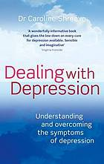
2010
Dr. Caroline Shreeve
British-based GP
“Dopamine, serotonin and noradrenaline . . . are known as the monoamines . .
Monoamine supplies are low in depression.”
Caroline Shreeve, Dealing with Depression: Understanding and Overcoming
the Symptoms of Depression, London: Piatkus, 2010, p. 39.

Slide 72
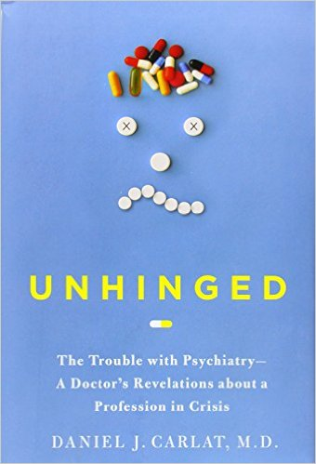
2010
Dr. Daniel Carlat
American psychiatrist
“I didn’t tell her that,
despite my training at Harvard’s Massachusetts General Hospital,
I have no idea how Lexapro works to relieve depression,
nor does any psychiatrist.
There is no direct evidence of a disorder of reduced serotonin.”
i.e. there is no evidence of a brain chemical imbalance,
of serotonin or any other chemical
But that is not what he told his patient
Daniel Carlat, Unhinged: The Trouble with Psychiatry—a Doctor’s Revelations about a Profession in Crisis, London: Free Press, 2010, p. 13.

Slide 73
Dr. Deborah Serani
2012
American psychologist
“These signaling networks can also show disruptions
in the production and/or absorption of brain chemical messengers,
called neurotransmitters .”
Deborah Serani, Living with Depression: Why Biology and Biography Matter Along the Path to Hope and Healing (2012) p.19

Slide 74
2013
Dr. Tim Cantopher
British psychiatrist
“Antidepressants do work, but only for real clinical depression,
the type involving a chemical imbalance in the brain”.
Dr. Tim Cantopher, in
The Guardian special report on antidepressants, The Guardian,
21 November 2013.

Slide 75
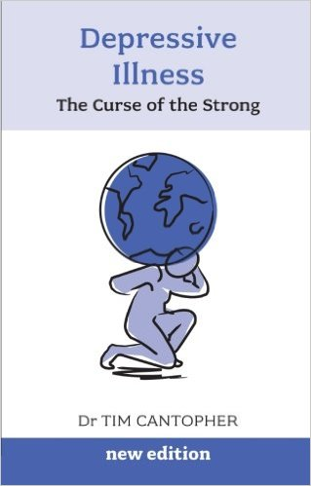
Dr. Tim Cantopher
British psychiatrist
“If I were to perform a lumbar puncture on my patients
(which, new patients of mine will be pleased to hear, I don’t),
I would be able to demonstrate
in the chemical analysis of the cerebro-spinal fluid
(the fluid around the brain and spine),
a deficiency of two chemicals”.
Dr. Tim Cantopher, Depressive Illness: The Curse of the Strong, 3rd edition, Scheldon Press, 2012, p.1.

Slide 76
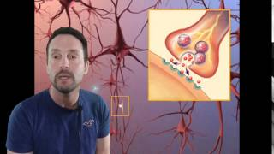
2013
Dr. Greg Castello
American family physician
“Many people suffer from depression and anxiety.
They share a common condition with those that have
Obsessive Compulsive Disorder (OCD),
anorexia nervosa, bulimia, Post Traumatic Stress Disorder (PTSD)
and even insomnia.
They are all due to a deficiency of serotonin,
a neurotransmitter in the brain.”
Dr. Greg Castello, “Depression, Anxiety, OCD and More: Serotonin the Master chemical”, YouTube video,
12 May 2013, https://www.youtube.com/watch?v=6YO6SMGHn_M, accessed 08 June 2014.

Slide 77
2014
Dr. Chris Steele
British GP
“She had a lot of stress.
It drained her brain of natural chemicals
and she got depression.”
“This Morning”, ITV, 18th March 2014.

Slide 78
2014
Dr. Dawn Harper
British GP
Depression:
“Is very much a chemical illness.
The reason that antidepressants work
is that we know that
they alter the chemicals in the brain and rebalance them”.
Dr. Dawn Harper, medical expert on ITV’s This Morning, during a discussion on depression on 12 August 2014.

Slide 79
2014

Slide 80
http://www.walkinmyshoes.ie/about/, accessed 16th May 2016

Slide 81
http://www.walkinmyshoes.ie/news/free-information-packs-download/, accessed 16th May 2016

Slide 82
http://www.walkinmyshoes.ie/wp-content/uploads/2016/04/Mind-your-selfie_your-mental-health.pdf, accessed 16th May 2016.

Slide 83
http://www.walkinmyshoes.ie/wp-content/uploads/2016/04/Mind-your-selfie_your-mental-health.pdf, accessed 16th May 2016.

Slide 84
http://www.walkinmyshoes.ie/news/free-information-packs-download/, accessed 16th May 2016.

Slide 85
http://www.walkinmyshoes.ie/wp-content/uploads/2016/04/Mind-Your-Selfie-Secondary-Ebook.pdf,
accessed 16th May 2016.

Slide 86
http://www.walkinmyshoes.ie/wp-content/uploads/2016/04/Mind-your-selfie_college.pdf, accessed 16th May 2016.

Slide 87
http://www.walkinmyshoes.ie/wp-content/uploads/2016/04/Mind-your-selfie_corporate.pdf, accessed 16th May 2016.

Slide 88
http://www.nimh.nih.gov/health/educational-resources/brain-basics/brain-basics.shtml#Brain-Basics-in-Real-Life, accessed 16th May 2016

Slide 89
http://www.nimh.nih.gov/health/educational-resources/brain-basics/brain-basics.shtml#Brain-Basics-in-Real-Life, accessed 21st April 2016

Slide 90
https://www.psychiatry.org/patients-families/depression/what-is-depression, accessed 16th May 2016.

Slide 91
https://www.psychiatry.org/patients-families/depression/what-is-depression, accessed 16th May 2016.

Slide 92
https://www.ndsu.edu/fileadmin/counseling/APAdepression.pdf, accessed 16th May 2016.

Slide 93
http://www.mayoclinic.org/diseases-conditions/depression/multimedia/antidepressants/vid-20084764, accessed 16th May 2016.

Slide 94
http://www.mayoclinic.org/diseases-conditions/depression/multimedia/antidepressants/vid-20084764, accessed 16th May 2016.

Slide 95
Robert Whitaker
American journalist and author
Finalist for the 1999 Pulitzer Prize for Public Service.
1998 National Association of Science Writers’ Science in Society Journalism Award for best magazine article.
2010
2015
2001

Slide 96
Medical profession
A
A
conspiracy
mass
to
delusion
misinform

Slide 97
Summary
No situation can rightly be called a chemical imbalance illness
Unless a pre-existing chemical imbalance has actually been fully established
No pre-existing or subsequent chemical imbalance has been established in depression
Depression is NOT a chemical imbalance illness

