Slide 1
Practices that Work
Courtney Byham, Recruiting Program Manager

Slide 2
The Need for Top Talent
Hyland’s Military Journey
Hyland’s VERG

Slide 3
15,000+ Customers in 67 Countries

Slide 4
LawLogix (Phoenix, AZ)
Melbourne, Australia
Our global offices
Notes:
Our Employees
With offices around the world. Approximate counts:
Westlake, OH:1,500
Brazil: 30
Switzerland: 10
London: 20
Australia: 10
Japan: 12
…And 300 remote employees covering everywhere in between.

Slide 5




Top Talent Needed
Business /
Technical Consultants
Quality
Assurance
Year Over Year Growth
Software Developers
Technical
Support
400+ New Annual Positions
Notes:
Experiencing year over year growth
International growth expansion
New locations
New remote territories
400+ budget new annual positions
Software Developers
Quality Assurance
Technical Support
Business/Technical Consultants

Slide 6




Ohio Veterans
Veterans call Ohio home
(6th biggest state)
Veterans currently in the labor force
830,000
450,000
3.5%-
4.5%
25,000
Student Veterans currently in the University System
Ohio Veteran Unemployment Rate
Notes:
Ohio Veteran’s: By the Numbers
[CLICK] 830,000 Veterans call Ohio home (6th biggest state)
10,000 Service Members return to Ohio each year
[CLICK] 450,000 Veterans currently in the labor force
[CLICK] 25,000 Student Veterans currently in the University System
[CLICK] 3.5%-4.5% Ohio Veteran Unemployment Rate

Slide 7

Where Did We Start?
Assessed the job application process.
Targeted specific veteran job boards.
Networked with local & national Veteran associations.
Researched the needs for onboarding, hiring & interviewing Veterans.
Notes:
So Where Did We Start? We Assessed Current State
Veterans were applying to Hyland, but not getting pass application status.
Veterans were not applying through popular job boards.
Indeed
Monster
Networked with local & national veteran associations.
Local veteran services
Ohio Department of Veteran Services
Military Bases
Fort Huachuca
Fort Bragg
Keesler Air Force
Wright-Patterson
Researched the needs for onboarding, hiring and interviewing veterans.
Hyland had no dedicated veteran resource
No MOS translator for job descriptions

Slide 8




Hyland’s Military Journey
Used Management Meetings to Train on Veteran Best Practices
Attended Three NEOVETS Workshops
Started Meeting with Hyland Veterans
Notes:
NEOVETS
1) Attended three workshops
Increased veteran applications by 2.6%
Networked with local & national veteran associations
Took advantage of their free resources
Setup weekly calls with NEOVETS to stay on track
Started a small internal group at Hyland
2) Started meeting with our Hyland Veterans
What would you like to see at Hyland?
What was a big challenge for you?
Onboarding
Training
New Employee Period
Would you be interested in assisting Hyland’s recruiting team?
3) Took advantage of management meetings to train Hyland on veteran best practices
Tammy Colson, TalentCrib
Free resources online
Ohio Means Jobs

Slide 9


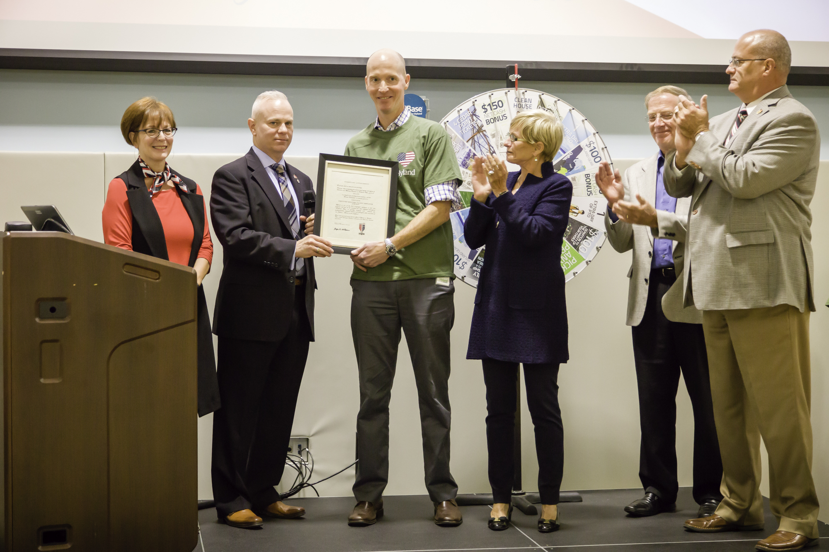
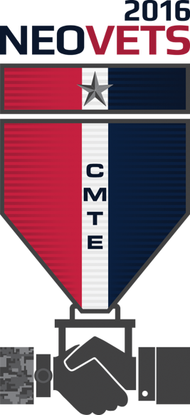
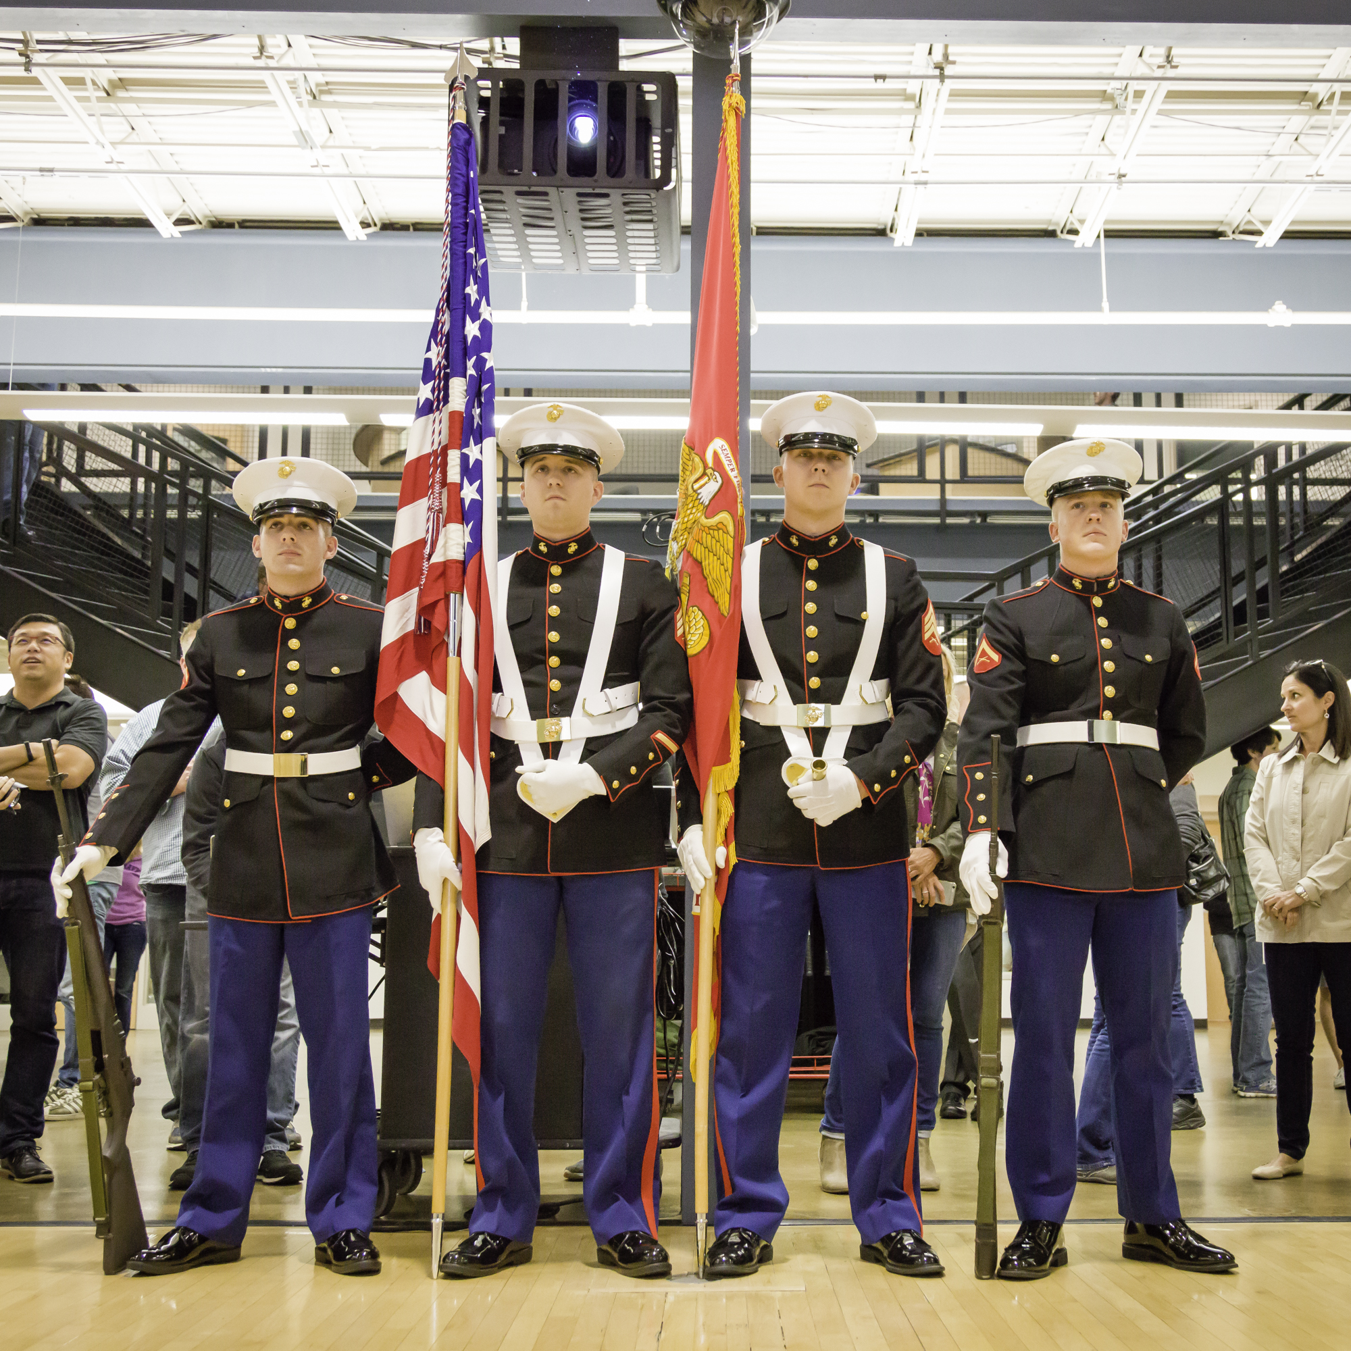
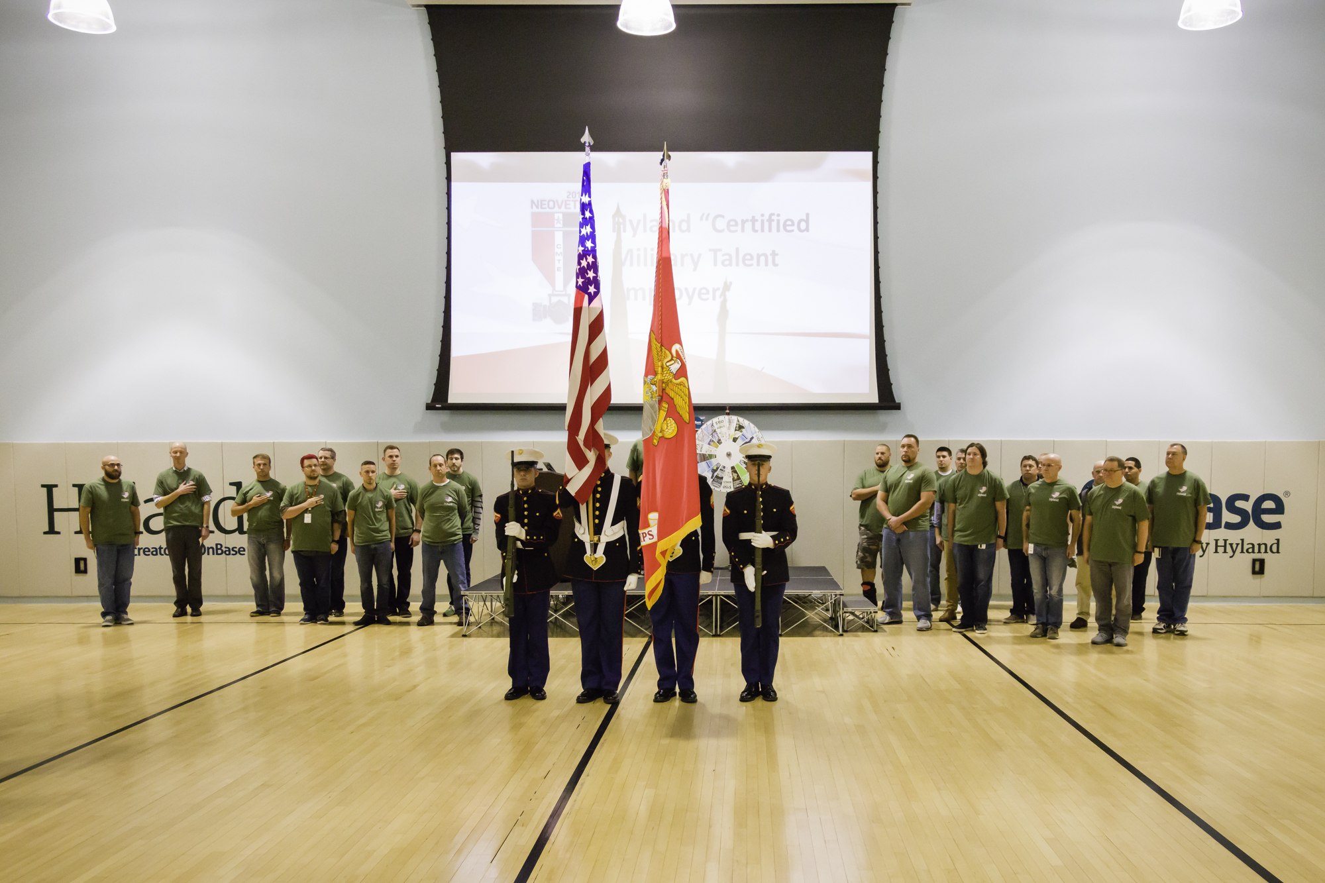
NEOVETS Certified Talent Employer Award
Notes:
We were honored to accept the NEOVETS Certified Talent Employer Award on October 10th, 2016.

Slide 10
Proven Track Record
Integrity
Instant Leadership
Adaptability
Loyalty
Teamwork
Hiring Vets

Slide 11

Hyland’s VERG
External Speaker Series
Veteran Mentorship Program
Assists Recruiting Team
Military Monthly Meetings
Notes:
Veteran Employees Resource Group – (VERG)
External Speakers Series
We have brought in speakers for each of our meetings. They spoke and let the vets know what their organizations could do for them. We also provide lunch for the meetings, since more people show up if there is free food!
Veteran Mentorship Program
Assists Recruiting Team – Job Fairs, Campus Visits, Military Bases, Meet & Greets, Open Houses
Talk to other employee veteran groups in the area. Share ideas, see what is and is not working. Bring your groups together for joint events if possible.
Work together, because no matter what branch you served in, or where you are employed, remember we are all brothers and sisters.
Military Monthly Meetings
Our first Veterans Group meeting took place during our benefits open season. We brought in a Hyland Benefits Rep, and a VA benefits rep. This allowed the vets to ask tons of questions about how to make the most out of their VA benefits and their Hyland Benefits. It also let them know what situations could compromise some of their benefits

Slide 12
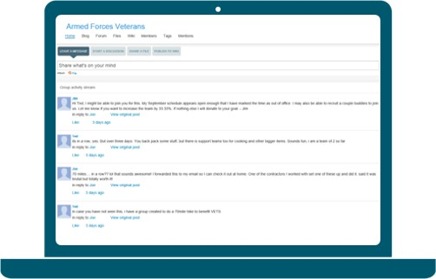


Communicating with VERG
Monthly Meetings
Connect
(Discussion Board)
E-mail
Notes:
As your organization and Veteran communities grow, your ability to communicate needs to grow as well. At Hyland we have several different ways to communicate:
Like I mentioned previously, we meet once a month, on the second Thursday of the month. It has a consistent day, if not date. This allows employees to plan ahead and let their supervisory team know.
We have a site called Connect, which is almost like a Facebook for work. There are forums and discussions as well as a public ‘wall’ everyone can post to. We created a closed group specifically for Veterans. In there we post meeting times, ideas we have, etc. I put posts in there if I need to get a specific set of skills.
And we use good old fashioned e-mail. I use this to get people to go to the veteran group. For example: Fellow Vets, we were given a new benefit.

Slide 13

Employee Buy-In
“What’s in
it for me?”
Notes:
Employee buy-in is essential for a program to succeed. As you heard from Joe and John, just a few motivated veterans and employees can build a program from nothing to something incredible.
Getting employee buy-in is not as easy as it sounds. You have to let them know What’s In It For Me (WIFFM). You need to give them some tangible (veteran specific) benefits.
The VERG is not MY group, or JOE or JOHN’S group, it is all of our group. I make sure to make that distinction when referring to it. We got everyone involved from the beginning. Even doing something as simple as letting everyone weigh-in and vote on the name of the group will help gain that buy-in.

Slide 14
2016-2017 Stats
VETERANS INTERVIEWED
Before NEOVETS 11%
After NEOVETS 15%
VETERANS IN HYLAND’S VERG
Before NEOVETS
23%
After NEOVETS
74%
Notes:
Not only have we created a community at Hyland that supports our Veterans, we’ve improved our overall process of recruiting Veterans.
We’re proud to say that we’re interviewing AND hiring more Veteran’s than we were before NEOVET’s.

Slide 15


Key Takeaways
Use manager meetings to train on veteran best practices
Start small & gain employee buy-in
Members should own the VERG
Veterans will recruit other veterans
Share expertise throughout organization
Notes:
Takeaways
Start small and gain buy-in
Find passionate veterans internally who want to help your mission.
Ask what they want your organization to do.
Assess their answers and implement.
Veterans will recruit other veterans – into the VERG and into the organization
Employee referral program
Take advantage of your management meetings to train on veteran best practices.
Finally, get your members to own the group.
Veteran’s have some much knowledge and expertise. Look for unique ways that they can be of assistance within the organization.

Slide 16
#HireVets

Slide 17
Courtney Byham
Recruiting Program Manager
Courtney.Byham@onbase.com
Notes:
Thank you for joining us today!
If you have any questions, feel free to reach out to me directly.

Slide 18
Current CMTETM Partners
Cleveland Clinic
EMC Precision
Hyland
Lorain County Community College
NE Ohio VA Healthcare System
Nagle Companies
Nation’s Lending Corporation
NE Ohio Regional Sewer District
Park Place Technologies
Rustbelt Reclamation
Selman & Company
You….

