Slide 1
Your Bank Credit Score

Slide 2
Business Bank Accounts
It is essential that a business owner separate personal and business banking
This is needed to run a successful business
One of the main financial tools used to accomplish this is a business bank account
A business bank account helps:
maintain accurate records
prepare reports
make deposits and withdrawals
make wire transfers
issue checks
and a lot more

Slide 3
Business Bank Accounts Have Benefits
Lessen tax headaches and liabilities by keeping business revenue and expenses separate from personal
This will keep you from accidentally commingling funds
Accept debit and credit cards as with a business account there is a place for the merchant processor to deposit funds
This makes it easy to accept more types of payments and get more sales

Slide 4
Business Bank Accounts Have Benefits
Business accounts have more lenient fees
For example, fees may be waved when you use online banking
Your business banking relationship can also help you secure bank loans
How you handle your business bank account is information for a possible lender...
...which goes beyond business and personal credit scores

Slide 5
Setting Up a Business Bank Account
Setting up a business bank account is one of the first things any business should do
This is the actual order of setting up a new business…
Set up your business entity, such as an LLC or corporation
Get your free EIN number from the IRS
Use your corporation papers and EIN to set up a business bank account

Slide 6
Bank Account Start Date
Your bank account start date is an important day
For lenders, it defines the entity start date
It’s essential to set up a business bank account quickly
This is because many lenders and credit issuers see a bank account setup date as the date a company really opened

Slide 7
Bank Account Start Date
It used to be that lenders would look at the entity inception date and call it the company start date
But due to so many fake company setups such as shelf corporations...
...now a bank account is used for business inception date in many cases
Banks use account start date because it helps make it so fraud doesn't pay

Slide 8
Getting a New Business Bank Account
You will need to provide several items when setting up a new account:
Entity papers, such as Articles of Incorporation
Completion of their application
Proof of your EIN number
Your ID
Initial deposit of $25 – 200 depending on the bank and account type

Slide 9
Setting Up a Business Bank Account
Set up your bank account the right way to make it easy to get credit and loans in the future
Your company name must perfectly match your entity paperwork
Your company address also must be the same
Make sure your EIN number is the same on the bank account as it is on EIN paperwork

Slide 10
Setting Up a Business Bank Account
Most banks are going to require you go into the bank to get a new account set up
When you leave they’ll give you a folder
It will have documents that outline the terms on the bank account
It will likely also include information on how to set up online banking
You’ll also get temporary checks for the account

Slide 11
Business Bank Account Details
The bank will probably have a service they recommend to get checks
On your first order, they might try to charge you $150 or more
But be careful as you won’t need all that they bundle in with the checks
Often on your first order they’ll give you a starter kit

Slide 12
Business Bank Account Details
A starter kit will include:
a binder
deposit bag
company stamp/seal for endorsements
and other perks
You do not need all of this

Slide 13
Business Bank Account Details
You can order most of what is in a starter kit online much cheaper anyways
Also watch out for the amount of checks they’re giving you
Start with as few as you can
You might not want or need 250 or more to start
This is particularly true if most of your business's expenses are paid online

Slide 14
Bank Credit Scores
Many people don’t know about these at all
Yet they are how banks determine who to loan to…
…and who to turn down
If you want a loan, then you’ll need to know this

Slide 15
Bank Credit Scores
Bank credit (Bank Rating) is total amount of borrowing capacity a business can get from the banking system
Business credit is a much broader category of lenders such as suppliers, credit card issuers, or leasing companies
A business can get more business credit quickly if:
it has a minimum of one bank reference and
an average daily account balance of at least $10,000
for the past 3 months

Slide 16
Bank Credit Scores
An average daily account balance of $10,000 for the past 3 months…
… yields a “Bank Rating” of Low-5
This means an Adjusted Debt Balance of $5,000 to $30,000
A lower rating (e. g. a High-4 or balance of $7,000 to $9,999) won’t stop a business’s application…
…but it will slow down the approval process

Slide 17
Bank Ratings
High-5 = account balance of $70,000 – $99,999
Mid-5 = account balance of $40,000 – $69,999
Low-5 = balance of $10,000 – $39,000
High-4 = $7,000 – $9,999
Mid-4 = $4,000 – $6,999
Low-4 = $1,000 – $3,999

Slide 18
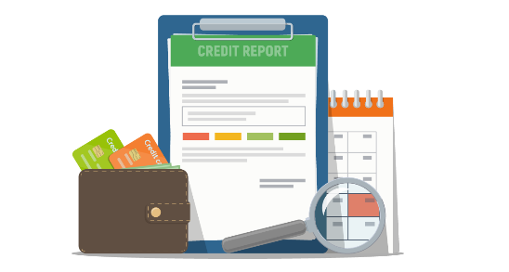
Bank Ratings
Keep bank ratings up
Do whatever it takes to keep at least $10,000 in an account over a 90-day period
Money should be kept there…
… just to ensure a bank rating is high enough to increase future financing approvals

Slide 19
Bank Ratings
Bank ratings are calculated in cycles
Each cycle is based on the balance rating in the previous 3 month period
Before a business decides to apply for credit…
…it should keep a balance rating of Low-5 for the last 3 months

Slide 20
Bank Ratings
Without at least a Low-5 rating, most banks will assume a business has little ability to repay a loan or a line of credit
Bank ratings are a measurement of how responsible the account owner is with funds
To a bank, the following are irresponsible:
Insufficient funds
Negative cash flow
Low balances

Slide 21
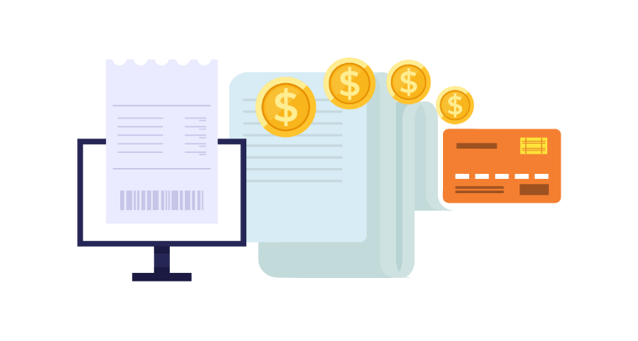
More Bank Rating Factors
Number of non-sufficient funds (NSFs)
Positive cash flow
Consistency of deposits
Age of the account
The bank products the business uses
Any savings account or investments a business has

Slide 22
Keeping a Bank Rating Up
Keep money in the bank over a 90-day period
Always retain a balance of $10,000 or better
Keep up a positive cash flow
Keep the accounts balanced to avoid NSFs

Slide 23
Recap for Your Bank Credit Score
A business bank account is vital for success
It can be set up correctly from the start…
…and that will help business owners get loans and credit
Bank credit scores measure account holder responsibility
Responsible financial stewardship will pay off every time

