Slide 1
Lewis Structures
Sharing in pictures

Slide 2
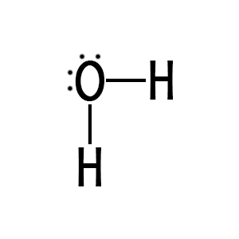
Lewis structures
Lewis structures are 2-D drawings of covalent molecules.
They use lines to represent the bonds and dots to represent valence electrons that are not involved in the bonding. The nonbonding electrons are called lone pairs.

Slide 3
Three Methods
Trial and Error
Pattern
Notes:
The pattern method has some exceptions, which is why I don’t use it exclusively. CO and SO2 are two common exceptions.

Slide 4
Three Methods
Calculation (NHSU)
Use the Octet Rule to find how many electrons the atoms NEED.
Use valence electrons to find how many elections we HAVE.
NEED – HAVE = SHARED. The shared electrons form your bonds (2 e- per bond).
HAVE – SHARED = UNSHARED. The unshared electrons are the dots in the picture.
Notes:
The Octet Rule states that everyone needs 8 valence electrons, except hydrogen who needs 2.

Slide 5
Calculation Method
Lets look at NH₃ as an example.
NEED: | 8 + 3(2) = | 14
HAVE: | 5 + 3(1) = | 8
SHARED: | = | 6 (3 bonds)
UNSHARED: | = | 2 (dots)

Slide 6
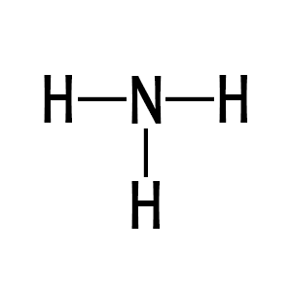
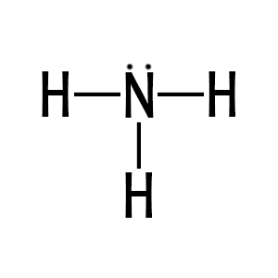
Calculation Method
Place the first element in the middle, unless it is hydrogen. Arrange the second element around it.
Draw in the bonds from the center atom out to the others. Draw bonds until you run out. It is possible to have a double or triple bond.
Check each atom to see if they satisfy the Octet Rule. If not, then add dots to represent extra electrons until they satisfy the Octet Rule.

Slide 7
Multiple Bonds
carbon dioxide: CO₂
NEED: | 8 + 2(8) = | 24
HAVE: | 4 + 2(6) = | 16
SHARED: | = | 8 (4 bonds)
UNSHARED: | = | 8 (dots)

Slide 8
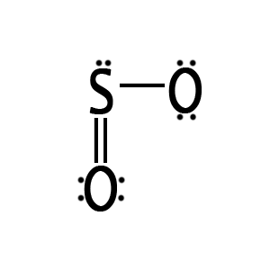
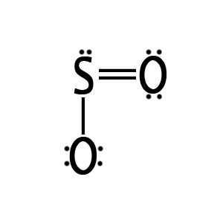
Resonance
sulfur dioxide: SO₂
NEED: | 8 + 2(8) = | 24
HAVE: | 6 + 2(6) = | 18
SHARED: | = | 6 (3 bonds)
UNSHARED: | = | 12 (dots)
OR

