Slide 1
Carrying Data Over an RF Signal

Slide 2
Carrying Data Over RF Signal
Characteristics of Antennas
To provide good wireless LAN coverage in a building, or outdoor area or between both locations, you're going to be dealing with allot of different variables
Cubicles
Offices along a long hallway
A big open lobby area
Classrooms
Sports Arena or Outdoor Park

Slide 3
Carrying Data Over RF Signal
Radiation Patterns
Antenna gain is normally a comparison on antenna against an isotropic antenna measured in dbi or decibel-isotropic. Which really does not exist.
An Isotropic antenna is simply an ideal, perfect and almost impossible to construct. But it is the easiest and most basic antenna that we can use to explain the concept of electro magnetic waves.

Slide 4
Carrying Data Over RF Signal

Slide 5
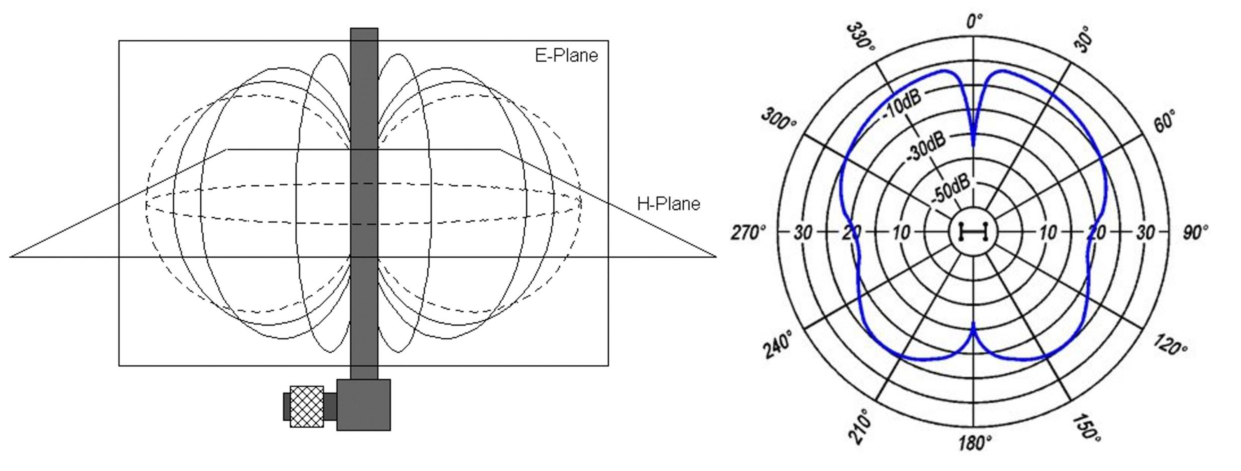
Carrying Data Over RF Signal

Slide 6
Carrying Data Over RF Signal

Slide 7
Carrying Data Over RF Signal
Objects and materials will affect your WLAN signal in different ways
Reflection
Absorption
Scattering
Refraction
Diffraction

Slide 8
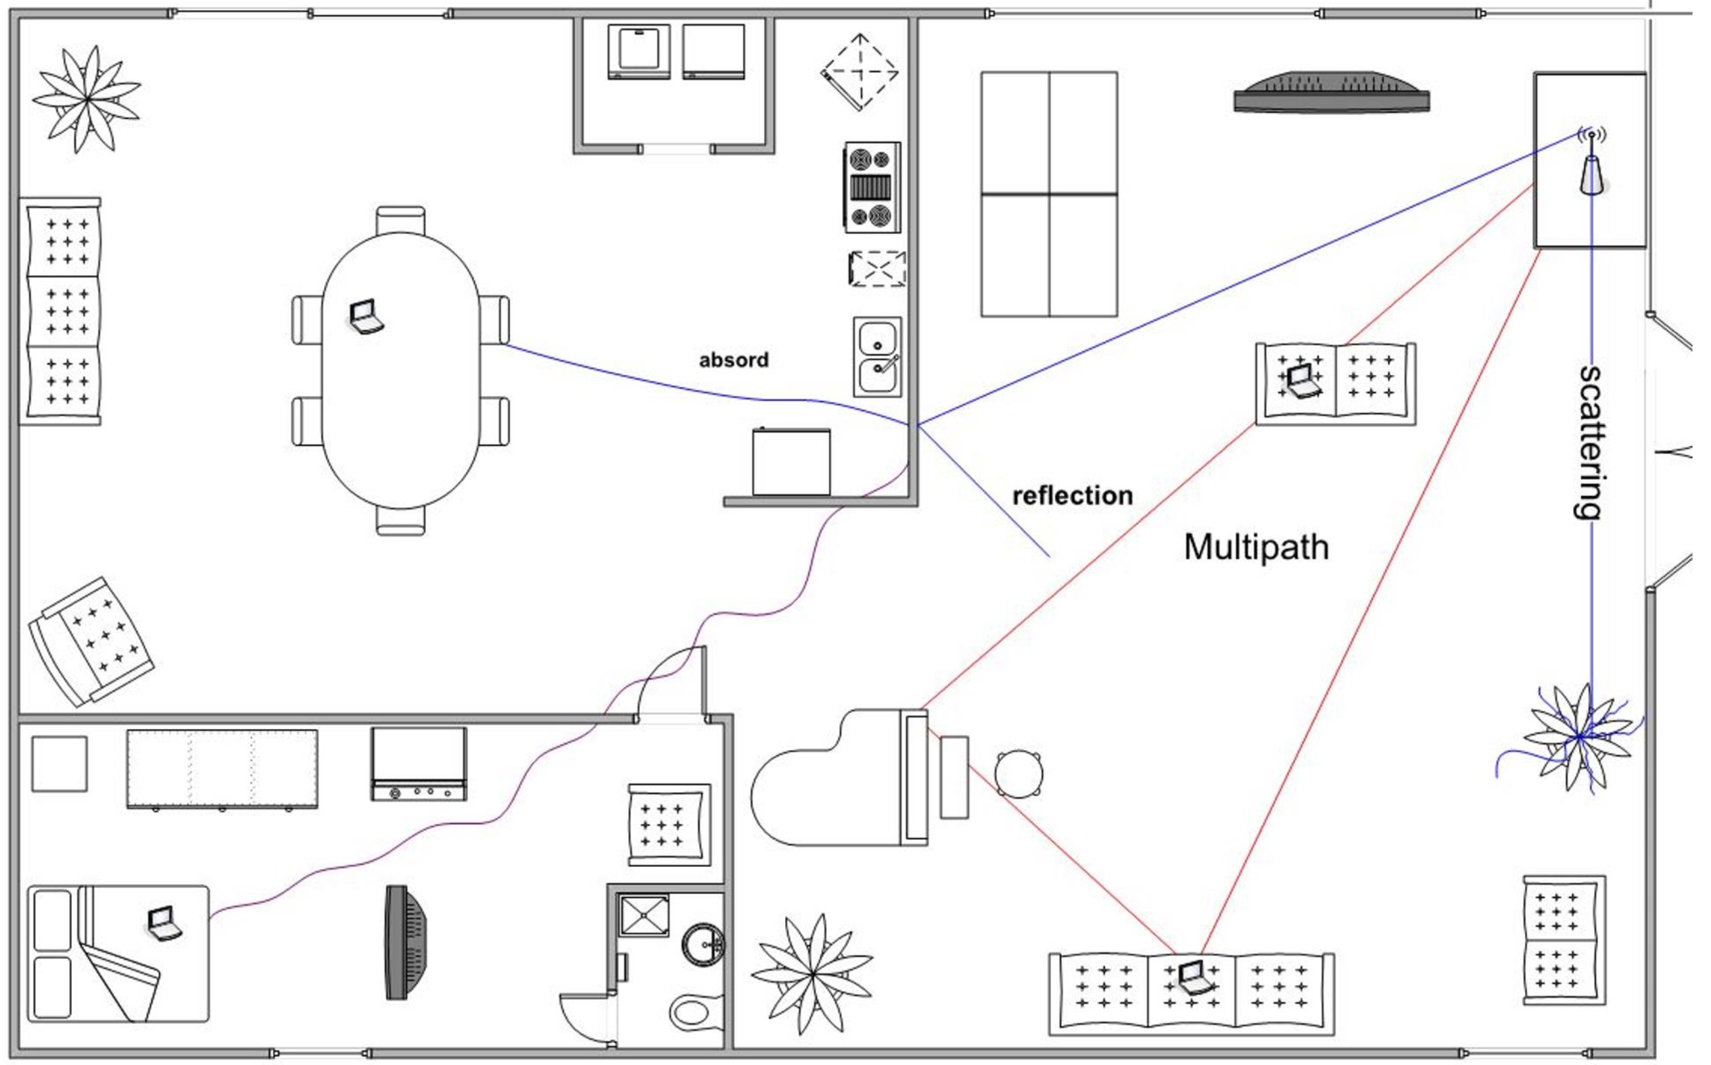
Carrying Data Over RF Signal

Slide 9
Carrying Data Over RF Signal
What is Modulation?
Where the carrier signal is modulated or changed according to some other source.
At the receiver, the process is reversed; demodulation interprets the added information based on changes in the carrier signal
RF Modulation have the following goals
Carry data at predefined rate
Be reasonably immune to interference and noise
Be practical to transmit and receive

Slide 10
Carrying Data Over RF Signal
Due to the physical properties of an RF signal, a modulation scheme can alter only the following attributes:
Frequency, but only by varying slightly above or below the carrier frequency
Phase
Amplitude
Wireless LANs must carry data at high bit rates, requiring more bandwidth for modulation.
Data is being spread out across a range of frequencies; this is known as spread spectrum.
FHSS
DSSS
OFDM

Slide 11
Basic Wireless Theory
Standard | 2.4GHz | 5GHz | Data rates Supported | Channel Widths Supported
802.11b | Yes | No | 1,2,5.5, and 11Mpbs | 22MHz
802.11g | Yes | No | 6,9,12,18,24,36,48, and 54Mbps | 22MHz
802.11a | No | Yes | 6,9,12,18,24,36,48, and 54Mbps | 20MHz
802.11n | Yes | Yes | Up to 150 Mbps per spatial stream, up to 4 spatial streams | 20 or 40MHz
802.11ac |  | Yes | Up to 866 Mbps per spatial stream, up to 4 spatial streams | 20,40,80, or 160MHz
802.11ax | Yes | Yes | Up to 1.2 Gbps per spatial stream, up to 8 spatial streams | 20,40,80, or 160MHz
SPATIAL STREAM: is a transmission technique used in MIlMO wireless communication to transmit independent and separately coded data signals, so called streams, from each of the multiple transmit antennas.

