Slide 1
KEYWORD RESEARCH strategies

Slide 2
Keyword research allows us to look at topics from a different perspective…
With Social Research, we’re looking at content that people share the most and questions that people ask the most.

Slide 3
Keyword research allows us to look at topics from a different perspective…
With Social Research, we’re looking at content that people share the most and questions that people ask the most.
With Keyword Research, we’re looking at specific terms that people are searching for on Google.

Slide 4
Why is keyword research such a big deal?

Slide 5
Keyword research is what connects SEO and social media…
Keyword research is essential for:
Discovering blog ideas
Driving traffic from social media
Driving traffic from search engines

Slide 6
Keyword Research and Social Media Traffic

Slide 7
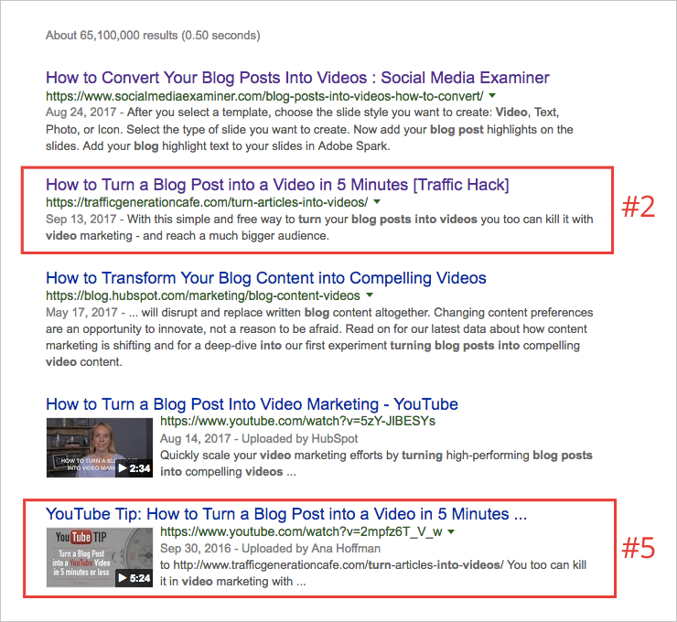
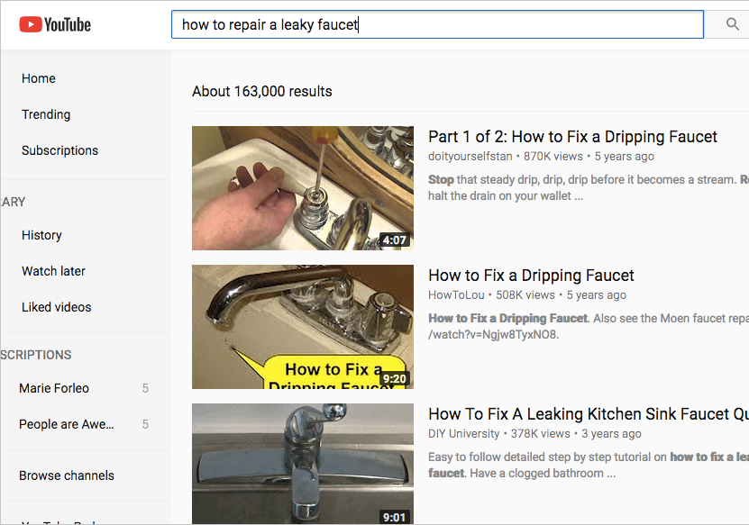
People search on social media AND on search engines.
Google search
YouTube search

Slide 8
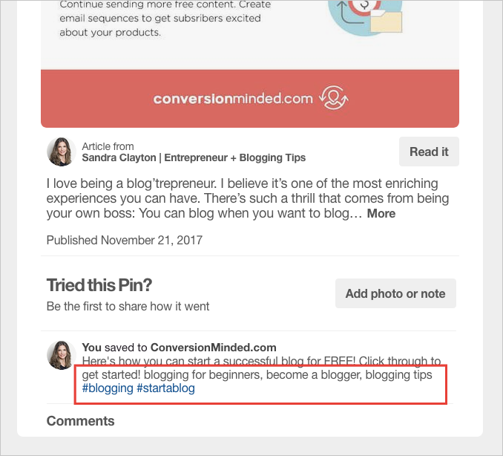
People search on social media AND on search engines.
Pinterest search

Slide 9
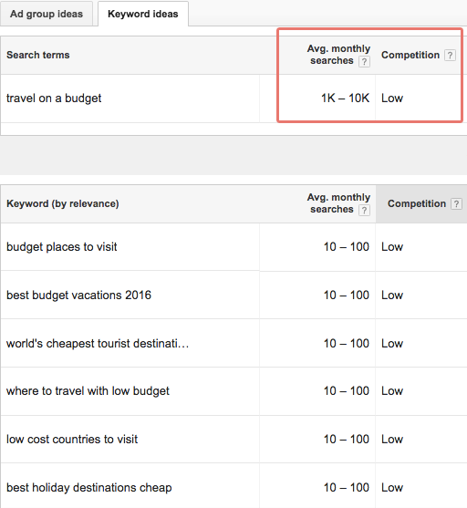
Find keywords with a lot of monthly searches and not a lot of competition.
Low competition = easier to rank on p.1 of Google.

Slide 10
Find keywords with a lot of monthly searches and not a lot of competition.
Low competition = easier to rank on p.1 of Google.
Aim for 500 monthly searches or more.

Slide 11
Find keywords with a lot of monthly searches and not a lot of competition.
Low competition = easier to rank on p.1 of Google.
Aim for 500 monthly searches or more.
The more monthly searches the better.

Slide 12
Find keywords with a lot of monthly searches and not a lot of competition.
Low competition = easier to rank on p.1 of Google.
Aim for 500 monthly searches or more.
The more monthly searches the better.
Stay away from keywords with 10 or less searches per month.

Slide 13
Find keywords with a lot of monthly searches and not a lot of competition.
Low competition = easier to rank on p.1 of Google.
Aim for 500 monthly searches or more.
The more monthly searches the better.
Stay away from keywords with 10 or less searches per month.
Avoid any keyword with no search value.

Slide 14
!
A keyword is really a keyword phrase, meaning that it should contain more than one word.
Travelling on a budget is a keyword
Travelling is not a keyword

Slide 15
How to use the Keyword Planner

