Slide 1
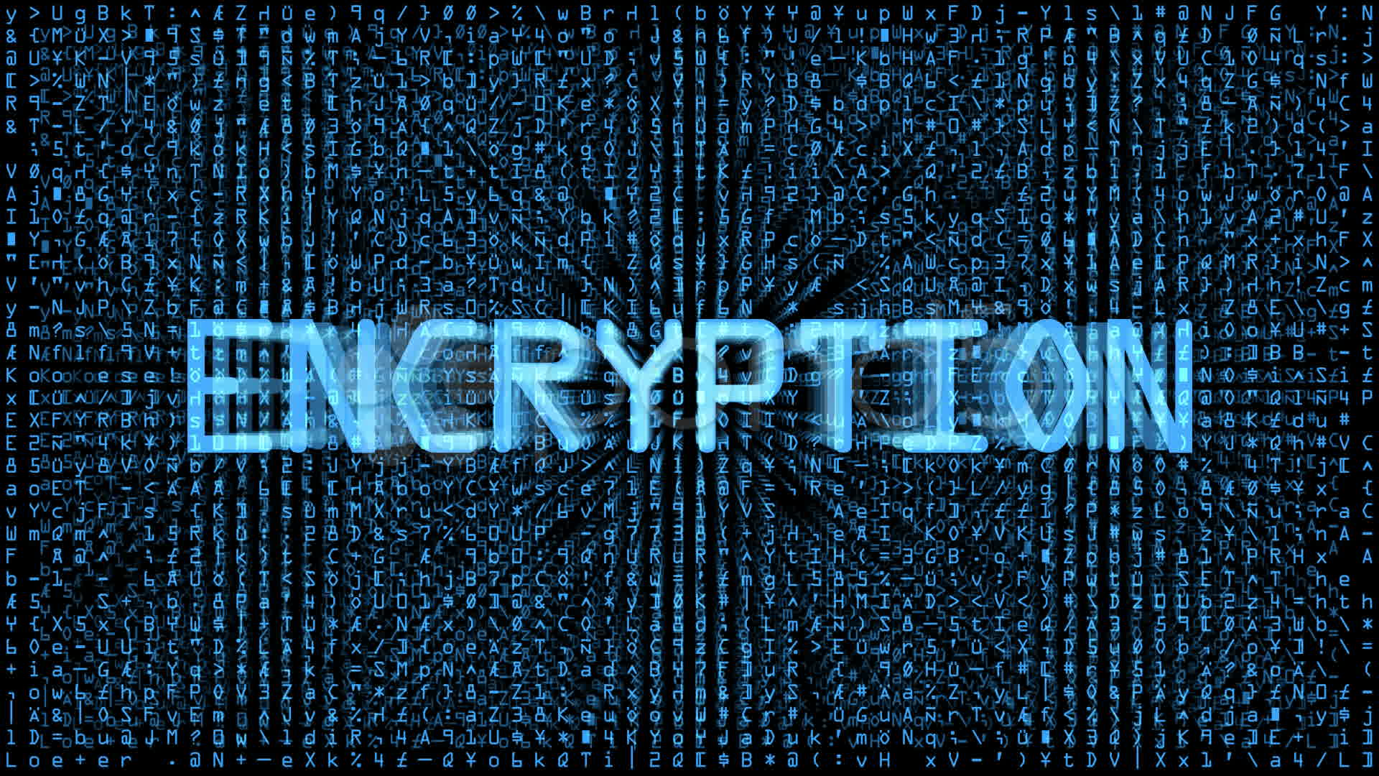
Encryption and Why it matters

Slide 2
Access Online Module Here: goo.gl/2gdsWv
Install Python Here:
www.python.org/downloads/

Slide 3
For a more hands on look at each of these:
http://crypto.interactive-maths.com/

Slide 4
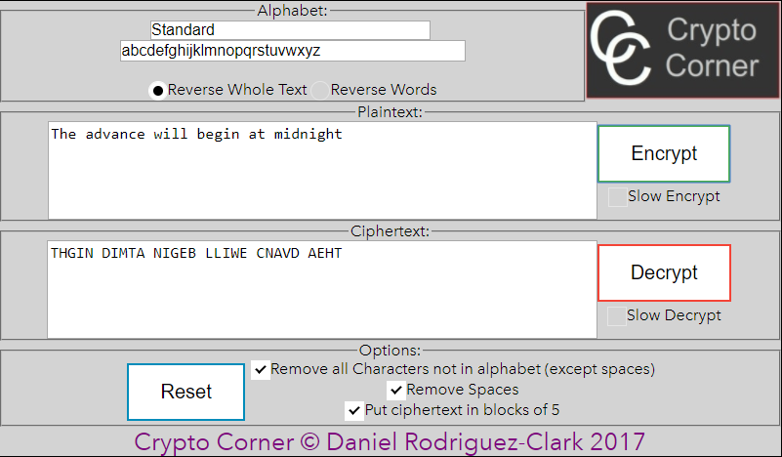
Transposition Cypher

Slide 5
What is a Caesar Cypher?
Over two thousand years ago information was decisive Roman wars of conquest. This information was carried by couriers who carried encrypted messages. In these messages each letter of the message was shifted by pre determined shift.
These messages looked like gibberish and could not be read when intercepted by enemies. What if you intercepted this message:
“xlmw xsso e xlsywerh cievw xs fvieo”

Slide 6
How does a Caesar Cypher Work?
 | A
 | B
 | C
A | D
B | E
C | F
D | G
E | H
F | I
G | J
H | K
I | L
J | M
K | N
L | O
M | P
N | Q
O | R
P | S
Q | T
R | U
S | V
T | W
U | X
V | Y
W | Z
X | A
Y | B
Z | C
Every letter inside a message is shifted by a certain number of places of the alphabet
So lets say the shift is 3. Then the letter b will become e
So lets shift the whole alphabet by a shift of 3 and see a dictionary which can translate each letter to the corresponding cypher letter
1
2
3
So lets use the dictionary on the left to
Translate the message below:
“wkh dgydqfh zloo ehjlq dw wkuhh sp”
W = T
K = H
H = E
So the first word is the and the rest of the
Message translates as:
“The advance will begin at three pm”
1 2 3
A | B | C | D | E | F | G | H
Normal text
Cypher text

Slide 7
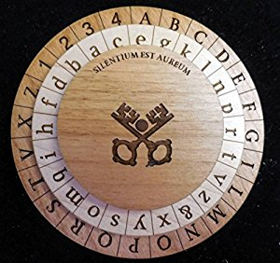
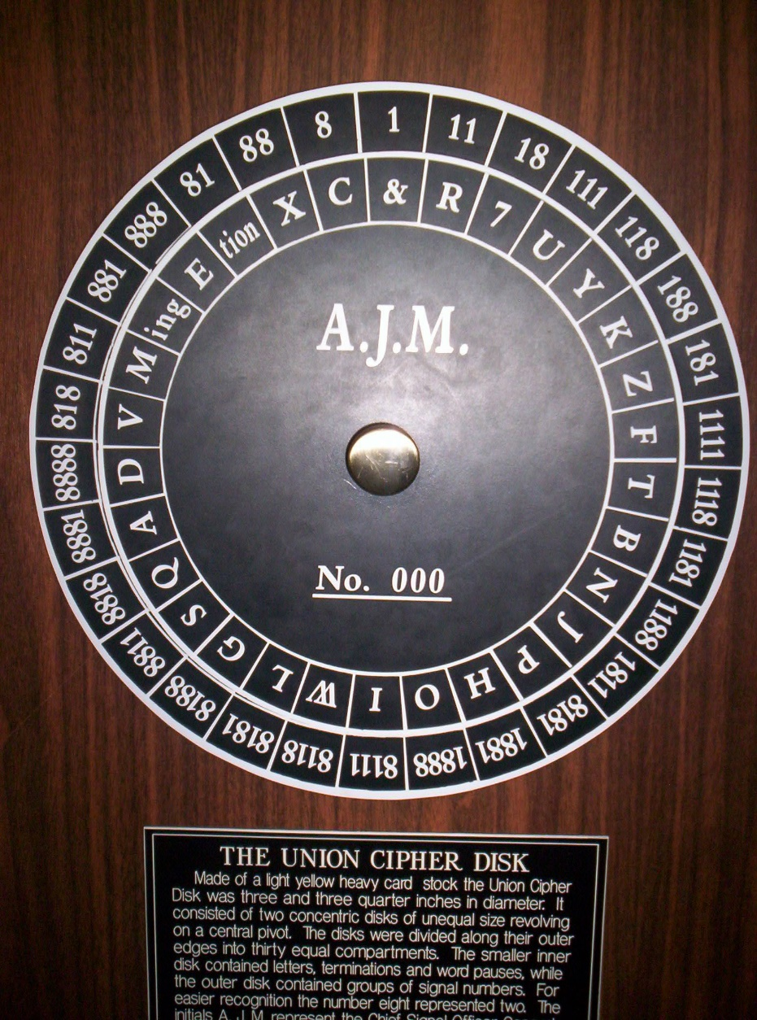
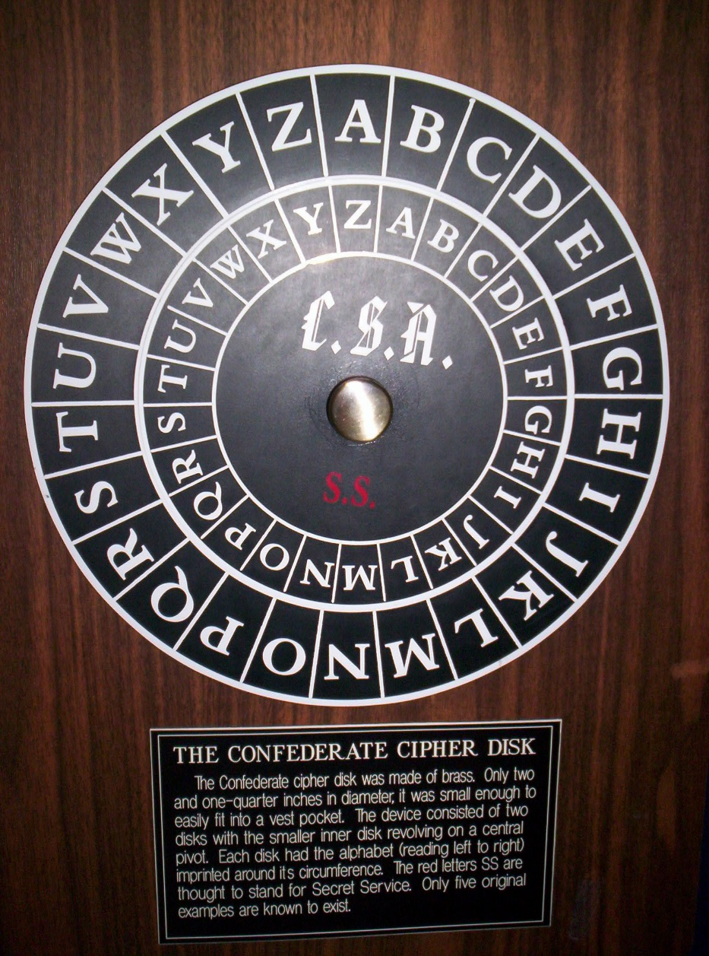
DIY Cypher Wheel
https://inventwithpython.com/cipherwheel/

Slide 8
Cypher Wheels
https://inventwithpython.com/cipherwheel/

Slide 9
See how much of this you can uncover
bvithzyz dn ocz gvmbzno viy hjno hvnndqz hjji ja epkdozm viy di ocz njgvm ntnozh ocz idioc gvmbzno jwezxo di ocz njgvm ntnozh do dn ocz gvmbzno rdocjpo v npwnoviodvg vohjnkczmz.
wlwdq lv wkh odujhvw prrq ri vdwxuq lw lv wkh rqob prrq nqrzq wr kdyh d ghqvh dwprvskhuh dqg wkh rqob remhfw lq vsdfh rwkhu wkdq hduwk zkhuh fohdu hylghqfh ri vwdeoh erglhv ri vxuidfh oltxlg kdv ehhq irxqg
https://inventwithpython.com/cipherwheel/

Slide 10
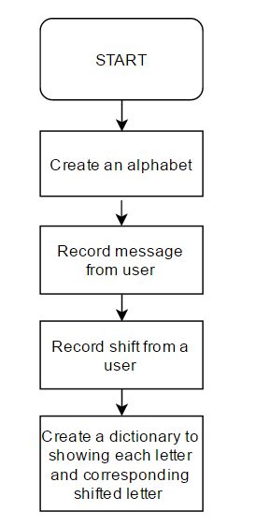
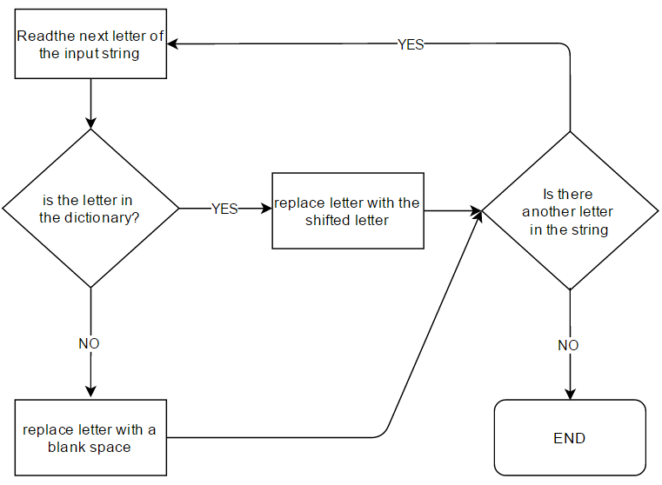
Stage 1:
Store string and
Create dictionary
Stage 2:
Swap letters of the input string
leave the letter unchanged

Slide 11
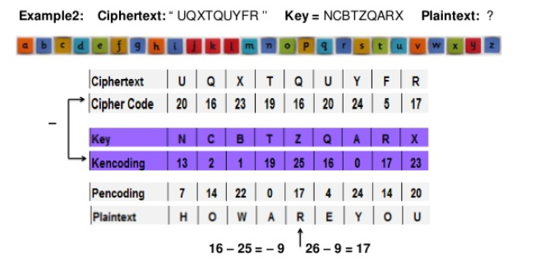
Polyalphabetic Cypher

Slide 12
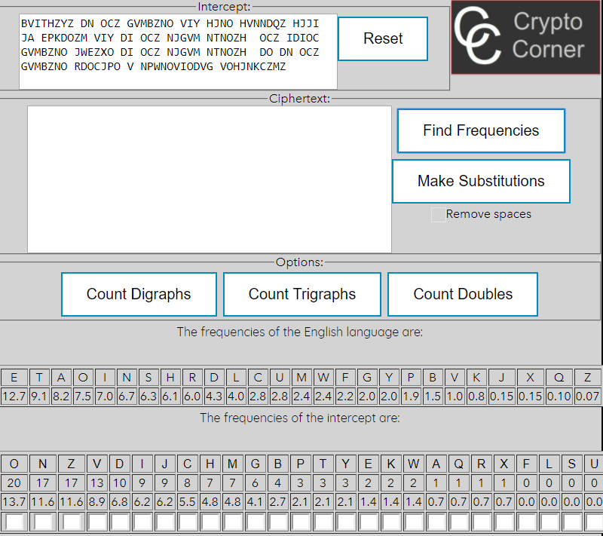
Frequency analysis

Slide 13
Encryption and you!
AES Encryption cannot be cracked (unless you have a functional quantum computer)
So how are you vulnerable?
Sites get hacked: LinkedIn 2012 Yahoo 2013, Uber 2016
User emails are public but passwords are ‘hashed’ which means hidden but hackers can try 1 Billion + different passwords per second
The length and variety of your password is the single biggest security measure you have on the internet.

Slide 14
Encryption and you!
Example 1: 6 letter lower case only password like pyjama, jumble or jockey
Example 2: 6 letter lower and upper case only password like Pyjama, jUmbLe or jOcKeY
Example 3: 10 letter password using all available characters like: !&fTb7”;,? or {\|%aY,~`J
$Possible passwords={26}^{6}=308,915,776$0.3 seconds
$Possible passwords={52}^{6}=19,770,609,664$19 seconds
$Possible passwords={90}^{10}=34867844010000000000$ 1105 Years

