Slide 1
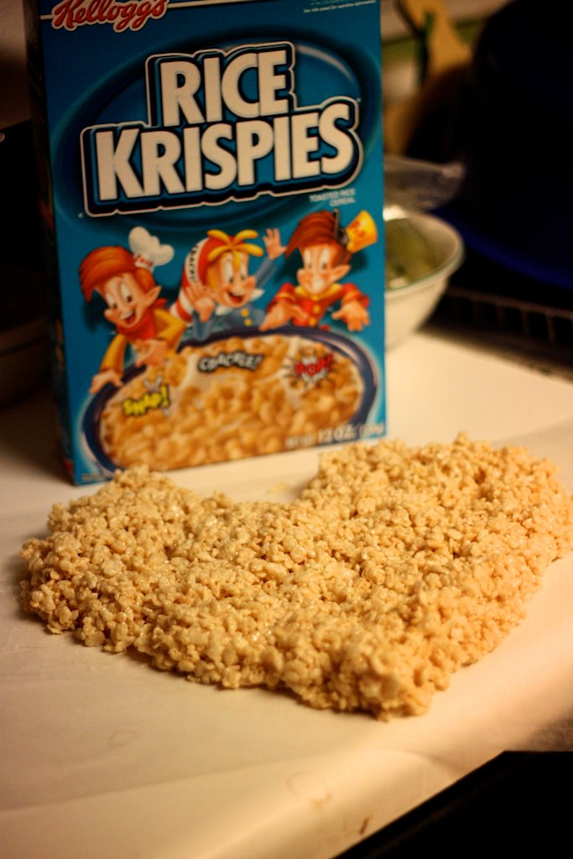
Let’s Make Rice Krispies

Slide 2
Ingredients:
6 cups of Rice Krispies cereal
1 bag (10 oz) of big marshmallows
3 tablespoons of butter or margarine
Big bowl for mixing (microwave safe)
Spoon for stirring
Pan
Pam or Oil spray so treats won’t stick to pan

Slide 3
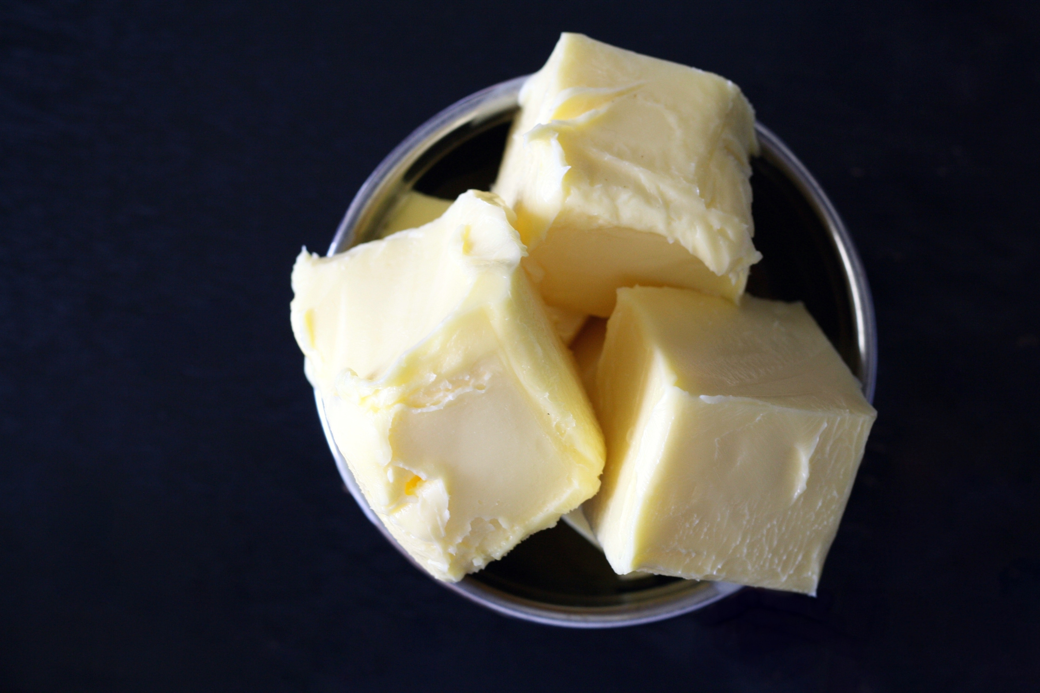
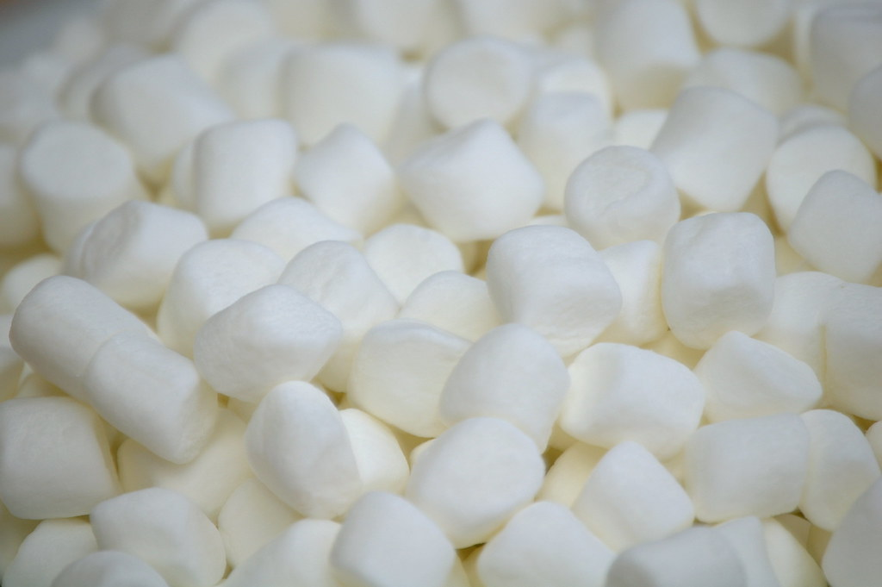
1. Put 3 tablespoons of butter and 1 bag of marshmallows into the big bowl.

Slide 4
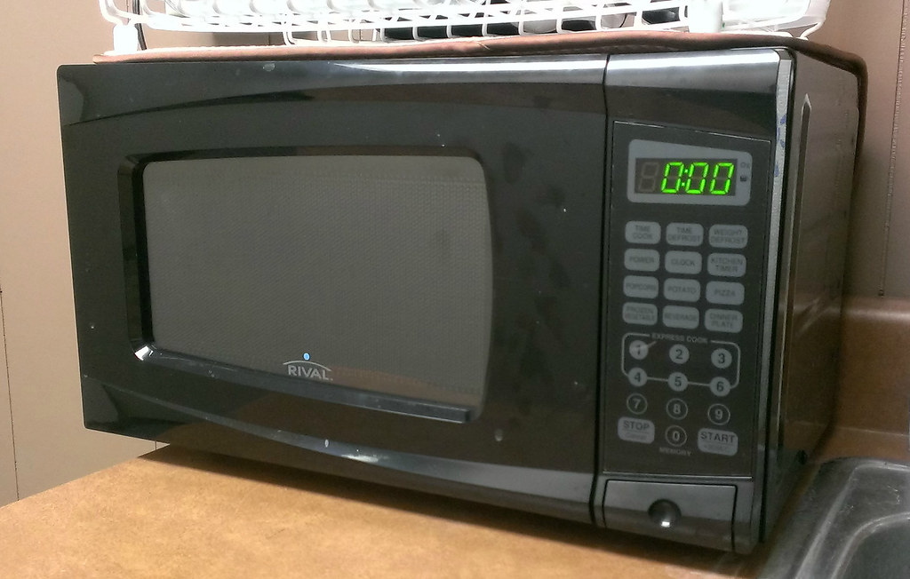
2. Put into the microwave for 2 minutes.

Slide 5
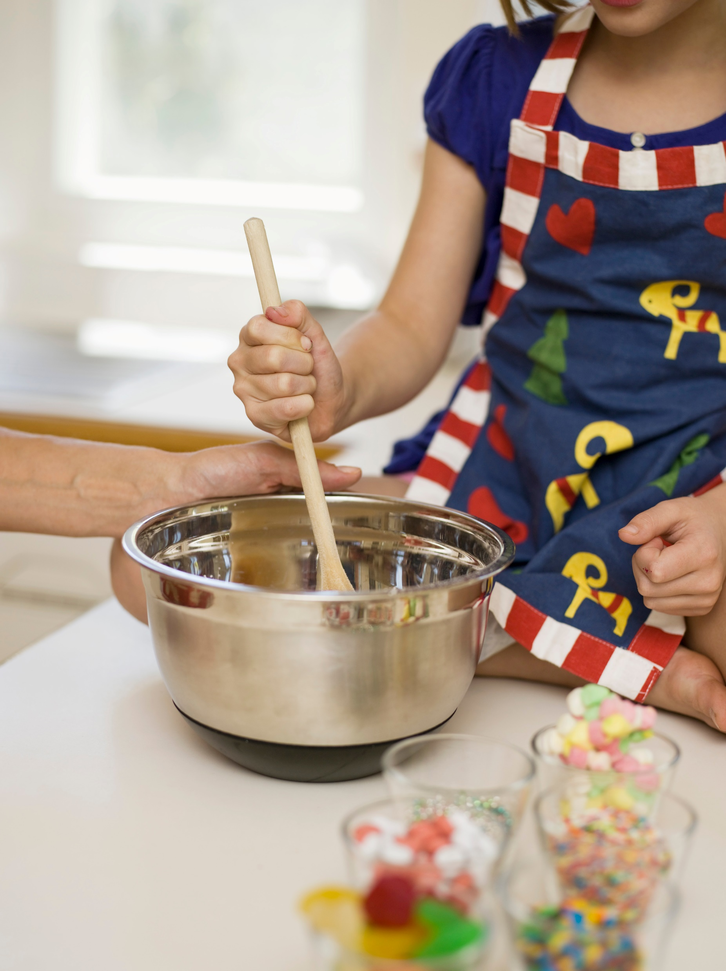
3. Stir and put back in microwave if needed until mixture is smooth.

Slide 6
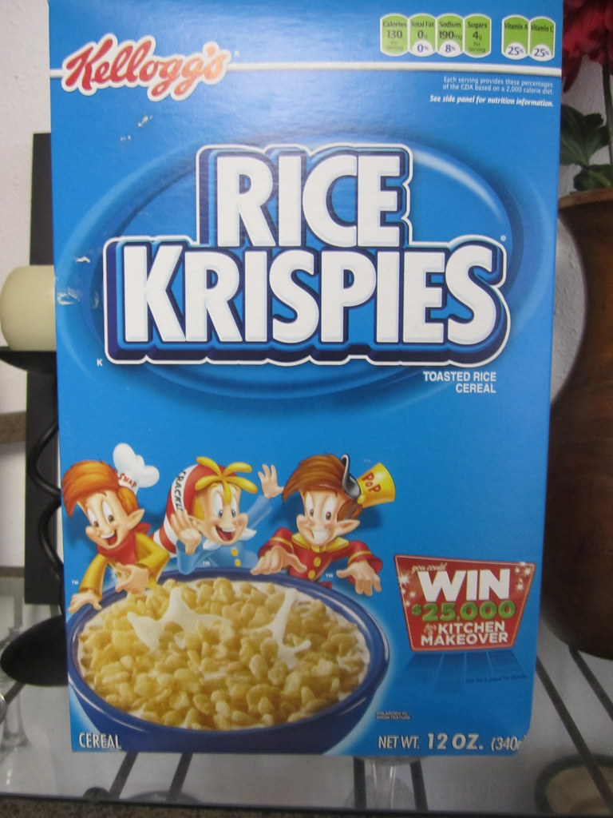
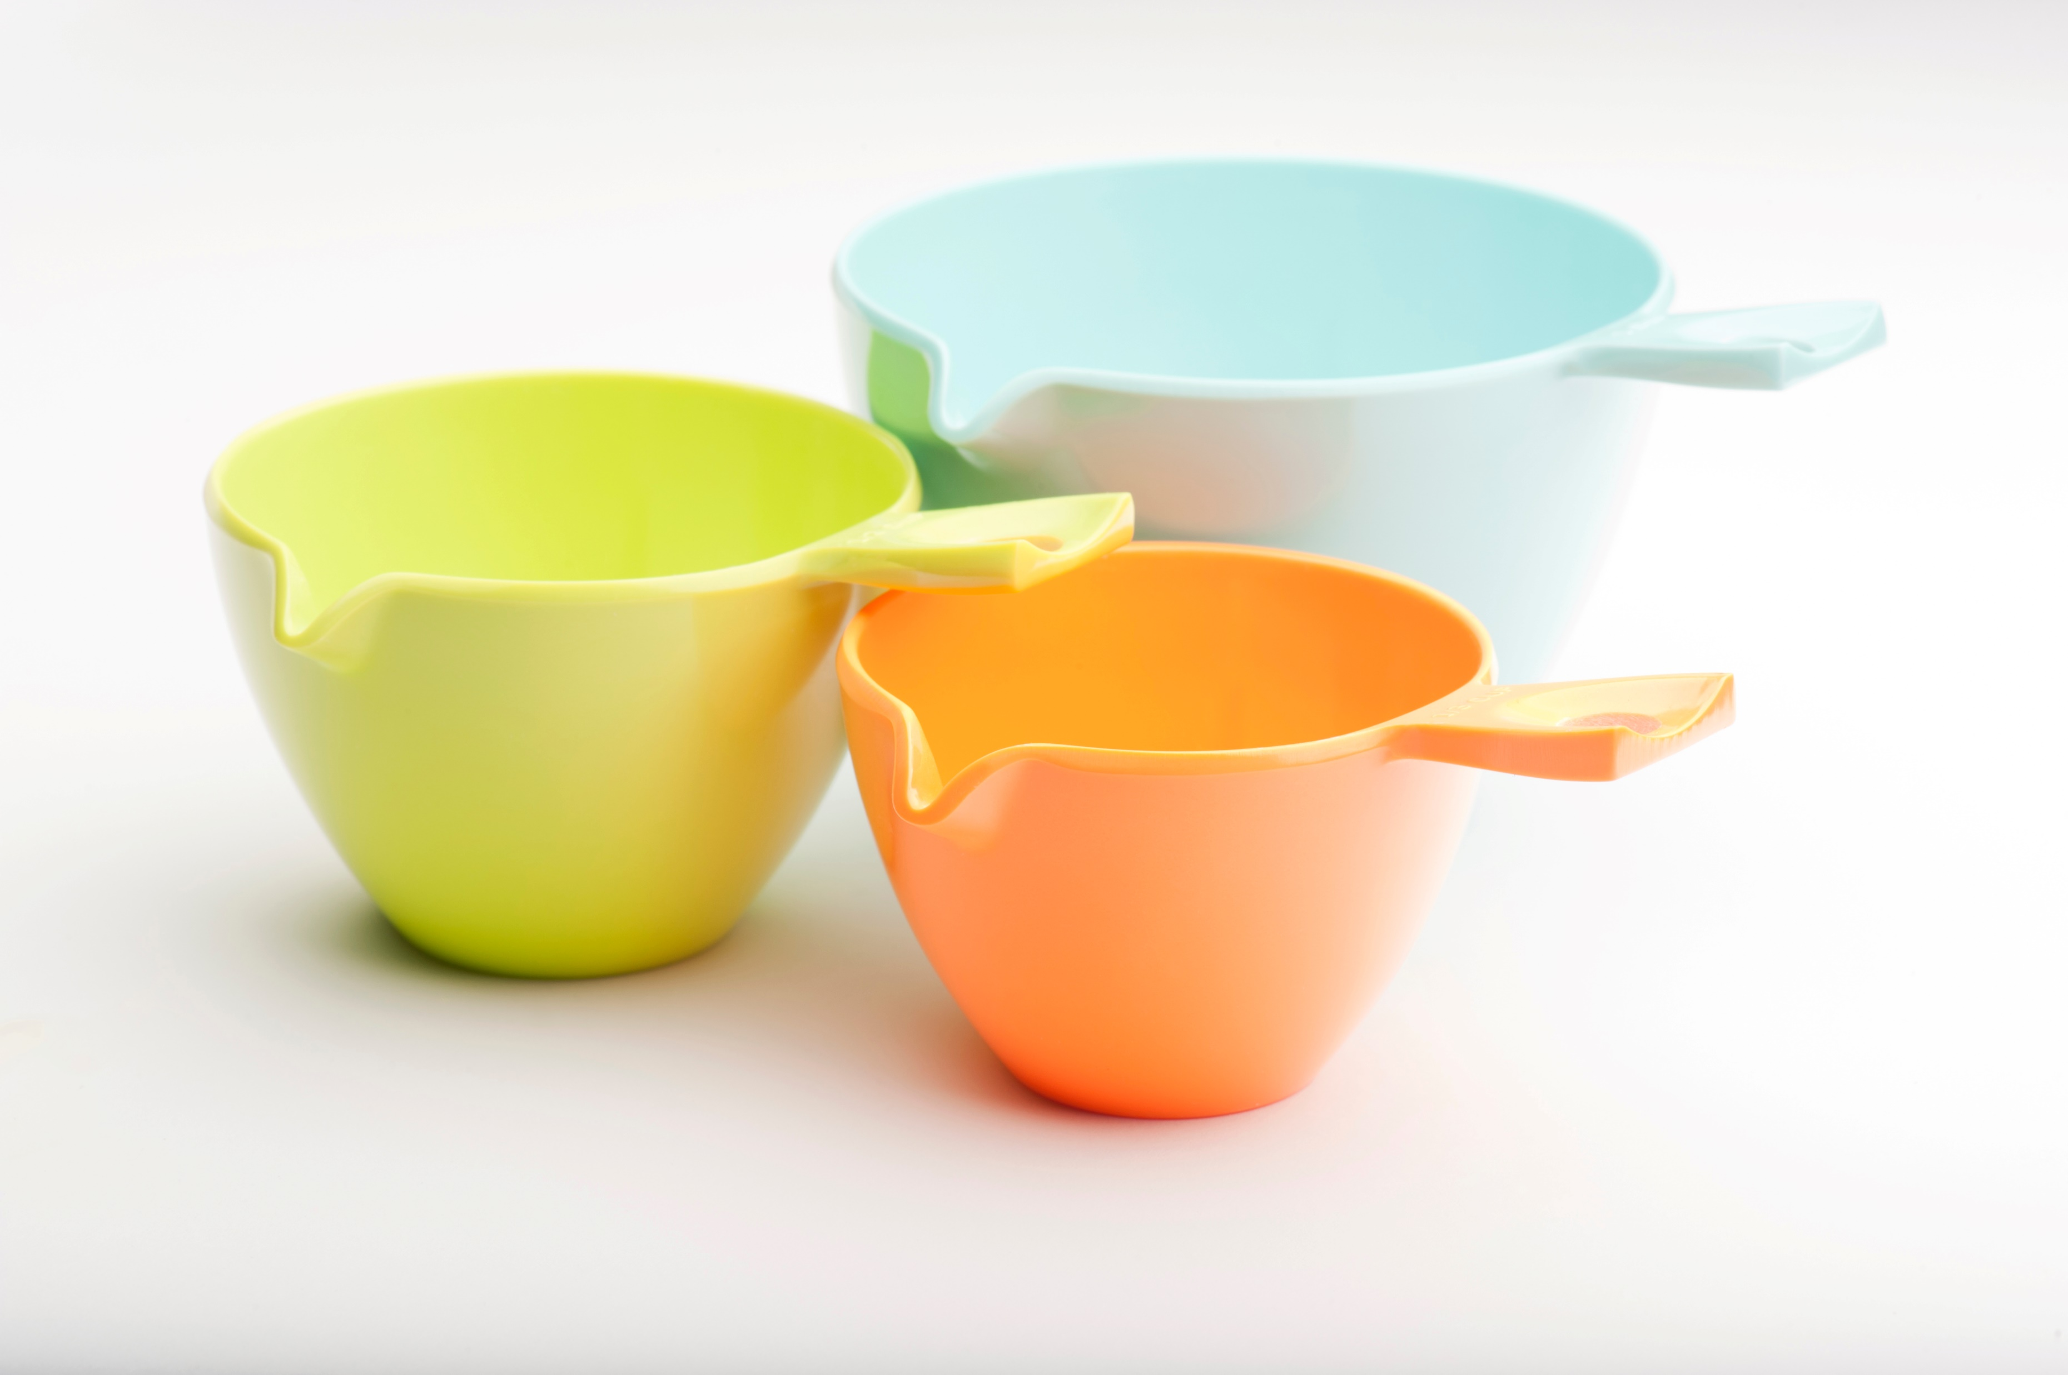
4. Add 6 cups of Rick Krispies cereal.

Slide 7
5. Stir, stir, stir until it’s all mixed and smooth.

Slide 8
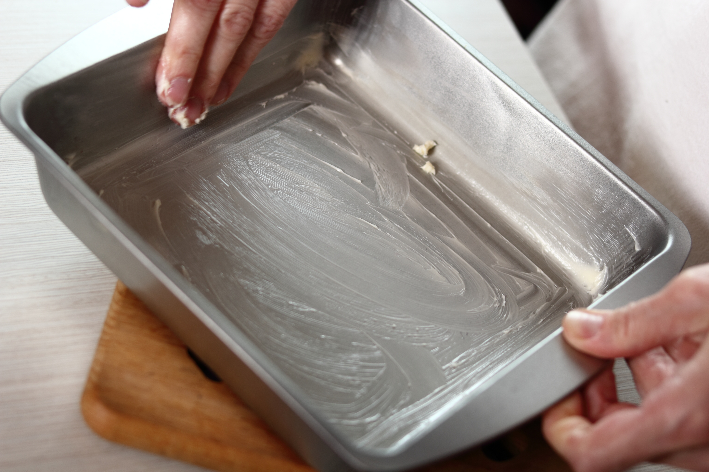
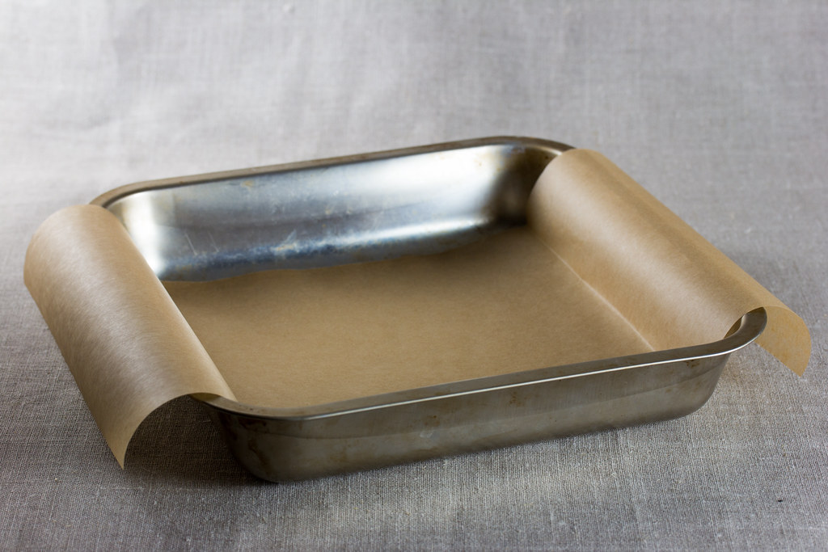
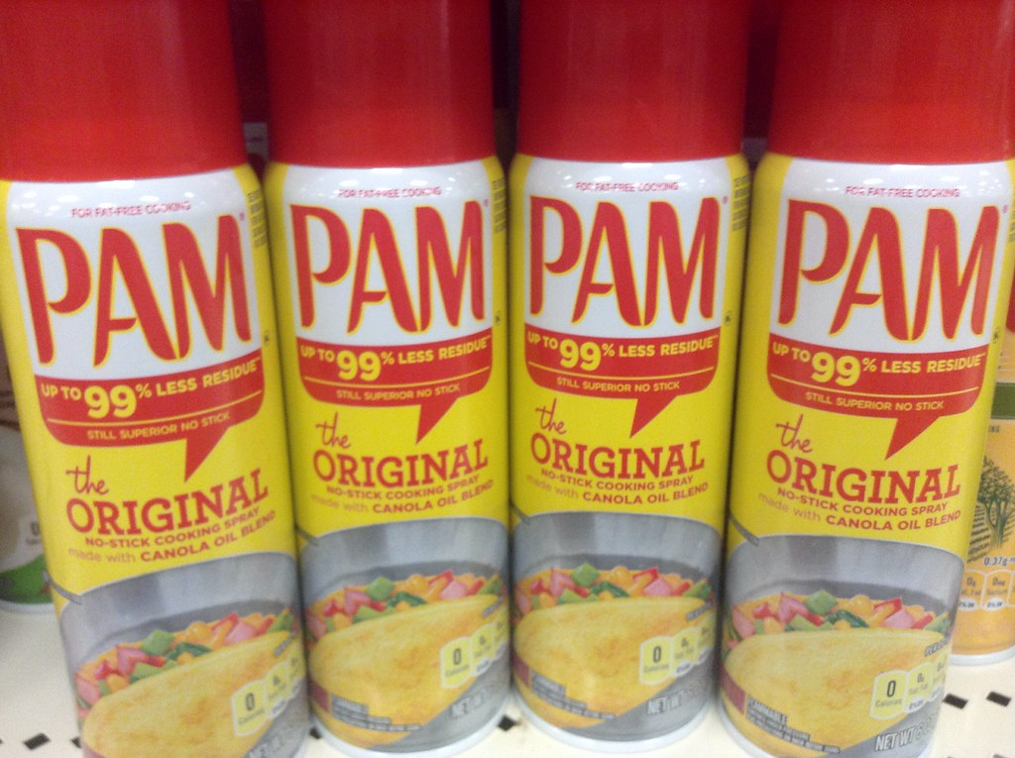
6. Spray oil into pan. (or use baking sheet if you’d like)

Slide 9
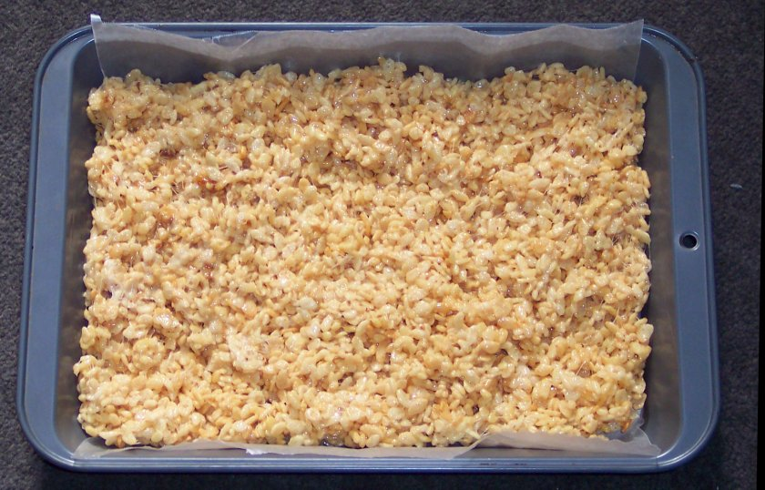
7. Pour rice krispies mixture into the pan and spread until even.

Slide 10
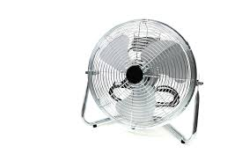
8. Allow treats to cool.

Slide 11
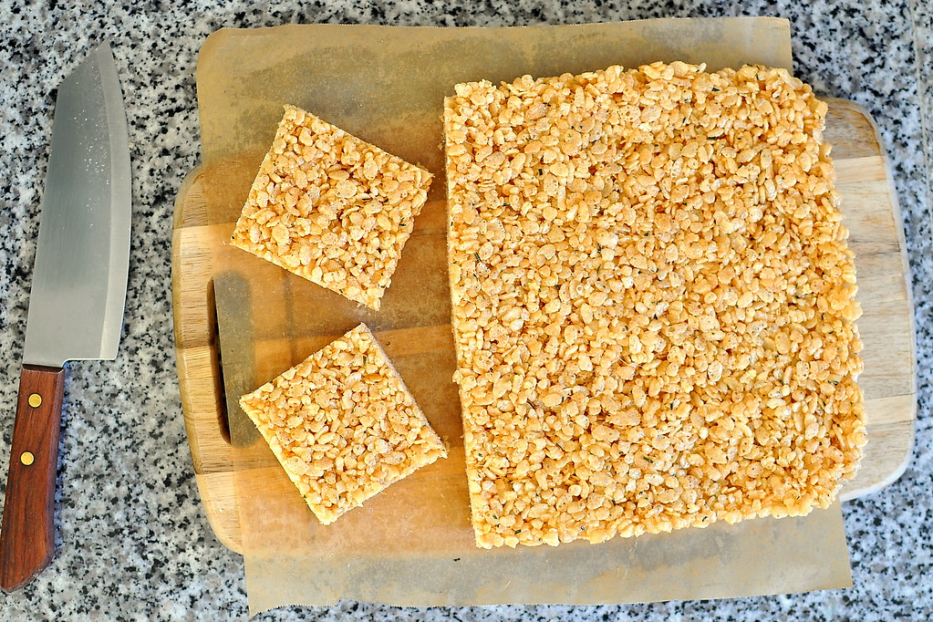
9. Eat and enjoy!!!!

Slide 12
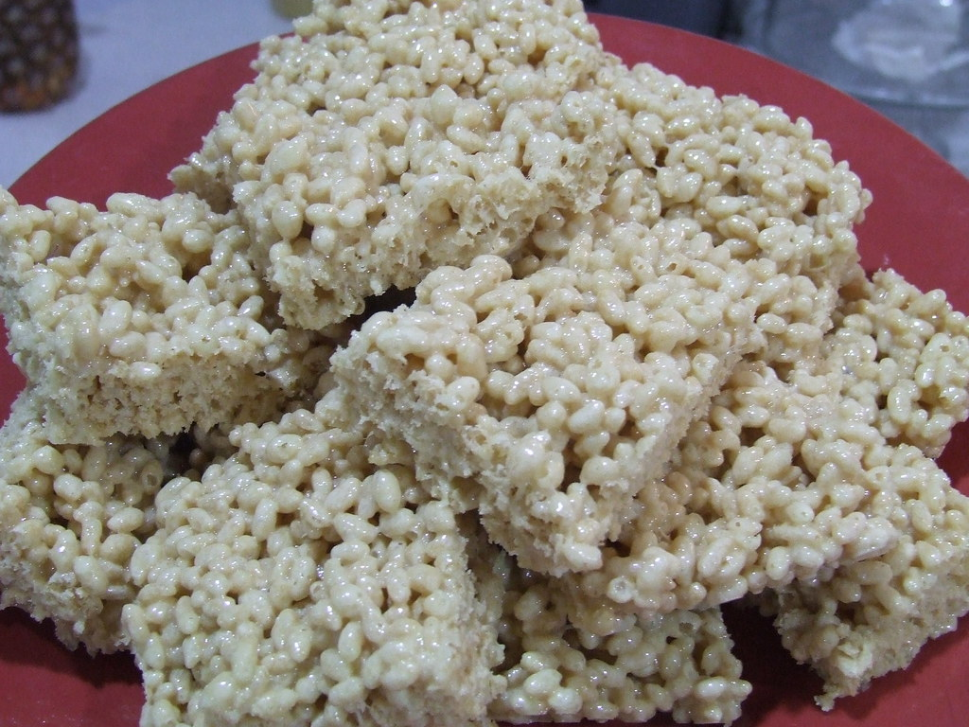
Review: Do you like rice krispies treats?

