Slide 1
Technology is a blast
but be careful!
Virtue in Media Grades 1-2
Permission granted to reproduce for personal educational use only. Commercial copying or selling is prohibited. No part of this resource may be uploaded to, or published on, any other site for any reason without the consent of the author.

Slide 2
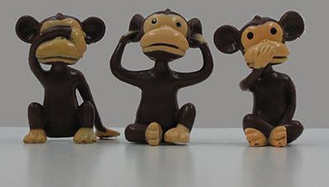
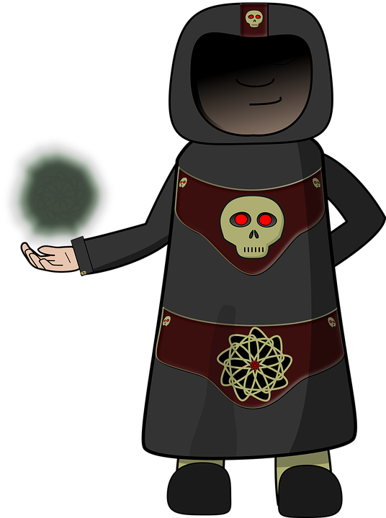
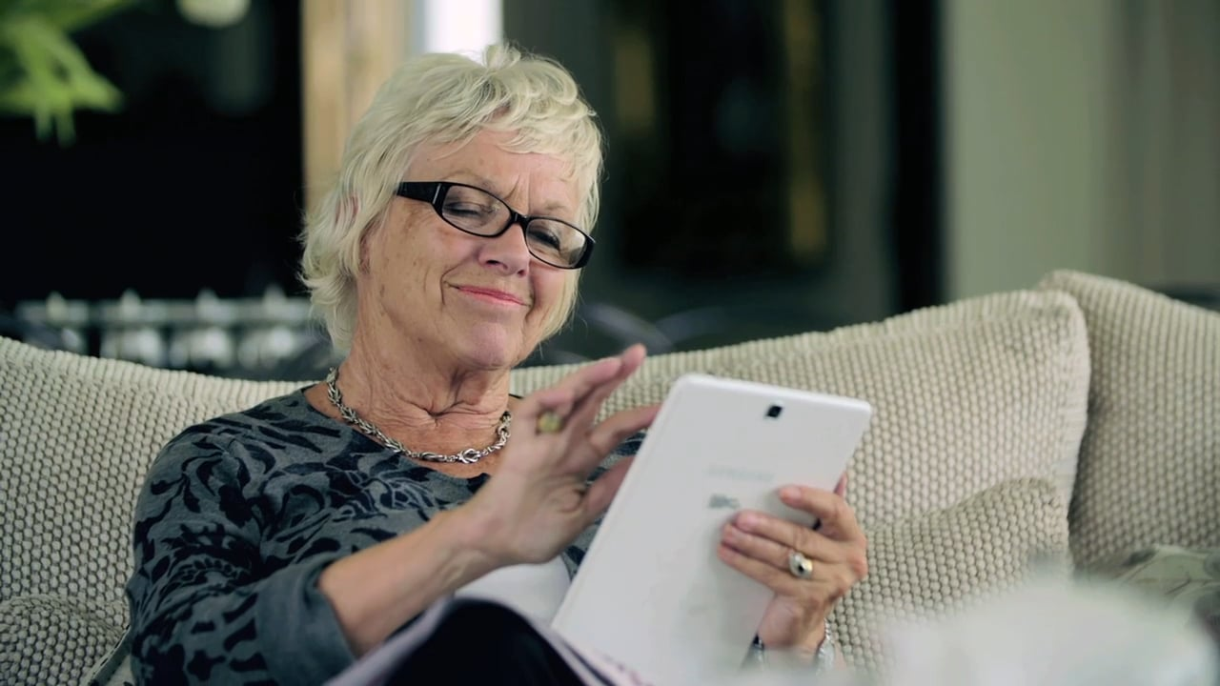
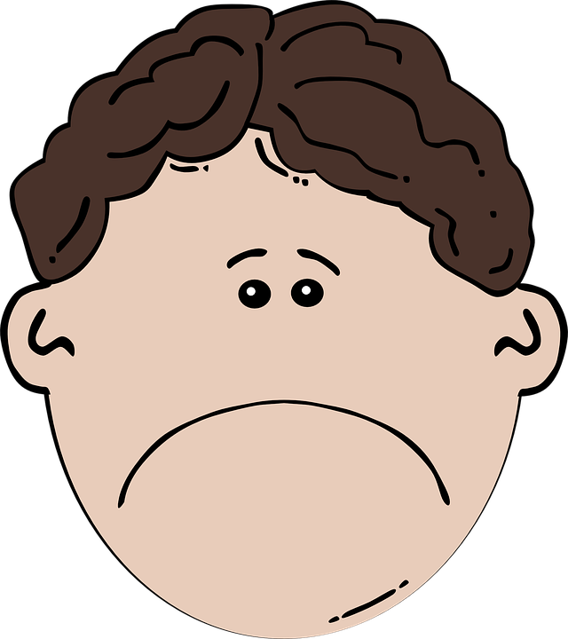
but be careful!
Technology is a blast

